Slide 1
The Church
Alpha Omega Christian Club
April/May 2025

Slide 2
The Church
What is the Church?
The Church and the Kingdom of God
The Purpose of the Church
The Life of the Church

Slide 3
What is church?
ekklesia the assembled, the called-out
1. Church (capital C). The thing that Jesus died for. It is the thing we enter when we are baptized into Christ. (Eph 5:25)
2. church (small c). A local body of believers who submit to a local leadership, who put the one another passages into effect, and who become the city on a hill that seekers are attracted to. (Romans 16:3-5)
Which do we love, give ourselves up for and make radiant?

Slide 4
What Is The Church?
The Bride of Christ
The Body of Christ
The Family of God
The Temple of the Holy Spirit

Slide 5
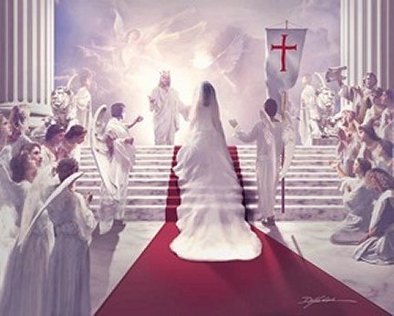
Ephesians 5:25-32 The Bride of Christ
v. 25 Christ loved the Church.
He gave himself up for her.
v. 26 He made her holy
v. 27 He presents us radiant to God.
He wants us to do the same. Have you been doing that?
- give yourself up for the Church
- make her holy
-present her holy

Slide 6
Revelation 19:6-8
At end-time the church is the bride of Christ. (technically, she is merely betrothed now 2 Cor 11:2)

Slide 7
Like a Bride Beautiful Radiant Admired Loved Cared for This is Jesus’ plan for the church

Slide 8
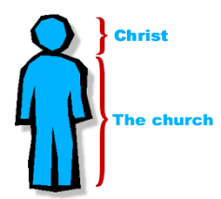
The Church is the Body of Christ
Colossians 1:15-18
The body obeys the head.
The head works in the world through the body.
But… The body concept is largely about unity in the church.

Slide 9
Church: The Body of Christ
Eph 2:12-18 Jew and Gentile are one in Christ
Eph 3:3-6 The mystery… That God could unify Jew and Gentile!!!

Slide 10
The Church: The Family of God
Ephesians 2:19-22
oikos = household = family
You choose friends. You do not choose family.
Family is a place where you are known and cared for.
Families have privileges and obligations

Slide 11
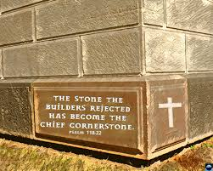
Church: The Family of God
Christ the cornerstone.
The Bible the foundation.

Slide 12
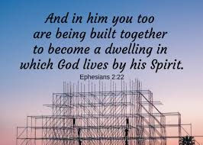
The Church: A Temple of the Holy Spirit
The corporate church is a place where God lives.
Individuality? Not so important.

Slide 13
Discussion Questions
1. What does it mean to you, personally, that the Church is the bride of Christ. What does it tell you God feels about you?
2. Which part of the body are you? A finger? A kidney? In other words, what gift/role do you bring to the local church?
3. What privilege and what obligation of being in the family of God comes to your mind?

Slide 14
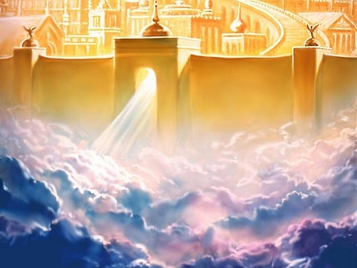
The Kingdom of God and the Church

Slide 15
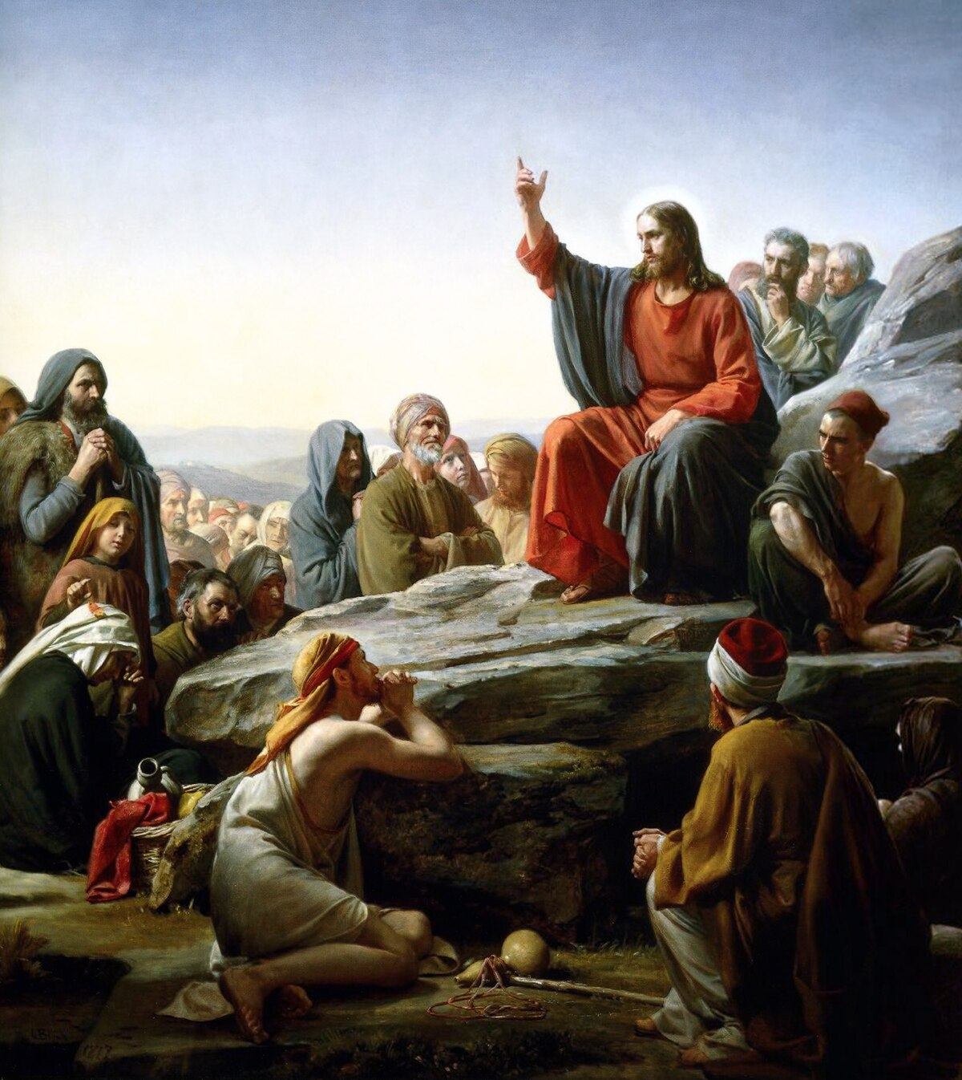
I. The Kingdom of God is the thing Jesus spoke about the most.
Acts 1:3 He appeared to them over a period of forty days and spoke about the Kingdom of God.

Slide 16
II. The Kingdom of God is a “place” where God is king—where God reigns. -It is a life lived in submission to God

Slide 17
What Is The Kingdom of God?
David Lipscomb: The Kingdom of God embraces everything and every person in the universe over which God rules as king.”

Slide 18
III. The Kingdom of God is something much greater than the Church.
The Kingdom of God includes the Church, but it is much greater than the Church.
David Lipscomb: “The Kingdom of God embraces the church, but it is more extensive in its signification.”
Matthew 6:33
Nature
Israel
Church
Heaven

Slide 19
IV. The Kingdom of God is already but not yet.

Slide 20
Already But Not Yet
“God’s colonial outpost, the church, lives as a witness, in the present, of things to come. Through Christ we have experienced resurrection, though we will face death. Because of Golgotha, we have salvation, yet we wait in hope for the revelation of our redemption. We have the “first fruits” (Rom 8:23) of the Spirit as God’s pledge of the rest of the harvest.” [Kingdom Come, Hicks and Valentine]

Slide 21
Already But Not Yet
Saved Already but not yet
Righteous Already but not yet
Holy Already but not yet

Slide 22
V. The Church is the Kingdom of God. (and I am not contradicting myself) Matthew 16:17-19 On this rock I will build my church. And… I will give you the keys to the kingdom of heaven

Slide 23
VI. The Kingdom of God is a radical ethic in complete opposition to the worldly ethic It is best described in the Sermon on the Mount. David Lipscomb: “God calls us to a radical alien mentality, but he provides the power for such a life through his indwelling and empowering Holy Spirit that transforms us into the image of his Son.”

Slide 24
A Radical and Unique Kingdom Ethic
Hebrews 11:8-10 We live in tents
Hebrews 11:13-16 Foreigners and strangers
Philippians 3:20 Citizenship in heaven

Slide 25
VII. The Kingdom of God is best described in the Sermon on the Mount.
Kingdom Valuse: Matthew 5:3-10
Kingdom Ethics: Matthew 5:17-48
The Key: Matthew 6:25-33 Seek first his Kingdom.
Treasures in Heaven Matthew 6:19-21

Slide 26
Discussion Questions
1. What aspect of the Kingdom of God do you find most attractive and interesting?
2. What does it mean to you to be a citizen of the kingdom of God?
3. How ought a citizen of the kingdom of God live? Any changes you can see you ought to make to live that way?

Slide 27
III The Purpose of the Church
To give glory to God.
B. To spread the knowledge of and the wisdom of God.
C. To create a unified people in Christ.
D. To build up and to mature the believers.

Slide 28
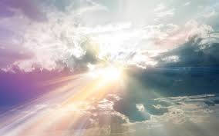
A. To give glory to God.
Eph 3:20-21
glory = doxa
Shining forth, radiance, splendour, honor, majesty.
Q: How does the church do this?

Slide 29
A. To Give Glory to God
2 Cor 3:12-18 (esp. v. 18) katoptrizomenoi
We contemplate/reflect the glory of Jesus Christ.
We are transformed into the image of Christ.

Slide 30
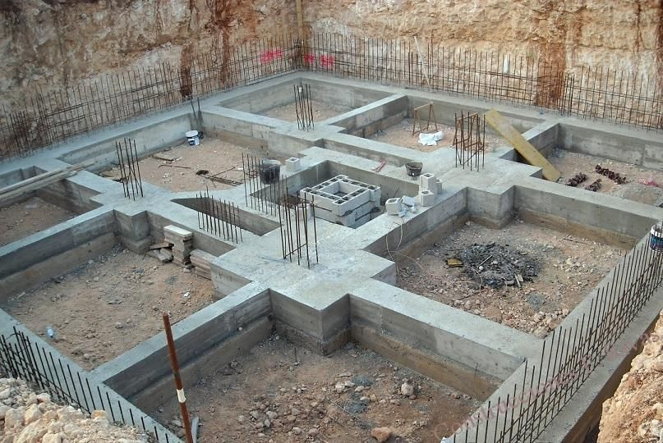
A. To Give Glory to God
1 Cor 3:10-15 We build carefully on the foundation—which is Christ

Slide 31
B. To spread the knowledge and the wisdom of God
Eph 3:7-11 (esp. v. 10)
God announces his plan, his wisdom, his glory to the world through the church.
Q: How does he do this?

Slide 32
B. To spread the knowledge and the wisdom of God
2 Cor 3:12 Because we have this hope, we are very bold.
2 Cor 4:13-15 We believe and therefore we speak.
2 Cor 2:14-17 The church spreads the aroma of Christ—Christlikeness is shown to the world.
2 Cor 5:18-19 The church offers the ministry of reconciliation.

Slide 33
C. To Create a Unified People in Christ.
Eph 2:14-18 (esp. v. 15) His purpose in the church is to create in himself one new humanity out of the two.
The Church brings opposites together in one family.
John 13:34-35 This is how the world recognized it is the true Church of Christ. By our love for one another.

Slide 34
D. To build up and to mature the members of the church.
Ephesians 4:11-16
The church is where individual believers are taught, trained, mentored, led, equipped.
The goal: Unity in the church
Maturity of the individual members.

Slide 35
Discussion Questions
1. What does it mean to you that the church should and does show the glory of God to the world?
2. Have you, and has your church corporately, been spreading the knowledge of God in Christ to the world? How?
3. What does the unity that exists in Christ’s Church mean to you, practically? What does the world need to see?

Slide 36
IV. The Life of the Church
Our Outline:
I. What is the Church?
the bride of Christ
the body of Christ
the family of God
the temple of the Holy Spirit.

Slide 37
Our Outline
II. The Church is an outward manifestation of the Kingdom of God.
III. The Purpose of the Church.
a. to give glory to God.
b. to spread the knowledge and wisdom of God.
c. to create a unified people of God.
d. to build up and to mature the members of the Church

Slide 38
III d. To edify and mature the Church
Ephesians 4:11-16 The “job” of the leaders:
The goal: 1. Unity in the Church.
2. Maturity of the individual disciples in the Church.
3. Teach correct, sound doctrine.

Slide 39
IV. The Life of the Church
Ephesians 4:15-16 The Church is a place where…
1. Truth is spoken to one another…. in love.
2. Growing and maturing is happening.
3. The purpose of the Church is happening. How? Through EACH MEMBER doing its work.
4. Each member’s gifts are developed and used to this end. 1 Peter 4:10-11.

Slide 40
The Life of the Church
Ephesians 4:17-5:21 Things to look for (and do!):
4:17-24 Very different from the world.
4:25-28 A safe place. Where disagreements are acknowledged and worked through.
4:29-5:7 A holy place.

Slide 41
The Church: A Holy Place
Very careful about “unwholesome talk. Eph 5:4
b. Speaking only what will build up those who hear and those who are not there.
-gossip is anathema in the Church. It is blaspheming the Holy Spirit!!!!
c. Eph 4:31 Bitterness, rage, anger, etc. are completely unacceptable.

Slide 42
Discussion Questions
1. What is one of your “gifts,” and what are you doing, specifically, to use it in the church, to achieve the purposes of the church?
2. How do you feel you do, overall, in speaking the truth in love? a. In “speaking the truth” and b. Doing it in love?
3. Have you had the habit of talking about others when they are not “in the room” in a way that they would not appreciate if they were there in the conversation? Let’s be real here.
4. Have you held any anger or bitterness toward a fellow believer? If appropriate, can you be open about that now? (consider not sharing right now if that would be best).

Slide 43
The Life of the Church
So far…
I. The church is very different from the world.
The church is a safe place.
III. The church is a holy place.
a. No unwholesome talk
b. Only edifying talk. No gossip!
c. No bitterness, rage, anger, verbal brawling.

Slide 44
The Church: A Holy Place
d. Eph 5:3-7 Absolute sexual purity. Not even a hint…
1 Tim 5:1-2 Absolute purity. Q: What does that look like?
But I am an exception. I have this covered. Don’t worry!
1 Corinthians 10:12-13 If you think you stand…

Slide 45
Ephesians 5:8-21 We are very different from the world!
v. 11 We expose deeds of darkness (appropriately and sensitively but…)
v. 21 Submit to one another out of reverence for Christ.
The church is a place where we express our thoughts, our opinions, our goals, our desires, but… We readily give way to the thoughts, opinions, goals and desires of others.
Philippians 2:3-4 Consider others “better” (ie. give preference to) than yourselves.

Slide 46
Ephesians 6:18-20 A Praying Church
All kinds of prayers
Keep on praying
Pray for your leaders

Slide 47
Discussion Questions
1. Has there been a situation in which you did not fully implement the admonition to have not even a hint of impurity or immorality?
2. In what way can you do a better job of submitting to one another?
3. Devoted to the apostle’s teaching, to the fellowship, to public worship and to prayer. Which of these is your strength and which is your weakness?

Slide 48
The Life of the Church III
Our Outline
What is the Church?
The Church and the Kingdom of God
The Purpose of the Church
The Life of the Church

Slide 49
What is the Church?
The Bride of Christ
The Body of Christ
The Family of God
The Temple of the Holy Spirit

Slide 50
The Purpose of the Church
To give glory to God.
To spread the knowledge and wisdom of God.
To create a miraculously unified people.
To build and mature believers in Christ.

Slide 51
The Life of the Church
So far…
I. The Church is a place very different from the world.
II. The Church is a safe place.
III. The Church is a holy place.
IV. The Church is a praying place.

Slide 52
Acts 2:42-47 A Model Church
V. Devoted to the apostle’s teaching.
VI. Devoted to fellowship.
VII. Devoted to public worship.
VIII. Devoted to prayer.
IX. Devoted to one another.
X. A growing church

Slide 53
V. Devoted to the Apostles’ Teaching
In-depth Bible study
Conversations about the Bible
Sharing Quiet times.
Reading through the Bible
Studying out a doctrine.
In-depth study of a Bible book.
Preparing lessons.

Slide 54
VI. Devoted to the fellowship
Daily fellowship.
Eating in homes.
Hanging out.
Double dates.
Game nights.
Informal get-togethers
Hebrews 10:23-25 Do not forsake the fellowship.

Slide 55
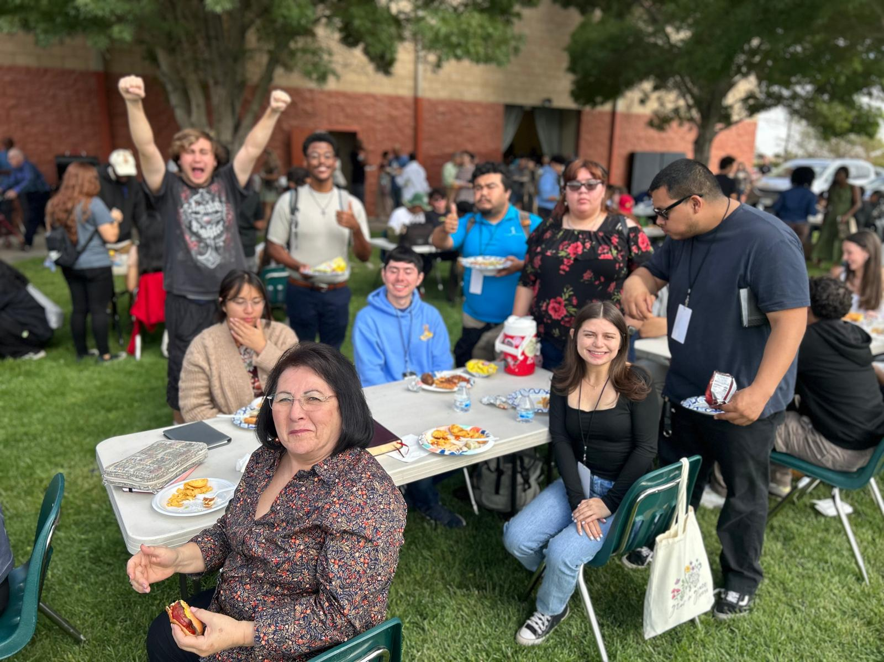
Fellowship

Slide 56
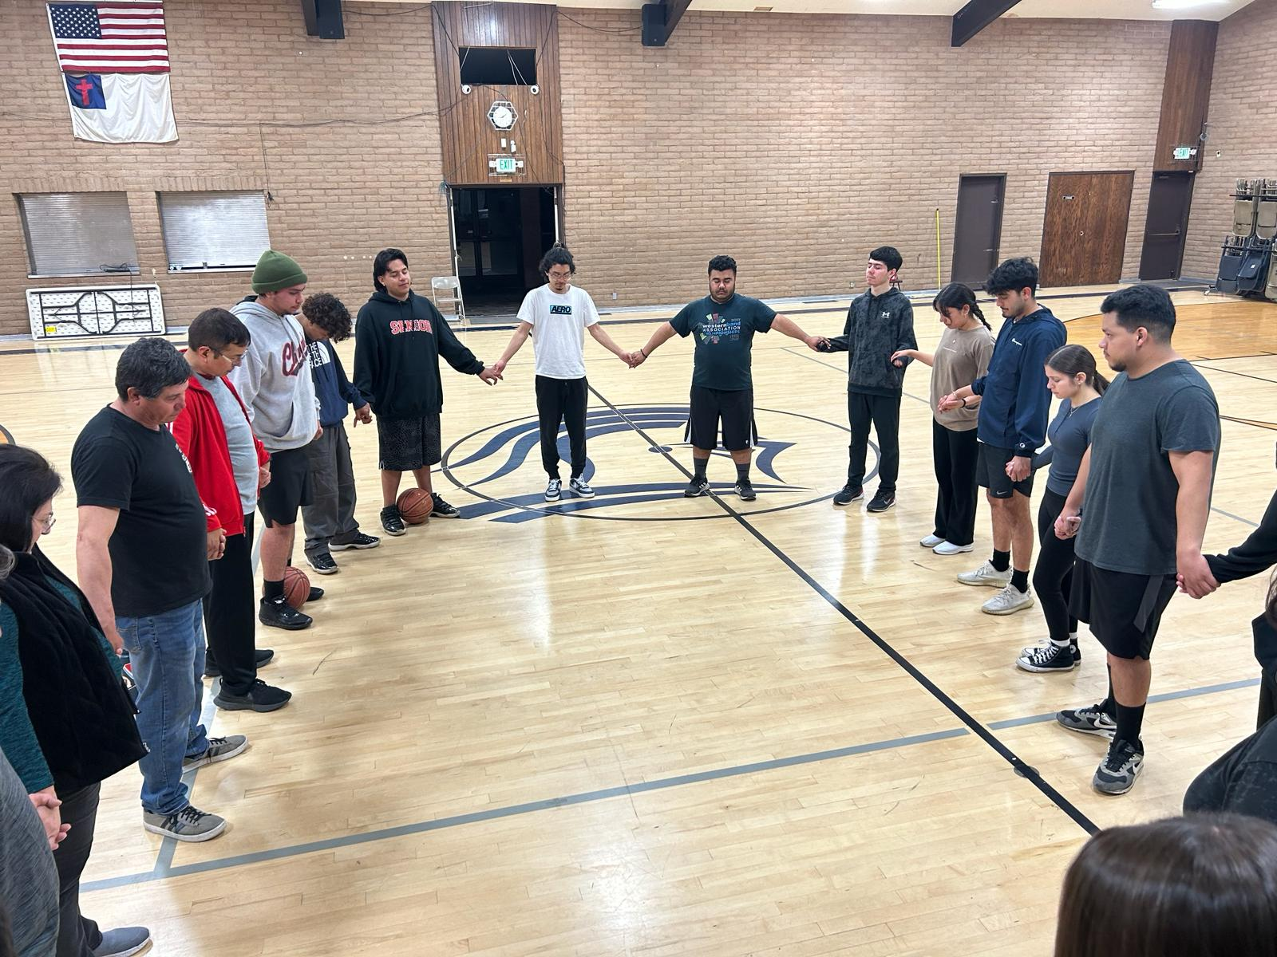
VII. Devoted to Public Worship
proskuneo
Lord’s Supper
Singing
Praying together
Ephesians 5:19-20
Let’s learn new songs and let’s improve our corporate worship!
Sat 9:00

Slide 57
VIII. Devoted to Prayer
This comment is about public prayer, principally.
Acts 4:23-31 Powerful, bold, faithful group prayers.
Wed 7:00 AM prayer times
Come to our prayer night Fri. 7/11.

Slide 58
IX. A place where needs are met
Emotional needs.
Physical needs.
Companionship.
Acts 2:44 Acts 4:32-37. There were no unmet needs among them!

Slide 59
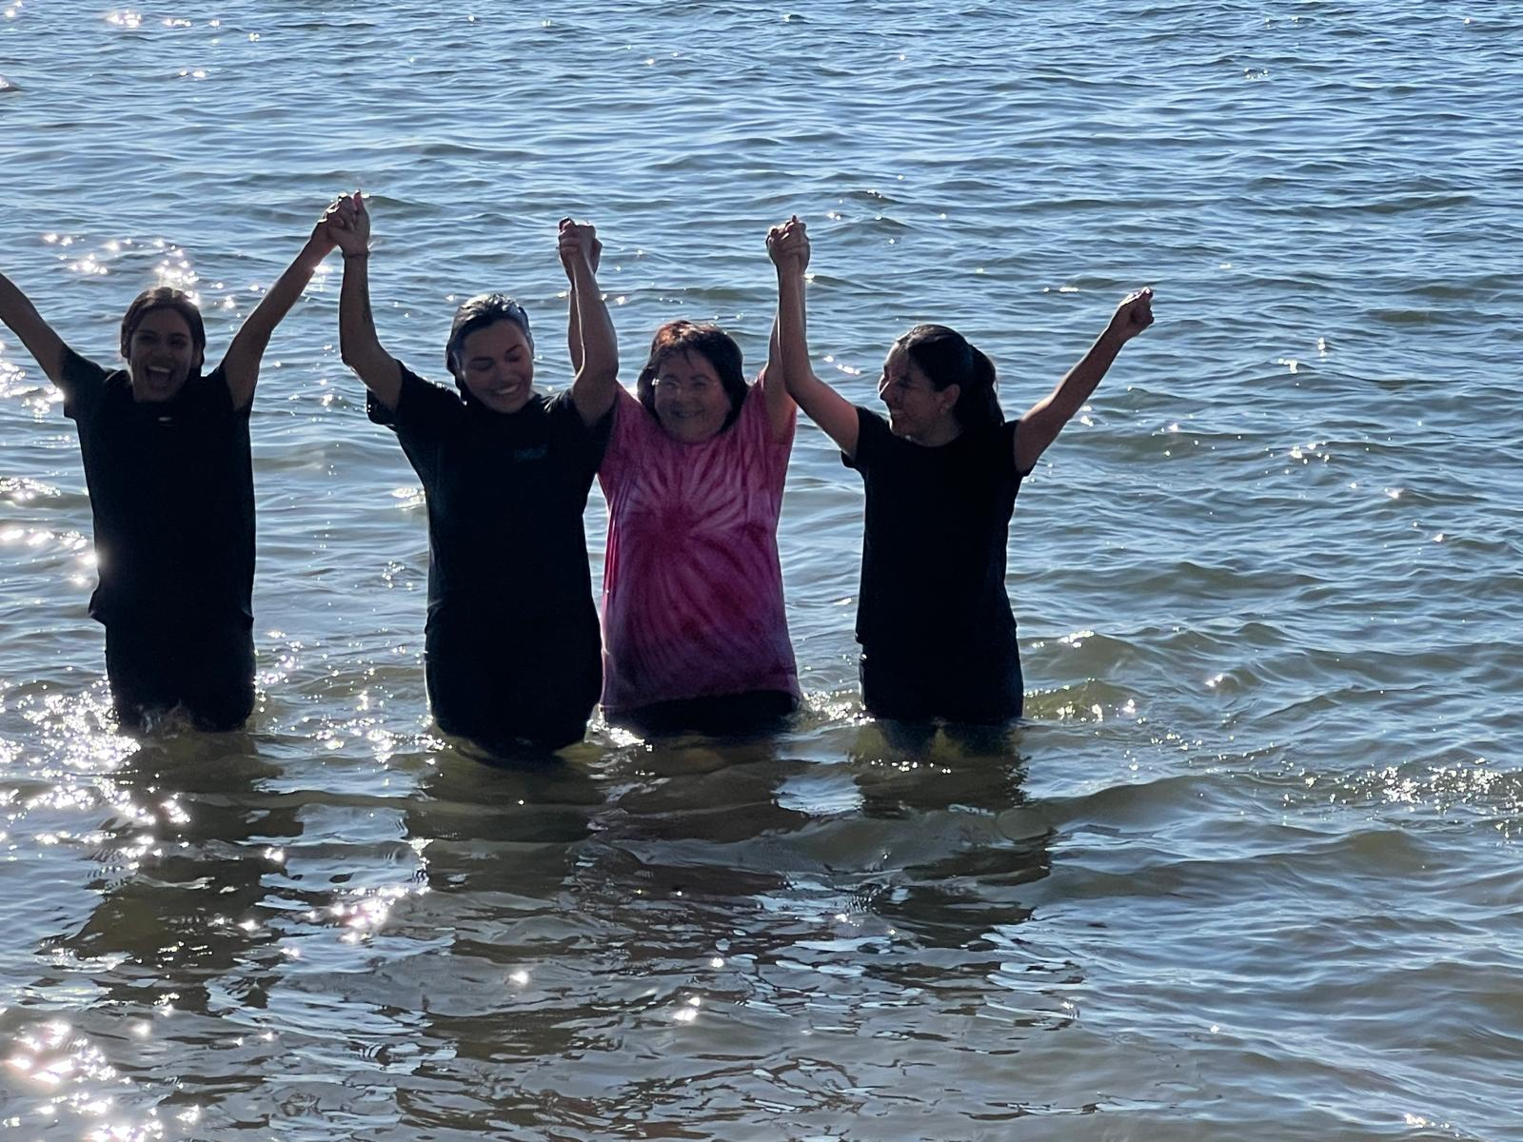
A Place Where Numerical Growth Happens
Acts 4:4
Acts 5:14
Acts 6:7
Numerical growth is natural in the Church.

Slide 60
Discussion Questions
1. How can we improve our worship times?
2. How is your Christian fellowship doing?
3. Are you involved in helping your church to grow in numbers?
4. Have you been devoted to the apostle’s teaching? How might you improve this?

