Slide 1
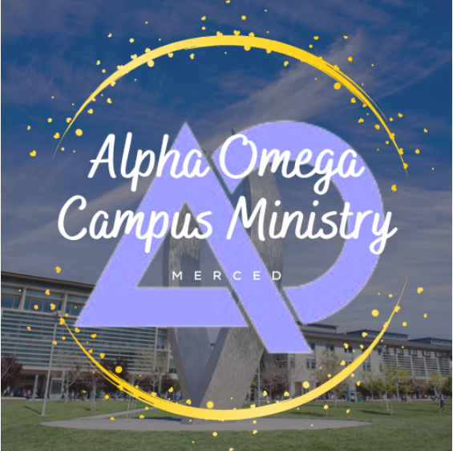
Welcome to the Alpha Omega Campus Midweek

Slide 2

Announcements
Fri 12:15 Serving at St. Patricks Church on Yosemite Ave.
Fri 7:00 Sports Night at 500 Buena Vista Dr.
Worship Sun 11:00 500 Buena Vista Dr.
UC Merced Bible Talk Mon 7:00 by the lake (postponed one week?)
Wed 7:30 Midweek UCM GLCR 120
Fri 6:00 Barbecue and Volleyball at Lake Yosemite Park

Slide 3
Coming Up
Campus Worship in Sacramento June 22
Special Contribution for Missions June 29
ICMC and Jubilee in OC July 31-Aug 3

Slide 4
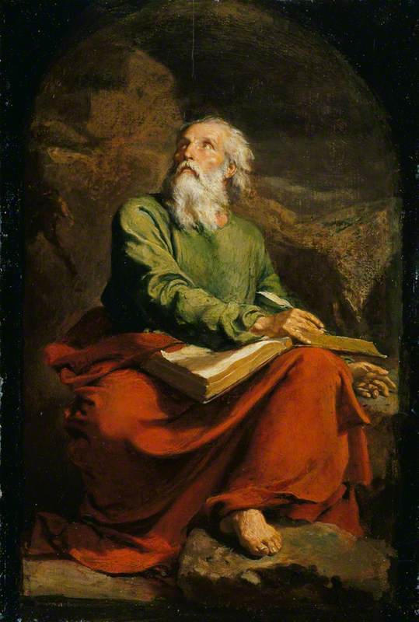
The Book of Isaiah The Lord Is Salvation
John Oakes
Summer, 2025

Slide 5
Isaiah Timeline
732 BC Syro/Ephriamite War (Isaiah 7, 2 Kings 15) Ahaz unfaithful.
722 BC Ephraim/Samaria destroyed by Assyria under Shalmaneezer V
701 BC Sennacherib takes Judah, puts Jerusalem under siege. Isaiah 1:7 Hezekiah faithful.

Slide 6
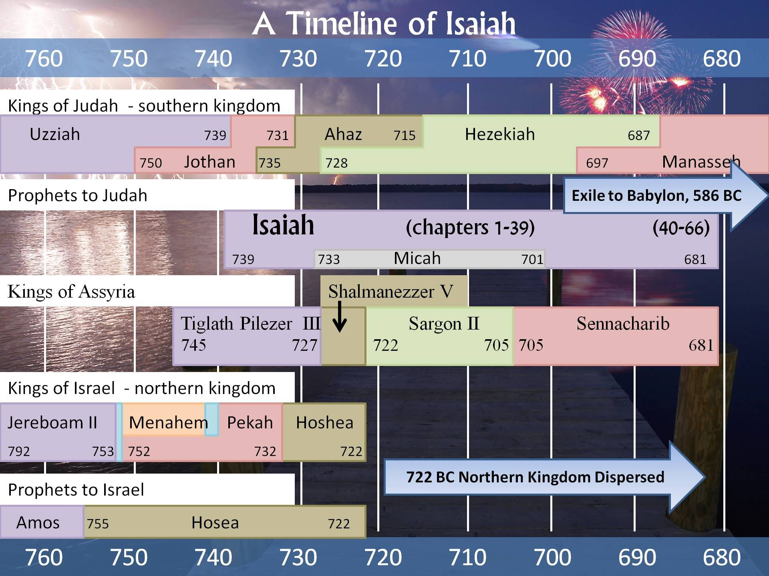

Slide 7
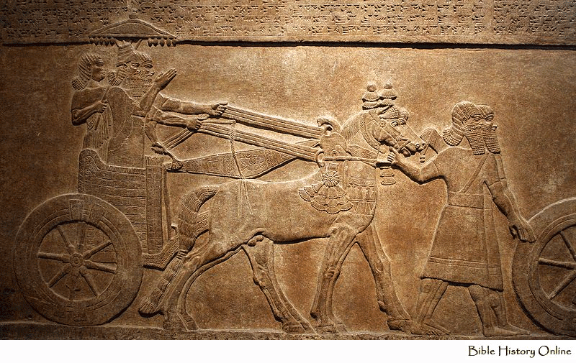
Tiglath- Pileser (Pul) standing with driver. (British Museum)

Slide 8
More Historical Context
Tiglath-pileser III 745-727 BC 2Kings 15:19-20 - known as Pulu in Babylon or Pul in Israel. Syro/Ephraim War, Jezreel.
Shalmaneezer V 727-722 BC Hosea 10:14, 2 Kings 17 Began destruction of Israel.
Sargon II 722-705 BC 2 Chronicles 28:1-27
Finished destruction of Samaria/Northern kingdom.
Sennacherib 705-681BC 2 Chronicles:29-33, Is 36:1-7, 37:21,35-37 - constant threat to Judah under king Hezekiah

Slide 9
Worth Noting
Isaiah contains 111 separate predictions. Of the 1,292 verses in the book, 754 (59%) deal with future events.
Forty-seven chapters of this book were directly quoted or alluded to by Christ or the Apostles. With more than four hundred allusions, Isaiah stands second only to Psalms as the most cited book in the New Testament.

Slide 10
One Outline of Isaiah
Isaiah 1-39 Messiah the king -Assyria
Isaiah 40-55 Messiah the Servant -Babylon
Isaiah 56-66 Messiah the Conqueror -World

Slide 11
Another Outline of Isaiah
I. God Judges the Nations (Ch. 1-35)
II. God Comforts his People (Ch. 36-48)
III. God’s Prince of Peace (Ch. 49-57)
IV. God’s Program for Salvation (Ch. 58-66)

Slide 12
Themes of isaiah
1. The utter sinfulness of Judah and Jerusalem
2. Appeal of God to turn to him—to repent.
3. Judgment if they do not.
4. The Messiah—the Suffering Servant—is coming to save.
5. Restoration of a Remnant

Slide 13
Subthemes
God rules the nations.
The glory of the Lord.
Social Justice

Slide 14
Isaiah ch. 1-5 Intro to Isaiah
Isaiah 1 themes
The utter sinfulness of Jerusalem/Judah (v 3-8)
Tender appeal by Jehovah that Judah repent (v. 16-19)
The inevitability of judgment (v. 24-25, 29-31)
The possibility of salvation (v. 26-27)

Slide 15
Isaiah 1:2-4
Isaiah 1:2 A courtroom scene, with Judah as defendant and the heavens and earth as witnesses. (Deut 30:19)
v. 2-4 God: I have always maintained hesed. I have been like a parent with its children (Hos 11:1-4)
But we have rebelled. We are worse than dumb animals.
v. 3 yada know intimately My people (ammi as opposed to Lo-Ammi Hos 1)

Slide 16
ISAIAH 1:4-9
Would Judah agree with the assessment in 1:4?
Would you?
Isaiah 1:5-8 God’s compassion.
Isaiah 1:7 is literally true at this time for Judah under Sennacherib.
Isaiah 1:9 Hope. The remnant.
Remnant theology: Isaiah 10:20-23 Zeph 2:7-11, Hos 11:8-11, Ezek 5:1-3

Slide 17
Isaiah 1:10-20 God is angry repent!
Isaiah 1:10-15 God is very angry. Why? Empty religion without faithfulness/hesed.
v. 13 Could our worship become “worthless assemblies?”
Isaiah 1:16-17 Repent. How? By seeking justice.
Isaiah 1:18-20 Come, let us reason together. God offers salvation.
We can willingly obey or we can resist and rebel.

Slide 18
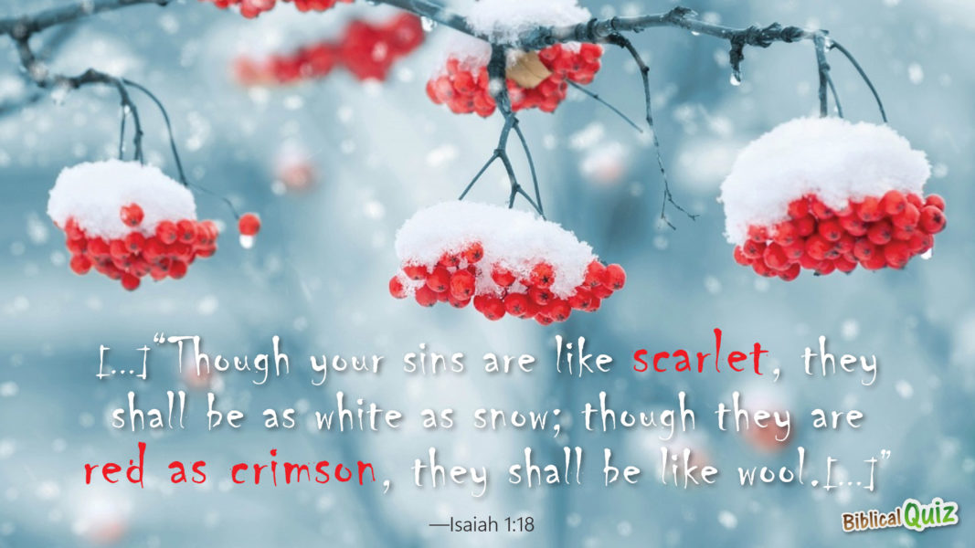
Though your sins are like scarlet

Slide 19
Isaiah 1:21-31
Isaiah 1:21-23 No more justice. The rich get richer. Does that sound familiar?
v. 24-25 Therefore, wrath.
v. 26-27 Hope. Zion—the Kingdom will be delivered.
v. 29-31 The idols will be destroyed.

Slide 20
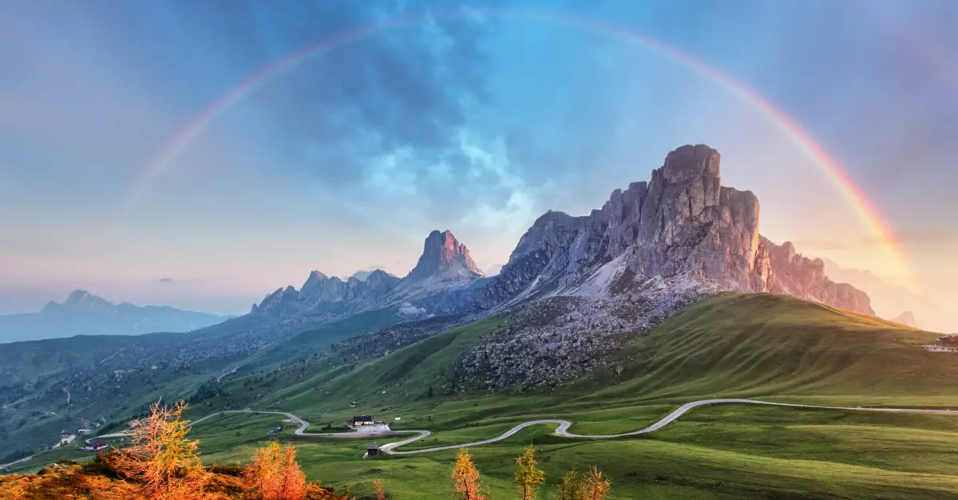
Isaiah 2:1-5 A Kingdom prophecy
Isaiah 2:2 In the last days Heb 1:2, Acts 2:17, Joel 2:28-32
The mountain of the Lord is Mt. Zion/Jerusalem/the kingdom of God (and maybe even the Church).
v. 3 Pentecost.
v. 4 Inscribed at the UN.

Slide 21
Kingdom Prophecies
1. The future temple which attracts Gentiles (2:2–4).
2. The glorious Branch (4:2–6).
3. The virgin birth of Immanuel (7:13–14).
4. The dawning of a new day in the birth of a child (9:1–7).
5. The Shoot of the stem of Jesse (11:1–10).
6. The conversion of Gentiles (19:18–25).
7. The new Jerusalem (54:9–13; 60:19–22).

Slide 22
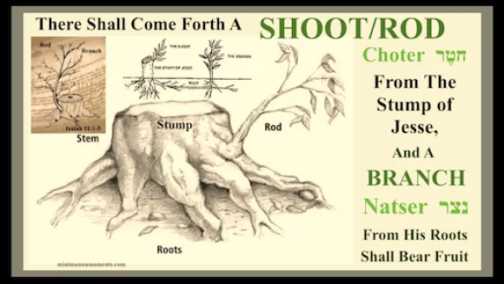
Isaiah 11:1-12:6 Another kingdom prophecy
Isaiah 11:1 A root, a branch of Jesse nazer
Matthew 2:23 He will be called the nazerene

Slide 23
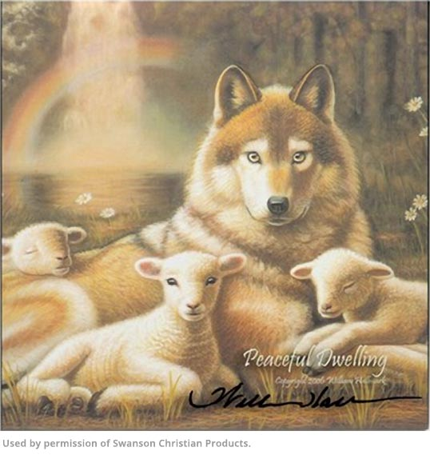
Isaiah 11:1-16 The Kingdom of god
v. 4-5 Messiah/Branch brings justice and righteousness.
v. 6-9 A kingdom of peace/shalom.
Already but not yet!
v. 10-16 A banner, a resting place, a gathered remnant, a highway to heaven.
Get the picture!

Slide 24
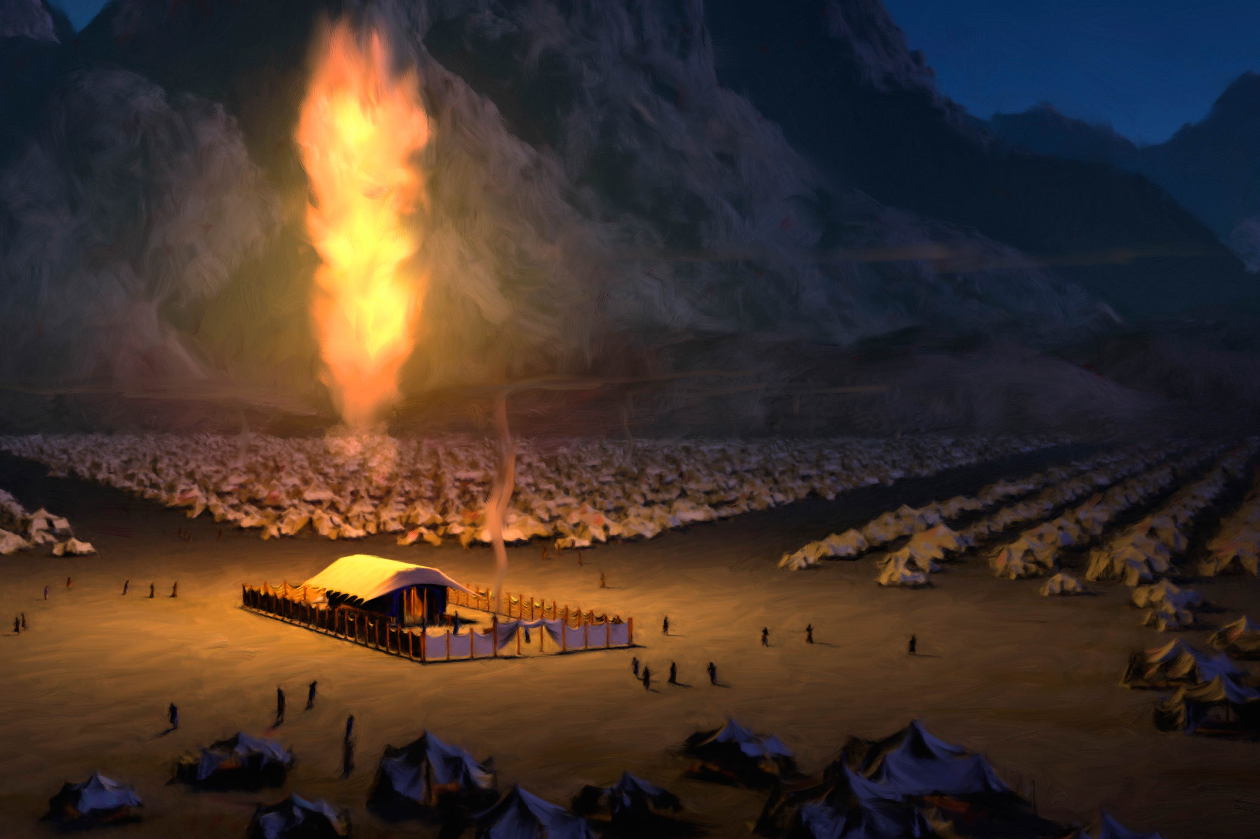
Isaiah 2:2-4 Isaiah 4:2-6 a sandwich
Isaiah 4:2 Branch will be beautiful and glorious.
Emphasis here on glory!!!
Isaiah 4:5 The shekinah—glory of God.
John 1:18

Slide 25
Isaiah 2:6-22 The Day of the lord
TDOTL Obadiah 4, Amos 3:2, Amos 5:2 Micah 3:12 Zephaniah 1:14-18 Is. 2:12 Is. 13:6-9Is. 13:10-13 Is. 34:4, 8-10 Jer. 46:10 Lam. 2:22 Ezek. 13:5 Ezek 30:3 Joel 1:15 Joel 2:1 Joel 2:11 Joel 2:31 Joel 3:14
The Day of the Lord signifies “The moment when Jehovah grasps the reigns, which he seems to have held slackly before, when the currents of his moral rule, which have been running sluggishly, receive a mysterious quickening, and the Lord’s work on the earth is at last fully performed.”
Or “The Day in which Jehovah will manifest himself as God.”

Slide 26
Isaiah 2:6-22
v. 10 The unrighteous are hiding in the rocks.
v. 12-17 The proud, the rich and prosperous… All will be brought low.
v. 20 TDOTL is a day people throw away what they formerly valued greatly. Ezek 7:19-20
v. 22 Great advice Stop trusting in mere humans.

Slide 27
Isaiah 3 God Against Us
v. 1 God removes supply and support.
v. 8 Jerusalem staggers
v. 11 Disaster
v. 13-14 God is judging us.
v. 18-23 God will snatch away our finery

Slide 28
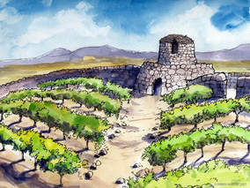
Isaiah 5 Song of the Vineyard
The vineyard is Israel and Judah. The vineyard is the church.
prepared the land
Set up a watchtower
Built a winepress—gave us work to do in the vineyard

Slide 29
Isaiah 6-12
Isaiah 6 Isaiah commissioned
Judah is in deep trouble
Isaiah 7, Isaiah 9 Isaiah 12:1-6 Hope for Judah
But…
Isaiah 7 Ahaz rejects faithful reliance on God. The end for Judah is inevitable

Slide 30
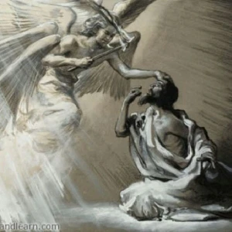
Isaiah 6 God commissions Isaiah
Holy, Holy, Holy…
Woe is me!
Sin removed.
Here am I, send me.
I am sending you to a stubborn people.
How long?
v. 13b. A ray of hope

Slide 31
Isaiah 7 Unfaithful Ahaz
Is 7:1-9 Ephraim and king Pekah allied with
Rezin of Syria attack Jerusalem/Judah
The Syro/Ephraim war of 734 BC
v. 3 Shear-Jashum a remnant will return
v. 9 If you do not stand firm in your faith, you will not stand at all.
Isaiah 7:10-12 Ahaz does not ask for God’s deliverance. He chooses to rely on Egypt, not God.

Slide 32
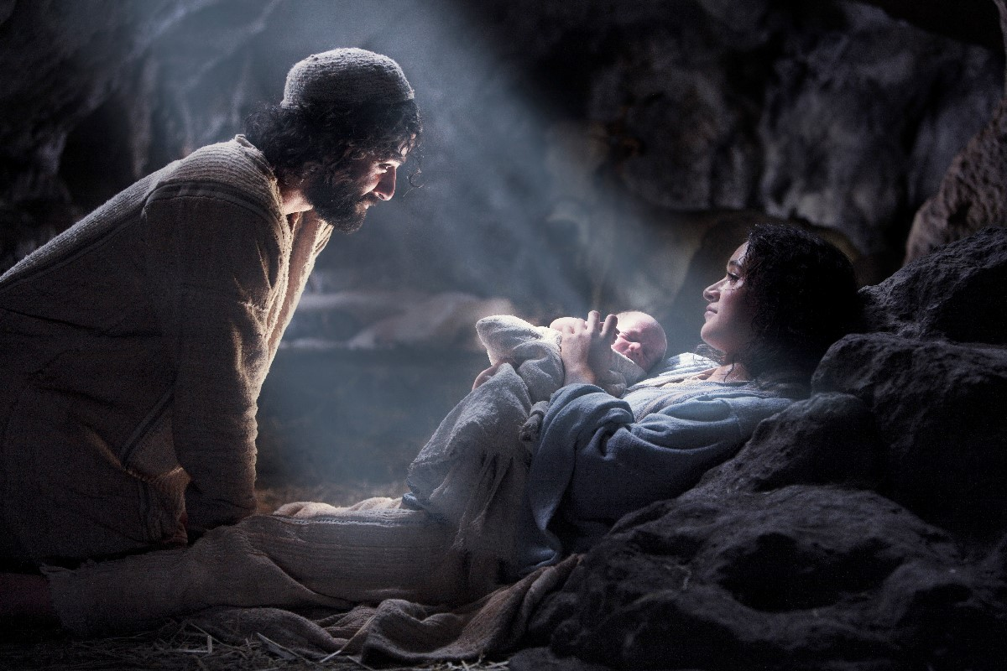
Isaiah 7:13-17 a sign The virgin will be with child
v. 14 a sign The virgin
(Heb alma, young maiden) will be with child.
He will be God-with-us Immanuel Matt 1:22, 28:20

Slide 33
Isaiah 8 Isaiah’s other son
Maher-Shalal-Hash-Baz (quick to the plunder, swift to the spoil)
Isaiah 8:4 Judgment is coming from the North (Assyria)
Isaiah 8:6-8a This is exactly what happened in 701 BC
under Sennacherib. God is with us (but not in a good way)
But… see Isaiah 36-38

Slide 34
Isaiah 9:1-7 The Lord’s deliverance
Isaiah 9:1-2 Nevertheless, there will be no more gloom for those who were in distress. In the past he humbled the land of Zebulun and the land of Naphtali, but in the future he will honor Galilee of the Nations, by way of the Sea, beyond the Jordan.
Isaiah 9:6 For to us a child is born, to us a son is given. He will be called Counselor, God, Father, Prince of Peace
v. 7 He will reign on David’s throne 2 Sam 7:16

Slide 35
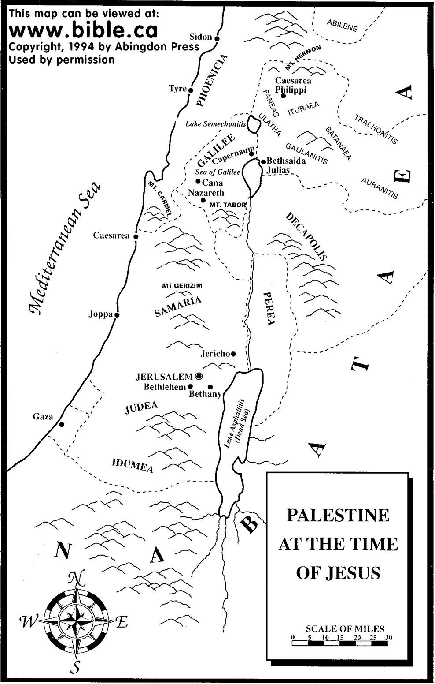
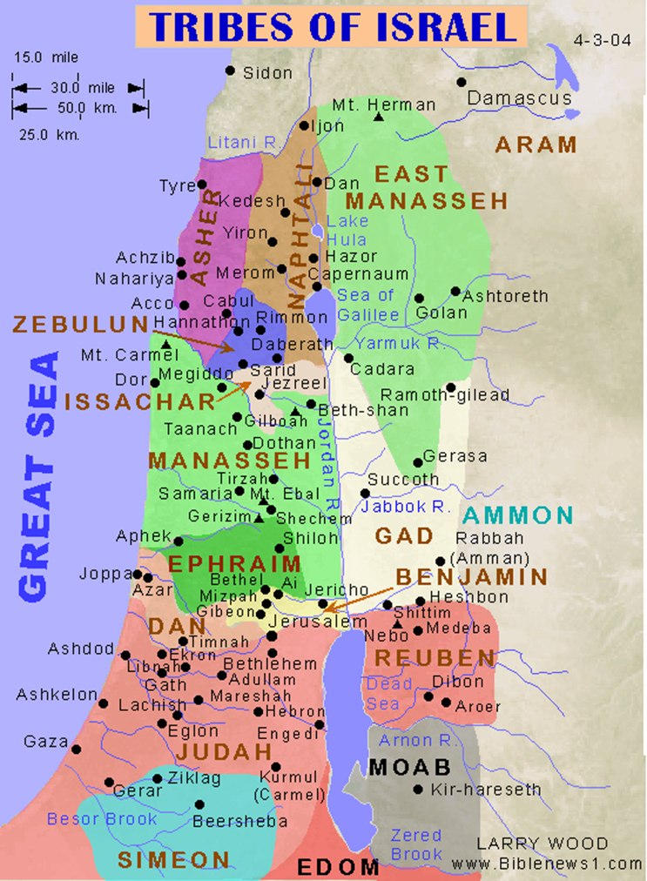
The Land of Zebulun and naphtali

Slide 36
Isaiah 10 What Gets god angry? Injustice
Isaiah 10:1-4
-oppressive decrees
-depriving the poor of their rights
-withholding justice from the marginalized
Social justice is big in Isaiah!
Isaiah 58:5-8
v. 3-4 (Ezekiel 7:19) The things they relied on will not save them!
v. 5-6 Therefore I am sending Assyria!

Slide 37
Isaiah 10:20-25 The remnant
v. 20 Who are the remnant? They are those who do not rely on Assyria for their strength.
Those who trust instead in the Lord.
v. 24 The remnant is not afraid of the Assyrians, even though they beat you with a rod.
They will be destroyed

Slide 38
Isaiah 12 A psalm of isaiah
Isaiah 12 finishes the sandwich that was begun in Isaiah
v. 2 God is our salvation.
v. 4 We praise his name to all the nations.
v. 6 Shout it aloud! Are you doing this?

Slide 39
Isaiah 13-30 Judgment on the nations
Isaiah 13-24 Judgment on Babylon, Philistia, Moab, Damascus, Cush, Egypt and more.
Isaiah 25-30 Judgment (mostly) on Israel and Judah.
Isaiah 31:1-9 Do not go down to Egypt!
Isaiah 32:1-4 A righteous king will reign. A shelter from the storm. A stream of water in the desert.

Slide 40
Isaiah 36-39 Historical Interlude
Isaiah 36-37 Hezekiah trusts in the Lord and saves the remnant in Jerusalem from destruction.
Isaiah 38 Hezekiah’s illness, prayer, and Isaiah’s answer. Hezekiah (unlike Ahaz) asks for a sign.
Isaiah 39 Hezekiah’s terrible mistake. Jerusalem will go into captivity!

Slide 41
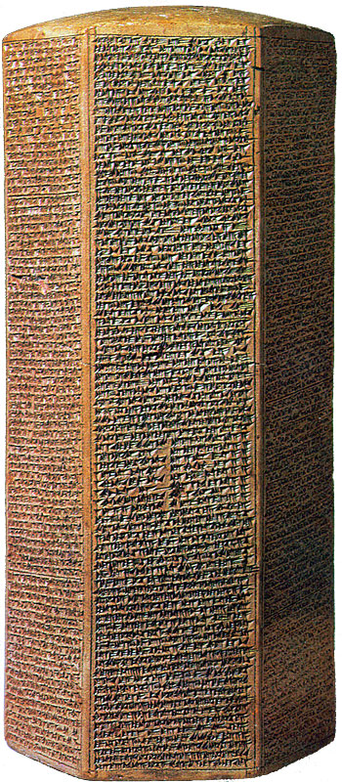
The Sennacherib Cylinder or Taylor Prism British Museum, London (2 Kings 18) 691 BC
As to Hezekiah the
Jew… I made him…
“like a bird in a
cage”

Slide 42
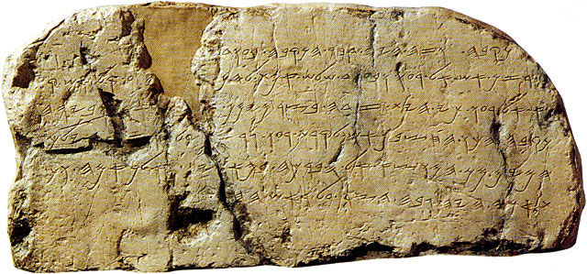
The Siloam Inscription.
2 Kings 20:20-21
"Now the rest of the acts of Hezekiah--all his might, and how he made a pool and a tunnel and brought water into the city--are they not written in the book of the chronicles of the kings of Judah? So Hezekiah rested with his fathers."

Slide 43
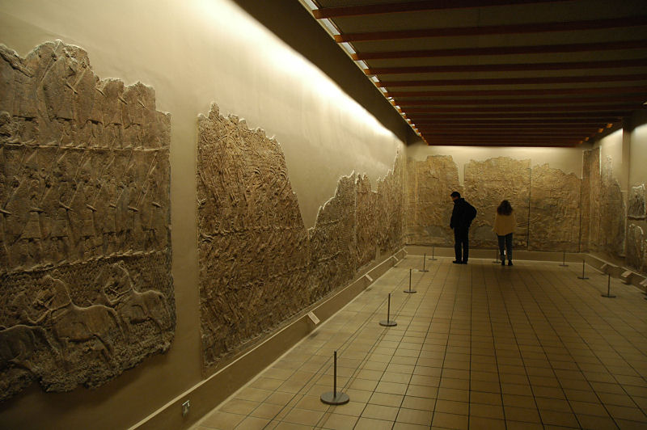
Lachish Room, British Museum

Slide 44
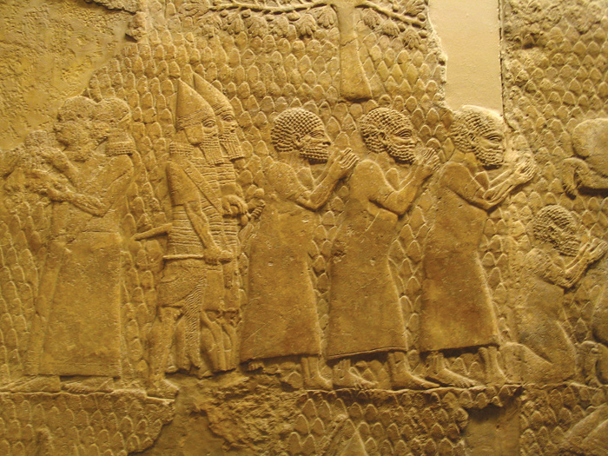
Israeli Captives Being Led from Lachish

Slide 45
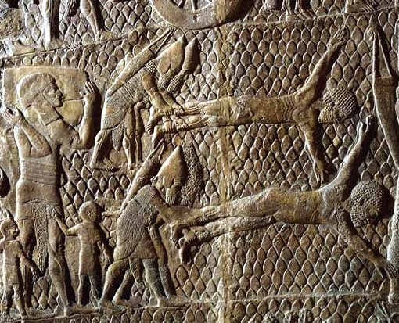
Jewish captives skinned alive in front of Lachish Walls

Slide 46
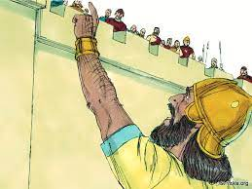
Isaiah 36 & 37 Hezekiah trusts In jehovah
36:5 Who are you relying on? A great question!
Satan’s schemes:
Don’t rely on Jehovah. I beat him already
Don’t rely on a godly leader Hezekiah
God told me to tell you.
Let’s make a compromise
Have the other gods saved them?

Slide 47
Isaiah 36-37 Hezekiah trusts in jehovah
Hezekiah: A model for trusting God. Isaiah 37
v. 1 He humbles himself before God
v. 2 He seeks advice from his spiritual mentor.
v. 3-4 He repents and decides to trust in God, not Egypt.
v. 15-20 He prays to God for deliverance
God’s answer Isaiah 37:30-35
I will save a remnant
A band of survivors will come from Mt. Zion.

Slide 48
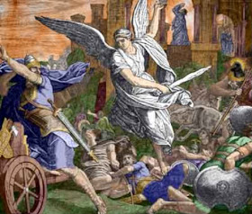
Isaiah 37:36 Jehovah vindicates Hezekiah

Slide 49
Isaiah 38 Hezekiah’s illness
Isaiah 38:1-6
Hezekiah has a deadly sickness
Isaiah: Prepare to die!
Hezekiah pleads with the Lord in prayer
God grants 15 more years of life
Isaiah 38:22 Hezekiah asks for a sign (unlike unfaithful Ahaz)

Slide 50
Isaiah 39 Hezekiah’s fatal error Transition to Isaiah 40
Isaiah 39:1-2 Envoys from Babylon appeal to the pride of Hezekiah.
Hezekiah (looking for a possible treaty?) shows them all the treasure in the temple.
v. 3-7 Isaiah confronts Hezekiah. All this treasure will be carried off to Babylon.
Your descendants (Daniel, Hananiah, Azariah and Mishael) will be made eunuchs in the palace in Babylon.

Slide 51
Outline of Isaiah
Isaiah 1-39 Messiah the king -Assyria
Isaiah 40-55 Messiah the Servant -Babylon
Isaiah 56-66 Messiah the Conqueror -World

Slide 52
Isaiah 40-55 Messiah the servant
Isaiah 40 Judah will go into captivity. But what about those promises?...
Isaiah 40:1-2 Comfort, Comfort my people. My anger is complete. A remnant will return.
Isaiah 41:9-10 From the farthest corners I called you.
You are my servant. I will uphold by my right hand.
The suffering servant is Israel and it is Messiah.

Slide 53
Isaiah 40 A Highway for our God
Is 40:3-5 A voice calling… John the Baptist Matt 3:3
God is clearing the way.
The glory of the Lord will be revealed. John 1:14
Isaiah 40:6-30 Jehovah is the only God!
I am great, I am sovereign, I rule the nations. The gods are nothing. The people are like grass.
-v. 14 Whom did I consult?
-v. 14 All the nations are nothing.
-v. 22 All the people are like grasshoppers!
Isaiah 40:31 Put your hope and trust in Jehovah.

Slide 54
Isaiah 41 God is Calling His Servant
Is 41:1-2 God is calling one from the East. Cyrus
Is 41:8 Jacob is “my servant” whom I have chosen. Who is this servant? Israel? The Church? (41:8, 49:3) The Messiah? (50:4-9, 53:9)

Slide 55
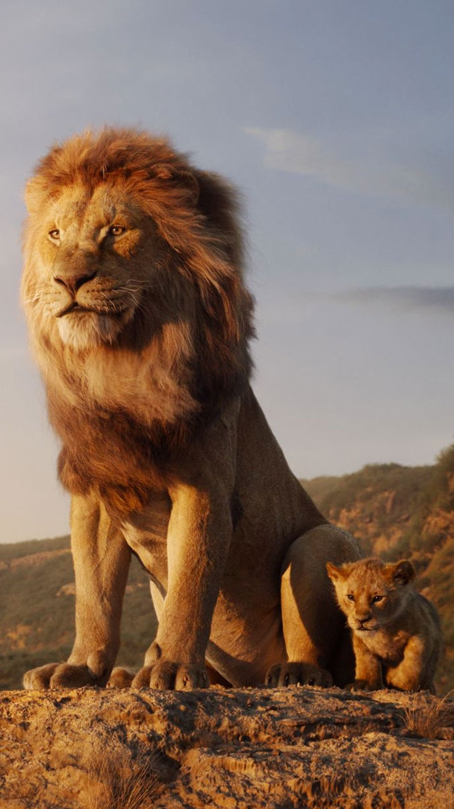
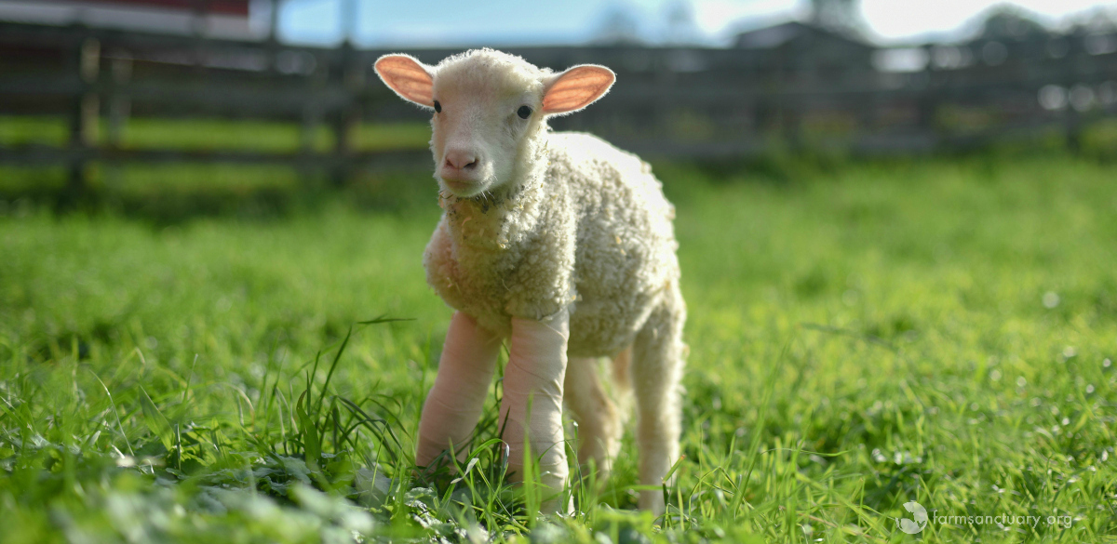
Isaiah 42 The Suffering Messiah
Isaiah 42:1-4 Look! The suffering servant! In whom I delight
v. 3 A bruised reed he will not break. Quoted in Matthew 12:15-21.
Is Jesus a lion or is Jesus a lamb? Revelation 5:5-6
Lion: Matthew 16:23, Matthew 23:29-37
Lamb: John 8:11, Matthew 9:35-38
Is 42:4 How can a lamb bring about justice?

Slide 56
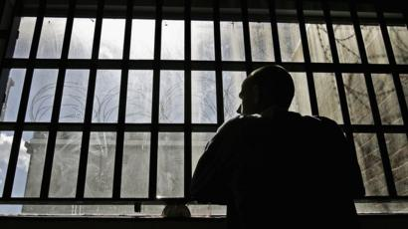
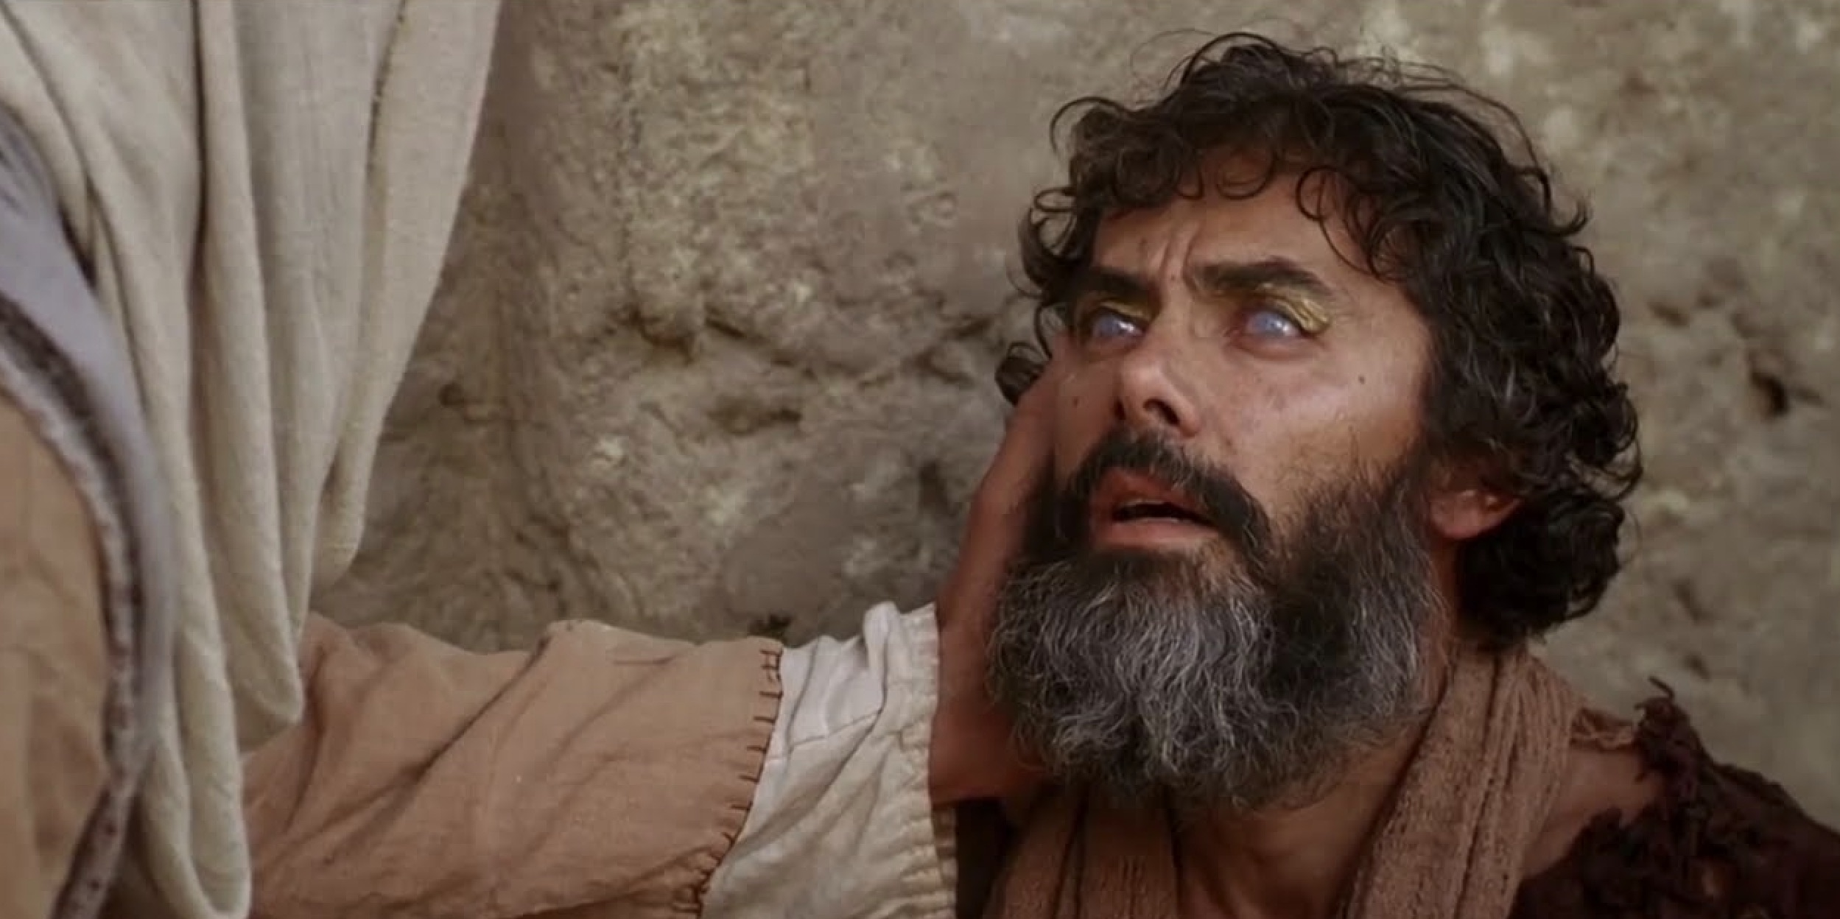
Isaiah 42:4-9 Messiah’s Ministry
Isaiah 42:4-9, Isaiah 61:1-3, Luke 4:17-21
Good news for the poor.
Freedom for the prisoners.
Healing for the sick/blind.
Release for the oppressed/from dungeons.
The favor of the Lord

Slide 57
Isaiah 42:8-17 I AM the Lord
Is 42:8-9 I announce things before they happen.
Is 42:10-17 God marches out triumphant.

Slide 58
Isaiah 44 The foolishness of idols
Isaiah 44:6-20 Idols vs YHWH
v. 6-8 I am the alpha and omega. I am the only God! Can the other “gods” foretell the future?
v. 9-20 The foolishness of idols.
v. 21-23 They make idols. I made you!
I sweep away your sins, so return to me!

Slide 59
Isaiah 44:26-45:13 I am sending cyrus
Is 44:26-28 I can call Cyrus 150 years before he is born!
Cyrus is the savior of my people. Reinhabit Jerusalem. Rebuild Judah. Restore the cities.
Confirmed by the Cyrus Cyllinder and Ezra 1:1-4
Is 45:1-7 Cyrus is a prefigure of the Messiah
Isaiah 45:9-13 The potter will raise up Cyrus.
Rom 9:14-24. Cyrus the new Moses.

Slide 60
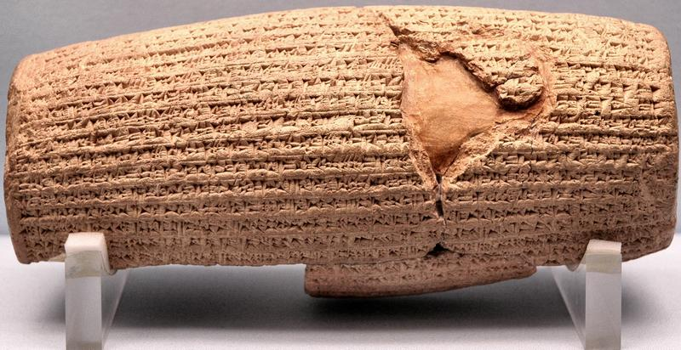
Cyrus Cylinder British Museum 535 BC
Ezra 1:2-4

Slide 61
Isaiah 49 God restores a remnant
Isaiah 49:1-13 2nd Servant Song
Is 49:1-7 I planned to send Messiah from the beginning.
What will Messiah do?
v. 5 bring Jacob back to God.
v. 6 restore the remnant of Israel.
v. 7 despised and abhorred.
v. 8 salvation… a new covenant. Restoration.

Slide 62
Isaiah 49:8-18 God’s remnant.
v. 8 restoring a remnant.
v. 9b pasture on every barren hill.
v. 10 no more spiritual hunger or thirst.
v. 10 compassion on them.
v. 10 lead them to springs of water.
v. 11 prepare a smooth road to the kingdom.
v. 12 all nations, North, South, East, West.
v. 13 comfort.
Isaiah 49:15-16 God a tender parent.
Like a mother with a child at her breast.
Engraved in the palm of God’s hand.

Slide 63
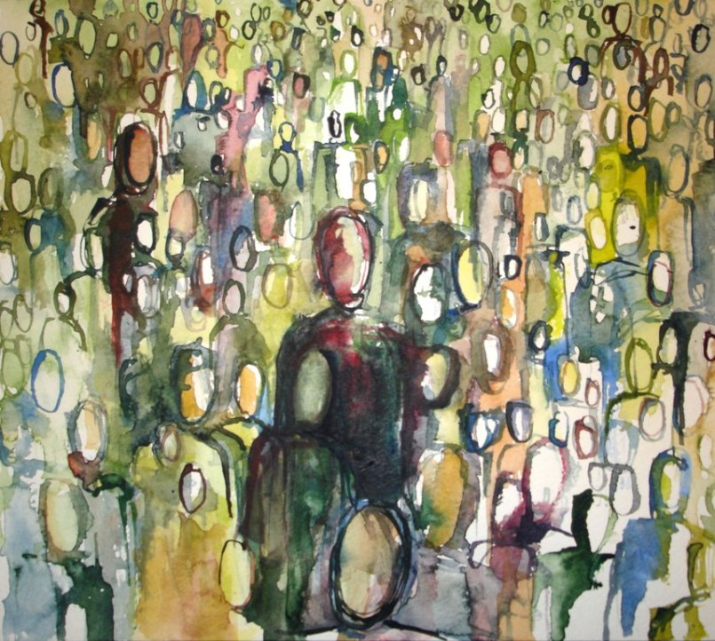
Isaiah 49:18-26 A fruitful remnant
v. 18-20 Your spiritual children are gathered around you.
v. 19-23 The barren become very fruitful.

Slide 64
Isaiah 52-53 The Suffering Servant Comes to Save
Isaiah 52:1-6 Wake up, Zion. Shake off the dust.
v. 2 Remove the bonds of slavery
v. 3 We were sold into slavery for nothing.
v. 4 We went down to Egypt or into Assyria.
v. 5 We sold ourselves for nothing.
Isaiah 52:7-12 But… How beautiful are the feet of those who bring the gospel of salvation—who say “God reigns.”
v. 11 Leave Egypt!

Slide 65
Isaiah 52:13-15
How will this work? Messiah will be lifted up!
John 12:32
The path out of Egypt is the death of one more precious than silver. It is the blood of Jesus.
He will sprinkle many nations.

Slide 66
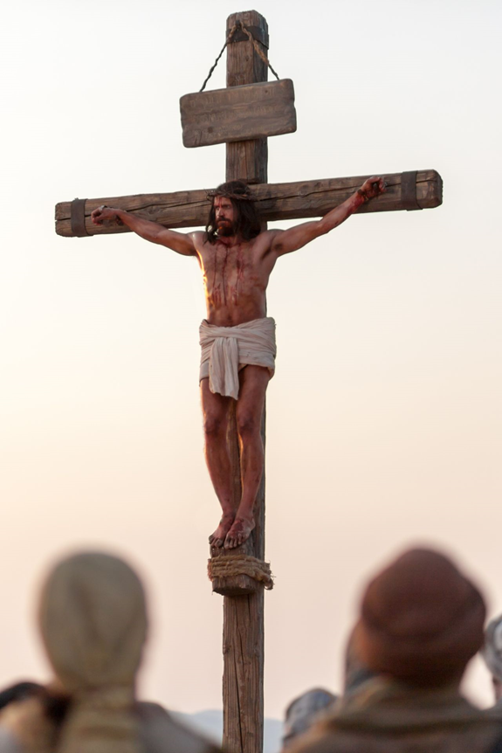
Isaiah 52:13-53:12 Servant Song #4
52:13 Messiah will be lifted up.
52:15 His blood will sprinkle many nations

Slide 67
Isaiah 53
Is 53:1 The arm of the Lord yet…
v. 2-3 Very human
v. 4-6 He took on our pain and suffering.
Our transgression → His piercing
His wounds → Our healing
Could anyone have believed this?

Slide 68
Theories of redemption
Ransom Theory
Satisfaction Theory Penal Substitutionary Atonement
Ultimate Example of God’s Love
Jesus defeated the powers of the world

Slide 69
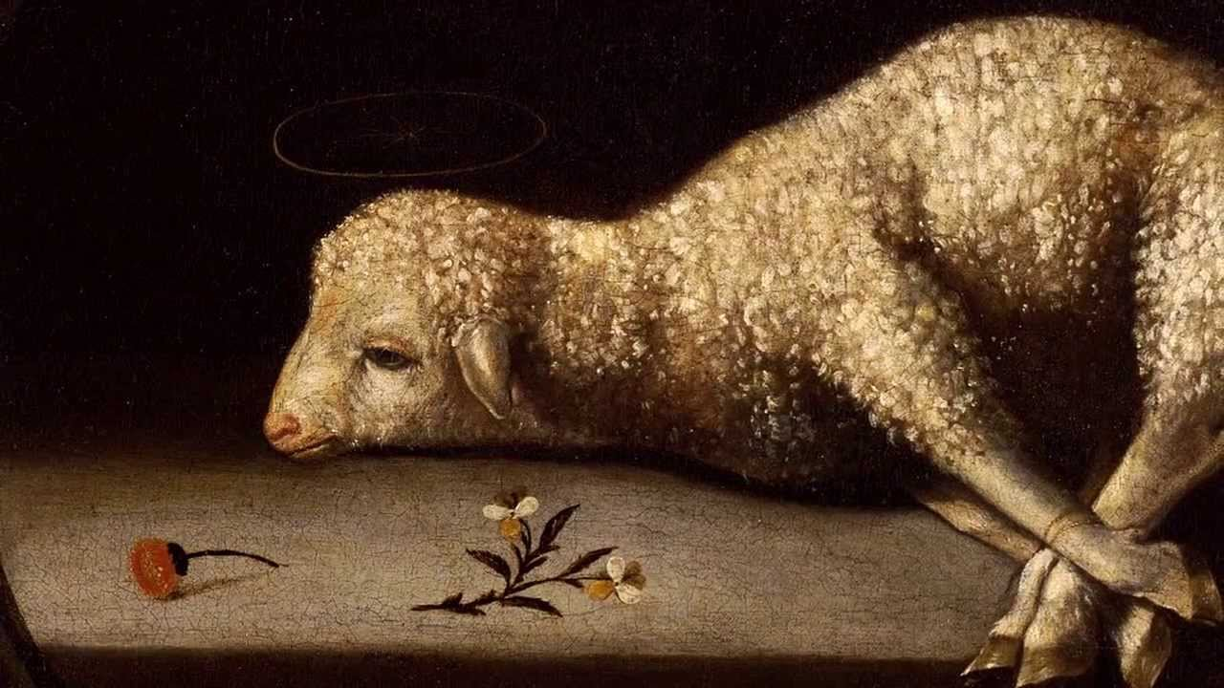
Isaiah 53 Cont.
v. 7 Led like a lamb. Was he helpless? No! A willing sacrifice.
v. 9 A grave with the wicked (plural) and with the rich (singular)
v. 10 It pleased the Lord… What does that mean?

Slide 70
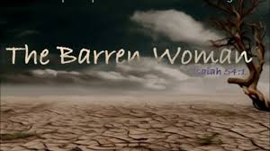
Isaiah 54
Is 54:1-3 The barren woman is the Gentiles
The one with a husband is the Jews
Sing, barren woman! More are the children of the desolate woman than of her who had a husband!
54:4-6 No more shame. Guilt-free.
54:7-15 I briefly abandoned you. Now I take you back forever.

Slide 71
Isaiah 55 Come to the waters
55:1-5 Come to the waters… Come, buy and eat.
v. 2 Things that satisfy.
v. 2 The richest of fare.
v. 3-5 The New Covenant
promised
eternal
Messiah as ruler
many nations

Slide 72
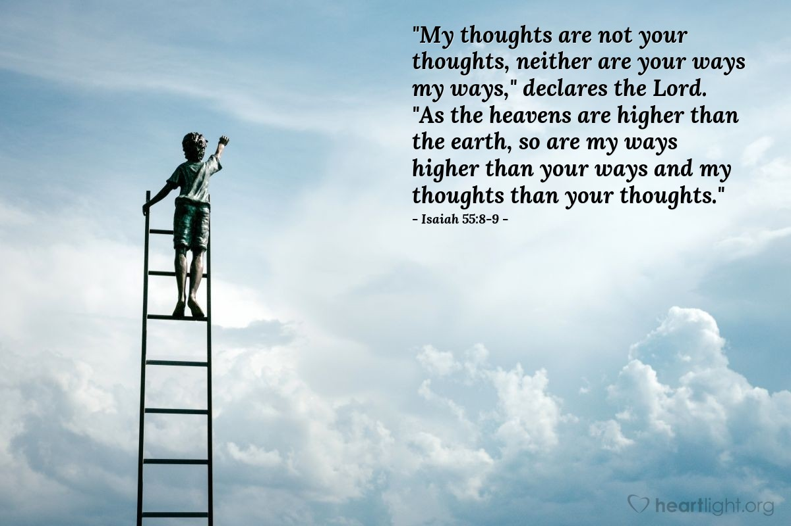
Isaiah 55 God’s ways
As the heavens are above the earth…
God’s words always accomplishes their purpose.
Even when people do not believe?

Slide 73
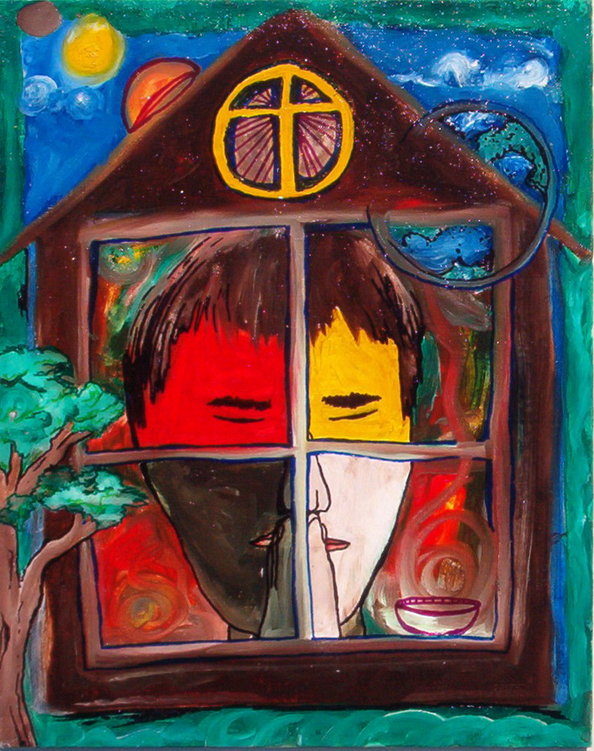
Isaiah 56:1-8 A House of prayer for all nations
Isaiah 56:1-8 Our part in the kingdom….
Maintain justice
Do what is right
Even the foreigner and the eunuch will be given a new name.
My house will be a house of prayer for all nations.

Slide 74
Isaiah 57:1-2 What about those who have died?
Why do they perish?
…to be spared from evil.
…enter into peace
…find rest as they lie in death

Slide 75
Isaiah 58 godly fasting
v. 1-2 They act religious, but their religion is about self, not God.
v. 5-7 Do not act humble, be humble.
-loose the chains of injustice
-untie the cords of the yoke
-share your food with the hungry
-clothe the naked
v. 8-14 The result: blessings from God.

Slide 76
Isaiah 59 The problem is sin
v. 1-2 Can God hear our prayers? Of course he can.
Does God hear our prayers? No! God choses
not to hear.
v. 3-15 Is God exaggerating here? (Romans 3:9-18)
None is righteous.

Slide 77
Isaiah 60 Great encouragement
Is 60:1-7 His glory appears over you.
Blessings: Sons, daughters, wealth on the seas, herds of camels, gold and incense.
Isaiah 60:10-22 Is this the Church or is this heaven?
-v. 11 foreigners will rebuild your walls
-v. 11 your gates will always stand open
-v. 13 juniper, fir, cypress
-v. 15 forsaken and hated becomes joy
-v. 16 drink the milk of nations
-v. 18 no more violence, ruin or destruction
-v. 19 God will be our light
-v. 21 only the righteous there

Slide 78
Isaiah 62 a great promise
Is 62:1-5 One of the most beautiful promises in the Bible
-a new name
-a crown of splendour
-a royal diadem in God’s hand
-Hephzibah (my delight is in her)
-Beulah (married to God)
Isaiah 62:6-7 “You who call upon the Lord give yourselves no rest, and give him no rest till he establishes Jerusalem and makes her the praise of the earth.”

Slide 79
Isaiah 65 The kingdom of god
Is 65:1-2 God is holding his hand out to an obstinate people. This was us!
But… to those who listen
Isaiah 65 17-25
-the former things will be remembered no more
-Jerusalem (the kingdom) will be a delight
-weeping will be heard no more
-no more death of the young—live to great age
-I will answer before they even call
-the wolf and the lamb will lie down together

Slide 80
Isaiah 66 A summary
Isaiah 66:9-24 A summary. What have you learned from the Book of Isaiah?
Isaiah 66:17 A stark reminder.
Isaiah 66:19 God will send a sign—the Messiah!
Isaiah 66:20 We will bring many visitors from all nations to the mountain/kingdom of God.

