Slide 1
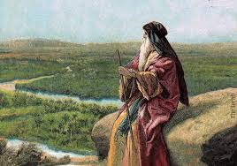
Deuteronomy I Remembering
The Second Reading of the Law

Slide 2
Deuteronomy
The Second Reading of the Law

Slide 3
Themes in Deuteronomy
Covenant loyalty: hesed
Theme verse: Deuteronomy 6:4-5 the shema.
Hear, O Israel, the Lord our God is one. Love the Lord your God with all your heart, and with all your soul and with all your strength.
That is hesed, and that is what God wants.

Slide 4
Things to Look For in Deuteronomy
I. Law
II. Story
III. Exhortation

Slide 5
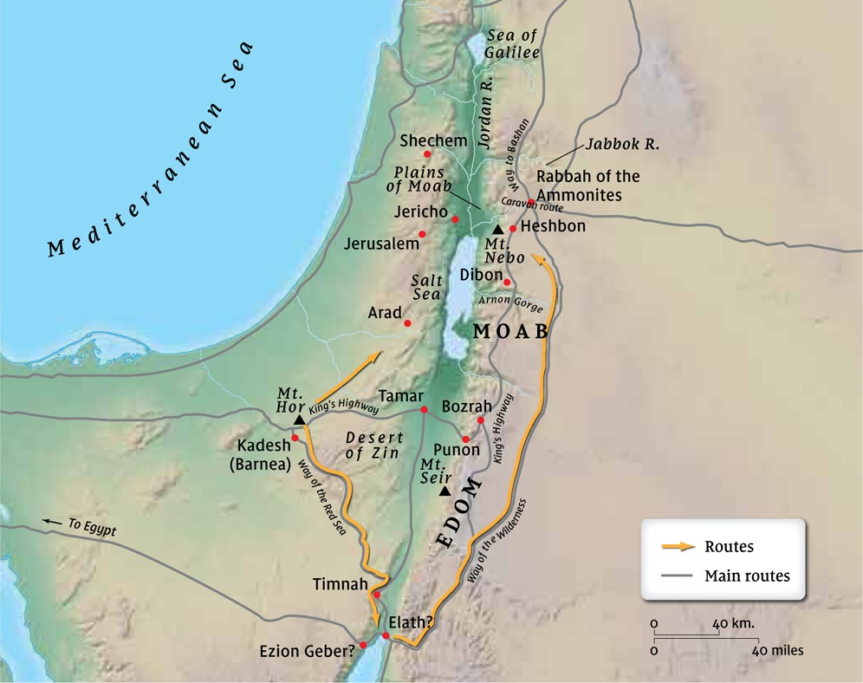
The Setting: Entering the Promised Land Numbers 14:20-24

Slide 6
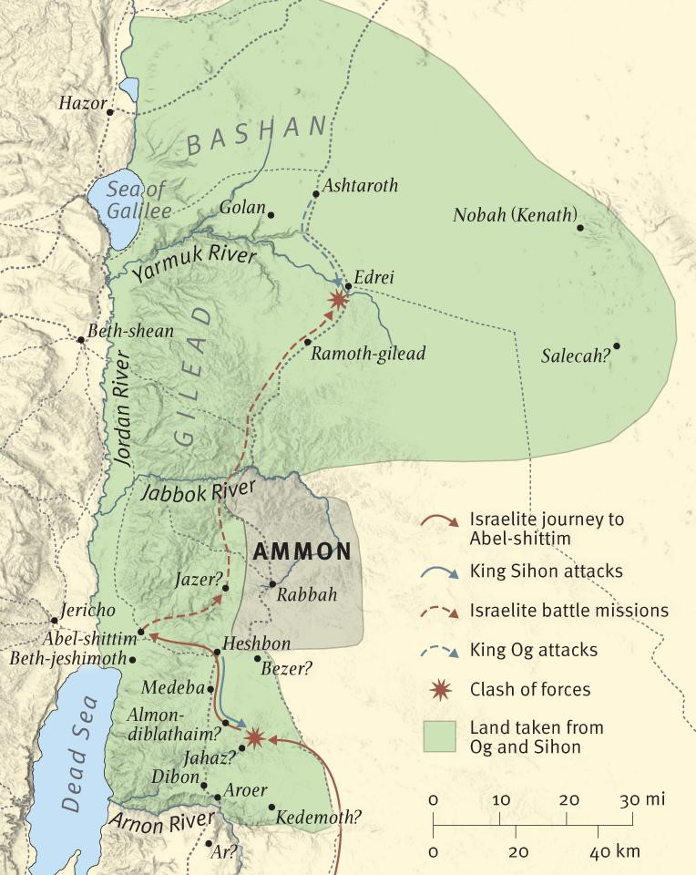
Let’s Get Started
Deut 1:1-5
The back story
The defeat of Sihon of the Amorites and Og of Bashan

Slide 7
Deuteronomy 1:6-8
God to Israel at Kadesh Barnea:
Let us break camp and advance!
I am giving you UC Merced, Merced College, Merced and Atwater! No go up and take it!

Slide 8
Deuteronomy 1:9-18 But First…
The burden on Moses was too great.
Time to appoint some young leaders to help take the land!

Slide 9
Deuteronomy 1:19-46 A Sad Story
v. 26-28 When God says to “go up,” we need to go up!!!
Taking the Promised Land is both a command and a promise.
The people grumbled and accused God of hating them!
But… God is merciful and he will fulfill his promises, one way or another.

Slide 10
Deuteronomy 1:30
Confidence!!!
Why? Because God is going before us

Slide 11
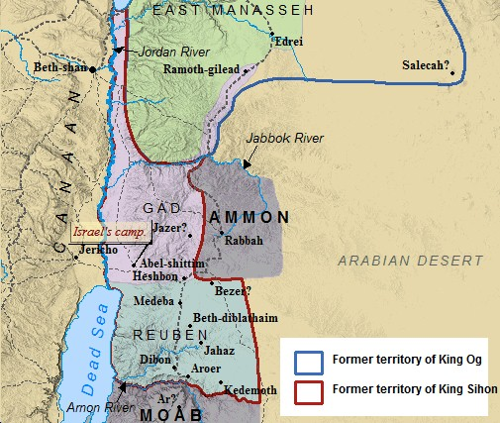
We are skipping Deuteronomy 2:1-3:20

Slide 12
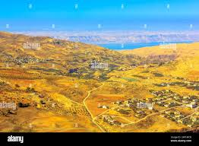
Deuteronomy 3:23-29
Canaan from Mt. Nebo
Joshua: Do not be afraid of them.
Why? Because of what God has already done.
God to Moses: You will not enter!

Slide 13
Deuteronomy 4:1-8 Moses’ Speech Begins
Follow my decrees and laws carefully!
Then you will go in and take possession of the Promised Land.
What a great God we have, who is near to us whenever we pray to him!!!!

Slide 14
Summary
Deuteronomy is a book of Law, of story and of exhortations.
It is time to “break camp,” and advance.
When God says to “go up,” we need to go up!
We need plans and we need to raise up leaders.
We can take the land, because God is going before us.
As we do, let us pay very careful attention to the Word of God.

