Slide 1
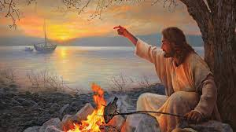
The Gospel of John XXI
John Ch 21
Feed My Sheep

Slide 2
John 21 An Epilogue
John has completed his purpose.
He has revealed Jesus as the Messiah through his miracles and his statements about himself.
He has shown Jesus as the one who came full of grace and truth.
He has shown us the passion—the death, burial and resurrection of Christ.
But he has a couple of loose ends to tie up.

Slide 3
But First… John 20:30-31
These were written that you may believe… and have life in his name.
So… Do you believe in Jesus?
Are you holding to his teachings? (John 8:31)
Do you have a belief like that of Abraham—a saving faith?

Slide 4
John 21:1-9 An Eighth Sign
Have the seven disciples abandoned Jesus? No!
So, what is the problem?
They need marching orders. They need a mission.
Matthew 28:18-20 and Acts 1:8 will come later.

Slide 5
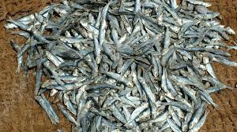
John 21:1-9 An Eighth Sign
v. 5 How’s the fishing going without a mission?
Cast you nets!!!!
153 fish

Slide 6
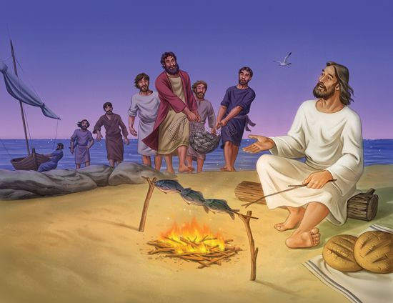
John 21:10-14 Jesus Feeds His Sheep
Jesus reenacts John 6: Loaves and Fishes

Slide 7
John 21:15-19 Jesus Reinstates Peter
Simon: Do you love me more than these? 3 times!
Do you love me more than you love them?
or
Do you love me more than they love me?
agape vs phileo?
I said I would give you the keys. Did I make a mistake?

Slide 8
Jesus’ Marching Orders
Jesus: Feed my sheep.
Two Questions from Jesus:
Do you believe in me? Obey my word.
Do you love me? Feed my sheep.

Slide 9
John 21:20-23
What about John?
Jesus: Mind you own business. Follow me (to the cross).

Slide 10
John 21:24-25
These things were written that you may believe, and by believing him, and by knowing him (John 17:3) you may have life in his name.

Slide 11
Summary
Do you believe in Jesus? Then obey his Word.
Do you love Jesus? Feed his sheep.
Do you know Jesus? Follow him to the cross.

