Slide 1
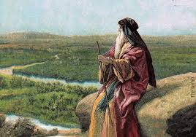
Deuteronomy II Love the Lord your God

Slide 2
Themes in Deuteronomy
Covenant loyalty: hesed
Theme verse: Deuteronomy 6:4-5 the shema.
Hear, O Israel, the Lord our God is one. Love the Lord your God with all your heart, and with all your soul and with all your strength.
That is hesed, and that is what God wants.

Slide 3
Things to Look For in Deuteronomy
I. Law
II. Story
III. Exhortation

Slide 4
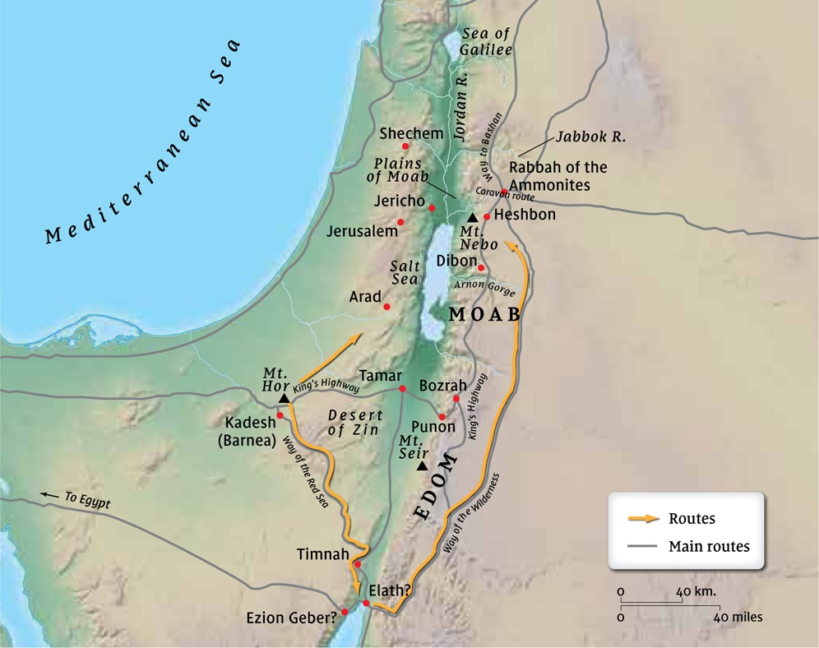
The Setting: Entering the Promised Land

Slide 5
Deuteronomy 4:1-8 Moses’ Speech Begins
Follow my decrees and laws carefully!
What a great God we have, who is near to us whenever we pray to him!!!!

Slide 6
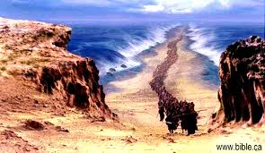
Deuteronomy 4:9-14
Do not forget what God has done for you.
What has God done for you/us?

Slide 7
Deuteronomy 5 Rereading the Law
Love the Lord your God (Deuteronomy 6:4-5):
No other gods
No images of God
Do not use God’s name to make empty promises
Observe the Sabbath
Honor your father and mother (as they honor God)

Slide 8
Deuteronomy 5 Rereading the Law
Love you neighbor (Leviticus 19:18):
Do not murder
Do not commit sexual sin
Do not steal or be greedy
Do not give false testimony about others
Do not be envious of what others have

Slide 9
Deuteronomy 5:8 I am a jealous God. Why? Because of his passionate, loyal, covenant love for us.
God will punish to the third or even the fourth generation those who take on other gods. (and this does not contradict Ezekiel 18)
“Our idolatry will rebound on the ensuing generations”
J. G. McConville

Slide 10
Deuteronomy 5:15 Sabbath is a celebration of and a reminder of the fact that we were freed from slave labor. Galatians 5:1 If Christ has set you free, you are free indeed.
Sabbath is not just about rest (Exodus 20:11). It is about celebration. It is a Jubilee.

Slide 11
Deuteronomy 6 Exhortation
Deuteronomy 4 is about story.
Deuteronomy 5 is about law.
Deuteronomy 6-9 is exhortation.

Slide 12
Deuteronomy 6:1-3
Hear the commands, decrees and laws and Obey
(So I may bless you)

Slide 13
Deuteronomy 6:4-9 The Shema Hear and Obey
shema means “hear.”
Ehad Yahweh Elohenu Yaweh Y’israel Shema
One God our one God YHWH Israel hear!!!!!
This is about hesed. It is about covenant loyalty
“Deuteronomy 4:4-5 is the language of covenant loyalty.”
J. G. McConville

Slide 14
Deuteronomy 6:4-9
v. 6 can be translated as “These instructions I am giving you today, you must know by heart.”
Covenant-based loyalty is expressed through
1. Gratitude for deliverance from slavery to sin and
2. Hearing and obeying his commands

Slide 15

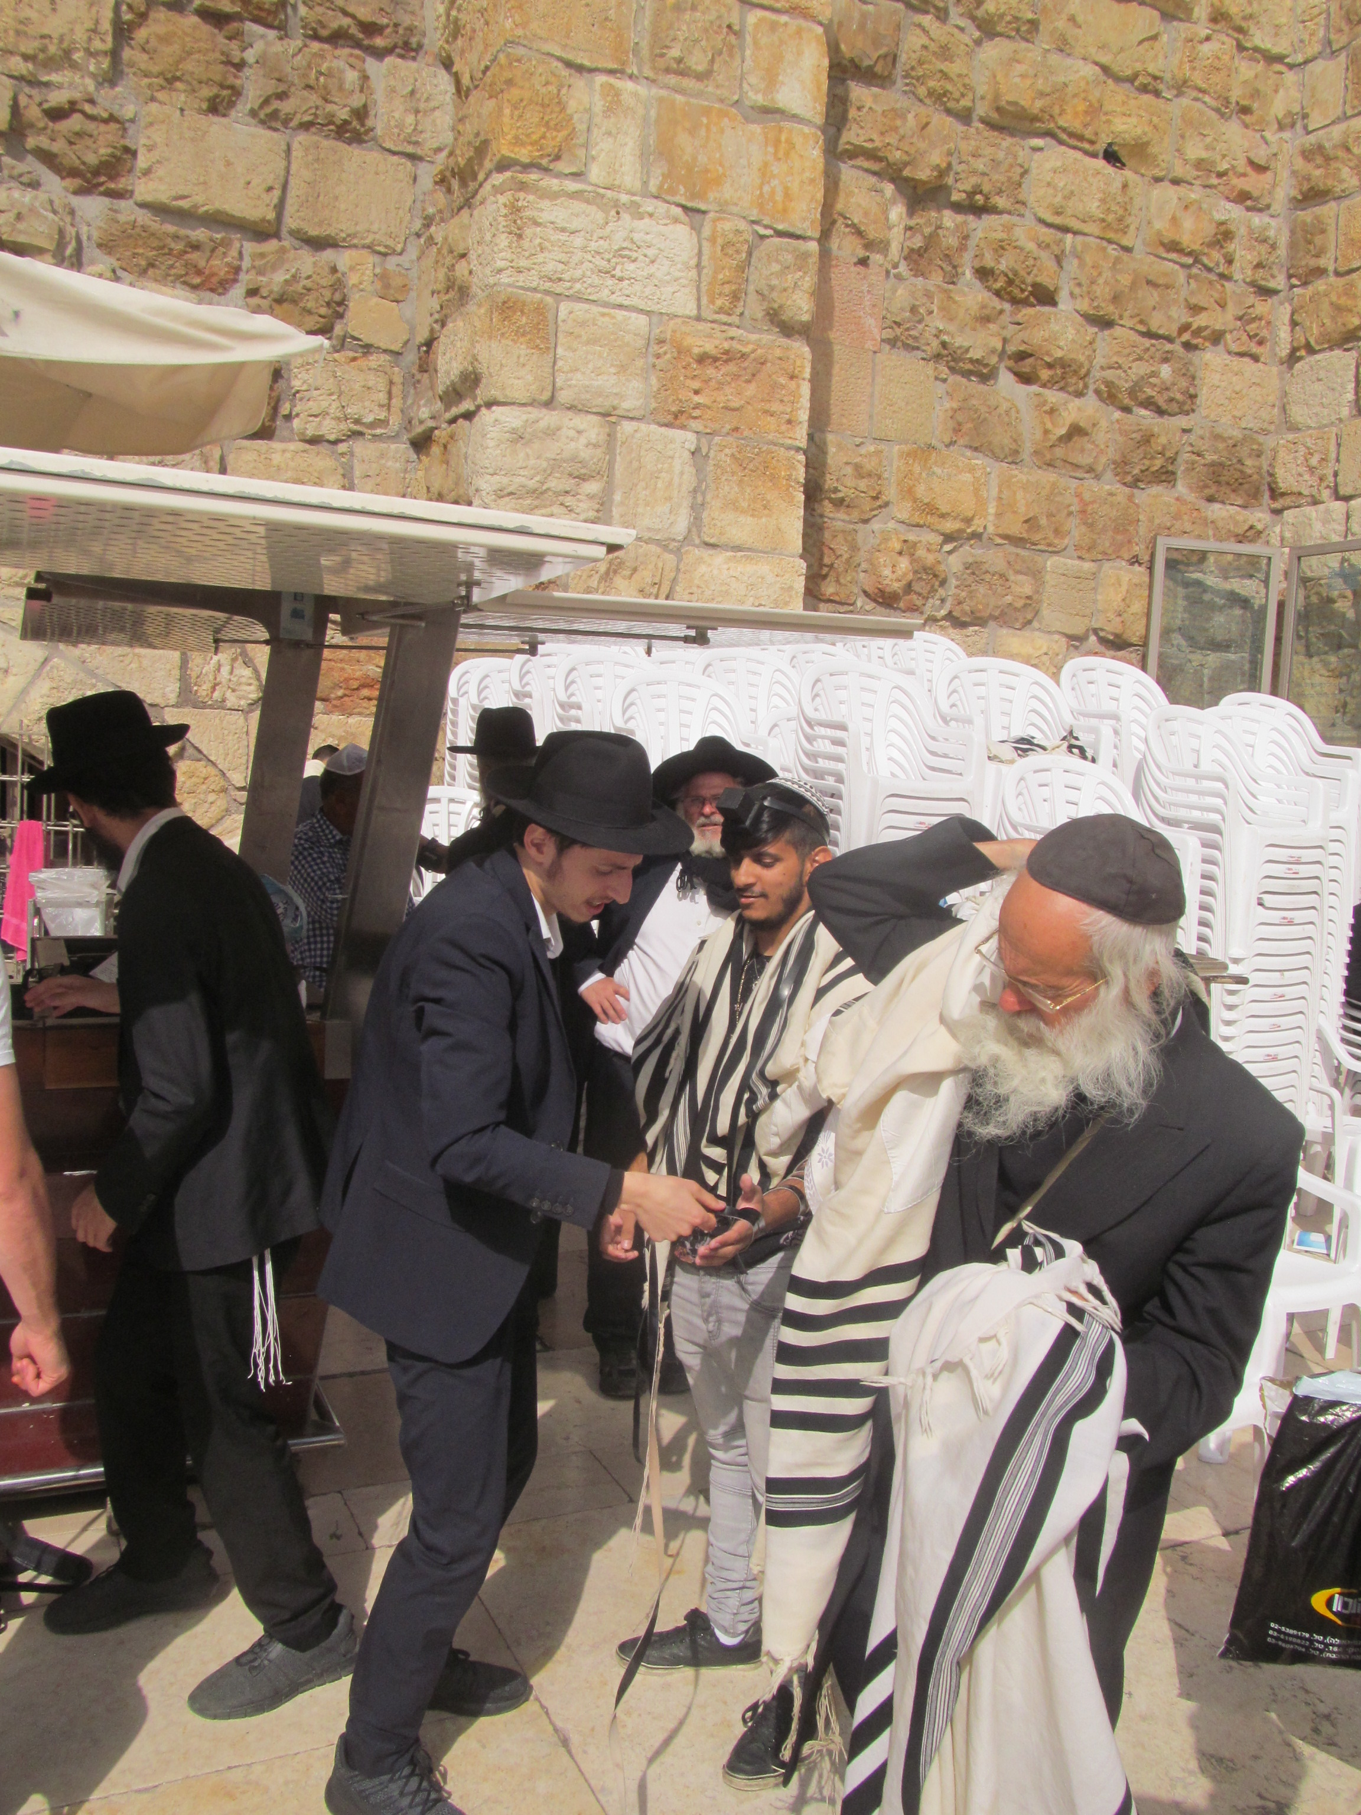
Should we take Deut 6:8-9 literally?
A phylactery

Slide 16
Deuteronomy 6:10-12
Remember!!!

Slide 17
Deuteronomy 6:16-26
Do not do what your parents did at Massah. (they refused to go in and take the land)
Your children (young disciples, people you are studying with): Why all these laws?
It is about hesed. Because God has freed you from sin.

Slide 18
Summary
Remember the things God has done for us and for you.
YHWH is a jealous God because of his intense hesed toward us.
Hear This: Love the Lord your God.
Covenant love/hesed is expressed through gratitude for deliverance and through hearing and obeying.

