Slide 1
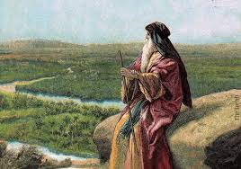
Deuteronomy III Make No Treaties!

Slide 2
Themes in Deuteronomy
Covenant loyalty: hesed
Theme verse: Deuteronomy 6:4-5 the shema.
Hear, O Israel, the Lord our God is one. Love the Lord your God with all your heart, and with all your soul and with all your strength.
That is hesed, and that is what God wants.

Slide 3
Things to Look For in Deuteronomy
I. Law
II. Story
III. Exhortation

Slide 4
Deuteronomy 6:4-9 The Shema Hear and Obey
shema means “hear.”
Ehad Yahweh Elohenu Yaweh Y’israel Shema
One God our one God YHWH Israel hear!!!!!
This is about hesed. It is about covenant loyalty
“Deuteronomy 4:4-5 is the language of covenant loyalty.”
J. G. McConville

Slide 5
Deuteronomy 7 Make No Treaties!
Deut 7:1-6 Detroy them totally.
v. 2 God: I will destroy the Hittites, Girgashites, Amorites, Canaanites, Perizzites, Hivites and Jebusites.
The seven things that God hates: Prov 6:16-19
You: Make no treaty
1 Corinthians 1:2 God has made us holy.
Our job: to maintain holiness.

Slide 6
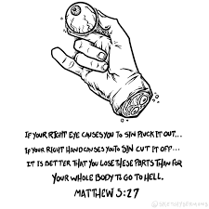
Matthew 18:7-9
Cut It Off
Gouge It Out

Slide 7
Response to the Question of Violence in the OT
If you are not bothered by this on some level, I am worried about you!
The argument assumes that physical death is bad/evil. This is a false assumption. Sin is evil but death is not. Death is a transition, hopefully, to something better.
God has a perfect right to judge—not us.
There is the issue of the religion of the Amelekites. Sacrificing of children in fire, worshipping gods by having sex with a prostitute in the temple, etc.
The situation for the children in this situation was hopeless.

Slide 8
Violence in the OT (cont.)
In the case of Amelek and other Canaanites, both God’s love and his justice demanded that something be done.
Either God was going to create a nation or he was not. If God is going to have a “people,” then such people must have a physical land and must have an army.
God’s plan is to choose a man, then a nation, through whom to send a savior. God’s plan to bless humanity through Jesus trumps all else.
It is sinful to take the life of another in anger, out of greed or selfishness, but it is not necessarily sinful to take a life in war.
Everything God did to Israel as a nation was to limit their ability to wage war.
No authority to establish an empire.
No standing army.
No cruelty, no abuse, no rape

Slide 9
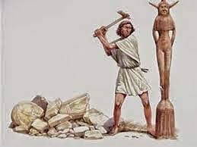
Deuteronomy 7:2-6
Destroy them totally.
Make no treaty with them.
Show them no mercy.
Break down their altars.
Smash their sacred stones.
Cut down their Asherah poles.
Smash their sacred stones.
Burn their idols.

Slide 10
Make No Treaties With Sin
Do not date them
“just a little weed”
“just one shot”
“just innocent entertainment at the casino”
“just a little social media”
“just blowing of a little steam”
God: Smash them, cut them down, burn them…

Slide 11
Deuteronomy 7:7-11
Why be so radical about sin?
Because God has kept his oath/covenant of love/hesed

Slide 12
Deuteronomy 7:12-16
God will ALWAYS keep his covenant of love.
God will ALWAYS bless you (if you, like Him, maintain loyal to the covenant—hesed.
But… You must destroy all God’s enemies.
Q: What are the snares in your life?

Slide 13
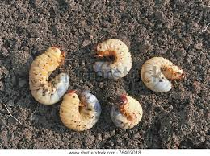
Deuteronomy 7:17-26
God’s amazing promises.
v. 19 So… No compromises!!!
Luke 12:4-5 Fear God, not men.
v. 22 God will drive the sin out of your life. But…
v. 25 Do not covet.
Put away all detestable things… Regard them as vile.

Slide 14
Summary
When it comes to sins in your life…
Make no treaties.
Make no compromises.
Break down those altars.
Smash those sacred stones.
Be holy as God is holy.
Treat sinful things as vile and detestable.

Slide 15
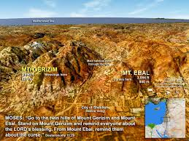
Mt. Gerazim and Mt. Ebal

Slide 16
