Slide 1
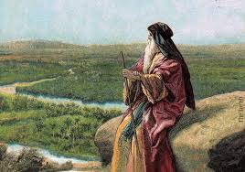
Deuteronomy IV Advice to Young Disciples or
Trust and Obey

Slide 2
Themes in Deuteronomy
Covenant loyalty: hesed
Theme verse: Deuteronomy 6:4-5 the shema.
Hear, O Israel, the Lord our God is one. Love the Lord your God with all your heart, and with all your soul and with all your strength.
That is hesed, and that is what God wants.

Slide 3
Things to Look For in Deuteronomy
I. Law
II. Story
III. Exhortation

Slide 4
Deuteronomy 7 Make No Treaties
Burn the idols
Break down the altars
Smash the sacred stones.
Do not intermarry
Treat sin as a vile and detestable thing
God showed hesed. He made you holy.
Your job: Make every effort to maintain holiness.

Slide 5
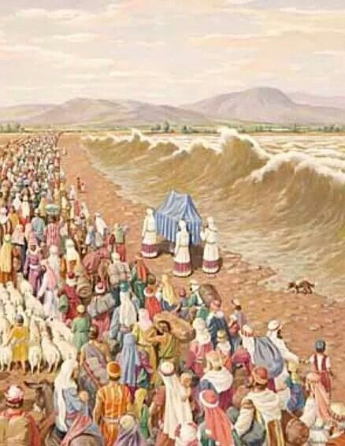
Deuteronomy 8:
Advice to Young Disciples

Slide 6
Deuteronomy 8:1-5
God’s purpose for us:
To prosper in this life
To make it to heaven
God’s method:
To humble you!!!! Deut 8:2b so you would keep his commands

Slide 7
Deuteronomy 8:1-5
Why does God want to humble us?
He wants us to learn to rely on Him, not on self.
How does he do this?
By causing us to hunger, and then feeding us with manna.
But… Numbers 11:4-6
So that we will keep his commandments. Deut 8:2b
How has God humbled you?

Slide 8
Memory Verse:
Deut 8:3 He humbled you, causing you to hunger and then feeding you with manna, which neither you nor your fathers had known, to teach you that man does not live on bread alone, but on every word that comes from the mouth of the Lord.
Matthew 4:4

Slide 9
Deuteronomy 8:3
God’s strategy to bless you:
Teach you to rely on him.
Q: Have you been eating the manna (God’s Word) this week?

Slide 10
Deuteronomy 8:4
Your clothes did not wear out and your feet did not swell during these forty years.
We need to recognize and appreciate God’s “little miracles” every day.
Q: What are the little miracles God has done in your life?

Slide 11
Deuteronomy 8:5
What is God’s plan for blessing you?
Discipline!

Slide 12
Deuteronomy 8:6-9
Why does God discipline us?
So that he can bless us.
Two ways God humbles us:
1. By giving us a lot of blessings.
2. By taking those blessings away from us.

Slide 13

Deuteronomy 8:10-11
When God blesses you, you better praise God!
Praise → Obedience

Slide 14
Deuteronomy 8:12-18 Warning!!!
They became satisfied….
Could this happen to us?
So do not be a prideful dog.

Slide 15
Deuteronomy 8:12-18 Warning!!!
The antidote to becoming “satisfied?”
Remember what he has done for you.
Saved you from slavery
Protected you from venomous snakes

Slide 16
Deuteronomy 8:12-18 Warning!!!
Have you ever said to yourself, “My power and the strength of my hand have produced this wealth?”
1 Cor 4:7

Slide 17
Deuteronomy 8:19-20 A Solemn Warning
Conclusion:
Do not EVER forget the Lord your God

Slide 18
So… Let’s take the medicine.
Give God permission to humble you and test you.
Learn to rely on God, not self.
Live on God’s Word.
Praise God and obey him!
Give God all the credit and glory for his blessings.

