Slide 1
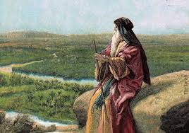
Deuteronomy V Summing It Up

Slide 2
Themes in Deuteronomy
Covenant loyalty: hesed
Theme verse: Deuteronomy 6:4-5 the shema.
Hear, O Israel, the Lord our God is one. Love the Lord your God with all your heart, and with all your soul and with all your strength.
That is hesed, and that is what God wants.

Slide 3
Things to Look For in Deuteronomy
I. Law
II. Story
III. Exhortation

Slide 4
Deuteronomy 8 Advice to Young Disciples
God’s purpose for us:
To prosper in this life
To make it to heaven
God’s method:
To humble you!!!! To test you. To teach you to rely on him. To remember that “Man does not live on bread alone, but on every word that comes from the mouth of the Lord.

Slide 5
Deuteronomy 8:4
Your clothes did not wear out and your feet did not swell during these forty years.
We need to recognize and appreciate God’s “little miracles” every day.

Slide 6
Deuteronomy 8:12-18 Warning!!!
Have you ever said to yourself, “My power and the strength of my hand have produced this wealth?”

Slide 7
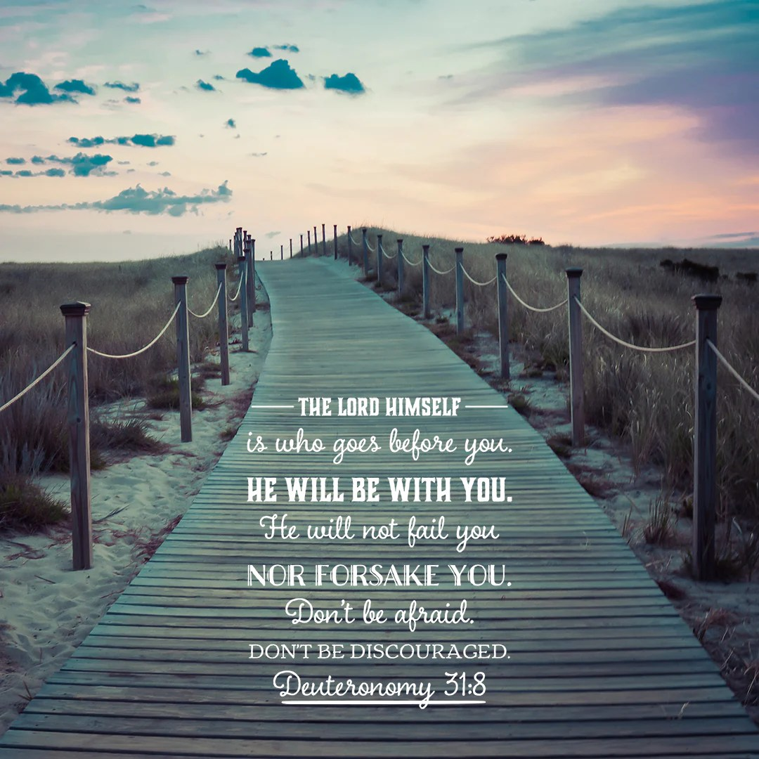
Deuteronomy V Summing It Up
Deut 9:3 The Lord your God is the one who goes across ahead of you like a devouring fire.
Deut 9:4-6 It is not because of your righteousness, or your integrity that you are going to take possession of their land.

Slide 8
Deuteronomy 10:12 And Now, Israel…
What does YHWH ask of you?
1. Fear Him.
2. Walk in humble obedience.

Slide 9
Deuteronomy 10:14-15
How blessed are we?
He chose you above all the nations.

Slide 10
So What Should We Do?
Deut 10:16 Circumcise Your Hearts. Col 2:11-12.
Deut 10:17-22 Treat others as an impartial God treated you.
Defend the orphan, the widow and the foreigner.
Why? You were an orphan and a foreigner.
Deut 15:4,11-15, Deut 26:1-12, Deut 14:28-29.

Slide 11

Deut 11:10-15
… a land of mountains and valleys that drinks rain from heaven… a land that the Lord your God cares for; the eyes of the Lord your God are continually on it from the beginning of the year to its end.

Slide 12
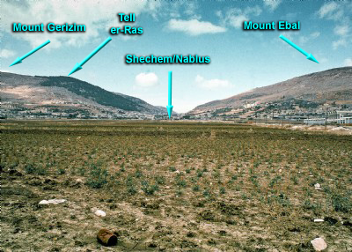
Deuteronomy 11:26-32 Blessings and Curses

Slide 13
Summary
What does God want from you?
-Fear God
-Walk in humble obedience to Him
To that end:
-Circumcise Your Heart and
-Treat others as God treated you—the disadvantaged, but especially both the physical and the spiritual foreigner

