Slide 1
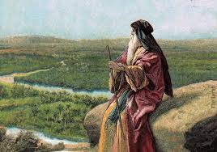
Deuteronomy VI
Blessings and Curses

Slide 2
Last Week: Summing It Up
What does God want from you?
-Fear God
-Walk in humble obedience to Him
To that end:
-Circumcise Your Heart and
-Treat others as God treated you—the disadvantaged, but especially both the physical and the spiritual foreigner

Slide 3
Deuteronomy 12-26
A Second Reading of the Law
Deuteronomy 12:3 break down, smash, burn, cut down the idols.
Deuteronomy 12:8-9 You are not to do as we do here today, everyone doing as they see fit.

Slide 4
Deuteronomy 13:1-9
If a prophet says, “Let us go after other gods… and worship them.
Do not listen to the words of that prophet!!!
Instead, keep God’s commands.
v. 6 Even if it is a family member…
v. 8 Do not yield or even listen!
Show them (their teaching?) no pity.

Slide 5
Deuteronomy 18:14-20
A prophet like Moses from among the people of Israel.
Listen to him!
John 1:18 The one and only Son has made him known.

Slide 6
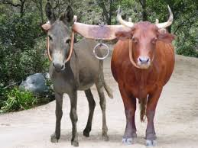
Deuteronomy 22:9-11
Do not mix crops in the same field.
Do not yoke an ox with a donkey.
Do not wear clothes of more than one material.
What’s that abotu?
Be Holy.
Do not mix the holy with the profane.

Slide 7
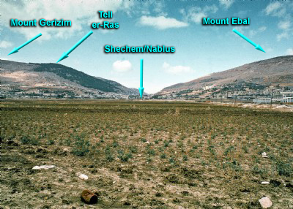
Deuteronomy 11:26-32
Deuteronomy 27:2-4
Blessings and Curses

Slide 8
Blessings and Curses
This actually happened Joshua 8:30-34
Blessings: Deuteronomy 28:1-14
Curses: Deuteronomy 28:15-68
What do you notice?

Slide 9
Deuteronomy 28:1-14 Blessings
Note: The blessings are conditional. If you fully obey the Lord your God and carefully follow all the commands I am giving you today, then…

Slide 10
Deuteronomy 28:15-68
v. 47 How did you end up here? Because you did not give thanks for the blessings he showered on you. Because you took credit to yourself and you forgot where your blessings come from.

Slide 11
Summary
Radically put away the idols—the things that tempt us to sin.
Let us not have “everyone doing as they see fit.”
Do not listen to those who teach false theology and false doctrines on salvation.
An encouraging messianic prophecy
Maintain holiness.
Blessings for faithful obedience and curses for not maintaining hesed

