Slide 1
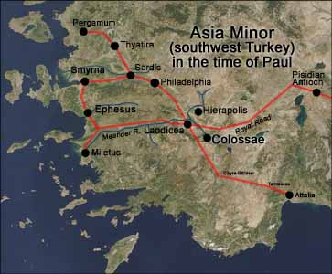
Christ vs. The World’s Philosophies
Colossians 2:6-23
John Oakes
2025 ICMC

Slide 2
Outline
I. Colossians: The Supremacy of Christ.
II. Premodernism, Modernism and Postmodernism
III. Progressive Theology
IV. Questions and Answers

Slide 3
Colossians
Theme: The supremacy of Christ. The all-suffiency of Christ.
Written to oppose the supposed “Colossian Heresy.”
This is a philosophy/world view that includes the stoicheia—ABCs of the world.

Slide 4
Christ in Colossians
Col 1:2 We are brothers and sisters in Christ.
Col 1:3 We thank God, the father of our Lord Jesus Christ.
Col 1:4 Our faith is in Christ Jesus.
Col 1:7 Epaphras a faithful servant and minister of Christ.
Col 1:13 God has brought us into the kingdom of his Son.
Col 1:14 We have redemption in Christ.
Col 1:14 We have forgiveness of sins in Christ.
Col 1:15 The Son is the firstborn over all creation.
Col 1:16 In Christ, through him and for him all things were created.

Slide 5
Christ in Colossians
Col 1:17 Christ is before all things.
Col 1:17 In Christ all things hold together.
Col 1:18 Christ has supremacy in all things.
Col 1:19 All the fullness of God dwells in Christ.
Col 1:20 Christ is reconciling all things to Himself.
Col 1:22 We are presented holy in God’s sight by Christ.
Col 1:24 Christ is the head of the body.
Col 1:27 God’s glorious mystery is Christ in you.
Col 1:28 Christ is him who we proclaim.

Slide 6
Christ in Colossians
Col 1:29 Christ’s power works in us.
Col 2:2 The mystery of God is in Christ.
Col 2:5 Our faith is in Christ.
Col 2:6 We live our lives in Christ.
Col 2:9 In Christ, the fullness of deity dwells in bodily form.
Col 2:10 In Christ, we are brought to fullness.
Col 2:11 In Christ we were circumcised.
Col 2:13 We are made alive in Christ.
Col 2:17 The Law is a shadow. The reality is in Christ.

Slide 7
Christ in Colossians
Col 2:20 We died with Christ.
Col 3:1 We have been raised with Christ.
Col 3:3 Our life is hidden with Christ.
Col 3:4 Christ is our life.
Col 3:11 Christ is all in all.
Col 3:17 Do all in the name of the Lord Jesus

Slide 8
Christ in You
Holy Spirit mentioned:
Romans 25 times
1 Corinthians 20 times
2 Corinthians 10 times
Galatians 15 times
Ephesians 10 times
Philippians 3 times
1 Thessalonians 4 times
Colossians 1 time (Col 1:8)

Slide 9
What do we have in Christ?
Coll 1:14 We have redemption, the forgiveness of sins in Christ
Col 2:2 The mystery of God is in Christ.
Col 2:6 We live our lives in Christ.
Col 2:10 In Christ, we are brought to fullness.
Col 2:11 In Christ we were circumcised.
Col 2:13 We are made alive in Christ.
Col 2:17 The Law is a shadow. The reality is in Christ.

Slide 10
Colossians 2:8 stoicheia
Let no one take you captive to hollow and deceptive philosophy which depends on human tradition and the elemental forces (stoicheia) of the world rather than on Christ.
Elemental forces
Basic components of philosophy
First principles of the world
ABCs
stoicheia vs Christ and his Kingdom

Slide 11
Stoicheia of our world
Prosperity gospel
American dream
Comfort/materialism
Personal security 401-k
Being a good person
Universal salvation
Moral relativism
Entertainment/leisure

Slide 12
stoicheia of our world
Postmodernism
Modernism/Scientism
Republicanism and social conservative politics
Democratism and progressive politics
Can these philosophies deceive us, kidnap us, and drag us from Christ?

Slide 13
Fullness in Christ
Col 1:10 We have fullness in Christ. We need nothing from the world.
Fullness = pleroma = filled full
Col 1:11-12 We are circumcised in Christ—the world/flesh has been removed in Christ.
We are moral being in Christ, not by moral behavior.
We are socially just people in Christ, not through supporting social justice causes.

Slide 14
v. 13-15 Christ has canceled the written code
The world’s “written codes” are not in charge.
Charge of legal indebtedness. NIV
Record of charges NLT
Certificate of death, with its obligations HCSB
v. 15 Christ nailed the stoicheia to the cross. They are disarmed and powerless.

Slide 15
Application
There cannot be a Christian political party or partisan effort.
As disciples, we value all human life, but our means of realizing this is principally through bringing people into the kingdom of God, and bringing the kingdom of God to the lost.
The same for issues such as homosexuality and social or racial justice. Our principle means of working in these areas is through the work of God in his kingdom, not through establishment of laws or through coercion.

Slide 16
Col 2:16-23
Therefore, do not let anyone judge you by what you eat or drink, or with regard to a religious festival, a New Moon celebration or a Sabbath day. found in Christ. Do not let anyone who delights in false humility and the worship of angels disqualify you. Such a person goes into great detail about what they have seen…
Since you died with Christ to the elemental forces (stoicheia) of this world, why, as though you still belonged to the world, do you submit to its rules: “Do not handle! Do not taste! Do not touch!” These rules, which have to do with things that are all destined to perish with use, are based on merely human commands ad teachings. Such regulations indeed have an appearance of wisdom, with their self-imposed worship, their false humility and their harsh treatment of the body, but they lack any value in restraining sensual indulgence.

Slide 17

The Reality is In Christ
In v. 16-23 Paul deals with a particular philosophy, which is the legalism of grace-free Judaism, but this can be applied to any human idea or philosophy.
Even the Law of Moses was a mere shadow.
Therefore the stoicheia of the world are powerless
Rules are powerless to create righteousness.
We do not use the politics of power. We use Christ as our power.

Slide 18
Stay Connected to Christ
Col 2:18 Do not rely on personal religious experience
Col 2:19 Those who rely on the stoicheia of the world have lost their connection with Christ.
Col 2:20 We have died to the stoicheia of the world in Christ.
So, do not obey its rules.

Slide 19
Conclusion
Our fullness is in Christ.
The world’s philosophies have nothing to offer us.
Let us strive to be like Christ and to exemplify his kingdom
Let us seek righteousness through Christ, not the stoicheia of the world

Slide 20
Christianity vs The World’s Philosophies :
Christianity in a Post-MODERN Age
John Oakes 2025 ICEC

Slide 21
Christianity and Postmodernism: Friend or Foe?
The good news is that secular humanism is on the way out. The bad news is that something worse is taking its place. That something worse is called postmodernism. -David McAlister
Evangelicals have often uncritically accepted the modern view of knowledge despite the fact that at certain points the postmodern critique is more in keeping with Christian theological understandings -Stanley Grenz A Primer on Postmodernism

Slide 22
Our Outline
What is Modernism and why has it been rejected by most intellectuals?
What is Postmodernism?
Postmodernism and Culture
A Christian Response to Postmodernism

Slide 23
A Very Brief Intellectual History
Pre-modern
Age
Modern
Age
Post-modern
Age
Rationalism breeding skepticism
Relativism breeding situationism

Slide 24
The seismic shift
Pre-modern | Modern | Post-Modern
Belief in divinity | Ambivalent about divinity | Divinity as self-expression
Conviction is virtue Tolerance is evil | Rationality is virtue | Tolerance is virtue Conviction is bad
Authority is God | Authority is logic and science | Authority is self or the group
Change brought about by adherence to a standard | Change brought about by what is rational | Change contingent on self-expression and culture

Slide 25
A Slightly More Detailed Outline
Pre-modern: Catholicism
Renaissanace/Humanism: Protestantism
Early Modernism/Enlightenment Age of Reason
Late Modernism: Deism and Skepticism
Postmodernism

Slide 26
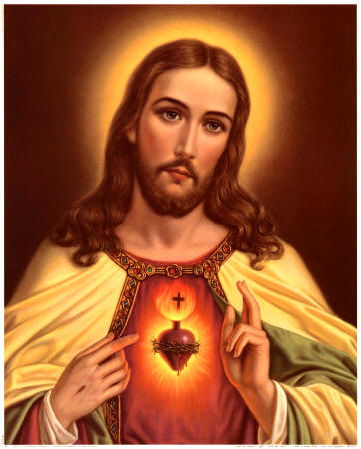
Pre-Modern Age
Knowledge based on faith and authority
Anselm of Cantebury “I believe in order to know.”
Emphasis on corporate rather than individual

Slide 27
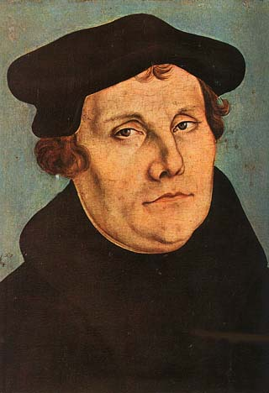
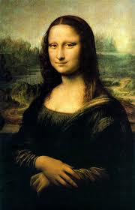
Renaissance and Reformation
More emphasis on the value of the individual
Led to the Reformation
Led to the Scientific Revolution and to Modernism

Slide 28
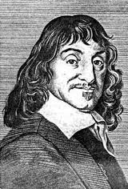
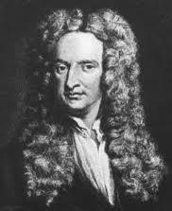
The Birth of Modernism
Rene Descartes: Rationalism. I think, therefore I am. Reason is king.
Isaac Newton: Principia
The Mechanical Universe. Do we need God any more?

Slide 29
Modernism
The autonomous rational human of Descartes meets the mechanical universe of Newton.
Modernism is essentially optimistic
Knowledge is objective, good, and accessible to humans
Human reasoning is the ultimate authority for truth.

Slide 30
The Enlightenment/The Age of Reason
Using Reason we can ask and answer all important questions.
Elevates the role of the individual and the value of personal freedom (John Locke)
How would that have impacted Christianity?

Slide 31
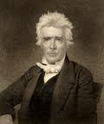
Modernism and Christianity
The “Restoration Movement” is a good example of Modernist Christianity
Command, Example, Necessary Demonstration
Scientifically analyze the Bible
Weak on principles
Strong doctrinal orientation
Alexander Campbell

Slide 32
Characteristics of a “Modern” Church
Stresses doctrine over practice. Either/or approach to truth.
Stresses individuality over corporate aspects of Christianity.
Right belief leads to right practice.
Rejects superstition, minimizes the miraculous and the influence of the Holy Spirit.

Slide 33
Characteristics of a “Modern” Church
More sectarian, less ecumenical because of the influence of propositional truth. More judgmental.
Emphasis on preaching more than worship
Relies on evidence, a stronger emphasis on verbal inspiration of the Bible
The ICOC is a modern, not a postmodern church movement

Slide 34
The Death of Modernism
Modernism is not dead, by the way, but….
WWI, WWII, Hiroshima
Exposure to alternative world views from the East—Western mindset is not the only powerful one.
Pessimism and Rejection by most of Modernism.

Slide 35
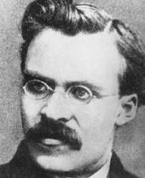
Rise of (Intellectual) Postmodernism
Nietzche (1844-1900): God is dead. Truth is dependent on language. Truth is created not discovered.
Reject the correspondence theory of truth: A proposition is
“true” if it corresponds to or is consistent with reality.

Slide 36
Martin Heidegger (1884-1976)
Rejects correspondence theory of truth
Truth is relational
Truth is found in culture, narrative, not facts

Slide 37
The Big Three: Foucault, Derrida and Rorty
Michael Foucault: Truth is a fabrication or a fiction. Science is an ideology. History has no objective meaning. It is socially produced. Truth is social.
Jacques Derrida: Reading is a violent act of mastery over the text. Invented deconstruction.
Richard Rorty: Truth a matter of human convention. Truth is found in coherence rather than correspondence.

Slide 38
Postmodern Thinking
Postmoderns have no worldview (except the view that there is no correct worldview)
Truth is found in the community, not in the individual.
Postmodernism rejects ontological truth and metanarritives. (in other words it accepts relativism)
The goal of postmodernism is to “deconstruct” beliefs such as Christianity—to destroy its violent metanarrative—to make it meaningless.

Slide 39
Postmodernism and Culture
Postmoderns prefer difference to uniformity heterogeneity to homogeneity
Postmoderns prefer the local to the universal “Think globally, act locally”
Postmoderns value the community over the individual.
Postmodernist is not searching for truth but collecting experience.
Current pop culture is a reflector of postmodern thinking.
The postmodern values, above all, diversity and tolerance.

Slide 40
Strengths of Postmodernism
1. Celebrates cultural and other kinds of diversity.
2. Open-minded, Tolerant (generally but not always a good thing).
3. A more accurate view of history than the modern view.
4. Open to Eastern and other ways of thinking. Not married to Western as the only good way of thinking.
5. Celebrates relationships and community.
6. Refutes the false and prideful claims of Modernism— especially the idea that humans can discover truth.

Slide 41
Weaknesses of Postmodernism
1. Denies the existence of truth when truth is real. Its most basic premise is simply not true.
2. Circular reasoning. Are you absolutely sure there is no absolute truth?
3. No moral compass. This is scary!
4. Dismisses the role of the revolutionary, the idealist (for example Jesus).

Slide 42
Postmodernism and Christianity
Christianity clearly includes propositional truth!
Jesus: Your Word is Truth. (John 17:17)
Postmodernists: There is no center. No metanarative
Christianity: Jesus is the center. Jesus/salvation is a metanarative
Postmodernism can be a helpful critique to modernist approach to scripture but it rejects the idea that a scripture has a single interpretation (2 Peter 1:21). This is absolutely unacceptable in the Christian context.

Slide 43
Strengths of Postmodernism for Christianity
(yes, there are some!)
Allows us to recognize that in Christianity which is not strictly rational. Helps us to appreciate that which is “mysterious” in Christianity.
Helps us to know that principles have different applications in different cultures.
Helps us to recognize that much of what we call Christianity is really just Americanity/Westernism—viewed through this lens
Helpful in hermeneutics—to recognize influence of culture and world view on scripture.

Slide 44
Positives (cont.)
Rightly points out that the Modernist ideal of discovering universal truth through rational analysis is not realistic.
It will help us to be less judgmental.
Helps us to celebrate the communal aspects of Christianity and to defeat the hyper individualism which has crept into the Church.
Helps us to remember the need to do social good, to help and be involved in our communities.

Slide 45
Characteristics of the Postmodern Church
1. Ecclectic. More open to a wide variety of ideas and beliefs.
2. More interested in community and relationships than in individual faith.
3. More socially aware and more oriented toward social justice.
4. Less interested in doctrine.

Slide 46
Summary
Watch your life (postmodernism) and your doctrine (modernism) closely. Persevere in them, for if you do so, you will save both yourself and your hearers (1 Tim 4:16)

Slide 47
Dealing with Progressive Theology
Colossians 2:6-15
John Oakes
2025 ICMC

Slide 48
A Response to Progressive Theology
Progressive politics
vs.
Progressive thinking
vs.
Progressive theology

Slide 49
Progressive Politics
The politics of the “left” wing of American and European countries.
Emphasizes unions, minorities, the poor, and intellectual liberalism.
Support social programs, minority rights, immigrants and liberal attitudes on social and moral issues.

Slide 50
Progressive Thinking/Philosophy
Related to secular humanism.
The idea that humans are getting better and better-that we are progressing over time.
Anything which is older is, by definition, worse (monarchy, conservative morality, authority in general, including religious authority)
“Spiritual,” but not tied to any religious authority.

Slide 51
Progressive Theology: What is It?
The idea that Christianity itself needs to progress.
The idea that the Bible itself is outdated.
It undermines the idea of the authority of the Bible.
Clear statements in the New Testament must be interpreted in light of culture

Slide 52
Progressive Theology
Eschatology influences progressive hermeneutics.
Does God change?
Malachi 3:6 I, the Lord, do not change.
Does God progress?
Does Christianity progress?

Slide 53
What is Progressive Theology?
It undermines the idea of absolute truth and absolute morality.
It implies that the Bible is sufficiently ambiguous that it must be reinterpreted according to current human thinking.
Much of God’s truth is delivered through narrative, but is there also propositional truth in the Bible?

Slide 54
Progressive Theology
Human progress is not evil or to be opposed a-priori by Christians.
Science, slaverh, human rights, dignity of women.
(and note that Christian churches have progressed in these areas as well, as they should!)
But… Has God changed? Has the Bible changed?
What about deconstruction?

Slide 55
Progressive Theology
Remember Colossians 2:8 Let no one take you captive to hollow and deceptive philosophy, which depends on human tradition and the elemental forces (stocheia) of this world rather than Christ.
We need discernment!

Slide 56
Michael Burns: Escaping the Beast
“When we yoke ourselves with one of the philosophies of the present age, we lose the ability to distinguish ourselves from the world, and the prophetic voice is silenced, as we are shouted down by those within our own ranks who accuse us of being what they actually are, which is partisan and beholden to the world.”

Slide 57


IPI Book Recommendations
Escaping the Beast by Michael Burns
Wildfire: How Progressive Theology is Impacting the Church Daren Overstreet

