Slide 1
Psalm 122
Peace In Our City
Our Missionary Journey
John and Jan Oakes

Slide 2
As a Church, we have a problem. We have lost our sense of being on a mission. We have a proposed solution! Let us return to having a sense of being on a mission!

Slide 3
Psalm 122 A psalm of ascents. Pray for Jerusalem. What will you bring with you to Jerusalem?
Three “Great Commissions” Matthew 28:18-20, Acts 1:8
John 21:15-17 John’s Great Commission:
Feed my lambs (young disciples and non-Christians)
Feed my sheep (more mature believers)
Romans 15:16 Our priestly duty…

Slide 4
A proposed (partial) solution: Let’s give your mature disciples—our empty nesters a renewed sense of mission. Let’s all go on a mission. Three possibilities: Right here at home. Go and support a smaller church. Help to plant a new church.

Slide 5
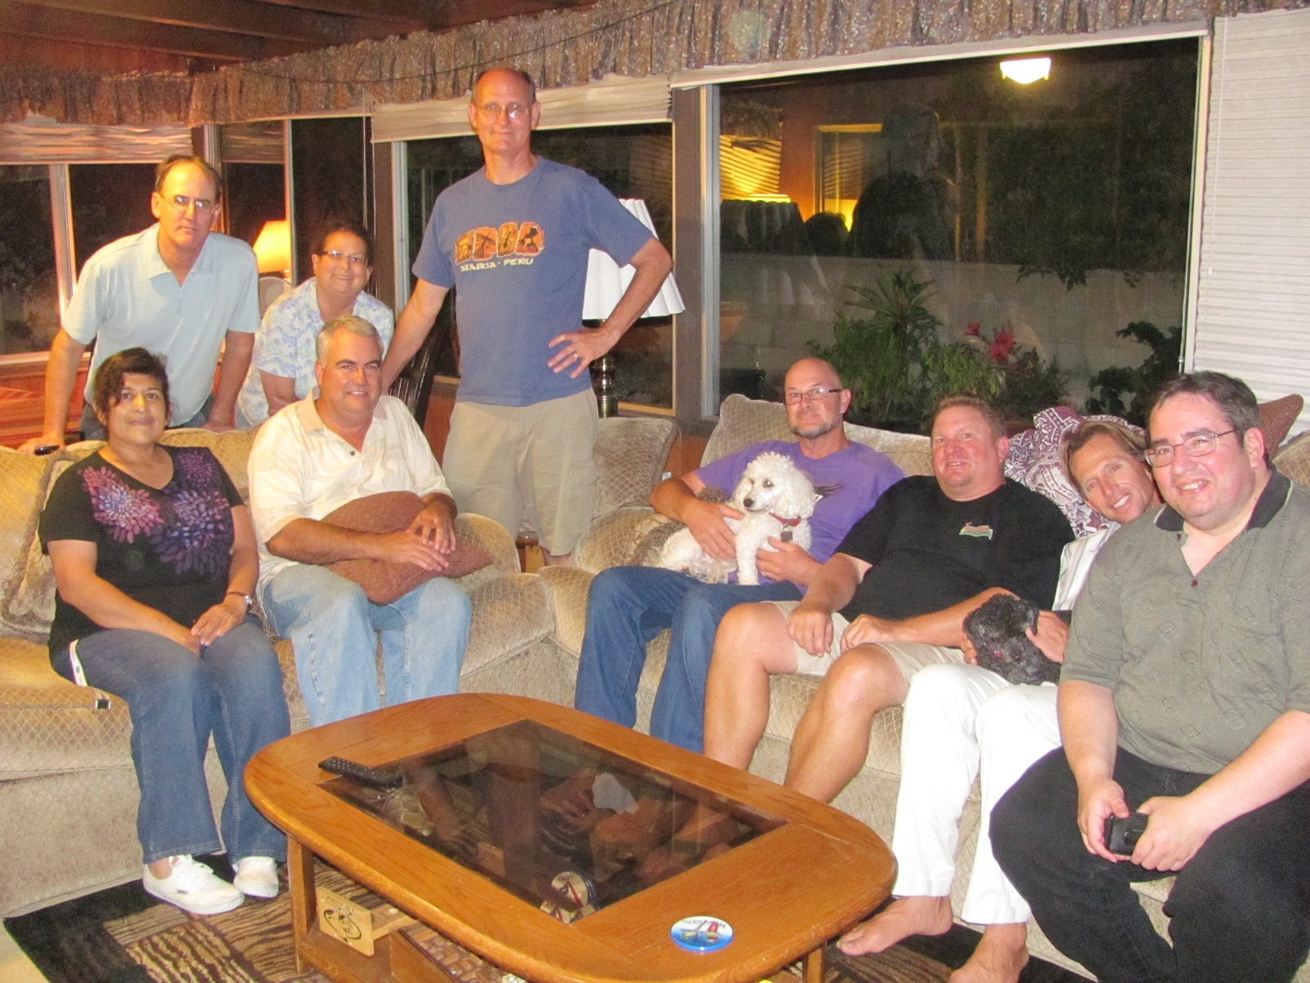
Our story… Part I San Diego

Slide 6
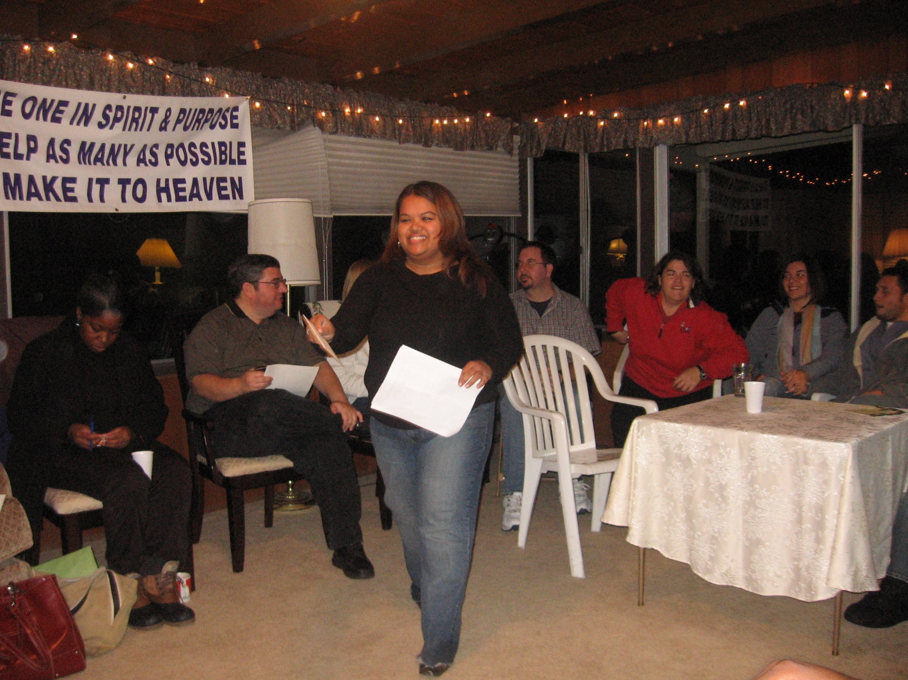
Our story… Part I San Diego

Slide 7
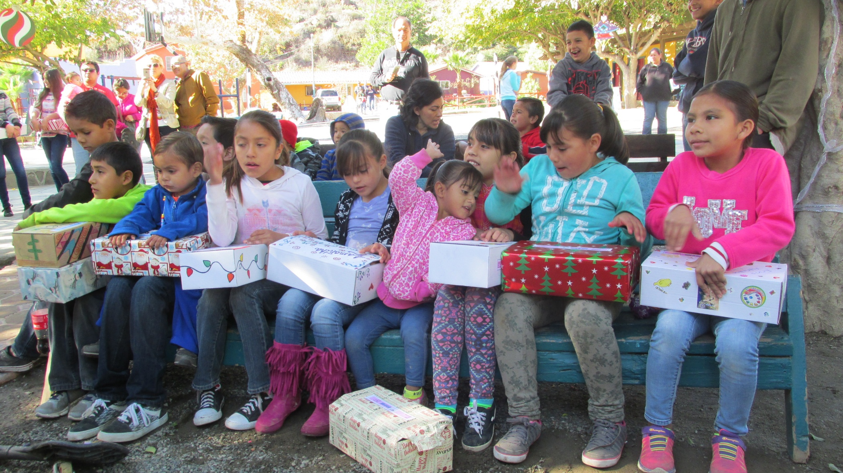
Our story… Part I San Diego
Gifts of Hope

Slide 8
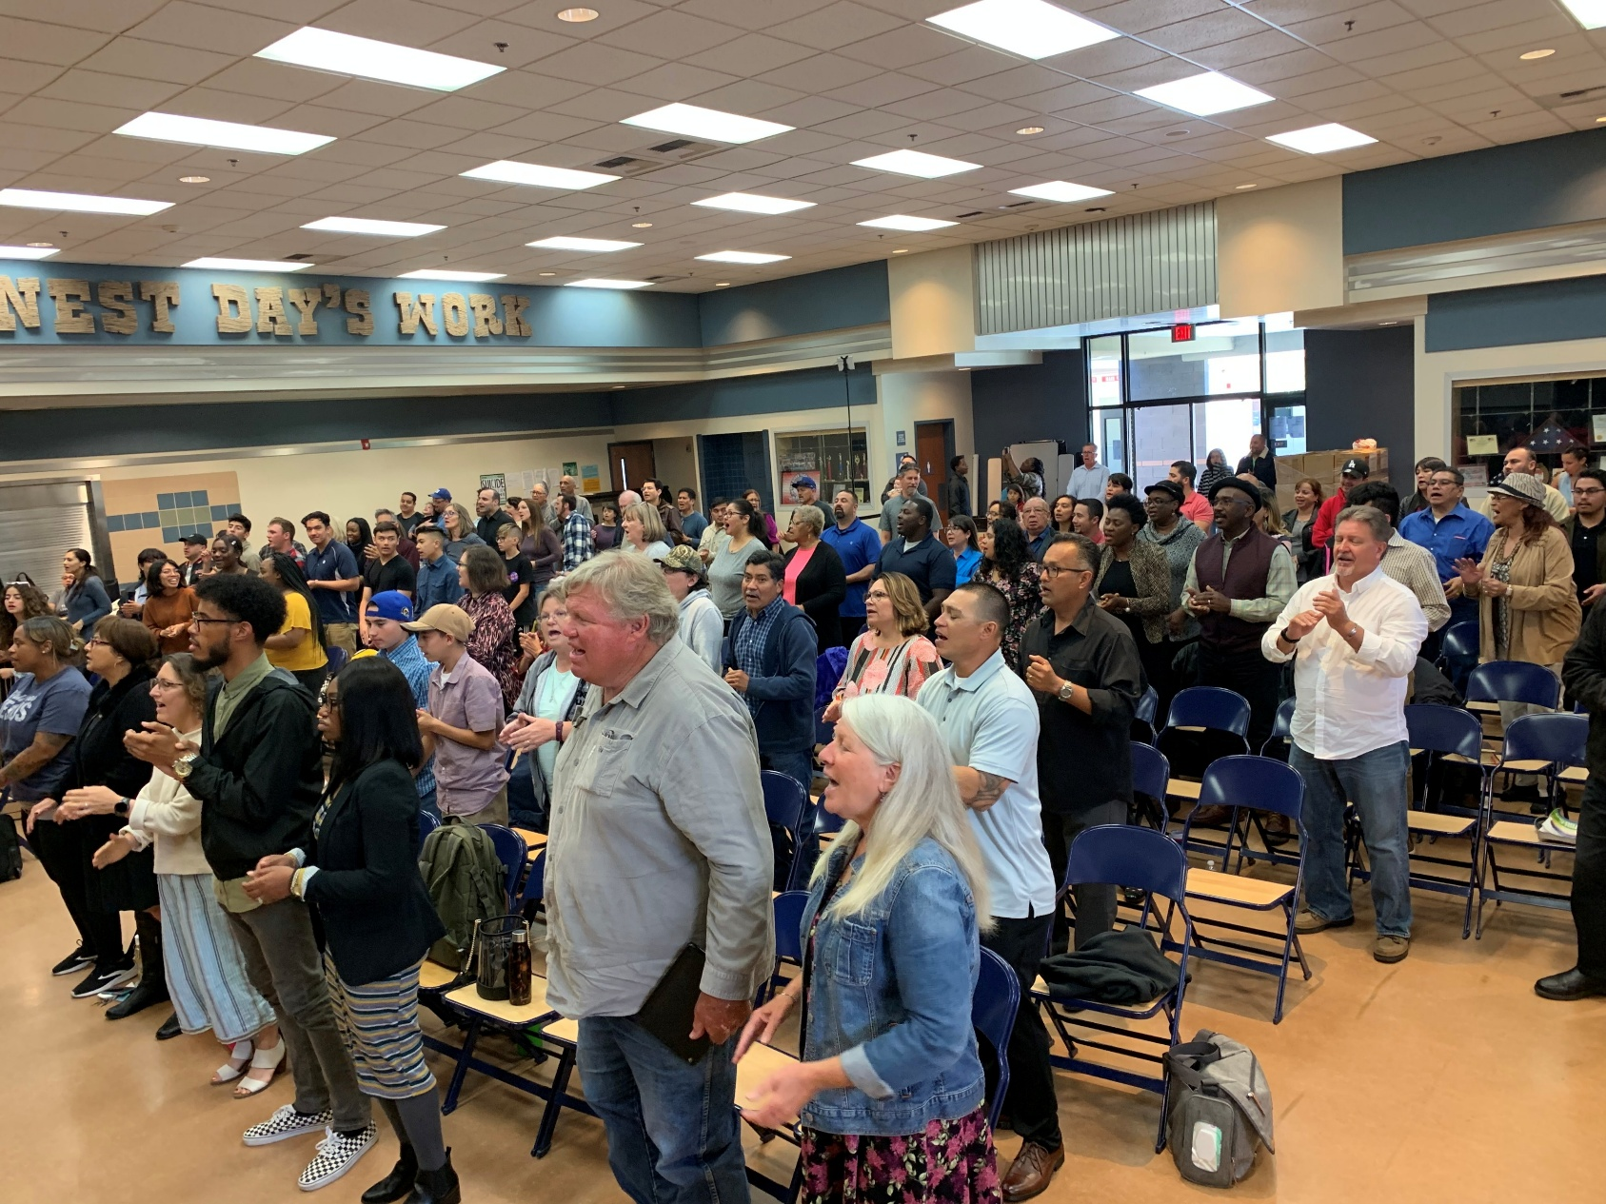
Our Story Part 2 Bakersfield

Slide 9
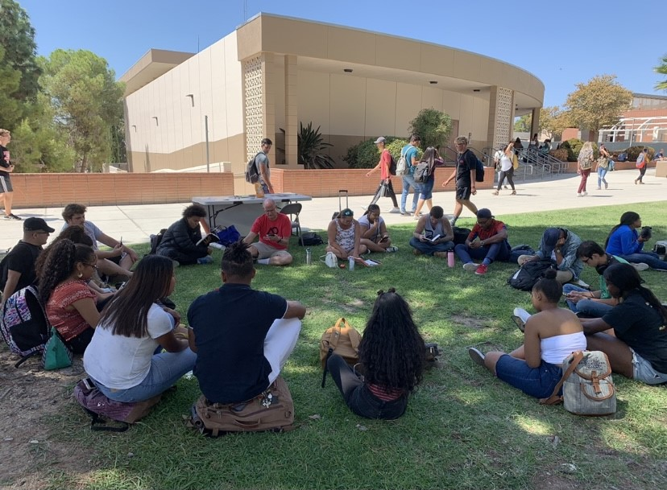
Our Story Part 2 Bakersfield

Slide 10
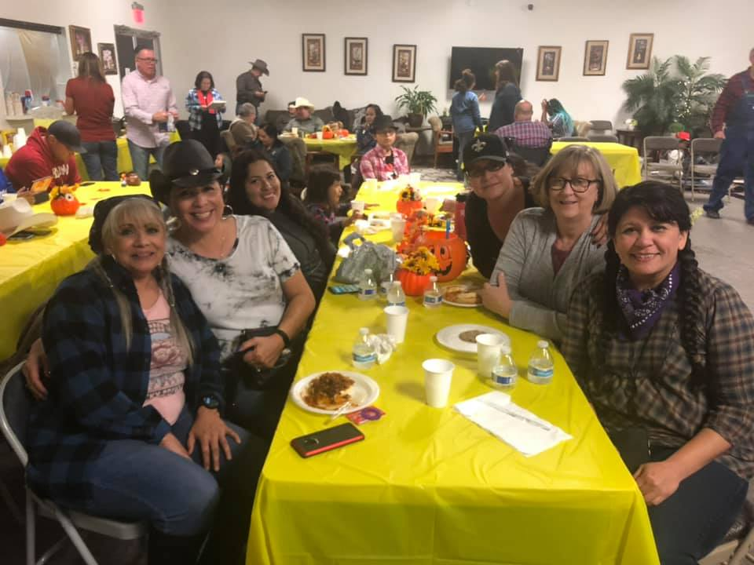
Our Story Part 2 Bakersfield

Slide 11
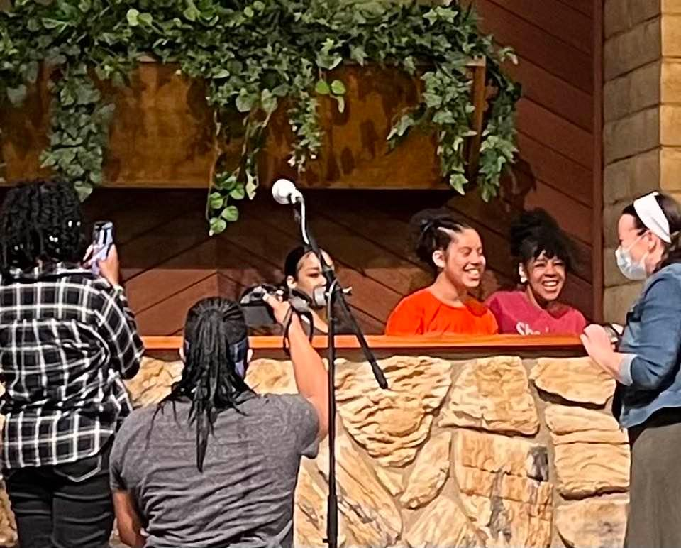
Our Story Part 2 Bakersfield

Slide 12
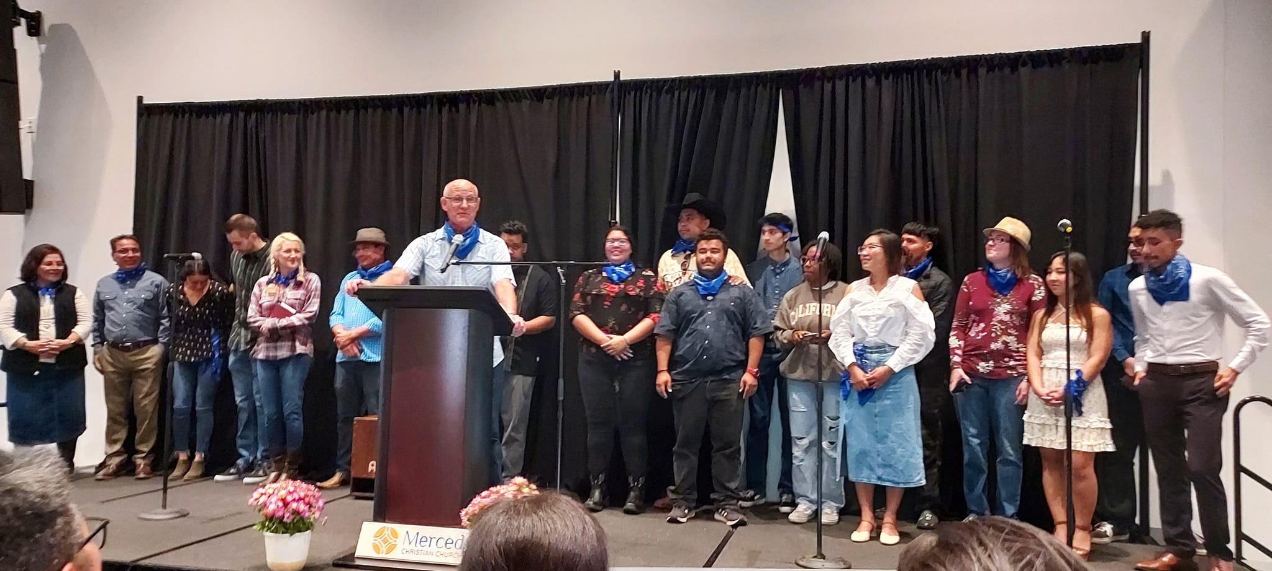
Our Story Part 3 Merced

Slide 13
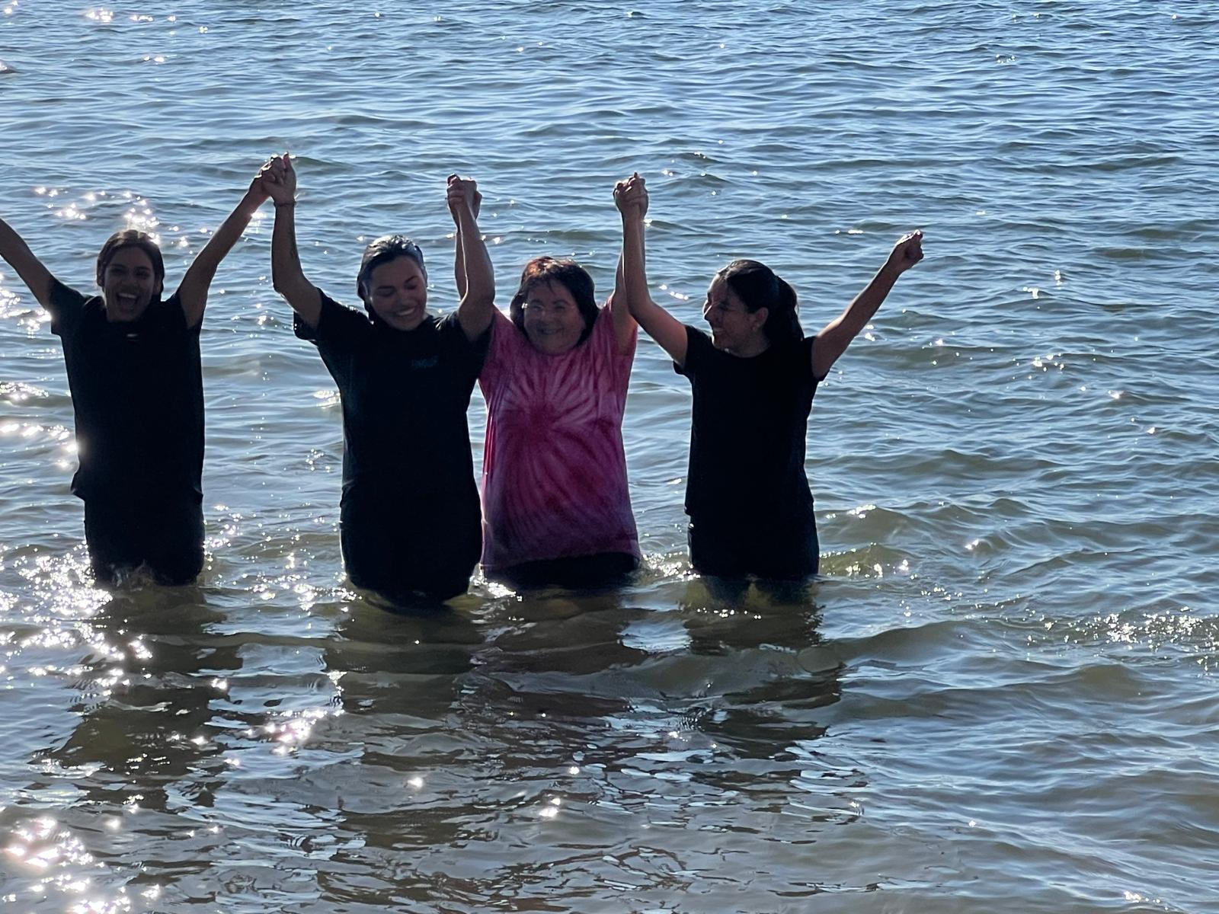
Our Story Part 3 Merced

Slide 14
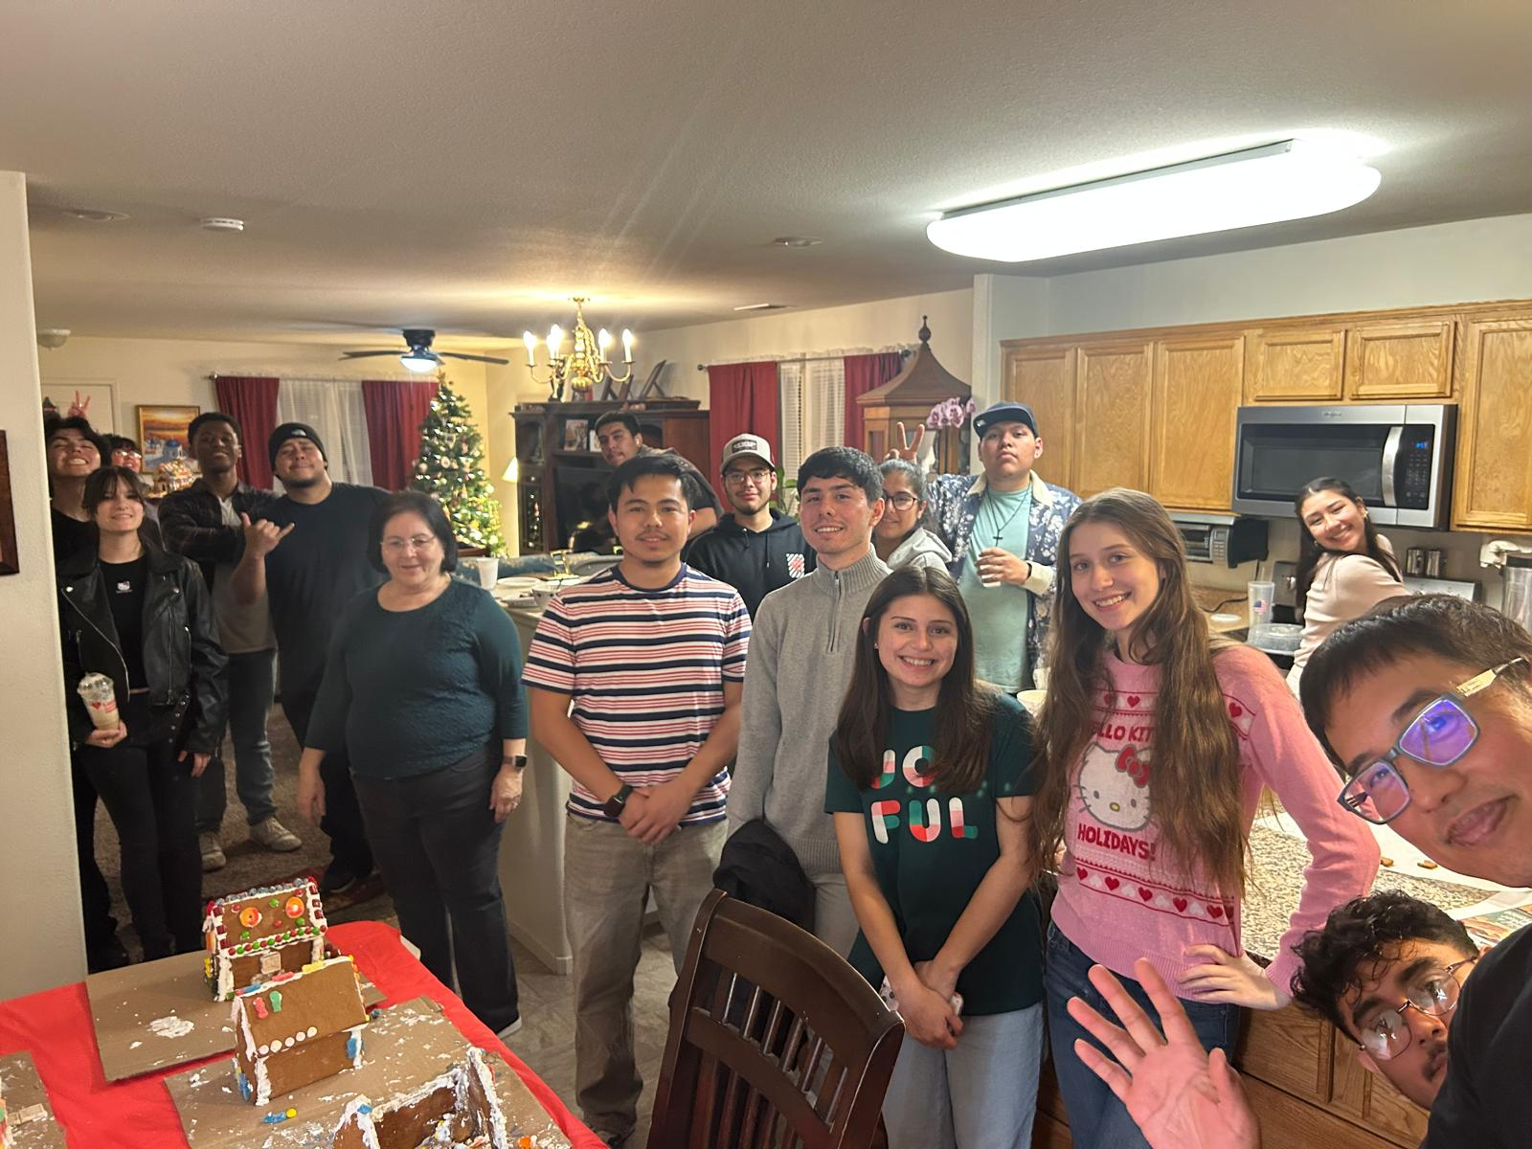
Our Story Part 3 Merced

Slide 15
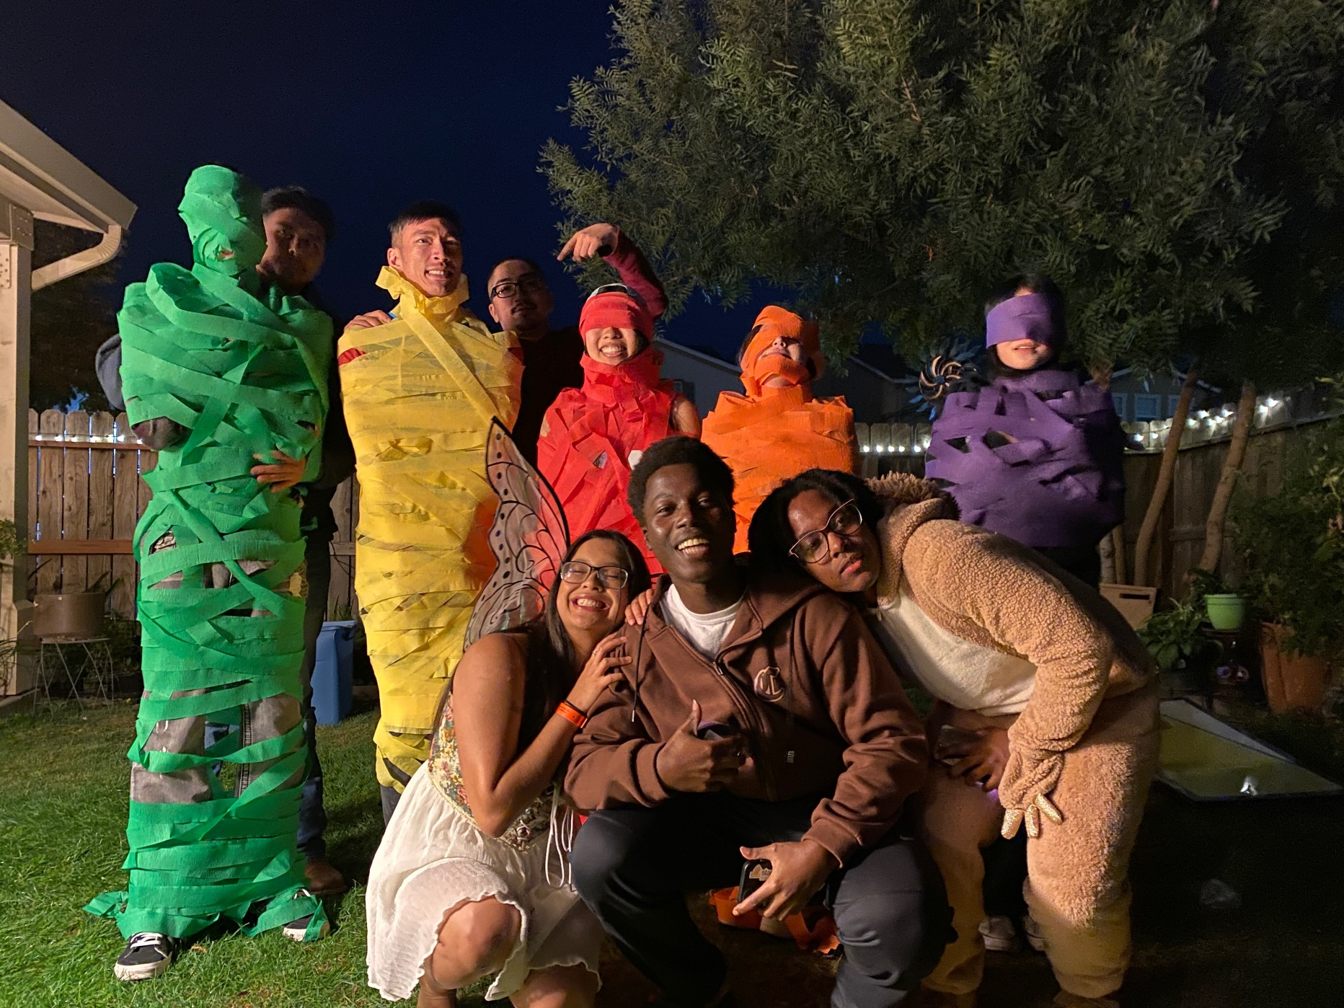
Our Story Part 3 Merced

Slide 16
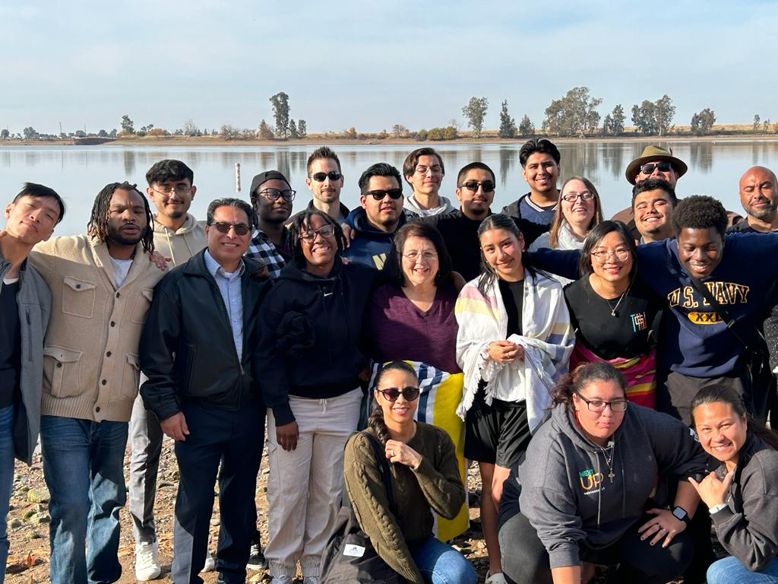
Our Story Part 3 Merced

Slide 17
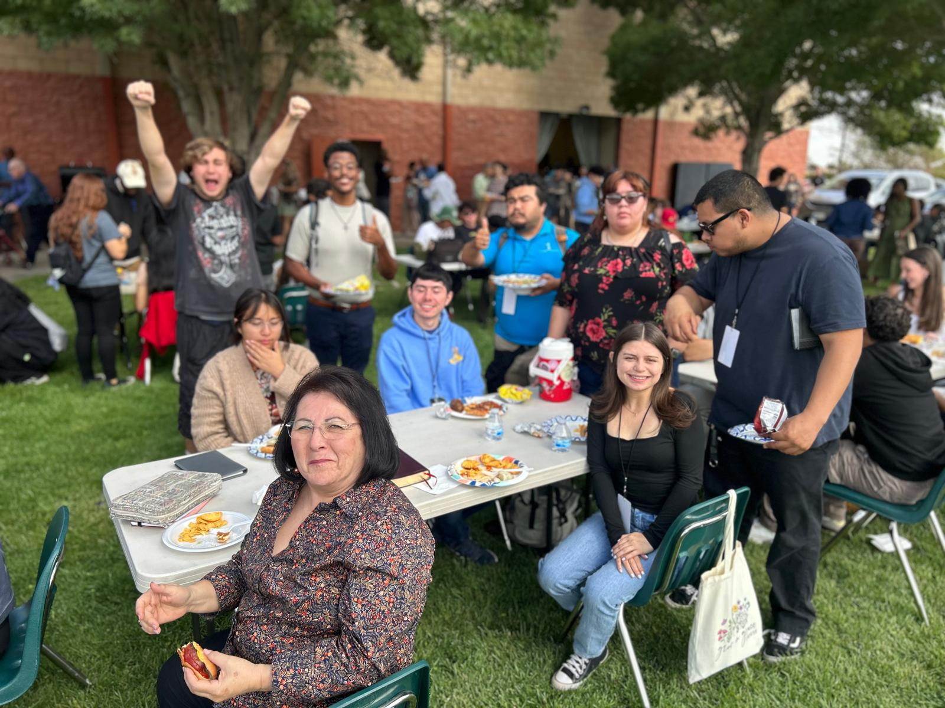
Our Story Part 3 Merced

Slide 18
Summary
Our Churches desperately need to regain a sense of having a mission.
Our mature members should play THE leading role in this.
Good: At-home mission
Better: Move to a smaller church
Best: Help to plant a church

