Slide 1
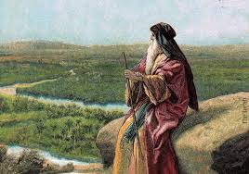
Deuteronomy VII
Decisions, Decisions.

Slide 2
Deuteronomy
Theme: hesed. Covenant loyalty. God wants from us, what he has already given us.
Theme passage: Deuteronomy 6:4-5 The shema
Hear, O Israel: The Lord your God, the Lord is one. Love the Lord your God with all your heart, and with all your soul, and with all your strength.

Slide 3
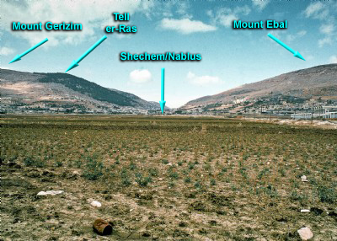
Last Week:
Deuteronomy 11:26-32
Deuteronomy 27:2-4
Blessings and Curses

Slide 4
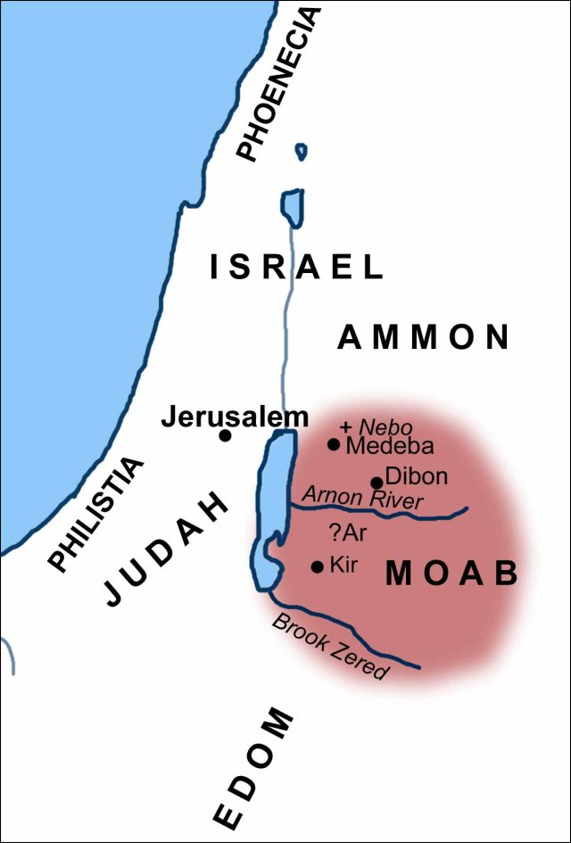
Deuteronomy 29
Deuteronomy 29:1 The “additional” Covenant at Moab
Deuteronomy 29:9-15 Carefully follow all the terms of this covenant…
Are you all in?

Slide 5
Deuteronomy 29:29
The secret things belong to the Lord our God, but the things revealed belong to us and to our children forever, that we may follow all the words of this law.
“secret things” = “mystery” in the New Testament
mystery: Colossians 2:2-3 Ephesians 1:9-10, 3:4-6
1 Corinthians 13:12 Now we know in part…
Let us live up to what we already know Phil 3:15-16

Slide 6
Deuteronomy 30:1-10
v. 2 When you return to the Lord
v. 3 God will restore you as a remnant.
v. 4 No matter how far you have wandered.
v. 5 God will bring you back!
v. 6 God will circumcise your heart (Deuteronomy 10:16)
v. 9 God will delight in you.
Only…
v. 6, 8, 10 Obey the Lord and love him.

Slide 7
Deuteronomy 30:11-20
v. 6,16 Love the Lord your God with ALL your heart.
v. 10,16 Fully obey all he commands.
v. 11 It is not too difficult for you! It is right there.
Us: Really????? Seems impossible to me!
It feels more like Everest or Mars to me…

Slide 8
A Discussion
Which is harder?
1. To love God with ALL your heart.
2. To fully obey all God has commanded us.

Slide 9
Deuteronomy 30:11-20
v. 14 God: the Word is near you, in your mouth, you can obey it. You can do it. Si! Se puede!
v. 15-18 A stark choice.
Who would choose death and destruction?

Slide 10
Two Possible Ways To Do This
1. Act my way to a better way of feeling. (obedience first)
2. Feel my way to a better way of acting (heart first)

Slide 11
How Can I Do This, Moses?
Deuteronomy 30:19-20
Choose Life!!! Choose today!!!
Luke 9:62 Put your hand to the plow and do not look back.
Then… You will be able to love God with all your heart, and to listen to His voice and hold fast to him.

Slide 12
Summary
God is calling you to do two things:
Love God with ALL your heart.
Fully obey all he has commanded you.
And he says it is not too hard. It is right near you.
How can I both love and obey fully?
Choose Life!

