Slide 1
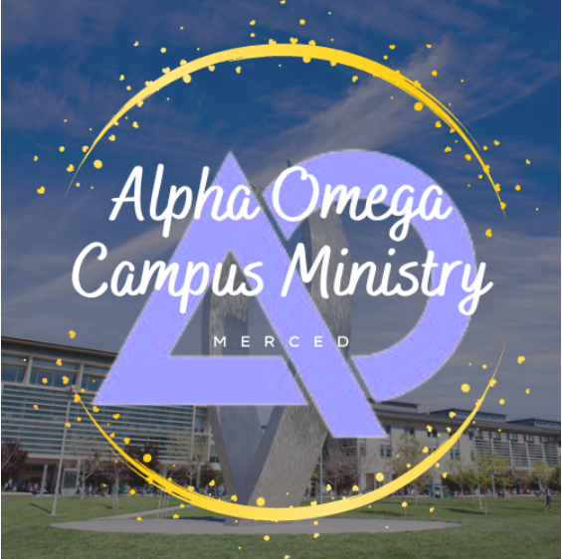
Welcome to the Alpha Omega Midweek

Slide 2

Announcements
Monday 7:30 Bible Talk UCMerced New Beginnings
Monday 6:30 dinner & Bible Talk in Atwater 106 Mulberry
Tuesday 6:30 Dinner and Bible Talk @ Oakes
Wed 12:15 Serving at Sacred Heart
Campus Midweek 7:30 UCM GLCR 120
Fri 7:00 Sports Night 500 Buena Vista Ave.

Slide 3
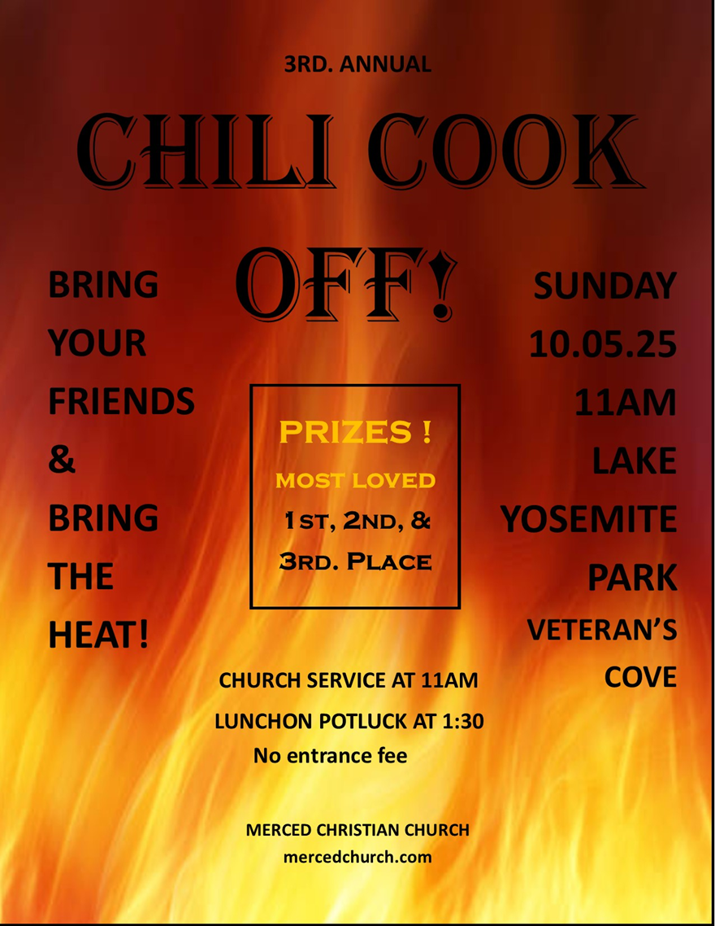
Coming Up
Chili Cookoff at Veteran’s Cove Oct 5th.
Who Is Jesus Fri October 10th.
Fall Campus Retreat October 15-17

Slide 4
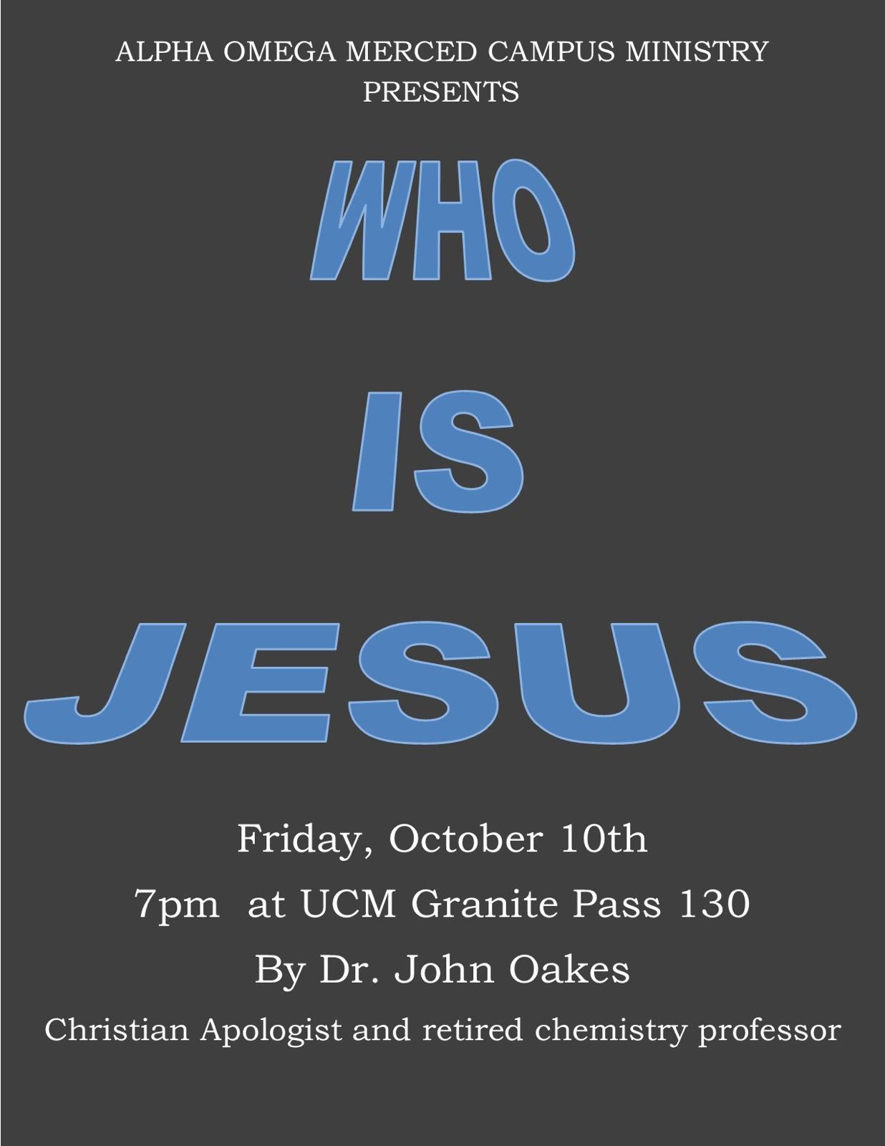

Slide 5
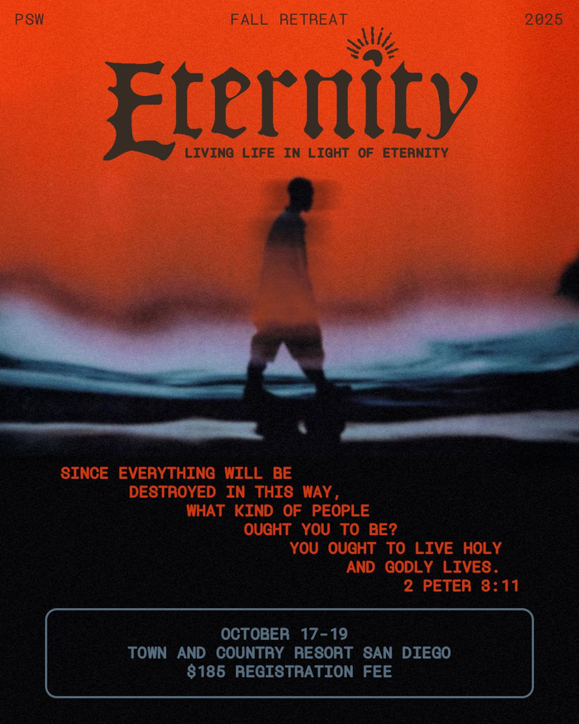
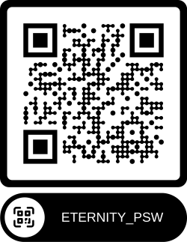

Slide 6

Announcements
Monday 7:00 Bible Talk UC Merced Library
Monday 6:30 Bible Talk dinner in Atwater 106 Mulberry
Tuesday 6:30 Dinner and Bible Talk @ Oakes
Campus Midweek 7:30 UCM GLCR 120
Fri 12:15 Serving at St. Patricks
Fri 7:00 Karaoke at the Oakes

Slide 7
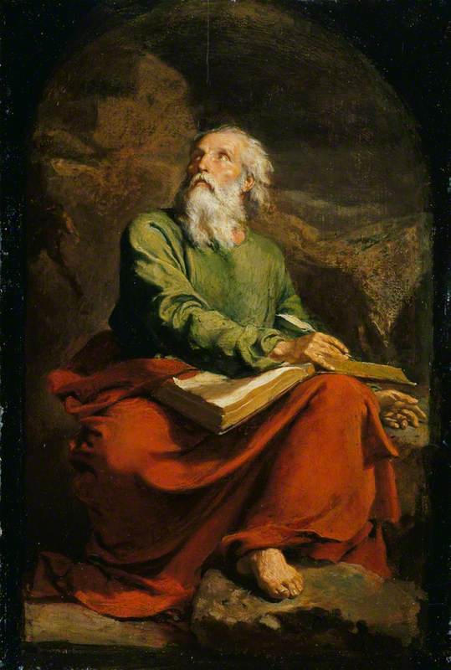
The Book of Isaiah
The Lord Is Salvation
John Oakes
Summer, 2025

Slide 8
One Outline of Isaiah
Isaiah 1-39 Messiah the king -Assyria
Isaiah 40-55 Messiah the Servant -Babylon
Isaiah 56-66 Messiah the Conqueror -World

Slide 9
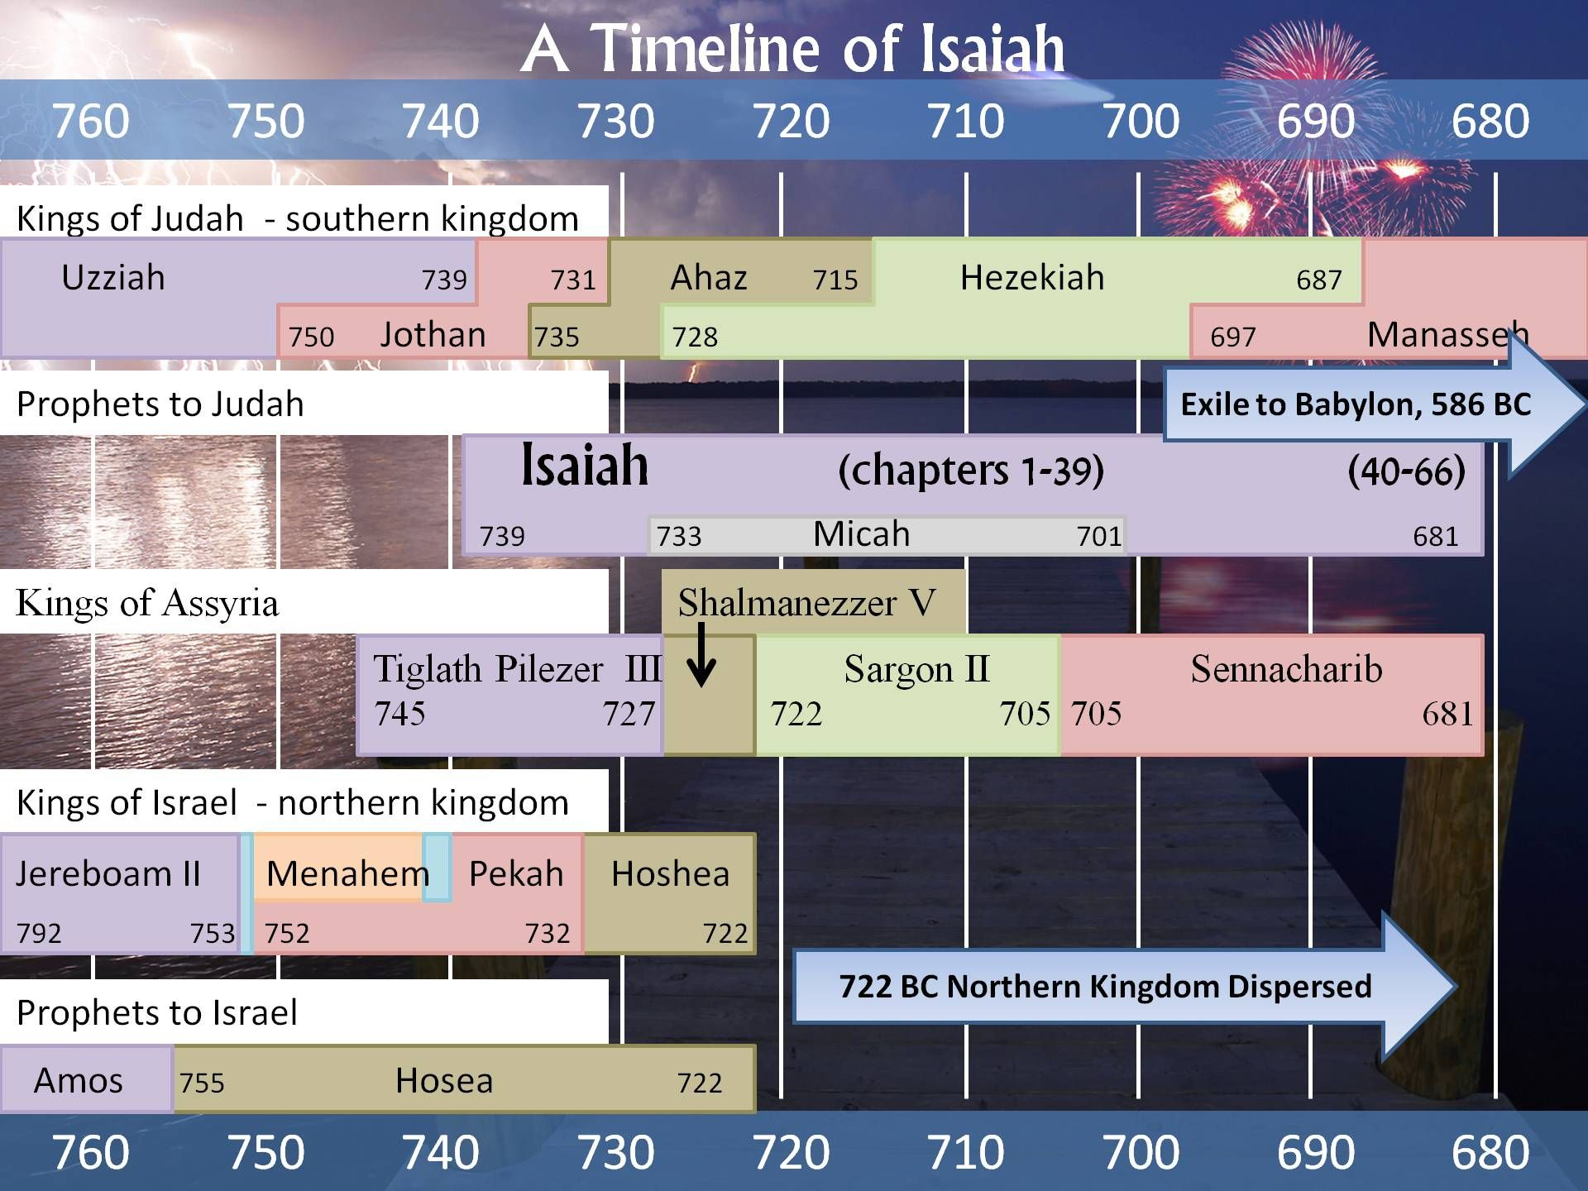

Slide 10
One Outline of Isaiah
Isaiah 1-39 Messiah the king -Assyria
Isaiah 40-55 Messiah the Servant -Babylon
Isaiah 56-66 Messiah the Conqueror -World

Slide 11
Themes of isaiah
1. The utter sinfulness of Judah and Jerusalem
2. Appeal of God to turn to him—to repent.
3. Judgment if they do not.
4. The Messiah—the Suffering Servant—is coming to save.
5. Restoration of a Remnant

Slide 12
Subthemes
The glory of the Lord.
Social Justice

Slide 13
Isaiah Timeline
732 BC Syro/Ephriamite War (Isaiah 7, 2 Kings 15) Ahaz unfaithful.
722 BC Ephraim/Samaria destroyed by Assyria under Shalmaneezer V
701 BC Sennacherib takes Judah, puts Jerusalem under siege. Isaiah 1:7 Hezekiah faithful.

Slide 15
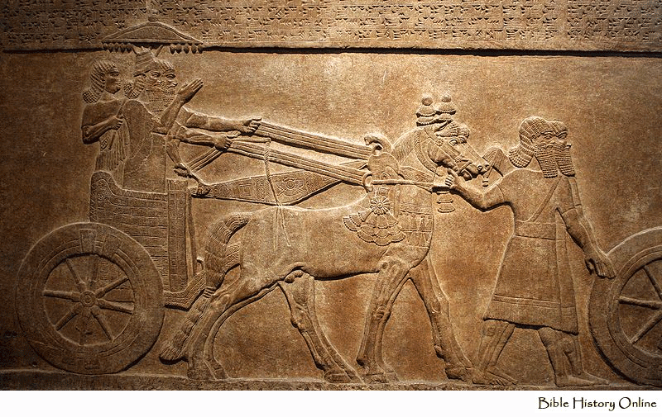
Tiglath- Pileser (Pul) standing with driver. (British Museum)

Slide 16
More Historical Context
Tiglath-pileser III 745-727 BC 2Kings 15:19-20 - known as Pulu in Babylon or Pul in Israel. Syro/Ephraim War, Jezreel.
Shalmaneezer V 727-722 BC Hosea 10:14, 2 Kings 17 Began destruction of Israel.
Sargon II 722-705 BC 2 Chronicles 28:1-27
Finished destruction of Samaria/Northern kingdom.
Sennacherib 705-681BC 2 Chronicles:29-33, Is 36:1-7, 37:21,35-37 - constant threat to Judah under king Hezekiah

Slide 17
Worth Noting
Isaiah contains 111 separate predictions. Of the 1,292 verses in the book, 754 (59%) deal with future events.
Forty-seven chapters of this book were directly quoted or alluded to by Christ or the Apostles. With more than four hundred allusions, Isaiah stands second only to Psalms as the most cited book in the New Testament.

Slide 18
One Outline of Isaiah
Isaiah 1-39 Messiah the king -Assyria
Isaiah 40-54 Messiah the Servant -Babylon
Isaiah 55-66 Messiah the Conqueror -World

Slide 19
Another Outline of Isaiah
I. God Judges the Nations (Ch. 1-35)
II. God Comforts his People (Ch. 36-48)
III. God’s Prince of Peace (Ch. 49-57)
IV. God’s Program for Salvation (Ch. 58-66)

Slide 20
Themes of isaiah
1. The utter sinfulness of Judah and Jerusalem
2. Appeal of God to turn to him—to repent.
3. Judgment if they do not.
4. The Messiah—the Suffering Servant—is coming to save.
5. Restoration of a Remnant

Slide 21
Subthemes
God rules the nations.
The glory of the Lord.
Social Justice

Slide 22
Isaiah ch. 1-5 Intro to Isaiah
Isaiah 1 themes
The utter sinfulness of Jerusalem/Judah (v 3-8)
Tender appeal by Jehovah that Judah repent (v. 16-19)
The inevitability of judgment (v. 24-25, 29-31)
The possibility of salvation (v. 26-27)

Slide 23
Isaiah 1:2-4
Isaiah 1:2 A courtroom scene, with Judah as defendant and the heavens and earth as witnesses. (Deut 30:19)
v. 2-4 God: I have always maintained hesed. I have been like a parent with its children (Hos 11:1-4)
But we have rebelled. We are worse than dumb animals.
v. 3 yada know intimately My people (ammi as opposed to Lo-Ammi Hos 1)

Slide 24
ISAIAH 1:4-9
Would Judah agree with the assessment in 1:4?
Would you?
Isaiah 1:5-8 God’s compassion.
Isaiah 1:7 is literally true at this time for Judah under Sennacherib.
Isaiah 1:9 Hope. The remnant.
Remnant theology: Isaiah 10:20-23 Zeph 2:7-11, Hos 11:8-11, Ezek 5:1-3

Slide 25
Isaiah 1:10-20
God is angry repent!
Isaiah 1:10-15 God is very angry. Why? Empty religion without faithfulness/hesed.
v. 13 Could our worship become “worthless assemblies?”
Isaiah 1:16-17 Repent. How? By seeking justice.
Isaiah 1:18-20 Come, let us reason together. God offers salvation.
We can willingly obey or we can resist and rebel.

Slide 26
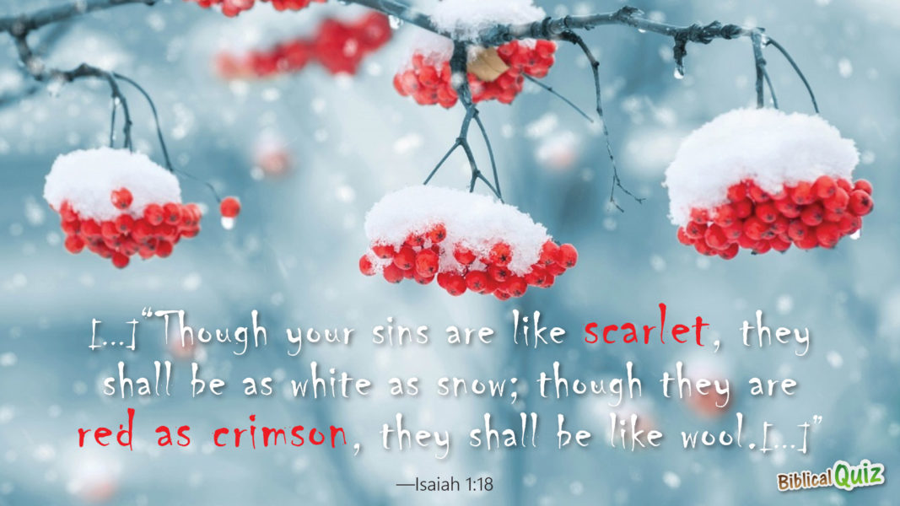
Though your sins are like scarlet

Slide 27
Themes of isaiah
1. The utter sinfulness of Judah and Jerusalem
2. Appeal of God to turn to him—to repent.
3. Judgment if they do not.
4. The Messiah—the Suffering Servant—is coming to save.
5. Restoration of a Remnant

Slide 28
Isaiah ch. 1-5 Intro to Isaiah
Isaiah 1 themes
The utter sinfulness of Jerusalem/Judah (v 3-8)
Tender appeal by Jehovah that Judah repent (v. 16-19)
The inevitability of judgment (v. 24-25, 29-31)
The possibility of salvation (v. 26-27)
The remnant (v. 9)

Slide 29
Isaiah 1:21-27
Isaiah 1:21-23 No more justice. The rich get richer. Does that sound familiar? They do not defend the fatherless.
v. 24-25 Therefore, wrath.
v. 26-27 Hope. Zion—the Kingdom will be delivered.

Slide 30
Kingdom Prophecies
1. The future temple which will attract Gentiles (2:2–5).
2. The glorious Branch (4:2–6).
3. The virgin birth of Immanuel (7:13–14).
4. The dawning of a new day in the birth of a child (9:1–7).
5. The Shoot of the stem of Jesse (11:1–10).
6. The conversion of Gentiles (19:18–25).
7. The new Jerusalem (54:9–13; 60:19–22).

Slide 31
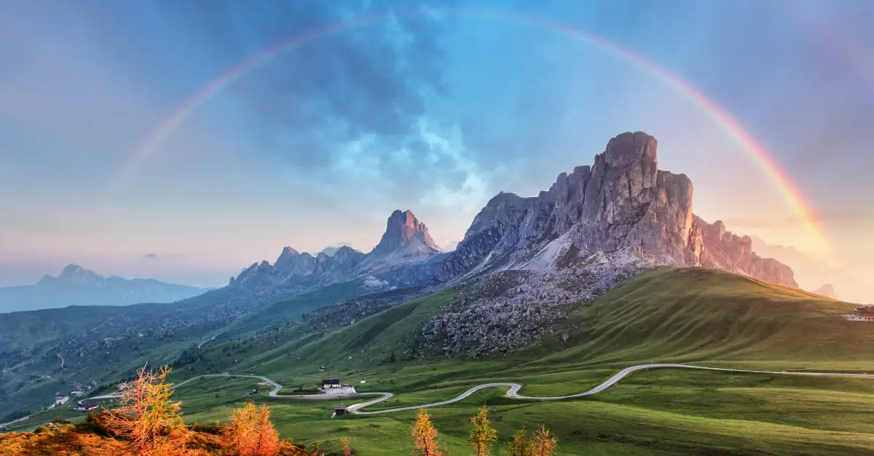
Isaiah 2:1-5 A Kingdom prophecy
Isaiah 2:2 In the last days Heb 1:2, Acts 2:17, Joel 2:28-32
The mountain of the Lord is Mt. Zion/Jerusalem/the kingdom of God (and maybe even the Church).
v. 3 Pentecost.
v. 4 Inscribed at the UN.

Slide 32
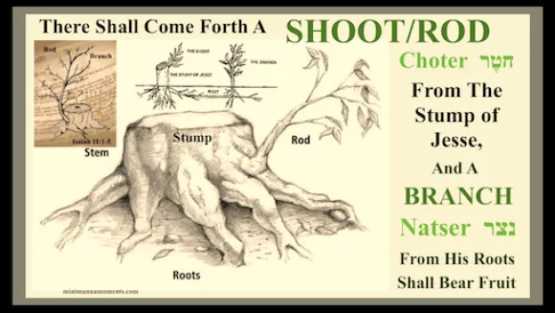
Isaiah 11:1-12:6
Another kingdom prophecy
Isaiah 11:1 A root, a branch of Jesse nazer
Matthew 2:23 He will be called the nazerene

Slide 33
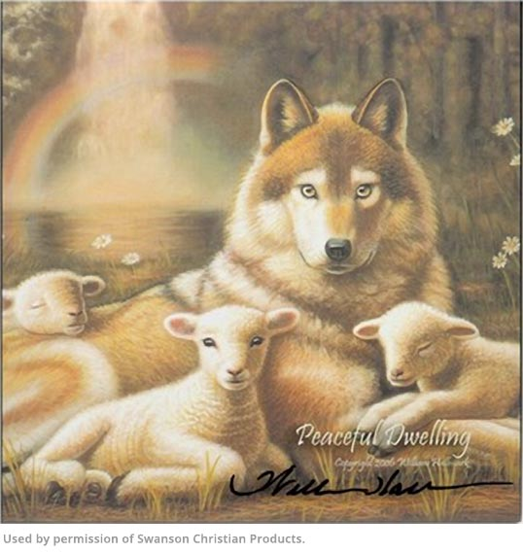
Isaiah 11:1-16 The Kingdom of god
v. 4-5 Messiah/Branch brings justice and righteousness.
v. 6-9 A kingdom of peace/shalom.
Already but not yet!
v. 10-16 A banner, a resting place, a gathered remnant, a highway to heaven.
Get the picture!

Slide 34
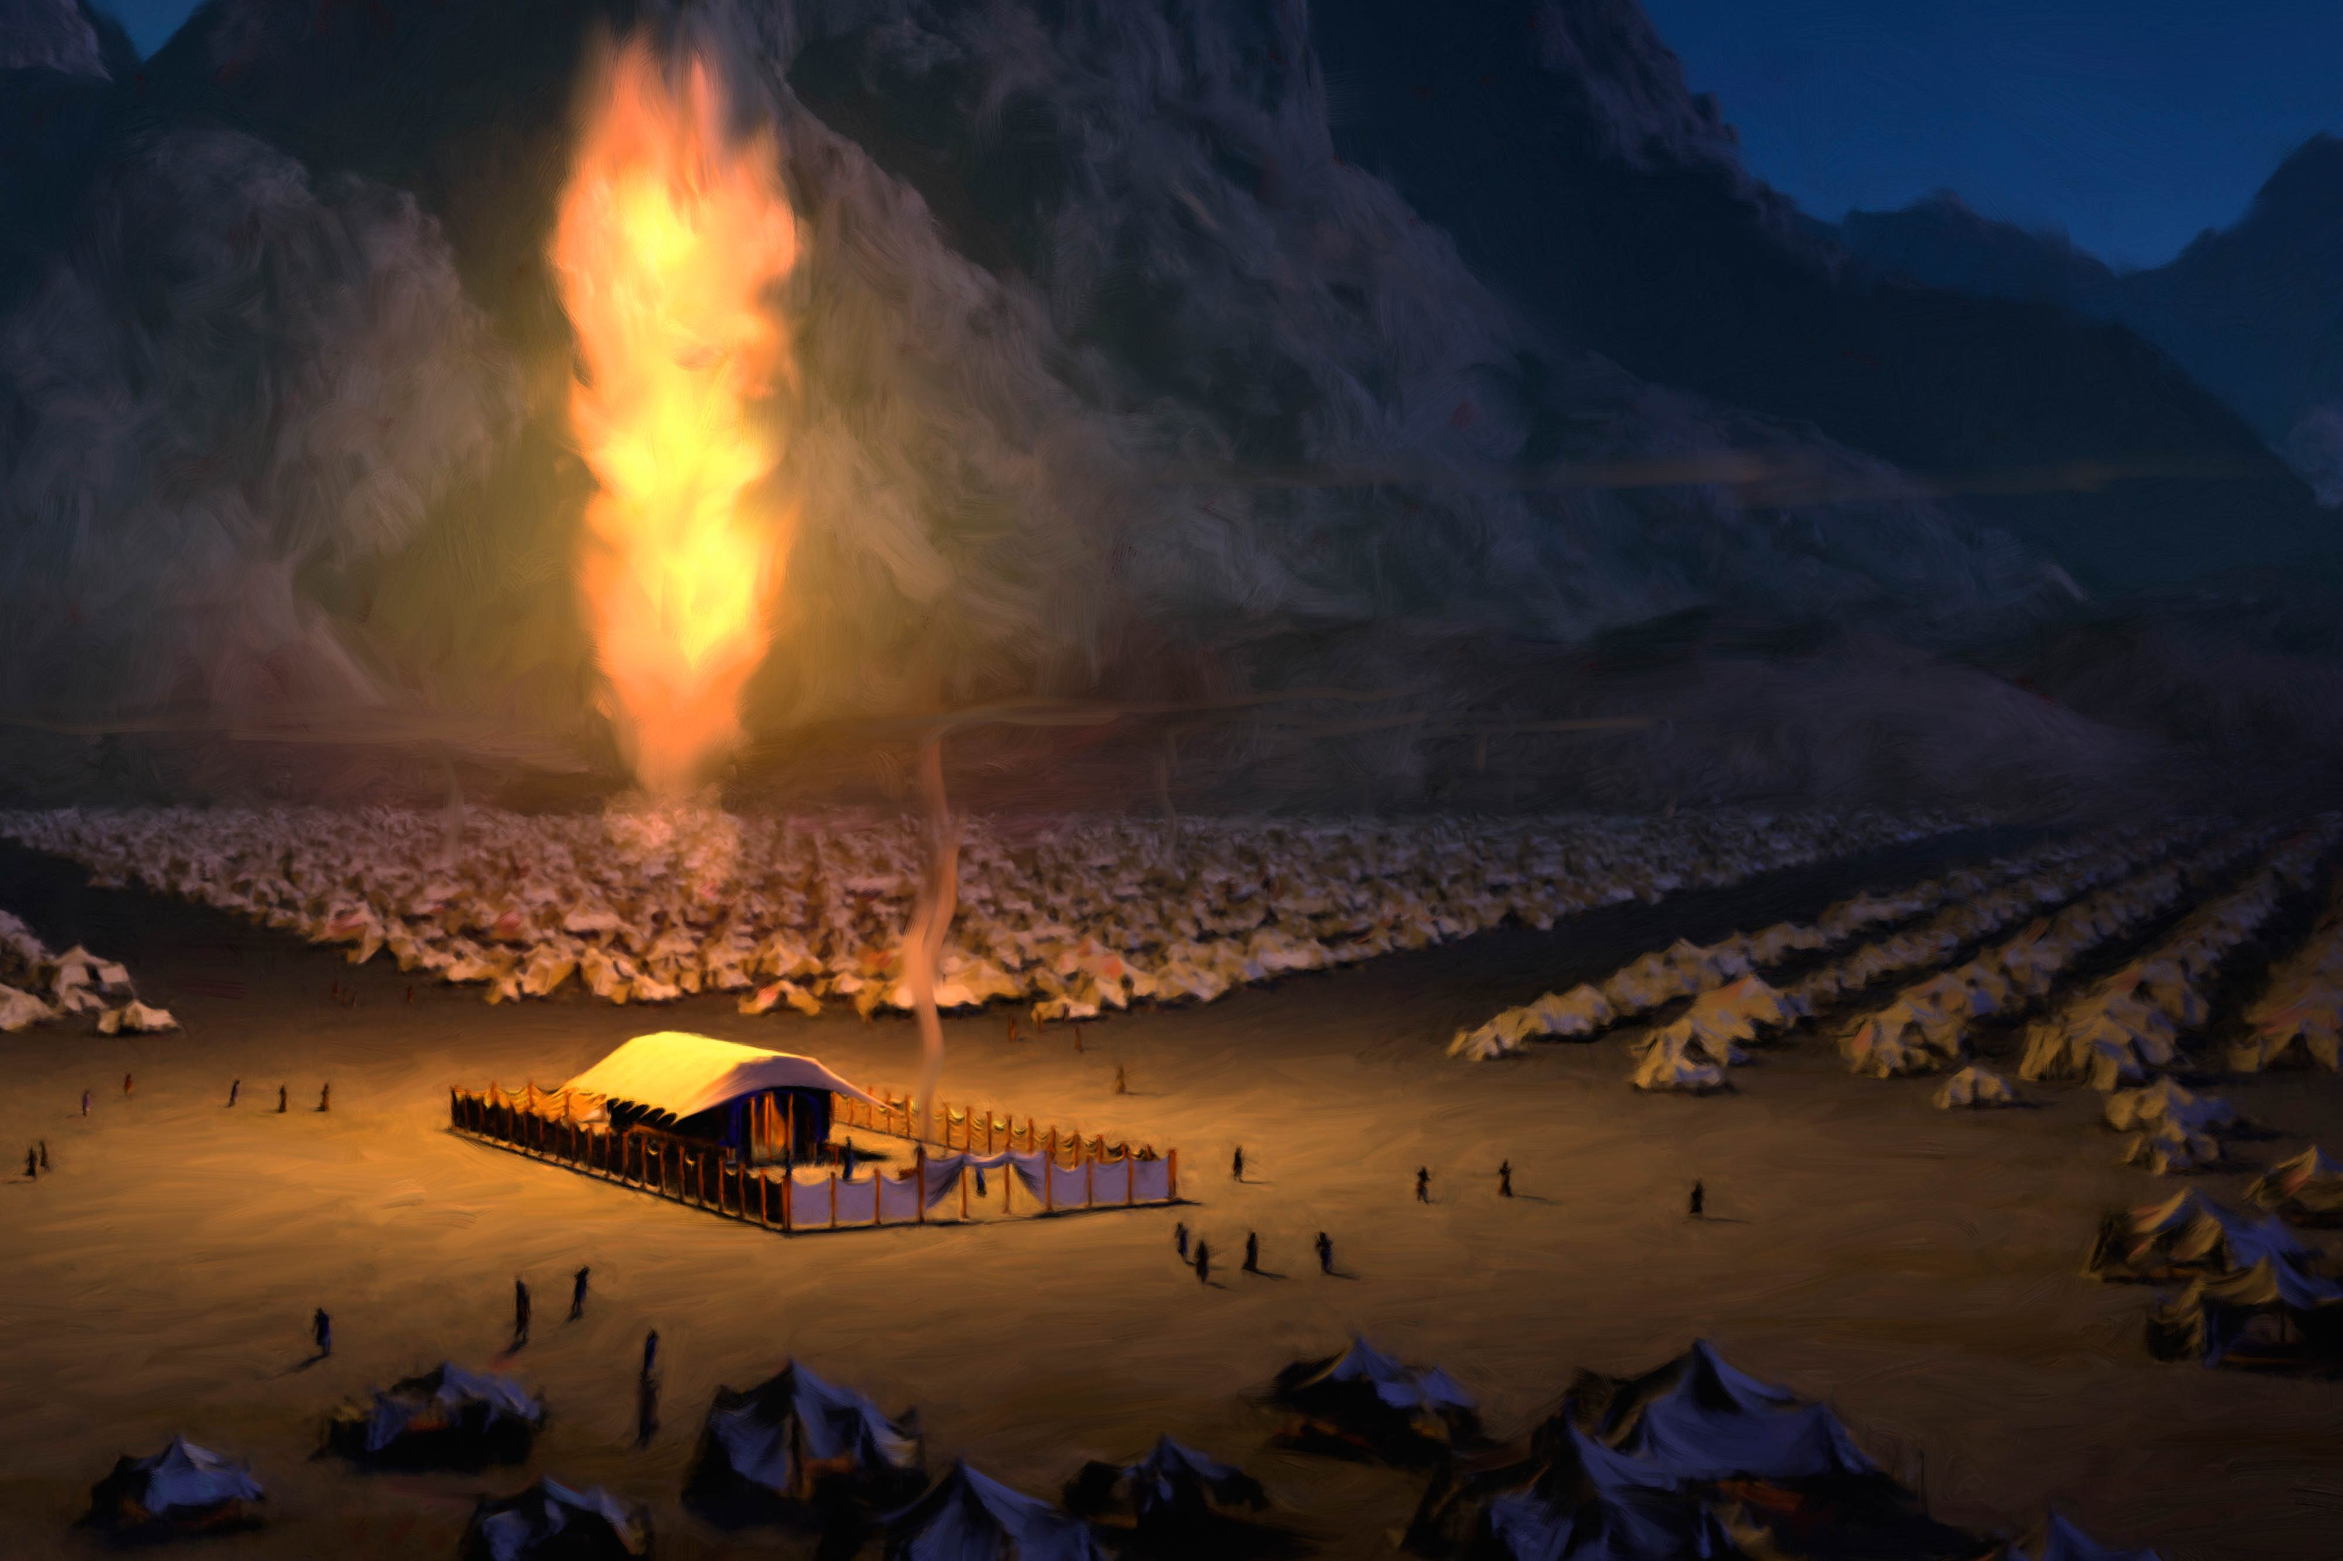
Isaiah 2:2-4 Isaiah 4:2-6 a sandwich
Isaiah 4:2 Branch will be beautiful and glorious.
Emphasis here on glory!!!
Isaiah 4:5 The shekinah—glory of God.
John 1:18
A refuge—a hiding place from the storm.

Slide 35
Isaiah 2:6-22 The Day of the lord
TDOTL Obadiah 4, Amos 3:2, Amos 5:2 Micah 3:12 Zephaniah 1:14-18 Is. 2:12 Is. 13:6-9Is. 13:10-13 Is. 34:4, 8-10 Jer. 46:10 Lam. 2:22 Ezek. 13:5 Ezek 30:3 Joel 1:15 Joel 2:1 Joel 2:11 Joel 2:31 Joel 3:14
The Day of the Lord signifies “The moment when Jehovah grasps the reigns, which he seems to have held slackly before, when the currents of his moral rule, which have been running sluggishly, receive a mysterious quickening, and the Lord’s work on the earth is at last fully performed.”
Or “The Day in which Jehovah will manifest himself as God.”

Slide 36
Isaiah 2:6-22
v. 10 The unrighteous are hiding in the rocks.
v. 12-17 The proud, the rich and prosperous… All will be brought low.
v. 20 TDOTL is a day people throw away what they formerly valued greatly. Ezek 7:19-20
v. 22 Great advice Stop trusting in mere humans.

Slide 37
Discussion Questions
1. What does the Kingdom of God mean to you?
2. What area of social justice are you interested in being involved in?
3. The “remnant” is a big theme in Isaiah. What does it mean to you to (hopefully) be part of that remnant?
4. What do you think about the Day of the Lord?

Slide 38
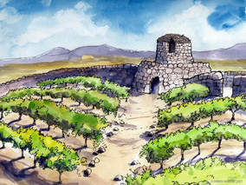
Isaiah 5 Song of the Vineyard
The vineyard is Israel and Judah. The vineyard is the church.
God prepared the land
He Set up a watchtower
He built a winepress—gave us work to do in the vineyard

Slide 39
Isaiah 6-12
Isaiah 6 Isaiah commissioned
Judah is in deep trouble
Isaiah 7, Isaiah 9 Isaiah 12:1-6 Hope for Judah
But…
Isaiah 7 Ahaz rejects faithful reliance on God. The end for Judah is inevitable

Slide 40
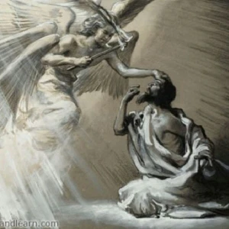
Isaiah 6 God commissions Isaiah
Holy, Holy, Holy…
Woe is me!
Sin removed.
Here am I, send me.
I am sending you to a stubborn people.
How long?
v. 13b. A ray of hope

Slide 41
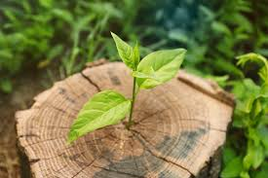
Isaiah 6:13
A stump will remain…
The remnant

Slide 42
Isaiah 7 Unfaithful Ahaz
Is 7:1-9 Ephraim and king Pekah allied with Rezin of Syria attack Jerusalem/Judah
The Syro/Ephraim war of 734 BC
v. 3 Shear-Jashum a remnant will return
v. 4 Advice to a worried/fearful disciple:
-be careful
-keep calm
-do not be afraid or lose heart. Trust in God!!!

Slide 43
Isaiah 7 Unfaithful Ahaz
v. 9 If you do not stand firm in your faith, you will not stand at all.
Isaiah 7:10-12 Ahaz does not ask for God’s deliverance. He chooses to rely on Egypt, not God.

Slide 44
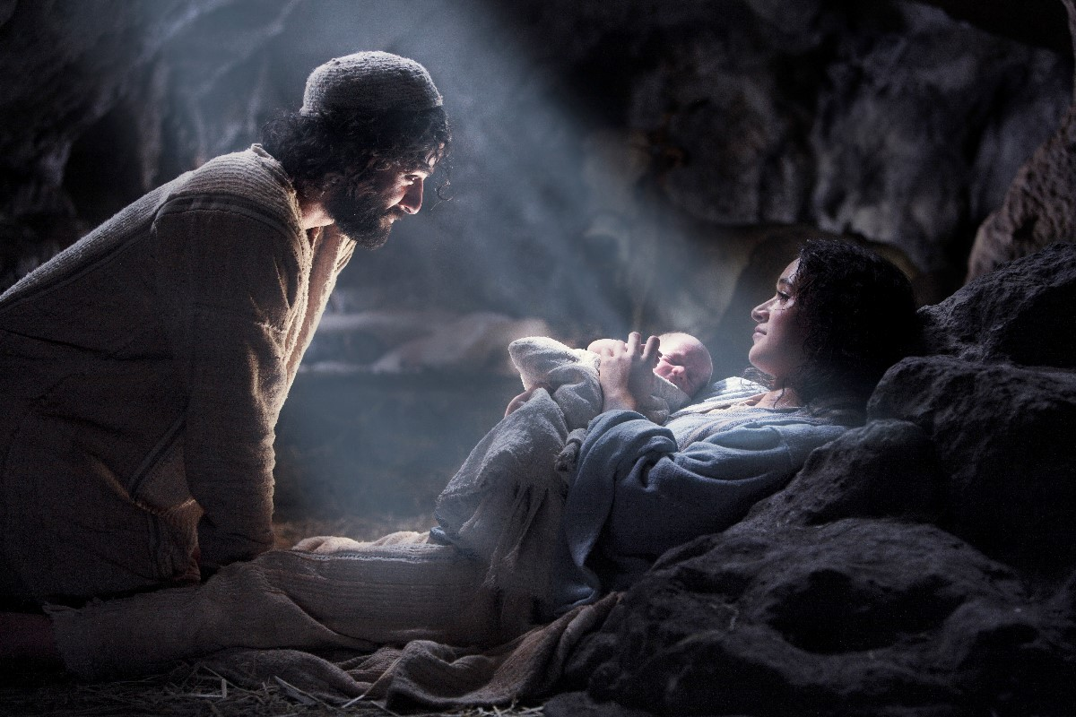
Isaiah 7:13-17 a sign
The virgin will be with child
v. 14 a sign The virgin
(Heb alma, young maiden) will be with child.
He will be God-with-us Immanuel Matt 1:22, 28:20

Slide 45
Isaiah 8 Isaiah’s other son
Maher-Shalal-Hash-Baz (quick to the plunder, swift to the spoil)
Isaiah 8:4 Judgment is coming from the North (Assyria)
Isaiah 8:6-8a This is exactly what happened in 701 BC
under Sennacherib. God is with us (but not in a good way)
But… see Isaiah 36-38

Slide 46
Isaiah 9:1-7 The Lord’s deliverance
Isaiah 9:1-2 Nevertheless, there will be no more gloom for those who were in distress. In the past he humbled the land of Zebulun and the land of Naphtali, but in the future he will honor Galilee of the Nations, by way of the Sea, beyond the Jordan.
Isaiah 9:6 For to us a child is born, to us a son is given. He will be called Counselor, God, Father, Prince of Peace
v. 7 He will reign on David’s throne 2 Sam 7:16

Slide 47
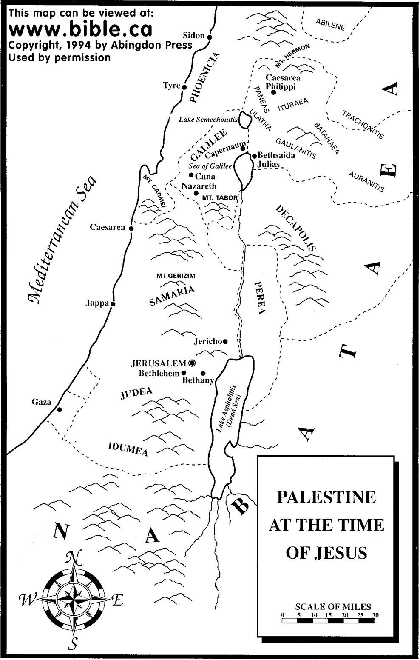
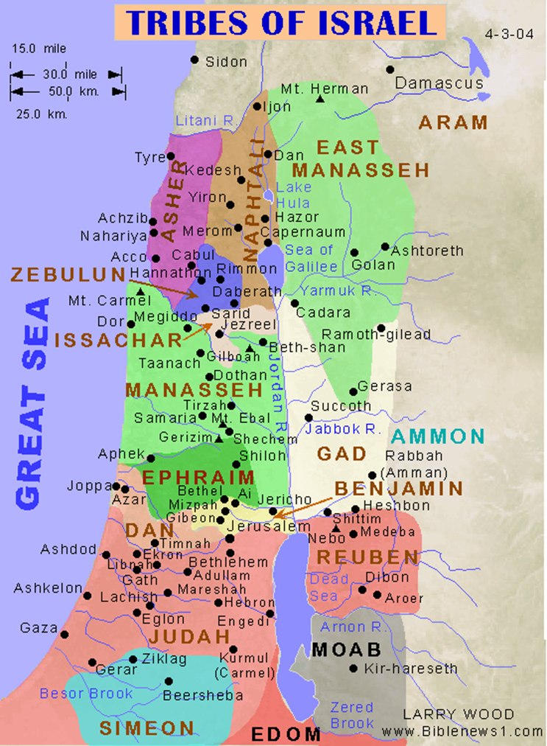
The Land of Zebulun and naphtali

Slide 48
.Discussion Questions
1. Have you been producing the fruit of the vineyard that God expects? Explain.
2. Can you relate to Isaiah when he said, “Here am I, send me”?
3. What was Ahaz’s error? How might we do this?

Slide 49
Isaiah 10 What Gets god angry?
Injustice
Isaiah 10:1-4
-oppressive decrees
-depriving the poor of their rights
-withholding justice from the marginalized
Social justice is big in Isaiah!
Isaiah 58:5-8
v. 3-4 (Ezekiel 7:19) The things they relied on will not save them!
v. 5-6 Therefore I am sending Assyria!

Slide 50
Isaiah 10:20-25 The remnant
v. 20 Who are the remnant? They are those who do not rely on Assyria for their strength.
Those who trust instead in the Lord.
v. 24 The remnant is not afraid of the Assyrians, even though they beat you with a rod.
They will be destroyed

Slide 51
Isaiah 12 A psalm of isaiah
Isaiah 12 finishes the sandwich that was begun in Isaiah 6
v. 2 God is our salvation.
v. 4 We praise his name to all the nations.
v. 6 Shout it aloud! Are you doing this?

Slide 52
Isaiah 13-30 Judgment on the nations
Isaiah 13-24 Judgment on Babylon, Philistia, Moab, Damascus, Cush, Egypt and more.
Isaiah 25-30 Judgment (mostly) on Israel and Judah.
Isaiah 31:1-9 Do not go down to Egypt!
Isaiah 32:1-4 A righteous king will reign. A shelter from the storm. A stream of water in the desert.

Slide 53
Isaiah 36-39 Historical Interlude
Isaiah 36-37 Hezekiah trusts in the Lord and saves the remnant in Jerusalem from destruction.
Isaiah 38 Hezekiah’s illness, prayer, and Isaiah’s answer. Hezekiah (unlike Ahaz) asks for a sign.
Isaiah 39 Hezekiah’s terrible mistake. Jerusalem will go into captivity!

Slide 54
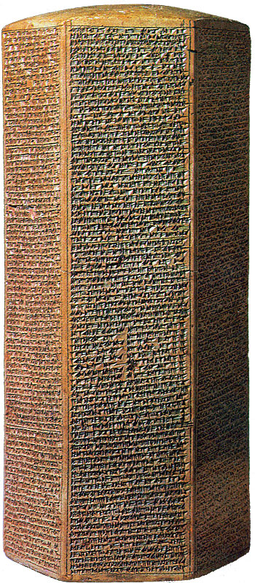
The Sennacherib Cylinder or Taylor Prism British Museum, London (2 Kings 18) 691 BC
As to Hezekiah the
Jew… I made him…
“like a bird in a
cage”

Slide 55
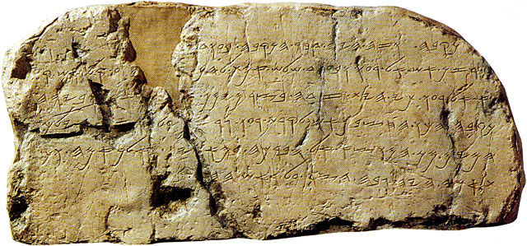
The Siloam Inscription.
2 Kings 20:20-21
"Now the rest of the acts of Hezekiah--all his might, and how he made a pool and a tunnel and brought water into the city--are they not written in the book of the chronicles of the kings of Judah? So Hezekiah rested with his fathers."

Slide 56
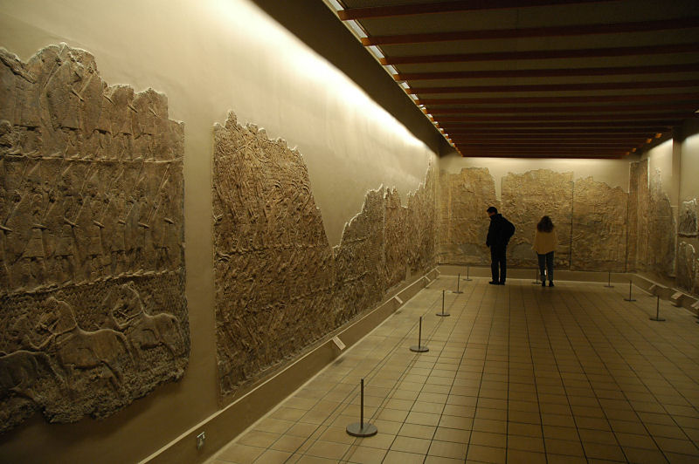
Lachish Room, British Museum

Slide 57
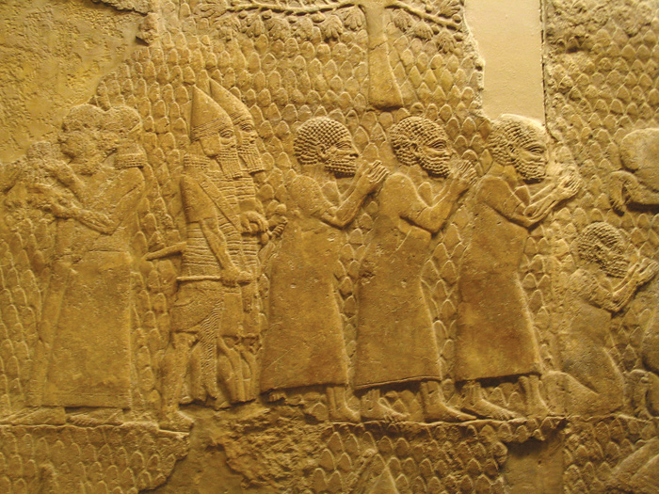
Israeli Captives Being Led from Lachish

Slide 58
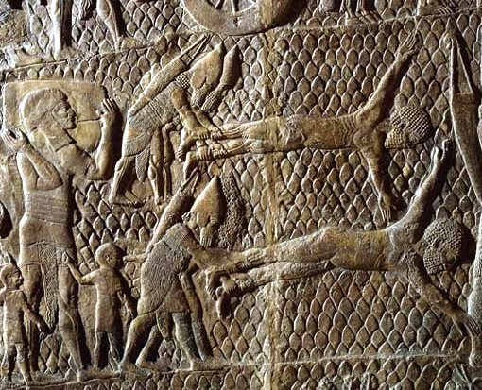
Jewish captives skinned alive in front of Lachish Walls

Slide 59
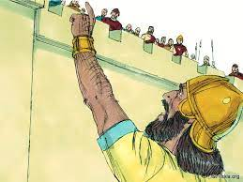
Isaiah 36 & 37
Hezekiah trusts In jehovah
36:5 Who are you relying on? A great question!
Satan’s schemes:
Don’t rely on Jehovah. I beat him already
Don’t rely on a godly leader Hezekiah
God told me to tell you.
Let’s make a compromise
Have the other gods saved them?

Slide 60
Isaiah 36-37
Hezekiah trusts in jehovah
Hezekiah: A model for trusting God. Isaiah 37
v. 1 He humbles himself before God
v. 2 He seeks advice from his spiritual mentor.
v. 3-4 He repents and decides to trust in God, not Egypt.
v. 15-20 He prays to God for deliverance
God’s answer Isaiah 37:30-35
I will save a remnant
A band of survivors will come from Mt. Zion.

Slide 61
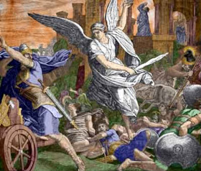
Isaiah 37:36
Jehovah vindicates Hezekiah

Slide 62
Isaiah 38 Hezekiah’s illness
Isaiah 38:1-6
Hezekiah has a deadly sickness
Isaiah: Prepare to die!
Hezekiah pleads with the Lord in prayer
God grants 15 more years of life
Isaiah 38:22 Hezekiah asks for a sign (unlike unfaithful Ahaz)

Slide 63
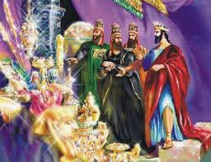
Isaiah 39 Hezekiah’s fatal error
Transition to Isaiah 40
Isaiah 39:1-2 Envoys from Babylon appeal to the pride of Hezekiah.
Hezekiah (looking for a possible treaty?) shows them all the treasure in the temple.
v. 3-7 Isaiah to Hezekiah. All this treasure will be carried off to Babylon.
Your descendants (Daniel, Hananiah, Azariah and Mishael) will be made eunuchs in the palace in Babylon.

Slide 64
Discussion Questions
1. Which of the schemes that Sennacherib’s general used on Israel is he likely to use on you? (Don’t rely on Jehovah. I beat him already. Don’t rely on a godly leader Hezekiah. God told me to tell you. Let’s make a compromise
Have the other gods saved them?
2. Are you, like Hezekiah, relying on the Lord, not on Egypt?
3. What was Hezekiah’s “fatal error?” What might that look like for one of us in our present situations?

Slide 65
Outline of Isaiah
Isaiah 1-39 Messiah the king -Assyria
Isaiah 40-55 Messiah the Servant -Babylon
Isaiah 56-66 Messiah the Conqueror -World

Slide 66
Isaiah 40-55 Messiah the servant
Isaiah 40 Judah will go into captivity. But what about those promises?...
Isaiah 40:1-2 Comfort, Comfort my people. My anger is complete. A remnant will return.
Jeremiah 29:10-14 After 70 years… I will gather you from San Diego, the Bay Area, Los Angeles, and the Central Valley to Merced!
Isaiah 41:9-10 From the farthest corners I called you.
You are my servant. I will uphold by my right hand.
The suffering servant is Israel and it is the Messiah. Both!

Slide 67
Isaiah 40 A Highway for our God
Is 40:3-5 A voice calling… John the Baptist Matt 3:3
God is clearing the way.
The glory of the Lord will be revealed. John 1:14
Isaiah 40:6-11 All the people… are like grass.
But… The Word of our God endures forever.
v. 9 Therefore, let us bring good news to Merced!
Let us lift up our voices this semester!
v. 10 Recompense

Slide 68
Isaiah 40:12-20 I am great, you are not
-v. 14 God: Did I consult you?
-v. 15 All the nations are a drop in the bucket!
v. 17 All the nations are nothing!!!
v. 19 The world’s idols are nothing! Hollywood, sports, entertainment, social media, video games, nice vacations are nothing!!!
-v. 22 All the people are like grasshoppers!
Isaiah 40:31 Put your hope and trust in Jehovah.

Slide 69
Isaiah 40:21-31 God is great!!!
Memory verse: Isaiah 40:22
He sits enthroned above the circle of the earth, and its people are like grasshoppers. He stretches out the heavens like a canopy, and spreads them out like a tent to live in.
v. 25 A rhetorical question: To whom will you compare me?
Do you not know…

Slide 70
Isaiah 41 God is Calling His Servant
Is 41:1-2 God is calling one from the East. Cyrus
Is 41:8 Jacob is “my servant” whom I have chosen. Who is this servant? Israel? The Church? (41:8, 49:3) The Messiah? (50:4-9, 53:9)

Slide 71
Discussion Questions
1. Do you need words of comfort from God right now? How does Isaiah 40 answer that need?

Slide 72
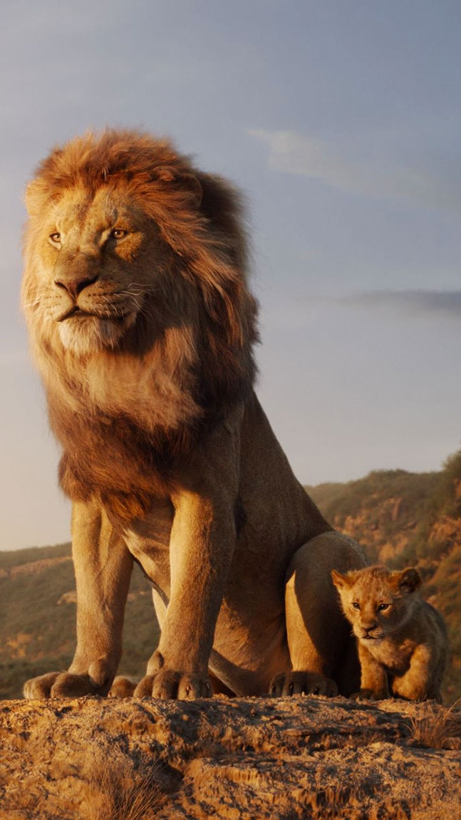
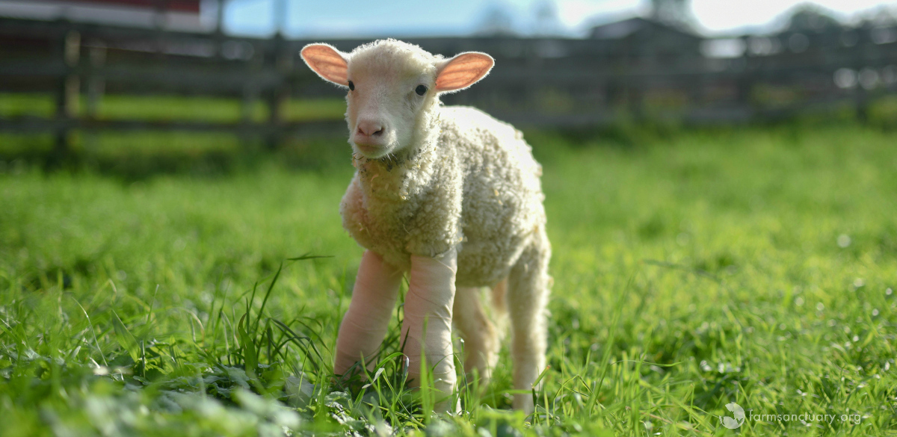
Isaiah 42 The Suffering Messiah
Isaiah 42:1-4 Look! The suffering servant! In whom I delight
v. 3 A bruised reed he will not break. Quoted in Matthew 12:15-21.
Is Jesus a lion or is Jesus a lamb? Revelation 5:5-6
Lion: Matthew 16:23, Matthew 23:29-37
Lamb: John 8:11, Matthew 9:35-38
Is 42:4 How can a lamb bring about justice?

Slide 73
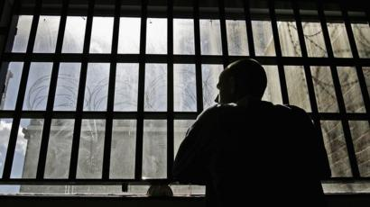
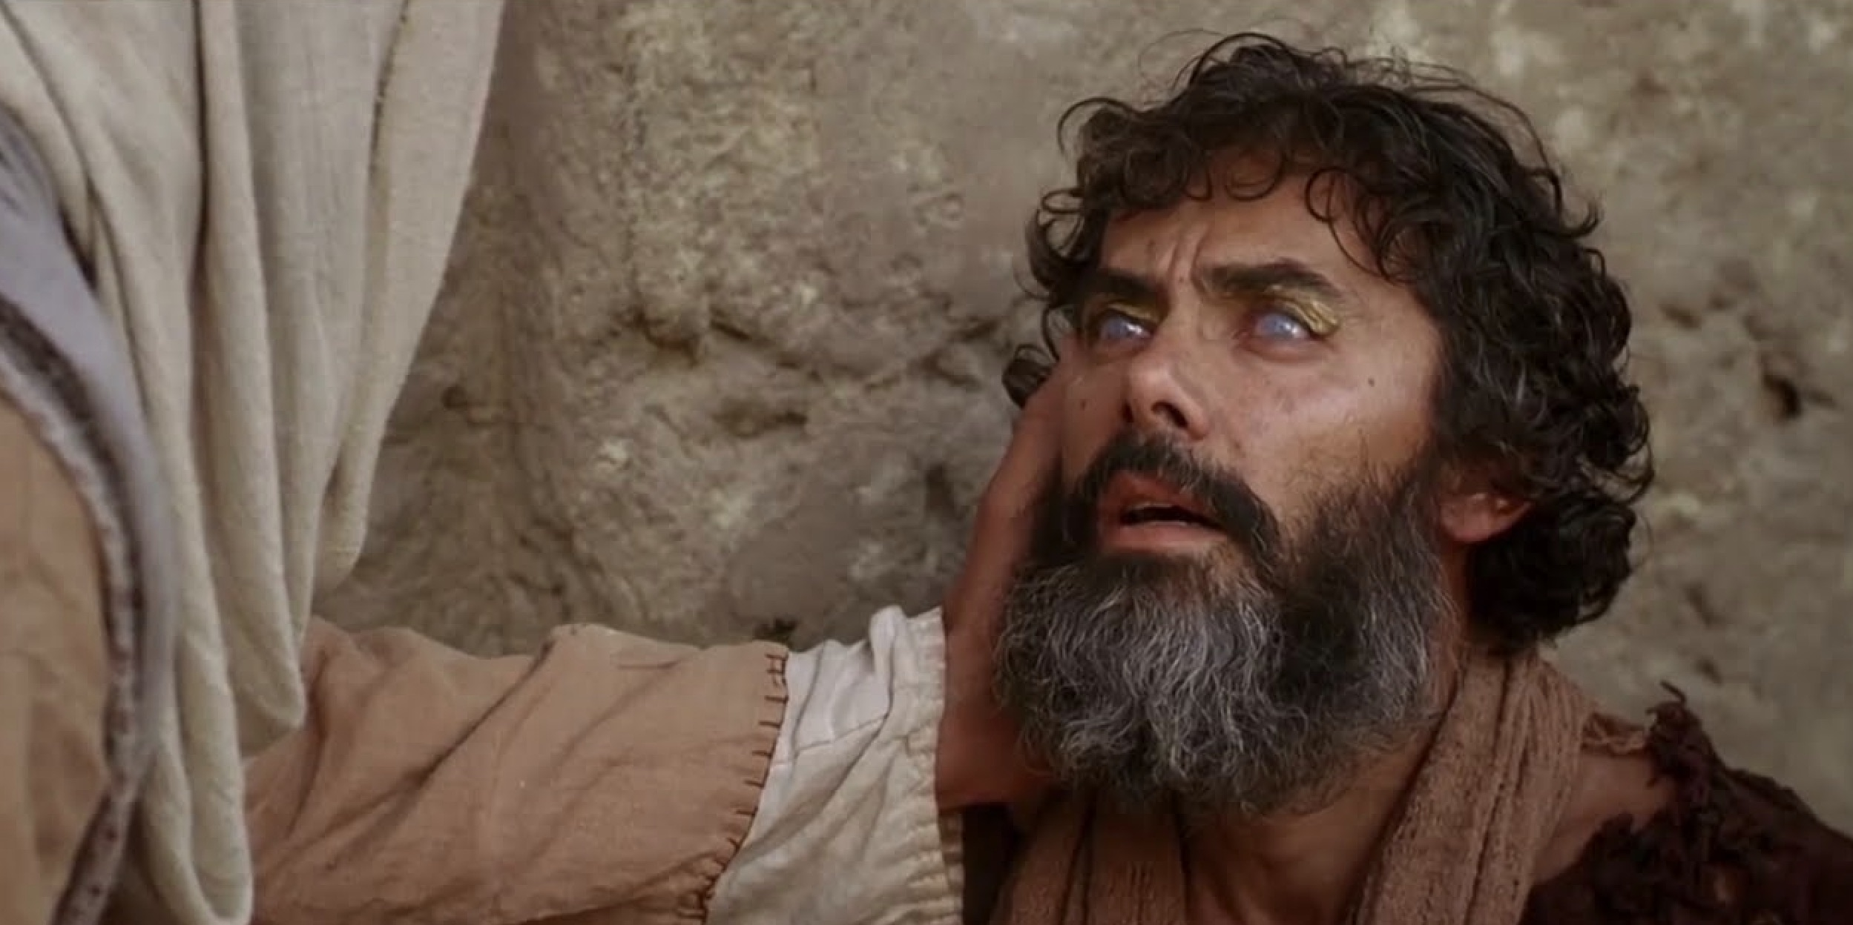
Isaiah 42:4-9 Messiah’s Ministry
Isaiah 42:4-9, Isaiah 61:1-3, Luke 4:17-21
Good news for the poor.
Freedom for the prisoners.
Healing for the sick/blind.
Release for the oppressed/from dungeons.
The favor of the Lord

Slide 74
Isaiah 42:8-17 I AM the Lord
Is 42:8-9 I announce things before they happen.
Is 42:10-17 God marches out triumphant.

Slide 75
Isaiah 44 The foolishness of idols
Isaiah 44:6-20 Idols vs YHWH
v. 6-8 I am the alpha and omega. I am the only God! Can the other “gods” foretell the future?
v. 9-20 The foolishness of idols.
v. 21-23 They make idols. I made you!
I sweep away your sins, so return to me!

Slide 76
Isaiah 44:26-45:13 I am sending cyrus
Is 44:26-28 I can call Cyrus 150 years before he is born!
Cyrus is the savior of my people. Reinhabit Jerusalem. Rebuild Judah. Restore the cities.
Confirmed by the Cyrus Cyllinder and Ezra 1:1-4
Is 45:1-7 Cyrus is a prefigure of the Messiah
Isaiah 45:9-13 The potter will raise up Cyrus.
Cyrus is the new Moses.

Slide 77
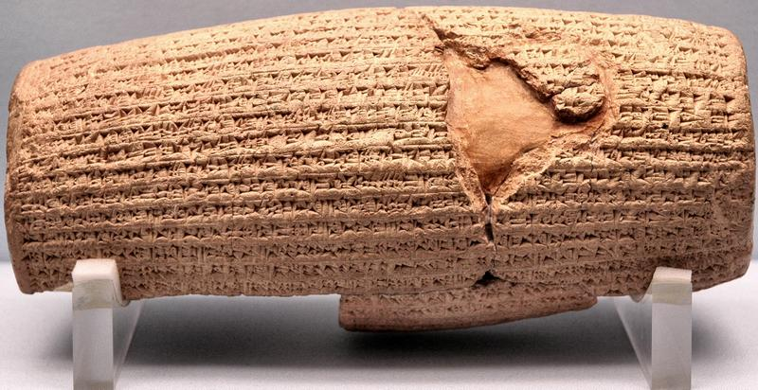
Cyrus Cylinder British Museum 535 BC
Ezra 1:2-4

Slide 78
Isaiah 49 God restores a remnant
Isaiah 49:1-13 2nd Servant Song
Is 49:1-7 I planned to send Messiah from the beginning.
What will Messiah do?
v. 5 bring Jacob back to God.
v. 6 restore the remnant of Israel.
v. 7 despised and abhorred.
v. 8 salvation… a new covenant. Restoration.

Slide 79
Isaiah 49:8-18 God’s remnant.
v. 8 restoring a remnant.
v. 9b pasture on every barren hill.
v. 10 no more spiritual hunger or thirst.
v. 10 compassion on them.
v. 10 lead them to springs of water.
v. 11 prepare a smooth road to the kingdom.
v. 12 all nations, North, South, East, West.
v. 13 comfort.
Isaiah 49:15-16 God a tender parent. Like a mother with a child at her breast. Engraved in the palm of God’s hand.

Slide 80
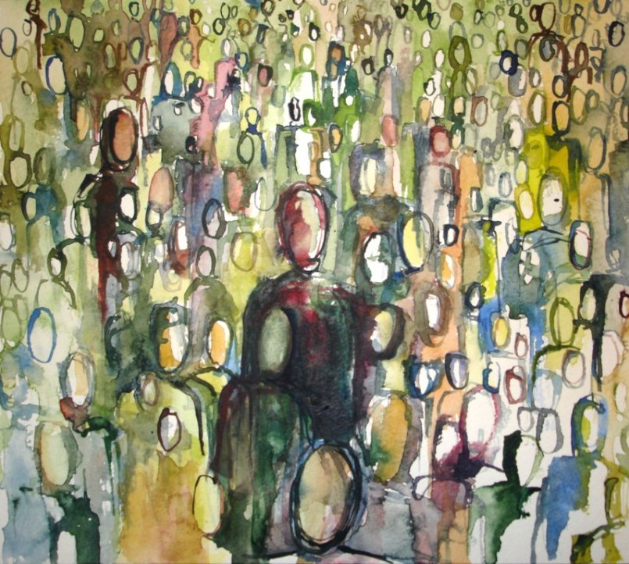
Isaiah 49:18-26 A fruitful remnant
v. 18-20 Your spiritual children are gathered around you.
v. 19-23 The barren become very fruitful.

Slide 81
Discussion Questions
1. Do you tend to see Jesus as a lamb, or do you tend to see Jesus as a lion? Explain.
2. Which picture of Jesus are you most attracted to?
Good news for the spiritually poor
Freedom from slavery to sin
Healing for the spiritually blind and sick
Released from oppression
Receive the Lord’s favor.

Slide 82
Isaiah 52-53
The Suffering Servant Comes to Save
Isaiah 52:1-6 Wake up, Zion. Shake off the dust.
v. 1 Beautiful garments. Gal 3:26 Matt 22:11-12
v. 2 Remove the bonds of slavery
v. 3 We were sold into slavery for nothing.
v. 4 We went down to Egypt or into Assyria.
v. 5 We sold ourselves for nothing.

Slide 83
Isaiah 52-53
The Suffering Servant Comes to Save
Isaiah 52:7-12 But… How beautiful are the feet of those who bring the gospel of salvation—who say “God reigns.”
Q: Do you have beautiful feet?
v. 11 Leave Egypt! Come out and be pure!

Slide 84
Isaiah 52:13-15
How will this work? Messiah will be lifted up!
John 12:32 I, when I am lifted up, will draw all men unto myself.
The path out of Egypt is the death of one more precious than silver. It is the blood of Jesus.
He will sprinkle many nations.

Slide 85
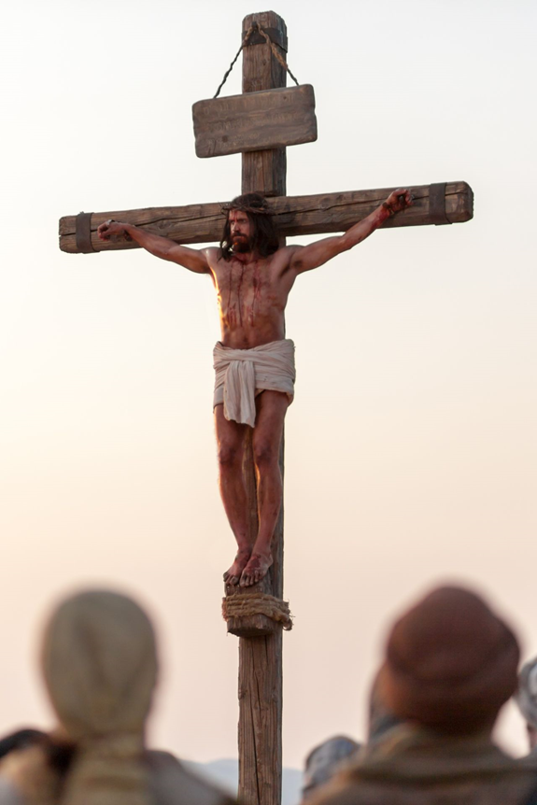
Isaiah 52:13-53:12
Servant Song #4
52:13 Messiah will be lifted up.
This is our path out of Egypt
This is the thing “more precious than silver.”
What? v. 14 Jesus being brutally beaten.
52:15 His blood will sprinkle many nations

Slide 86
Isaiah 53 Who would believe it???
Is 53:1 The arm of the Lord yet…
v. 2-3 Very human
a tender shoot…
no beauty or majesty.
despised and rejected.
Who would have believed it?

Slide 87
Isaiah 53 Who would believe it???
Isaiah 53:4-6 He took on our pain and suffering.
It was not forced on him… He took it up.
v. 4 But we got it all wrong! We couldn’t believe it!
v. 5 Cause: Our transgression → Effect: His piercing
Cause: His wounds → Effect: Our healing
v. 6 We left God but he did not leave us!!!
Could anyone have believed this?

Slide 88
Theories of redemption
Ransom Theory
Satisfaction Theory Penal Substitutionary Atonement
Ultimate Example of God’s Love
Jesus defeated the powers of the world

Slide 89
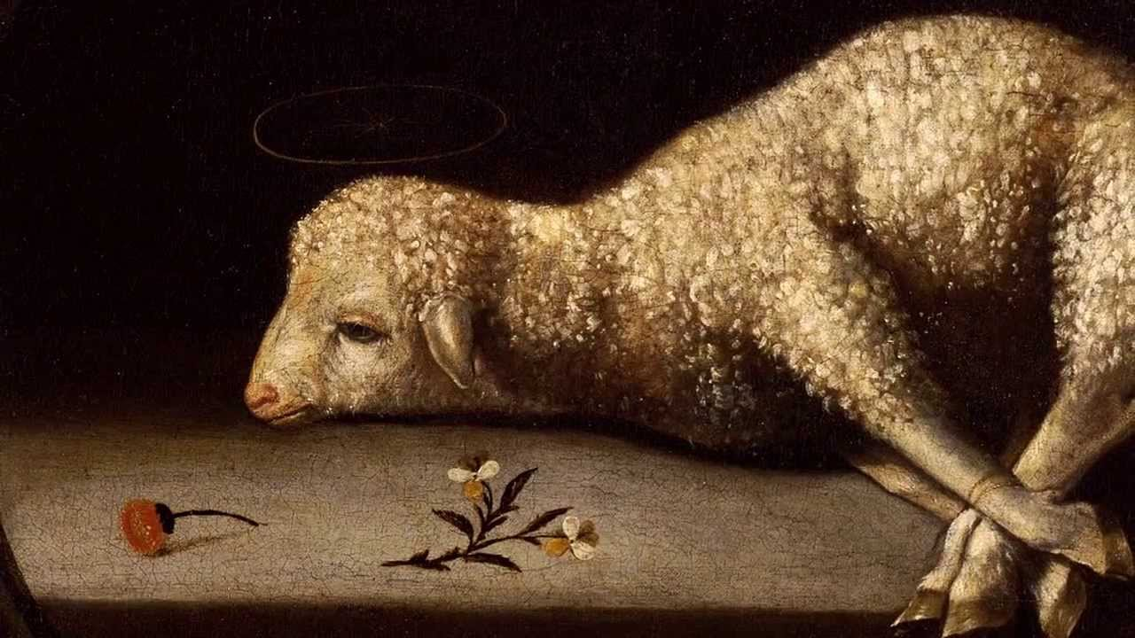
Isaiah 53:7-9 Who would have believed it?
v. 7 Led like a lamb. Was he helpless? No! A willing sacrifice. John 10:17-18
v. 9 A grave with the wicked (plural) and with the rich (singular)
v. 10 It pleased the Lord… What does that mean?

Slide 90
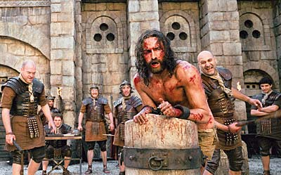
Isaiah 53:10
v. 10 It was the Lord’s will (KJV It pleased the Lord) to crush him, and to cause him to suffer.
Who would have believed that???

Slide 91
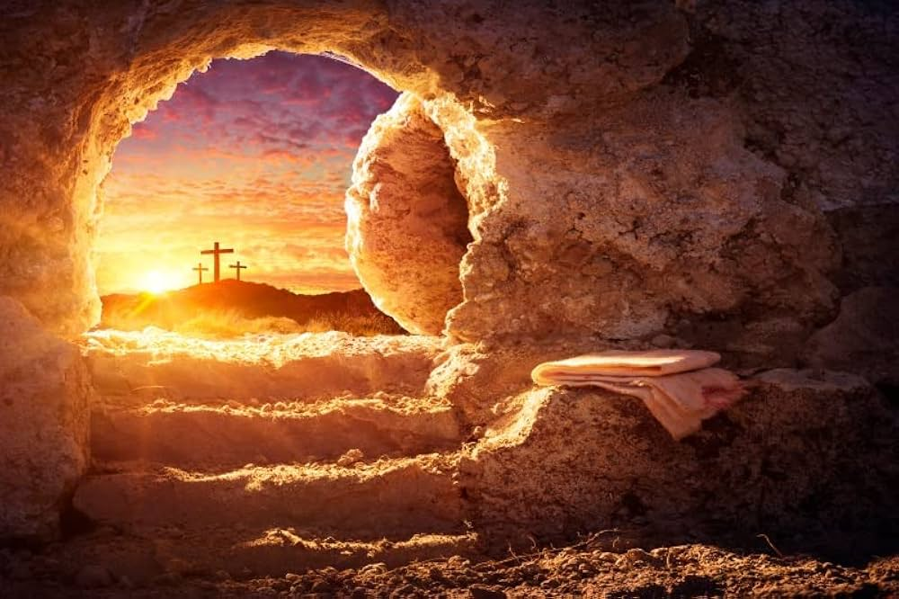
Isaiah 53:10-11
But… That is not the end of the story.
He will see his offspring (You!!!)
He will see the light of life.
Who would have believed that?

Slide 92
Isaiah 53:12
Jesus is great!!!! Why?
He poured out his life
He was numbered with the sinners.
He bore the sin of many.
He is making intercession for sinners—even now!
Who would have believed it???

Slide 93
Discussion Questions
1. “How beautiful on the mountains are the feet of those who bring good news.” Who brought the good news to you? Who had “beautiful feet” for you? Share a thought about that.
2. “Who would have believed it?” What is the most surprising thing we learn about Jesus in Isaiah 52:13-53:12?

Slide 94
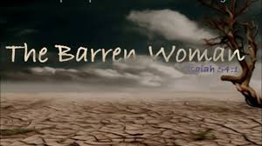
Isaiah 54
Is 54:1-3 The barren woman is the Gentiles
The one with a husband is the Jews
Sing, barren woman! More are the children of the desolate woman than of her who had a husband!
54:4-6 No more shame. Guilt-free.
54:7-15 I briefly abandoned you. Now I take you back forever.

Slide 95
One Outline of Isaiah
Isaiah 1-39 Messiah the king -Assyria
Isaiah 40-55 Messiah the Servant -Babylon
Isaiah 56-66 Messiah the Conqueror -World

Slide 96
Isaiah 55 Come to the waters
A Kingdom Prophecy
Isaiah 55:1-5 Come to the waters… Come, buy and eat.
v. 1 Come, all who are thirsty.
v. 2 Things that satisfy but cost no money.
v. 2 The richest of fare.
v. 3-5 The New Covenant
promised
eternal
Messiah as ruler
many nations

Slide 97
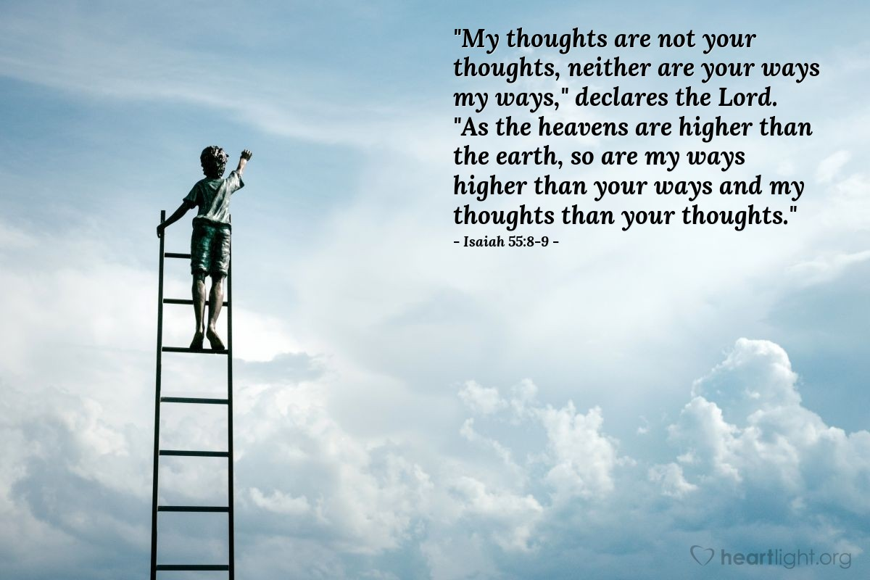
Isaiah 55:8-11 God’s ways
As the heavens are above the earth…
God’s words always accomplishes their purpose.
Even when people do not believe?

Slide 98
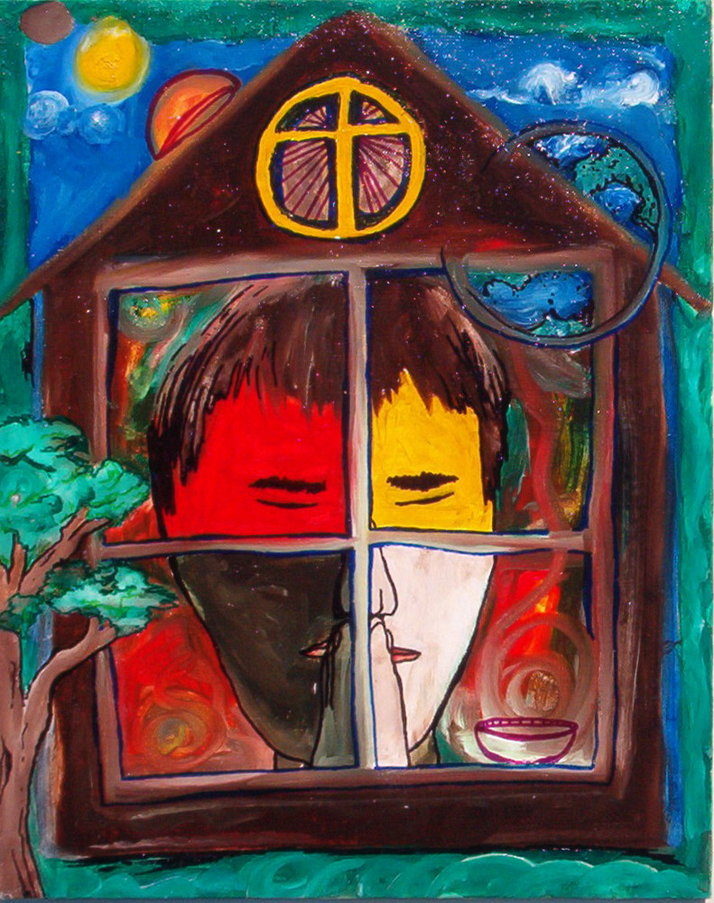
Isaiah 56:1-8 A House of prayer for all nations
Isaiah 56:1-8 Our part in the kingdom
Maintain justice
Do what is right
Even the foreigner and the eunuch will be given a new name.
My house will be a house of prayer for all nations.

Slide 99
Isaiah 57:1-2
What about those who have died?
Why do they perish?
…to be spared from evil.
…enter into peace
…find rest as they lie in death

Slide 100
Isaiah 58 godly fasting
v. 1-2 They act religious, but their religion is about self, not God.
v. 5-7 Do not act humble, be humble.
-loose the chains of injustice
-untie the cords of the yoke
-share your food with the hungry
-clothe the naked
v. 8-11 The result: blessings from God.

Slide 101
Isaiah 59 The problem is sin
v. 1-2 Can God hear our prayers? Of course he can.
Does God hear our prayers? No! God choses
not to hear.
v. 3-9 Is God exaggerating here? (Romans 3:9-18)
None is righteous. Not even one.

Slide 102
Isaiah 60 Great encouragement
Is 60:1-7 His glory appears over you.
Blessings: Sons, daughters, wealth on the seas, herds of camels, gold and incense.
Isaiah 60:10-22 Is this the Church or is this heaven?
-v. 11 foreigners will rebuild your walls
-v. 11 your gates will always stand open
-v. 13 juniper, fir, cypress
-v. 15 forsaken and hated becomes joy
-v. 16 drink the milk of nations
-v. 18 no more violence, ruin or destruction
-v. 19 God will be our light
-v. 21 only the righteous there

Slide 103
Isaiah 62 a great promise
Is 62:1-5 One of the most beautiful promises in the Bible
-a new name
-a crown of splendour
-a royal diadem in God’s hand
-Hephzibah (my delight is in her)
-Beulah (married to God)
Isaiah 62:6-7 “You who call upon the Lord give yourselves no rest, and give him no rest till he establishes Jerusalem and makes her the praise of the earth.”

Slide 104
Isaiah 65 The kingdom of god
Is 65:1-2 God is holding his hand out to an obstinate people. This was us!
But… to those who listen
Isaiah 65 17-25
-the former things will be remembered no more
-Jerusalem (the kingdom) will be a delight
-weeping will be heard no more
-no more death of the young—live to great age
-I will answer before they even call
-the wolf and the lamb will lie down together

Slide 105
Isaiah 66 A summary
Isaiah 66:9-24 A summary. What have you learned from the Book of Isaiah?
Isaiah 66:17 A stark reminder.
Isaiah 66:19 God will send a sign—the Messiah!
Isaiah 66:20 We will bring many visitors from all nations to the mountain/kingdom of God.

Slide 106
Discussion Questions
1. (Isaiah 55:10-13) What has the Word of God accomplishled in your life?
2. Sorry for such a vague question, but… What do you take home from our study of the Book of Isaiah? What is the principle impression from the book, and application for you?

