Slide 1

A Living Hope

Slide 2
1 Peter Principal Themes
A call to holy living in Christ.
“holy” 8 times
“righteous” 8 times
The Christian response to suffering and persecution.
Theme Passage: 1 Peter 4:19 “So, then, those who suffer according to God’s will should commit themselves to their faithful Creator to do good.”

Slide 3
Things To Look For in 1 Peter
The glory of God.
2. The sovereignty of God. (“according to God’s will)
The suffering of Christ.
Our suffering.
The call to holy living.
This is our outline!

Slide 4
1 Peter 1:1-2
Who am I? Who is Peter writing to?
I am an elect exile. A scattered, elect, exile.

Slide 5
Exiles…
parapidemos other-walkers exiles, sojourners, temporary residents.
Phil 3:20 Our citizenship is in heaven.
Life in the kingdom is like living on a bridge…

Slide 6
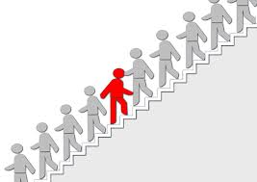
Elect Exiles
elektos
Chosen by God’s foreknowledge
By His Holy Spirit

Slide 7
1 Peter 1:3-5 A Living Hope
1 Pet 1:3 A living hope is one which is not only alive, but which is growing.
The source of that hope: The resurrection of Christ!
Colossians 1:18 The firstborn from the dead.
1 Corinthians 15:20 Firstfruits
Your inheritance is waiting for you. Like a trust fund.
It is waiting to be revealed. John 14:1-4

Slide 8
1 Peter 1:6-9
But… The Christian life is not all puppy dogs, roses, peaches and cream.
“All kinds of trials.”
Two things, though…
Suffering is temporary, joy is continual and eternal.
The suffering is very good for you!

Slide 9
1 Peter 1:6-9
A very important question for you:
Can you rejoice in trials?
Gruden: “Simultaneous grief and joy are a normal in the Christian life.”

Slide 10
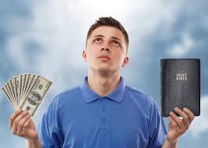
Faith Produced by Trial vs Gold
Even the most stable of all elements will perish.
But not your inheritance with God!!!
Besides, you are receiving the end result of your faith, even now!!!

Slide 11
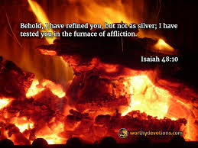
1 Peter 1:6-9
Gruden: “Trials have the effect of burning off the impurities in the believer’s faith.”
Is 48:10 I have tried you in the furnace of affliction.

Slide 12
1 Peter 1:10-12
Peter: Oh, and one more thing…
The prophets foresaw these things and were jealous of us.
Sufferings of Christ: Ps 22:1, Is 52:14-15, Isaiah 53, Zechariah 12:10
Glories of Christ: Ps 16:10-11, Is 40:5, Is 42:1-4, Is 53:11, Dan 7:13-14

Slide 13
1 Peter 1:13-14 Therefore…
Because…
We have a living hope.
We have an eternal inheritance waiting for us.
Even our trials are producing a faith which will produce glory and honor when Jesus is revealed.
We are even now receiving the salvation of our souls.
And all of this was foretold by the prophets.

Slide 14
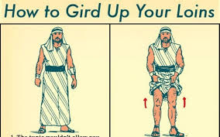
Therefore…
Set your minds = Gird your loins

Slide 15
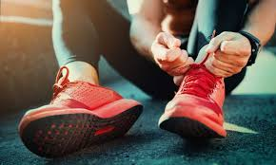
Set Your Mind
For what?
v. 14 For holy living. DO NOT CONFORM to this world.

Slide 16
Summary
We have a living, growing hope.
It will not fade, spoil or perish.
It is guarded in heaven.
Trials will come, but they will be temporary.
These trials will prove your faith, and produce ever more praise, glory and honor.
The prophets and angels are jealous of us!
So… Prepare your minds for action!

