Slide 1

Submit Yourselves

Slide 2
1 Peter Principal Themes
A call to holy living in Christ.
“holy” 8 times
“righteous” 8 times
The Christian response to suffering and persecution.
Theme Passage: 1 Peter 4:19 “So, then, those who suffer according to God’s will should commit themselves to their faithful Creator to do good.”

Slide 3
Things To Look For in 1 Peter
The glory of God.
2. The sovereignty of God. (“according to God’s will)
The suffering of Christ.
Our suffering.
The call to holy living.

Slide 4
Two Weeks Ago: 1 Peter 2:1-25
v. 9-10 We are a holy people, a royal priesthood a people of God.
But. v. 11 This means that in this world we are foreigners and exiles. paroikous and parapideimous other-homed and other-walkers. We are sojourners. This world is not our home!!!
Therefore v. 12 Live such good lives, that the people of the world will see your good deeds and become Christians!

Slide 5

Follow the signs!

Slide 6
1 Peter 2:13, 1 Peter 2:18, 1 Peter 3:1
Submit yourselves.
How do you feel about that?

Slide 7
Submit Yourselves
To what/whom?
1. To governing authorities.
2. To masters/bosses/professors.
3. To husbands.
4. To church leaders.
5. To sufferings and persecutions.

Slide 8
1 Peter 2:13-17
Submit yourselves for the Lord’s sake…
Why?
Because they have a God-given role to play. (v. 14)
Because it is God’s will that we do so. (v. 15)
3. Because, in doing so, we will “silence the talk of foolish people.” (ie. help people to be saved) (v. 15)

Slide 9
But what if the governing authority behaves badly?
1 Peter 2:16 Live as free people… live as God’s slaves.
Gal 5:1, 13 Do not use your freedom to indulge the flesh.

Slide 10
Submit yourselves, for the Lord’s sake, to every human authority.
We make ourselves voluntary slaves.
But… What does it NOT mean?
1. Submit to the authority when you are told to sin or to disobey God. Acts 4:18-20
Or when it requires you violating your conscience.
But… watch your heart Acts 16:37

Slide 11
1 Peter 2:18-25
Slaves… Submit yourselves to your masters.
Application:
Employees, submit yourselves to your managers/bosses.
Students, submit yourselves to your professors

Slide 12

Why? What if he/she is unjust?
1 Peter 2:19 “For it is commendable if someone bears up under the pain of unjust suffering, because they are conscious of God.
Because we believe that God is sovereign.

Slide 13
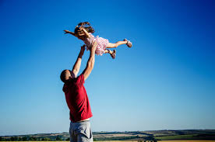
v. 21 To this you were called
To what?
To suffer for doing good, and to endure it.
v. 23 Jesus entrusted himself to God

Slide 14
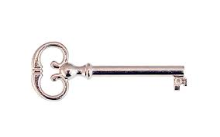
Do you trust God in such things?

Slide 15
Submit yourselves to bosses and professors
What it does NOT mean:
1. Not if they require you to sin, or to violate your conscience (but watch your heart)
2. It does not mean you cannot look for another job, or drop the course, or seek justice for others.

Slide 16
Summary
Submit yourselves to every governing authority for the Lord’s sake.
Submit yourselves to bosses, managers, teachers and others who are over you.
Why? Because, like Jesus, you are entrusting yourself to God.

