Slide 1

1 Peter IX
Suffering for Christ

Slide 2
Themes in 1 Peter
The glory of God.
2. The sovereignty of God. (“according to God’s will)
The suffering of Christ.
Our suffering.
The call to holy living.

Slide 3
1 Peter 3:18-22 Baptism Now Saves You
For Christ also suffered once for sins, the righteous for the unrighteous, to bring you to God. He was put to death in the body, but made alive in the [Holy] Spirit.

Slide 4
A paraphrase
Jesus was made alive in the [Holy] Spirit. In which also, as a prefigure, through Noah, he preached to the disobedient persons who are now imprisoned spirits—to those who were disobedient long ago, when God waited patiently in the days of Noah, while the ark was being built.
Christ, as a prefigure, through the Holy Spirit, spoke through Noah to the disobedient as he speaks to the disobedient today through us!

Slide 5
1 Peter 3:21-22 The flood as a prefigure of baptism
This water (the water of the flood of Noah) is a symbol of the water of baptism that now saves you.
Baptism saves you.
How? By the resurrection (remember 1 Peter 3:18)

Slide 6
1 Peter 3:22 It is a done deal!!!
Christ, the firstborn from the dead, is now in heaven, at God’s right hand.
Through Noah, Christ preached to those who disobeyed, and through the faith of Noah, eight were saved by faith.
Through us, Christ will preach to the disobedient, and through our and their faith, they will be saved.

Slide 7
1 Peter 4:1-2 Therefore.
Because you have participated spiritually in the death and resurrection of Christ, and since Christ suffered in his body, be prepared to suffer as he did.
Peter returns to his theme!
Have the same attitude toward persecution and suffering as Christ. Hebrews 12:2 Jesus “scorned the shame.”

Slide 8
Do you want to be “done” with sin?

Slide 9
1 Peter 4:3-6
Aren’t you fed up with sin? I hope so!
Our friends heap abuse on us while we are busy building the ark—which is the only thing that will save them when judgment comes!
They ask: How do you do it?

Slide 10
1 Peter 4:7-11
Is Peter changing the subject?
Two things needed to endure the scorn of others:
1. Arm yourself with the same attitude toward persecution as Christ.
And
2. Take strength from the family of God.

Slide 11
Family Matters
1. A no-brainer: Love one another deeply.
2. Be family: Offer hospitality.
3. Find purpose and meaning through using your gifts to serve God’s people and others as well.

Slide 12
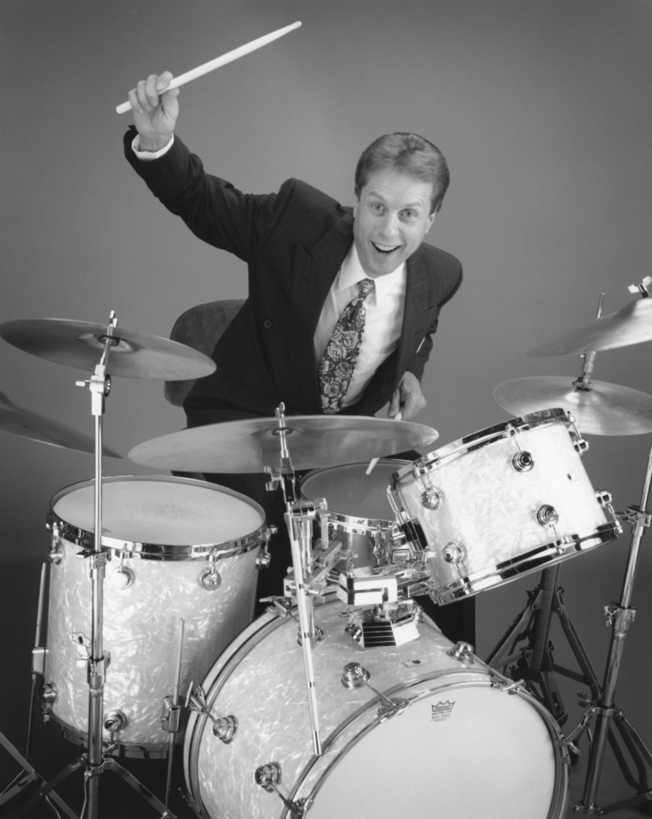
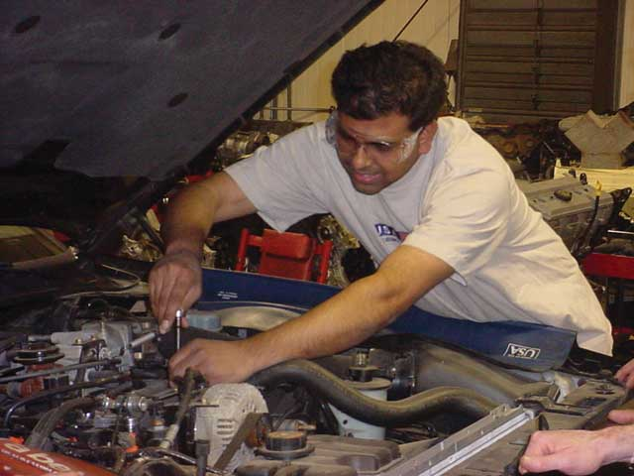
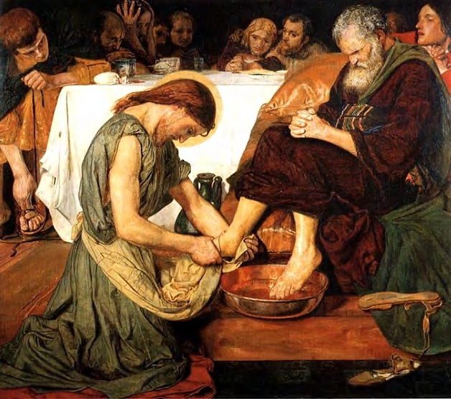
What is Your Gift?
Ephesians 2:10

Slide 13
Discussion
1. What is/are your gift(s)? How will you use them?
If you know your partner…
2. What gift to you feel your partner has? How can he/she use it?

Slide 14
Remember the context…
The context is interacting with a world which is not exactly supportive of our purpose and mission.
1 Peter 4:12 The fire that refines, not the one that destroys.

Slide 15
Just Two Points Today!
Have the same attitude toward those who abuse you and toward your suffering in general as that of Christ.
Be family. Find and offer safety withing the church.

