Slide 1

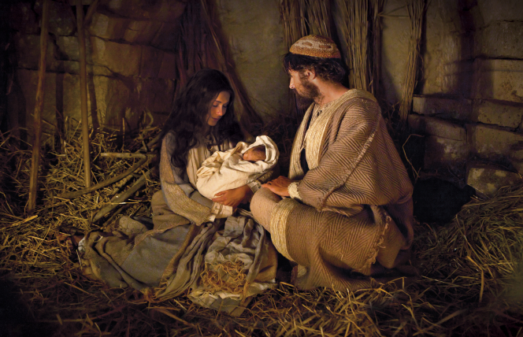
A Savior is Born
Luke 2:1-21

Slide 2
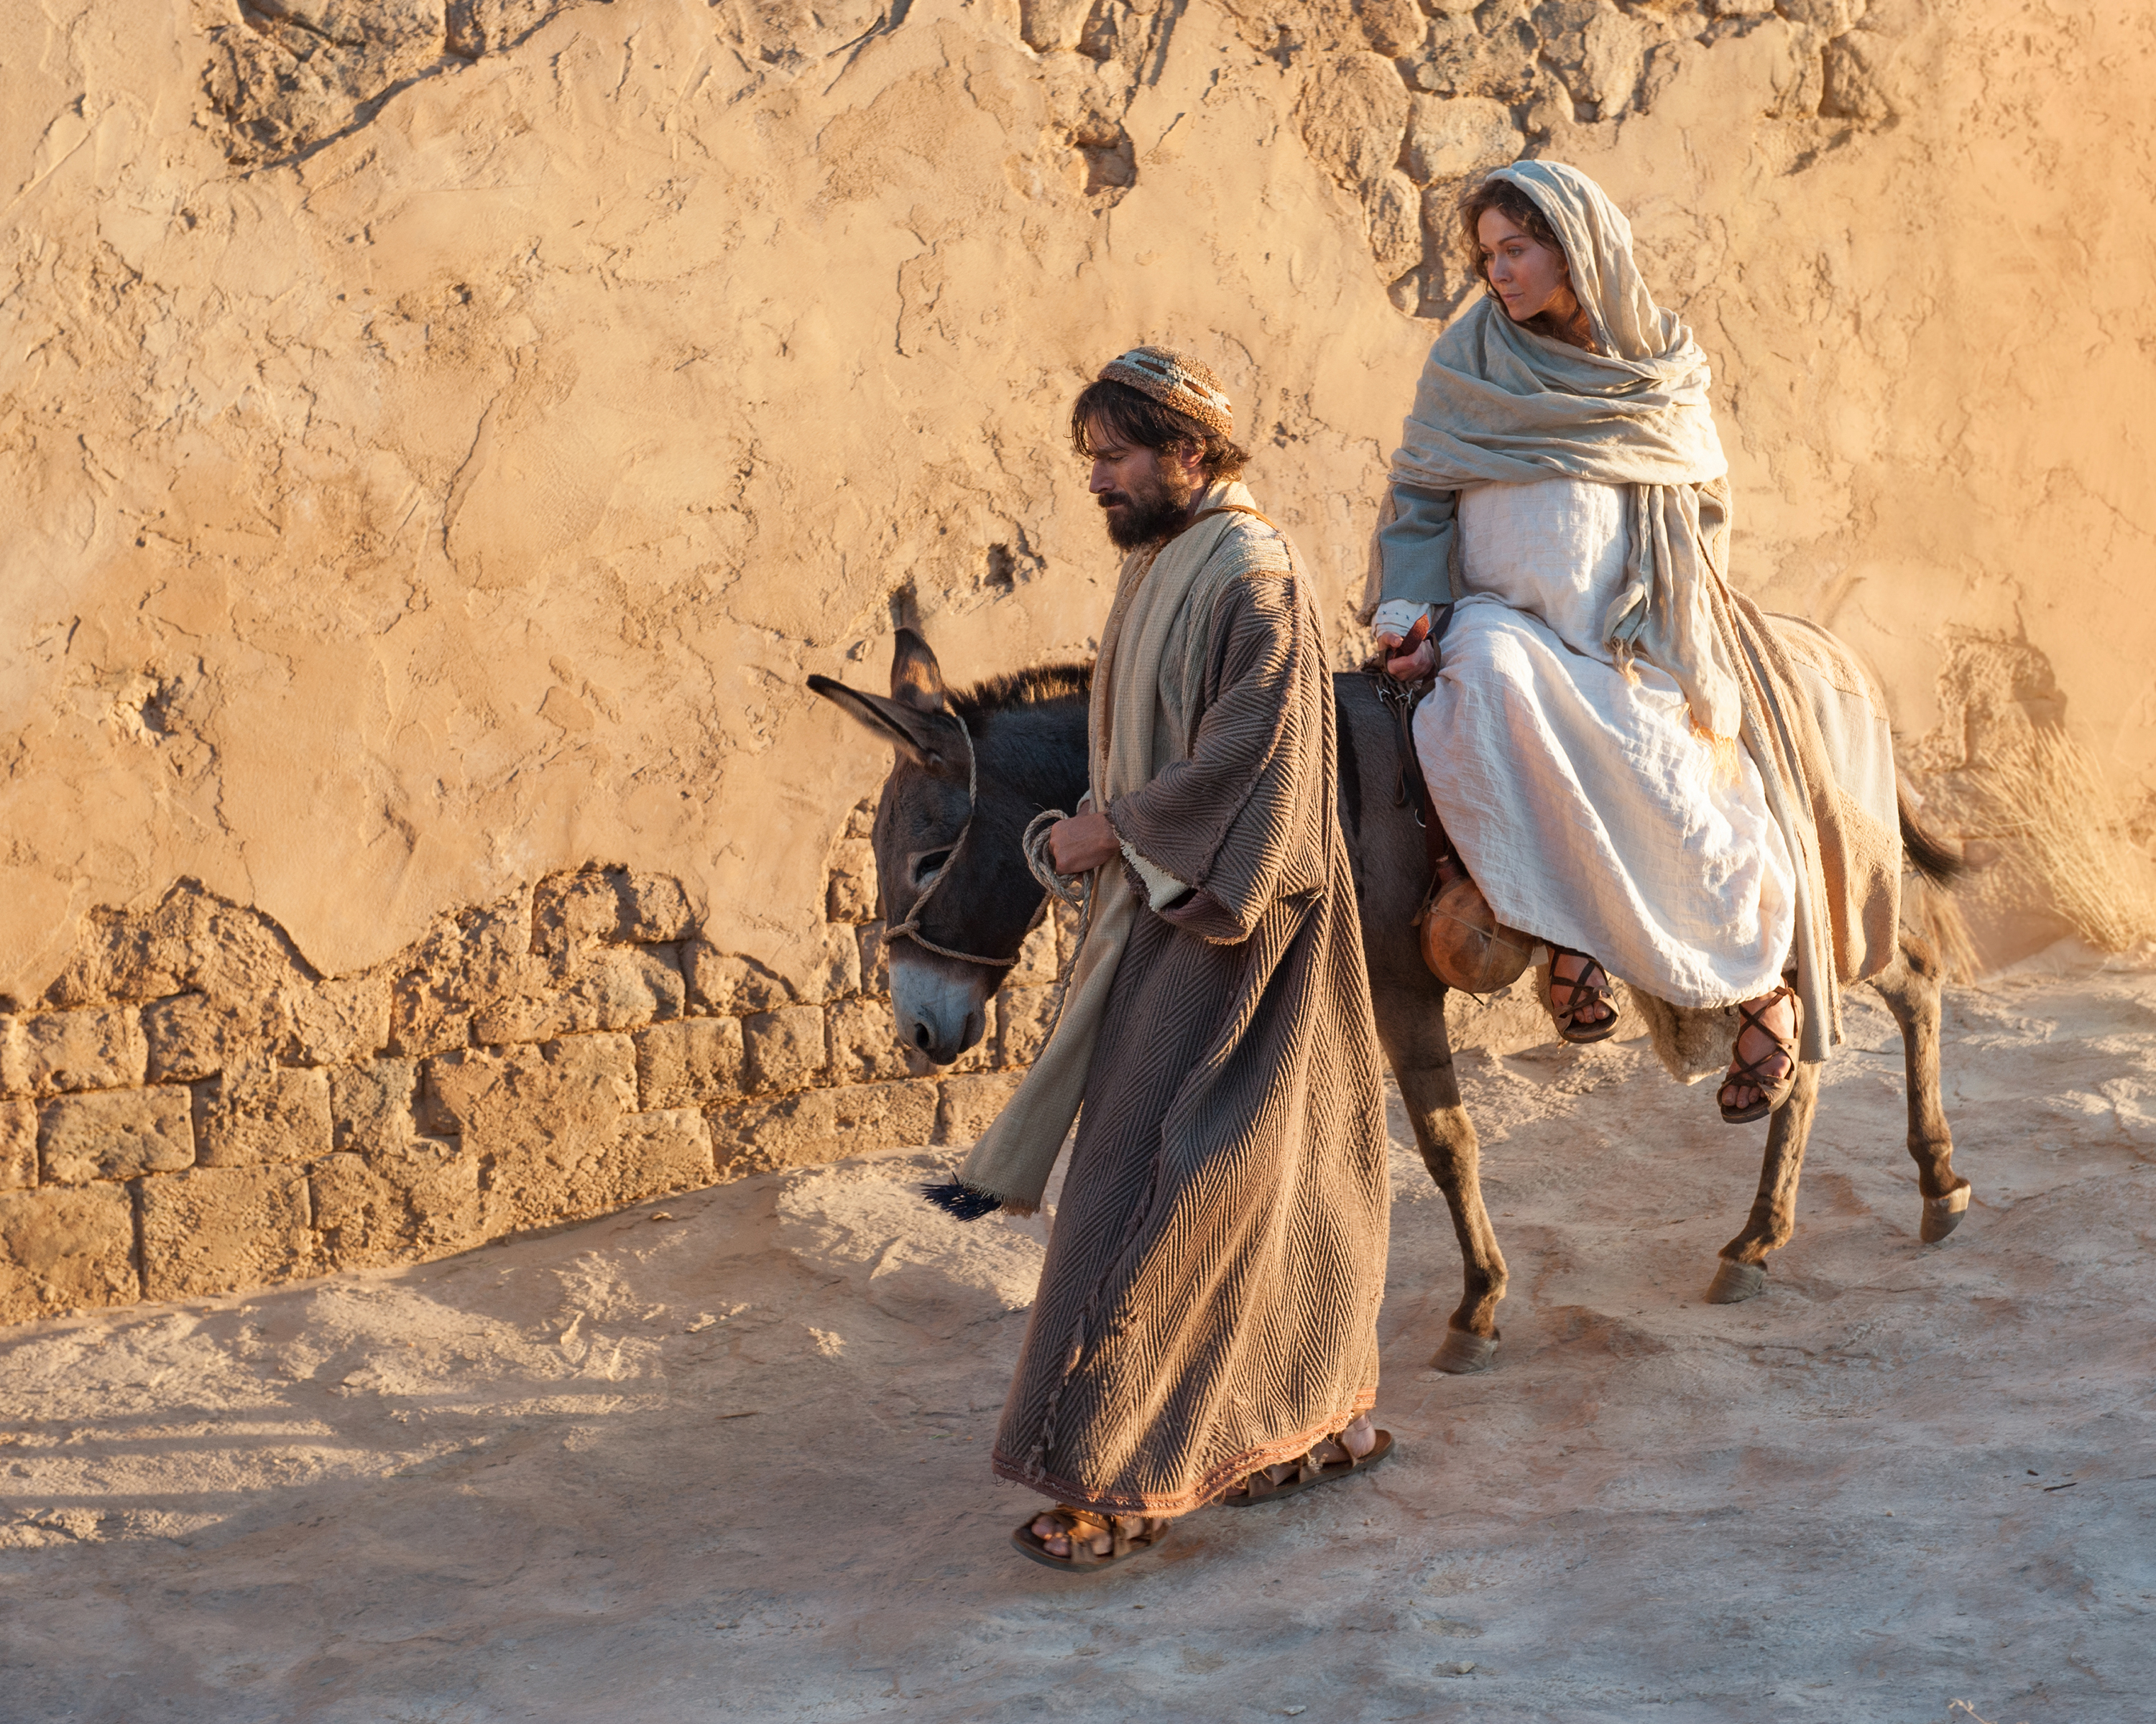
Luke 2:1-6 Joseph and Mary went up to Bethlehem for the census.

Slide 3
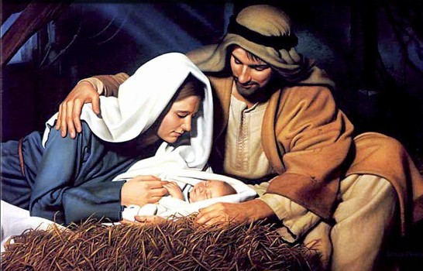
Luke 2:6-7 A Savior is born
A messiah is born.
A king is born.
A Savior is born.
No room at the
Inn….

Slide 4
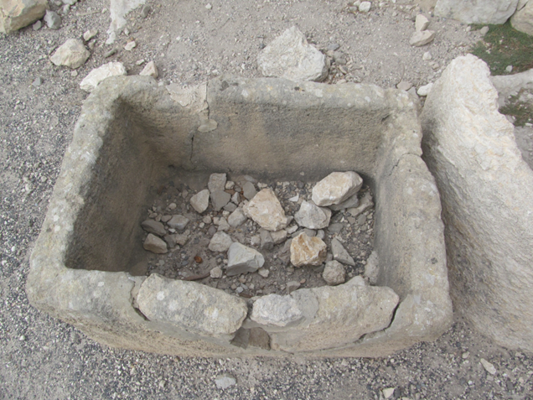
Luke 2:6-7 A Savior is born
Lying in a manger
No room at the
Inn….
A manger in Megiddo

Slide 5
Luke 2:6-7 A Savior is born
A messiah is born.
A king is born.
A Savior is born.
No room at the
Inn….

Slide 6
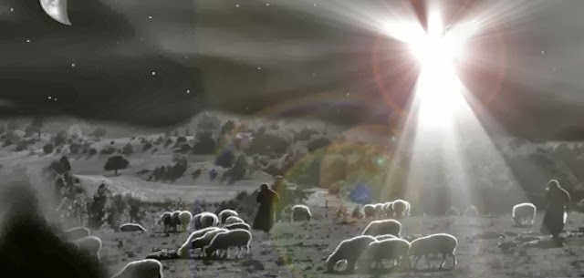
Luke 2:8-15
Good news that will cause great joy announced to shepherds
Today in the town of
David a Savior has
has been born to you.
He is ;;the Messiah,
the Lord.

Slide 7
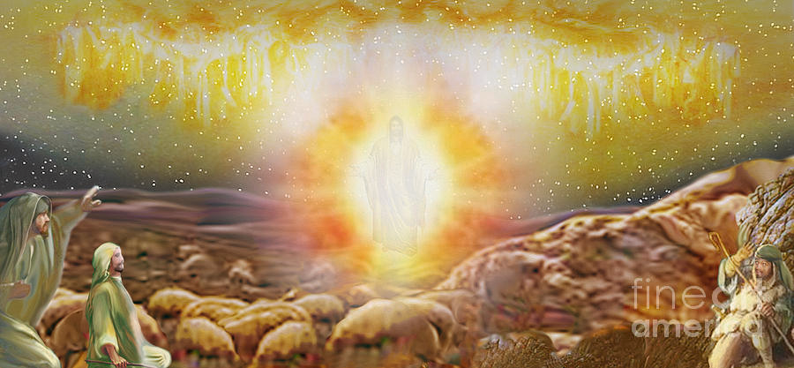
Glory to God in the highest heaven,
and on earth, peace to those on whom his favor rests.

Slide 8
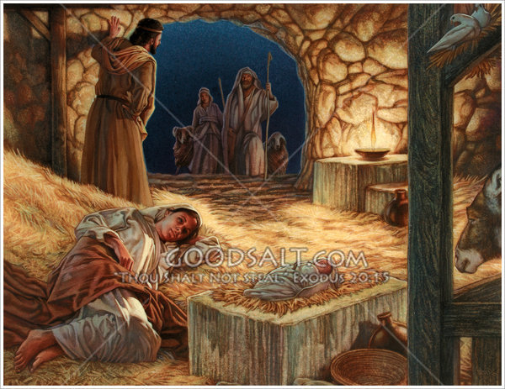
Luke 2:16-20 The King of kings and Lord of lords is lying in a feeding trough
The shepherds returned, glorifying God. Let us glorify the Lord, Jesus!

Slide 9
Isaiah 9:6-7
“For to us a child is born, to us a son is given
And the government will be on his shoulders,
And he will be called Wonderful Counselor, Mighty God, Everlasting Father, Prince of Peace….
He will reign in David’s throne and over his kingdom establishing it an upholding it with justice and righteousness from that time on and forever….
To us a Savior is born…

