Slide 1
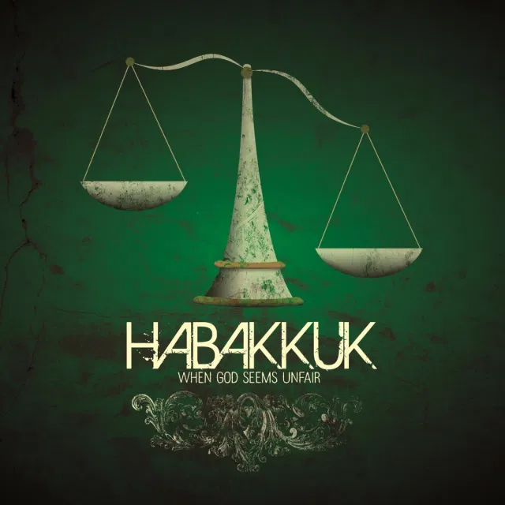
Habakkuk: Is God Faithful?
Is it OK to question God?

Slide 2
Background to Habakkuk
About 607 BC Just before Nebuchadnezzar and Babylon come to Jerusalem.
Isaiah 39:5-7 90 years earlier. All will be carried off to Babylon.
605 BC Hostages to Babylon
597 BC 10,000 captives.
586 BC Jerusalem and the temple destroyed. All Judah goes into captivity.

Slide 3
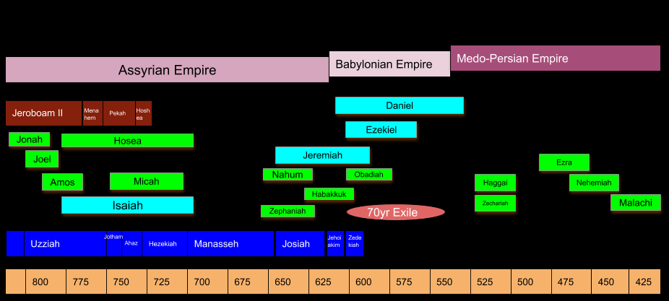

Slide 4
Theodicy
Theodicy: The vindication of divine goodness and providence in view of the existence of evil.
Does God still love us?
Has God abandoned us?
Are we still his people?

Slide 5
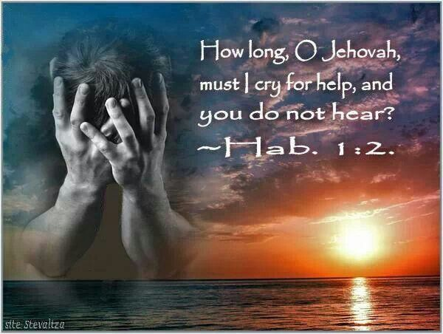
Habakkuk 1:1-4 First Complaint
How long must I call for help?
Why do you make me see injustice?
The righteous are not defended.

Slide 6
Habakkuk 1:5-11 God’s first answer
v. 5 I am going to do something in your days that you would not believe, even if you were told. I am raising up the Babylonians, that ruthless and impetuous people.
Will God use bad people and institutions to bring about his will in our lives?

Slide 7
Habakkuk 1:12-2:1 Second Complaint
I get that you are holy and do not tolerate sin.
But… What about the sin of the Babylonians?
v. 15 What about the fat-cat wicked? He enjoys the choicest food…

Slide 8
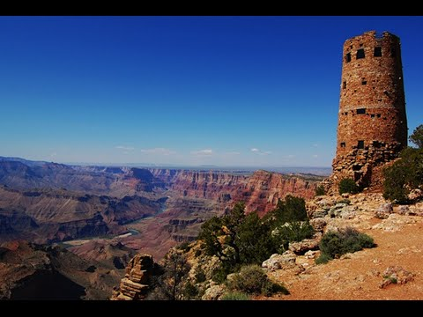
"I will stand on my guard post, and station myself on the rampart; And I will keep watch to see what He will speak to me, And how I may reply when I am reproved.” Habakkuk 2:1

Slide 9
Habakkuk 2:2-4 God’s Second Response
v. 2 You can mark it down.
v. 3 There is an appointed time. “the end.”

Slide 10

Habakkuk 2:4 The Key
My righteous person will live by his faithfulness.
Romans 1:17, Galatians 3:11, Hebrews 10:38

Slide 11
Habakkuk 2:4-19
Justice Will Be Done In The End
Five Woes in Habakkuk 2
Greed (2:6-8)
Exploitation (2:9-11)
Violence (2:12-14)
Immorality (2:15-17)
Idolatry (2:18-20)

Slide 12
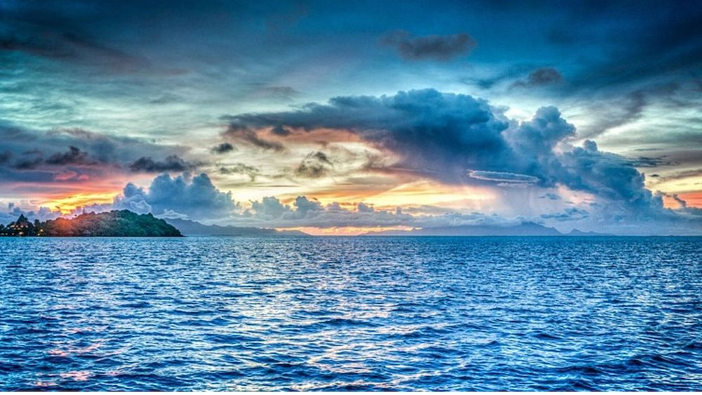
Habakkuk 2:13-14
For the earth will be filled with the knowledge of the glory of the Lord as the waters cover the sea.

Slide 13
Habakkuk 2:15-19
v. 15 Woe to him who gives drink to his neighbors.
v. 18 Of what value is an idol carved by a craftsman? Can it give guidance?

Slide 14
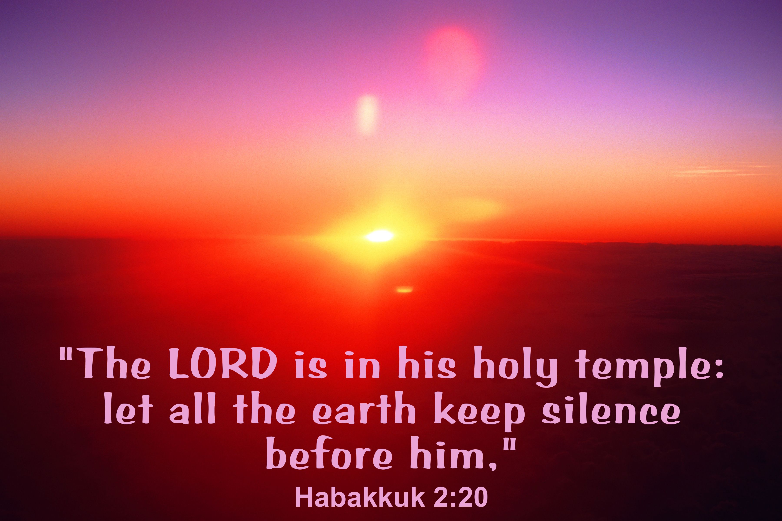
Habakkuk 2:20

Slide 15
Habakkuk 3:2-16
Habakkuk’s Final Response
v. 1 I stand in awe of your deeds.
v. 3 His glory covers the heavens and fills the earth.
v. 3 His splendor is like the sunrise.
v. 8 He rides his horses and chariots to victory.
v. 13 You come to deliver your people.

Slide 16
Habakkuk 3:17-19
Though the fig tree does not bud and there are no grapes on the vines,
Though the olive crop fails, and the fields produce no food,
Though there are no sheep in the pen and no cattle in the stalls,
Yet, I will rejoice in the Lord, I will be joyful in God my Savior.
The sovereign Lord is my strength!

Slide 17
Habakkuk: Conclusion
1. It is OK to question God’s justice, his mercy, and even his love for us.
2. When we do question God, we need to hold on to our faith in his providence.
3. We need to be patient—to wait for God to act in his own time.
4. We need to doubt our doubts and claim the promises of God.
The righteous will live by faith!

Slide 18
Discussion Questions
1. Have you ever questioned God? Over what thing that He did or that happened to you or to others?
2. God says that he will judge all in the end. Is that good enough for you, or do you to pursue your own vindication, or want God to judge now?

