Slide 1
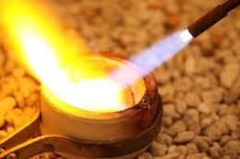
1 Peter X
A Fiery Ordeal

Slide 2
Themes in 1 Peter
The glory of God.
2. The sovereignty of God. (“according to God’s will)
The suffering of Christ.
Our suffering.
The call to holy living.

Slide 3
1 Peter 4:1-2 Therefore.
Because you have participated spiritually in the death and resurrection of Christ, and since Christ suffered in his body, be prepared to suffer as he did.
Have the same attitude toward persecution and suffering as Christ. It is totally worth it!

Slide 4
Do you want to be “done” with sin?
Our friends heap abuse on us while we are busy building the ark—which is the only thing that will save them when judgment comes.

Slide 5
1 Peter 4:7-11
Two things needed to endure the scorn of others:
1. Arm yourself with the same attitude toward persecution as Christ.
And
2. Take strength from the family of God.

Slide 6
Family Matters
1. Love one another deeply.
2. Be family: Offer hospitality.
3. Find purpose and meaning through using your gifts to serve God’s people and others as well.

Slide 7
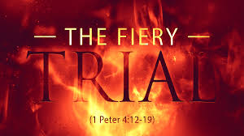
This Week 1 Peter 4:12-5:9
A Fiery Ordeal

Slide 8
1 Peter 4:12-19 A Fiery Ordeal
A fire which refines, not one that destroys.
Do not be surprised. Rejoice! Colossians 1:24
If (when) you are insulted for the name of Christ, carry the name proudly!!!

Slide 9
Where Does God’s Judgment Begin?
God is judging you and I even now.
How? Through suffering and persecution.
Ezekiel 9:1-6 Malachi 3:1-5

Slide 10
So… What Should I Do?
1. Entrust yourself to God’s sovereign will.
2. Continue to do good.

Slide 11
1 Peter 5:1-4 And Speaking of God’s Refining Fire…
Leaders… Set an example of having the same attitude as Christ toward suffering.
And
Shepherd God’s people with gentle firmness.

Slide 12
A Little Aside
1 Peter 5:1-5
elder (presbuteros)
= shepherd, pastor (poima)
= overseer, bishop (episkopos)

Slide 13
1 Peter 5:5-7
Likewise, those who are younger (members?)…
Clothe yourselves with humility.
Submit yourselves to your elders.
Take their advice!!!
Let GOD lift you up, not yourselves.
Do you want God opposing you?

Slide 14

The Key
Cast all your anxieties on God. Rely on Him!
But also, be alert! Don’t get caught sleeping at the switch.

Slide 15
Summary
A fiery ordeal is coming. Mark it down.
Don’t be surprised!
Two things:
Entrust yourself to God and to his will.
Continue to do good.
Leaders lead and serve in humility
All: Cast all your anxieties on God!

