Slide 1
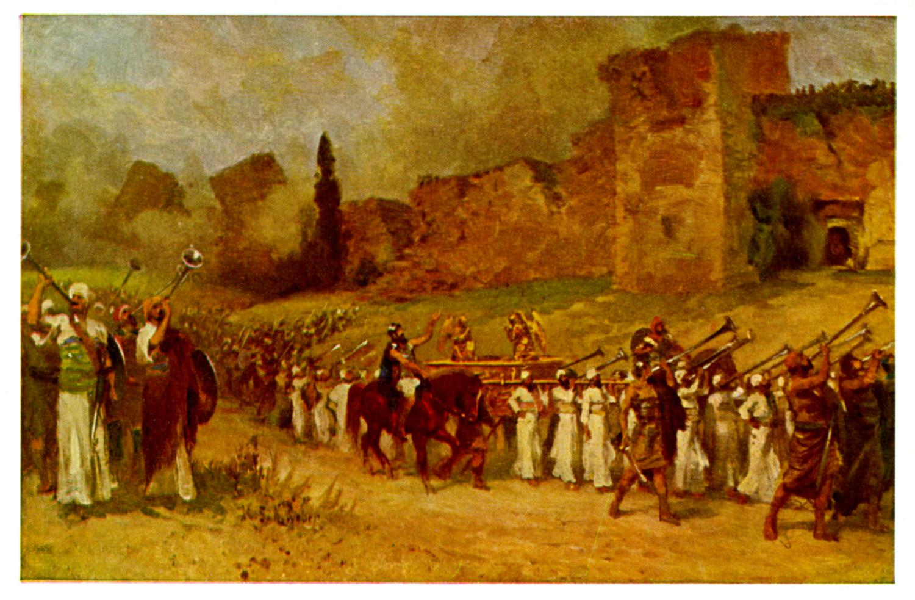
The Book of Joshua

Slide 2
Background to Joshua
Three ways of thinking about Joshua:
1. A Historical Book (Joshua, Judges, 1,2 Sam, 1,2 Kings)
2. The completion of Deuteronomy (Hexateuch)
3. A book about godly leadership

Slide 3
Joshua and Godly Leadership
More than any other biblical book, Joshua is about leadership of God’s people.
Deuteronomy: Preparation to lead God’s people
Performed tasks under mentorship
Proved loyal to God’s Word
Recognized by the people as a qualified leader

Slide 4
Theme Passage
Joshua 1:6 Be strong and courageous, because you will lead these people to inherit the land I swore to their ancestors to give them.
The land is yours, now go and take it.
Receiving the Promised Land is an event.
Taking it is a process. Already but not yet.

Slide 5
Joshua as History
Joshua 15:14 Sheshai, Ahiman and Talmai
Joshua Ch 1-3
29 cities
10 persons
17 “peoples”
Ex: The Hittites

Slide 6
Are the Hittites a real people?
Mentioned 47 times in the Old Testament.
In Joshua and Judges the Hittites appear to be the other dominant power in Canaan other than Egypt.
19th century: Historians claim the Hittites (and Hivites, Jebusites, Girgashites, Gibeonites…) were an invention of 5th century BC Jewish writers.

Slide 7
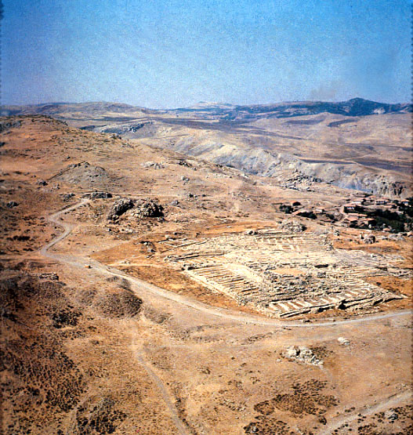
1906
Hugo Winkler
Ruins of Hattusha, capital of the Hittites

Slide 8
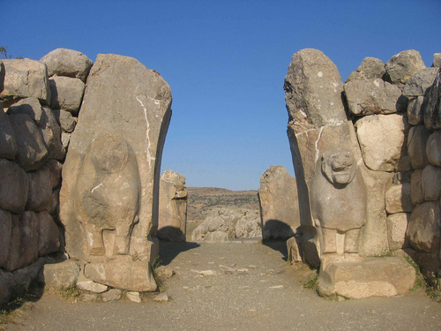
The Lion Gate in Hattusha

Slide 9
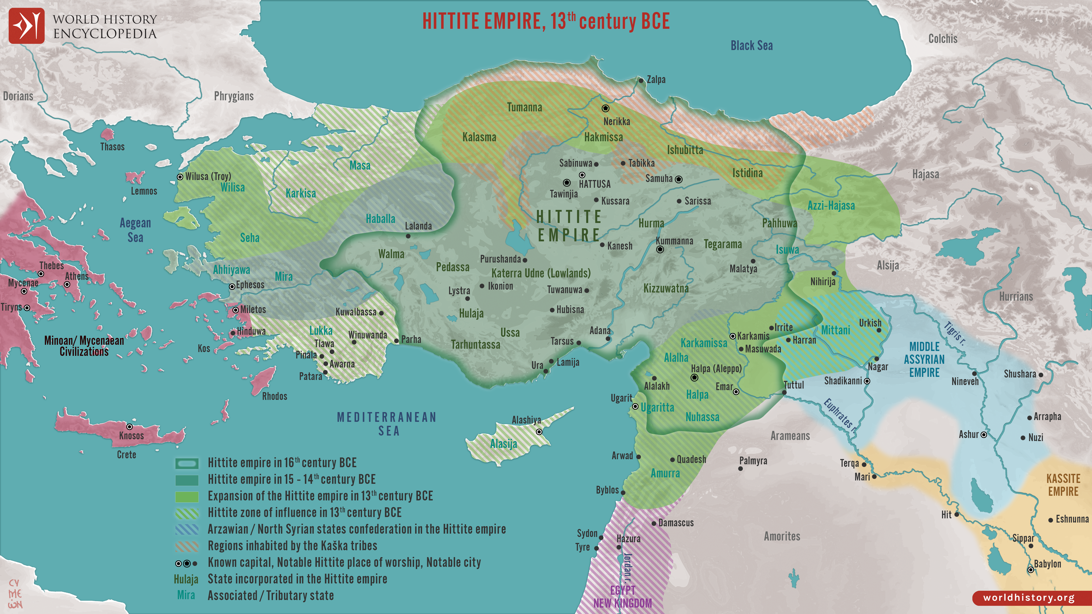

Slide 10
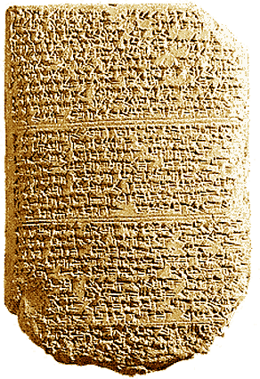
‘The Habiru plunder all lands of the king. If archers
are here this year, then the lands of the king, the
lord, will remain; but if the archers are not here,
then the lands of the king, my lord, are lost.’
Tel El Amarna Letters c. 1400 BC

Slide 11
Joshua as History
Conclusion: “The Book of Joshua is a contemporary historical account of actual events, which lends strong credence, both to the historical reliability of the Bible, and to the miraculous events recorded in the book.”
John Oakes
☺

Slide 12
Prefigures and Foreshadows in Joshua
Joshua is the New Moses.
Joshua is a prefigure of Christ.
Jeshua/Jesus The Lord Saves
The Jordan River is the new Red Sea

Slide 13
Foreshadows
Exodus – Deuteronomy:
Egypt = Slavery, lost
Wilderness = Disciple, saved
Promised Land = Heaven
Red Sea = baptism, when you were saved
Moses as messianic prefigure
Joshua-2 Kings
Egypt = Slavery, lost
Canaan = Disciple, saved
Heaven = Heaven
Jordan River = baptism, when you were saved
Joshua as messianic prefigure

Slide 14
Joshua I Be Strong and Courageous
Joshua 1:1-5
“After the death of Moses. Connects with Deuteronomy
Luke: Coming to Jerusalem.
Acts: Leaving Jerusalem.
Deuteronomy: Coming to the Jordan
Joshua: Crossing the Jordan, taking the land

Slide 15
Outline of the Book of Joshua
v. 2 Crossing the Jordan Ch 1-5
v. 3 Conquering the land Ch 6-12
v. 4 Dividing the land Ch 13-22

Slide 16
Joshua 1:5-9
Be strong and VERY courageous v. 6, 7, 9
Joshua: Why?
v. 6 Because I chose you to lead
v. 7 Because you have obeyed the Law of Moses
v. 9 Because the Lord your God will be with you wherever you go.
Deuteronomy 31:6 Matthew 28:20

Slide 17
Have you ever felt inadequate and discouraged?
God to Joshua: Do not be afraid. Do not be discouraged.
God says to Joshua and to you (Joshua 1:5)
“I will be with you. I will never leave you nor forsake you.”

Slide 18
Summary
God has already given you the land. An event
But taking the land, our mission, is a process.
Be strong and very courageous! Cross that river and take that land!

