Slide 1
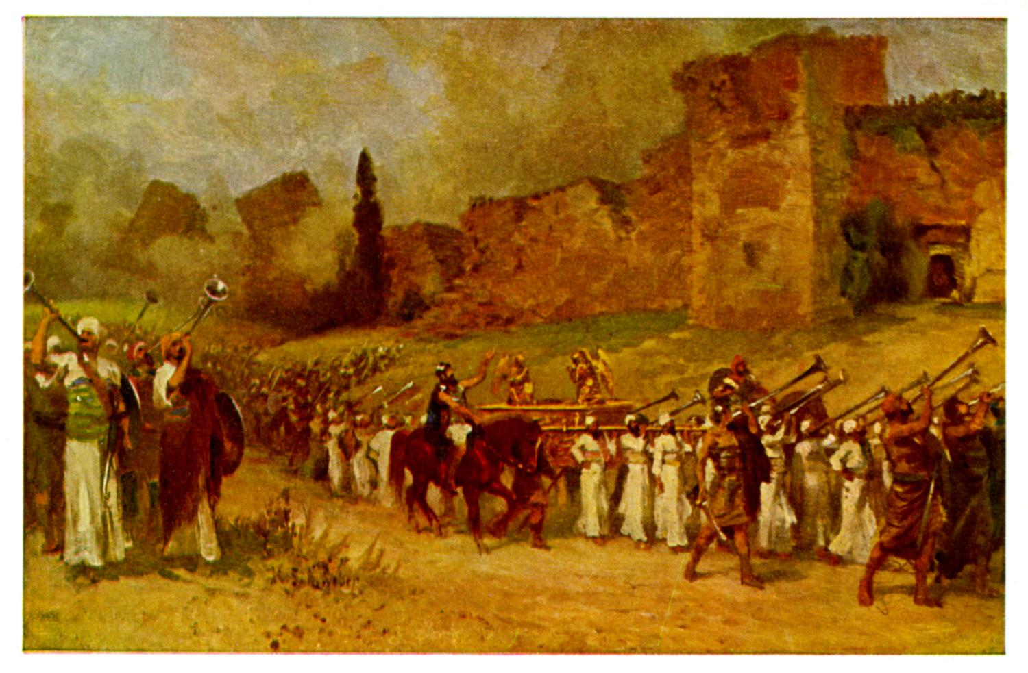
Joshua II Preparing to Enter

Slide 2
Background to Joshua
Three ways of thinking about Joshua:
1. A Historical Book (Joshua, Judges, 1,2 Sam, 1,2 Kings)
2. The completion of Deuteronomy (Hexateuch)
3. A book about godly leadership

Slide 3
Theme Passage
Joshua 1:6 Be strong and courageous, because you will lead these people to inherit the land I swore to their ancestors to give them.
The land is yours, now go and take it.
Receiving the Promised Land is an event.
Taking it is a process. Already but not yet.

Slide 4
Prefigures and Foreshadows in Joshua
Joshua is the New Moses.
Joshua is a prefigure of Christ.
Jeshua/Jesus The Lord Saves
The Jordan River is the new Red Sea

Slide 5
Foreshadows
Exodus – Deuteronomy:
Egypt = Slavery, lost
Wilderness = Disciple, saved
Promised Land = Heaven
Red Sea = baptism, when you were saved
Moses as messianic prefigure
Joshua-2 Kings
Egypt = Slavery, lost
Canaan = Disciple, saved
Heaven = Heaven
Jordan River = baptism, when you were saved
Joshua as messianic prefigure

Slide 6
Joshua 1:5-9
Be strong and VERY courageous v. 6, 7, 9
Joshua: Why?
v. 6 Because I chose you to lead
v. 7 Because you have obeyed the Law of Moses
v. 9 Because the Lord your God will be with you wherever you go.

Slide 7
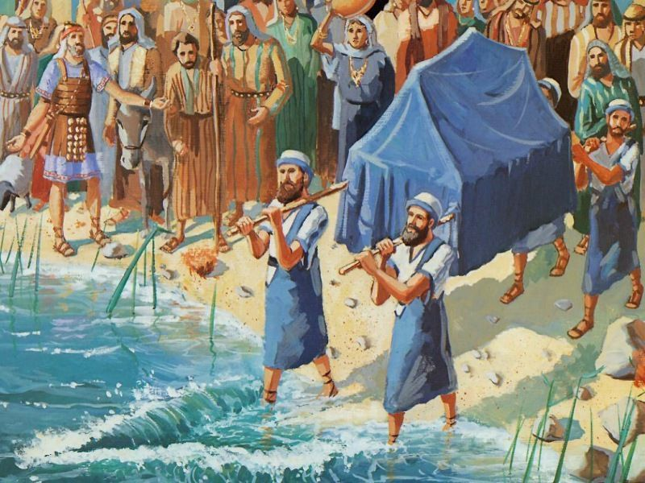
Joshua II Preparing to Enter
Joshua 1:10-11 Get ready to move!
Joshua 1:12-15 But unity of purpose is essential.
Joshua 1:16-18 “Wherever you send, we will go.”
Psalm 133:1

Slide 8
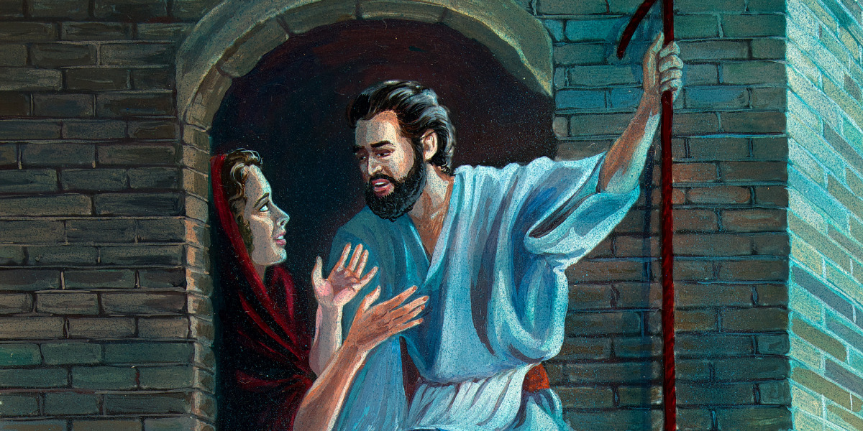
Joshua 2 Rahab and the Spies
An interesting story. Why?
Matthew 1:5
Salvation for the Gentiles
Salvation by faith
Rahab as a prefigure of Christ?
God is encouraging his people: God is preparing the way

Slide 9
Joshua 3:1-17 Time to Get Up and Go!
The key to spiritual victory?
Joshua 1:1-5 Consecrate yourselves.
Joshua 1:6-17 God will “pass on ahead of the people.”
God prepares a leader. God is doing miracles. God is preparing hearts.
The last missing ingredient: Great faith!

Slide 10
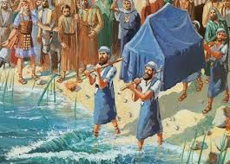
Entering the Promised Land
Joshua 3:17 “All Israel passed by [the ark] until the whole nation had completed the crossing on dry ground.
Baptism foreshadowed

Slide 11
Summary
It is time to take the land!
Unity of purpose is essential.
God is preparing the way
Consecrate yourselves
Walk by faith

