Slide 1
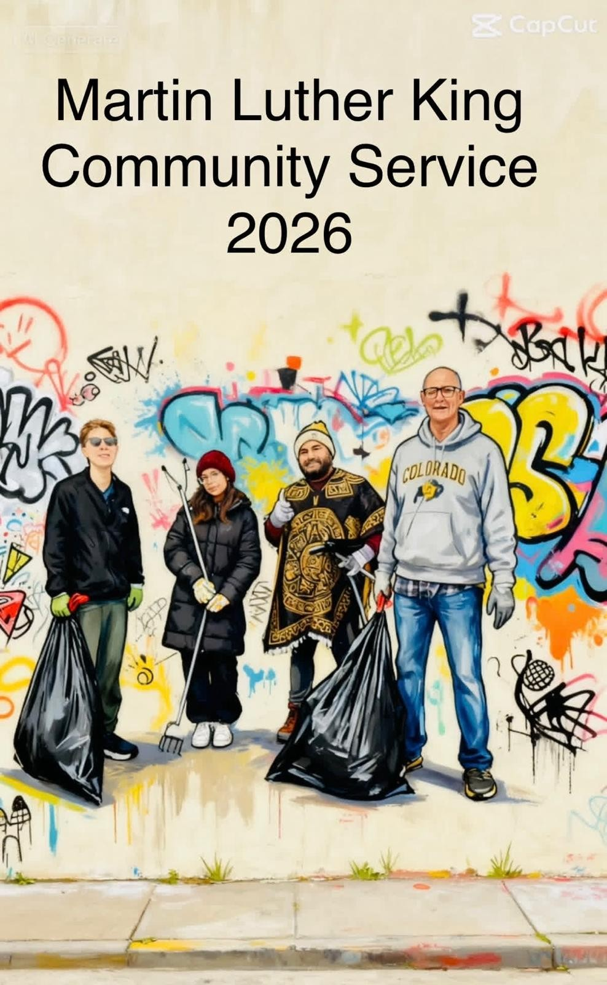
Thanks to all the workers!

Slide 2
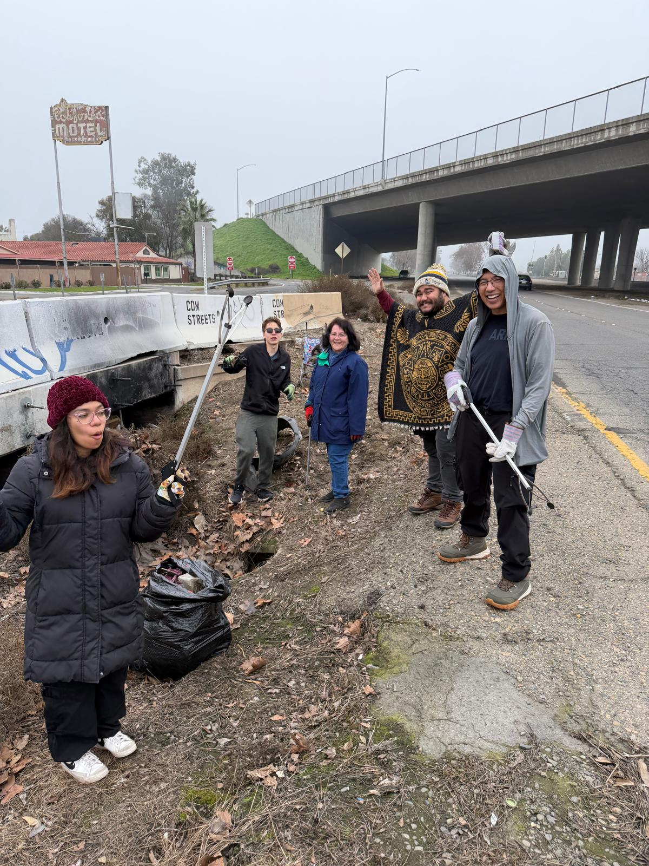
The Crew

Slide 3
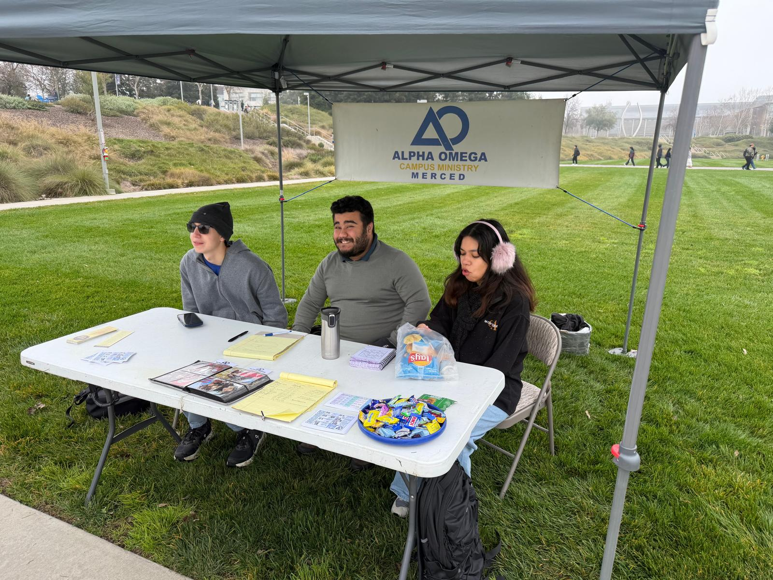
Mission Minded

Slide 4
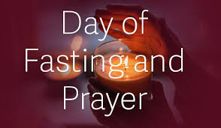
Announcements
Th 12:00 BT @ MC
Th 7:00 UCM basketball
Fri 1/23 Fasting. 7:00 Worship Night @ 1232 Villa Dr.
Sat 9:00 AM Breakfast @ Oakes
Frisbee golf 1:00 Fahrens Park
Sunday Love Feast and Worship

Slide 5

Coming Up
Valentine’s Party 2/13
Lecture: Finding Jesus 2/20
Grand Canyon Hike 4/11
Spring Retreat 4/24-26

Slide 6
Alpha Omega Themes for Sp, 2026
1. Christ-centered.
2. Mission focused.
3. Family-minded

Slide 7
The Next Few Weeks…
We will cover some of the relevant “hot topics” for students in 2026. To include…
Christianity and Race
Gender and Christianity
War and Peace
Politics and Christianity
Christianity and Culture
Bioethics
Other…???

Slide 8
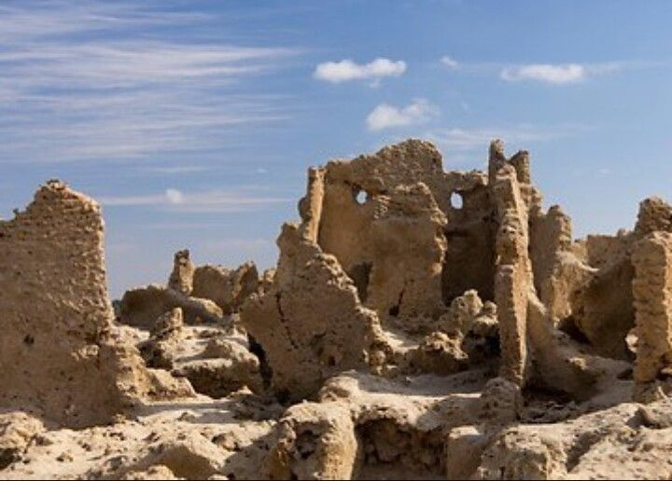
Nehemiah 1:1-10 The Walls Are Broken Down
Nehemiah’s response:
Mourned
Prayed
Confessed
“We” sinned
Boldness
Took action

Slide 9
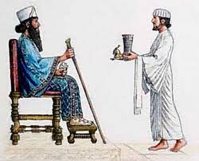
Nehemiah 1:11-2:10
Nehemiah: cupbearer
God is working behind the scenes.
Like Esther, Nehemiah takes a big risk for God.
Nehemiah says a quick prayer.
Nehemiah expects great things

Slide 10
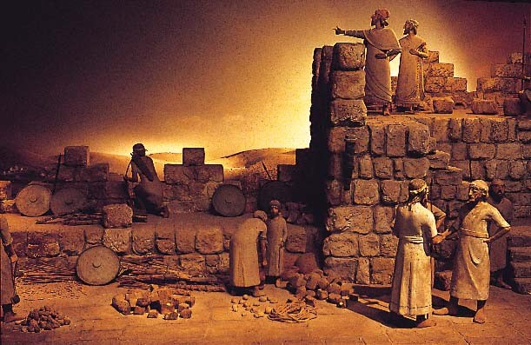
Nehemiah 2:11-18 Nehemiah forms a plan
Nehemiah evaluates the situation.
Nehemiah forms a plan.
Nehemiah creates a vision.
Nehemiah reminds people God is in control.
Nehemiah calls people to rise up and build!!!

Slide 11
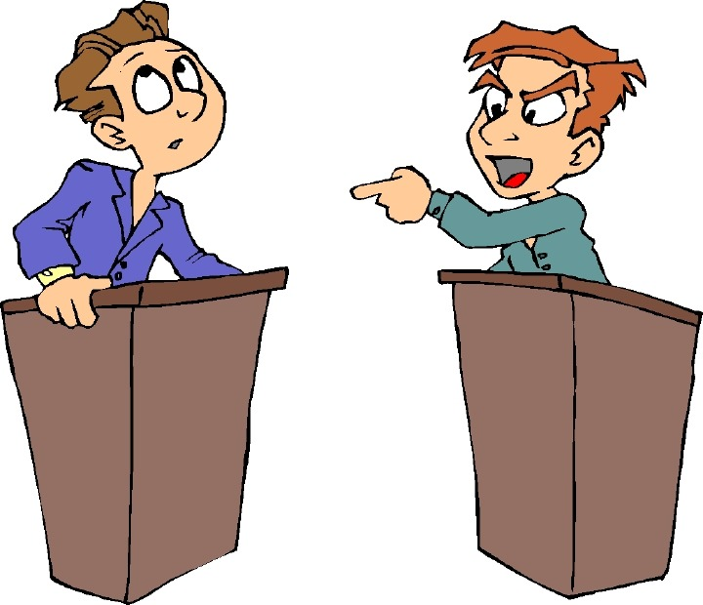
Nehemiah 2:19-20 Opposition!
Tobiahs and Sanballats will always oppose the work of God
Nehemiah: “The God of heaven will give us success.” We will not stop building!!!

Slide 12
Nehemiah 3:1-5 The Builders Get Building!
Neh 3:20 Baruch built zealously. Are you zealously building the wall?
Notes:
Learn from lists: Spiritual leaders are involved (3:1). It begins with dedication to God (3:1). Some give even though no direct benefit: Jericho (2), Tekoa (5), Gibeon (7), Mizpah (7, 15, 19), Zanoah (13), Beth Hakkerem (14), Beth Zur (16) and Keilah (17, 18). Not perfect (3:5).

Slide 13
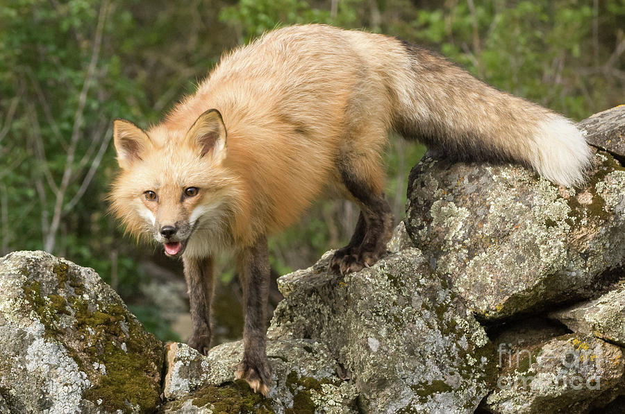
Nehemiah 4:1-9 More Opposition
When we get busy building the kingdom, opposition will come!
Tobiah: Even a fox…
You cannot build a church of 200 or a campus ministry of 100. Impossible!!!

Slide 14
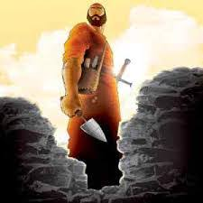
Nehemiah 4:10-20 Valid Concerns
- There is so much rubble.
Our strengthe is running out.
Danger: We will be attacked.
It’s HOOOOOTTTTTT
Let’s stop building!!!
Nehemiah:
Came up with a practical plan.
We will NOT STOP BUILDING!

Slide 15
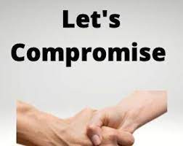
Nehemiah 6:1-2
Sanballat and Tobiah: Let’s compromise.
Nehemiah says Oh No! to going to the Valley of Ono

Slide 16
Nehemiah 5
Stop sinning!
Make restitution.
Nehemiah takes care of the poor

Slide 17
Nehemiah 6:1-2
Sanballat and Tobiah: Let’s compromise.
Nehemiah says Oh no to Ono

Slide 18
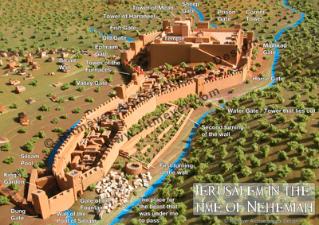
Nehemiah 6:15-16 The Wall is Completed
Notes:
They finally finish the wall! Really fast. Only because of God’s mercy and the people working hard. Amazing what can be accomplished. Pray and roll up sleeves when given direction from leaders.

Slide 19
Nehemiah: God Uses a Leader to Build the Kingdom
Nehemiah loves God and his kingdom.
Nehemiah prays boldly and humbly.
Nehemiah takes action.
Nehemiah is real with the people about the problem.
Nehemiah, nevertheless, creates a powerful vision.
Nehemiah calls the people to rise up and build.
Nehemiah refuses to stop building, despite opposition.
Jerusalem was restored and rebuilt.

Slide 20
Discussion Questions
What do you want to build this semester?
2. What will you do the next couple of weeks to begin to put this into action?

