Slide 1
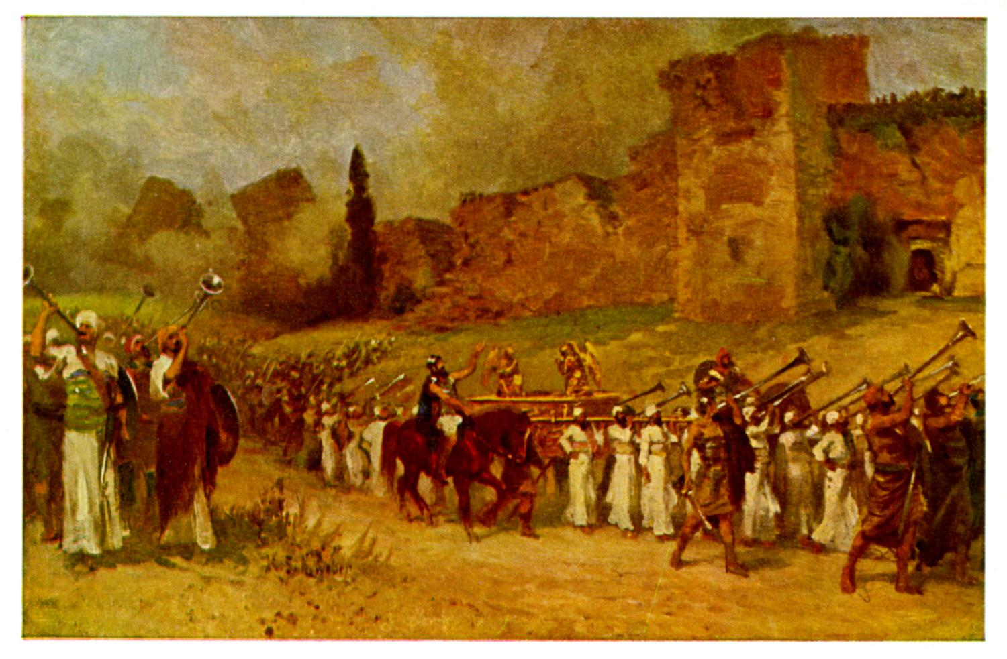
Joshua III Time to Enter the Promised Land

Slide 2
Background to Joshua
Three ways of thinking about Joshua:
1. A Historical Book (Joshua, Judges, 1,2 Sam, 1,2 Kings)
2. The completion of Deuteronomy (Hexateuch)
3. A book about godly leadership

Slide 3
Theme Passage
Joshua 1:6 Be strong and courageous, because you will lead these people to inherit the land I swore to their ancestors to give them.

Slide 4
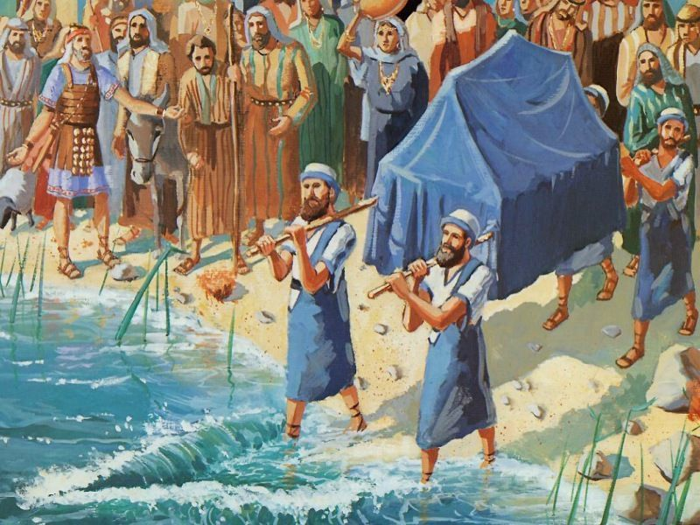
Last Week: Preparing to Enter
Joshua 1:10-11 Get ready to move!
Joshua 1:12-15 But unity of purpose is essential.
Joshua 1:16-18 “Wherever you send, we will go.”

Slide 5
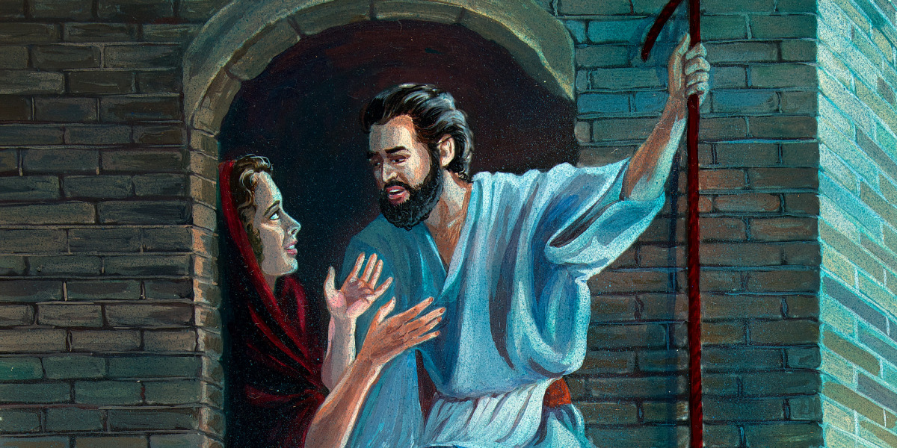
Joshua Ch 2 Rahab and the Spies
Matthew 1:5
Salvation for the Gentiles
Salvation by faith
God is encouraging his people: God is preparing the way

Slide 6
Joshua 3:1-17 Time to Get Up and Go!
Joshua 1:1-5 Consecrate yourselves.
Joshua 1:6-17 God will “pass on ahead of the people.”
The last missing ingredient: Great faith!

Slide 7
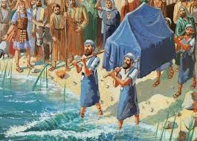
Joshua III Time to Enter the Promised Land
Joshua 3:17 “All Israel passed by [the ark] until the whole nation had completed the crossing on dry ground.
The second generation is baptized into Joshua
Baptism foreshadowed

Slide 8
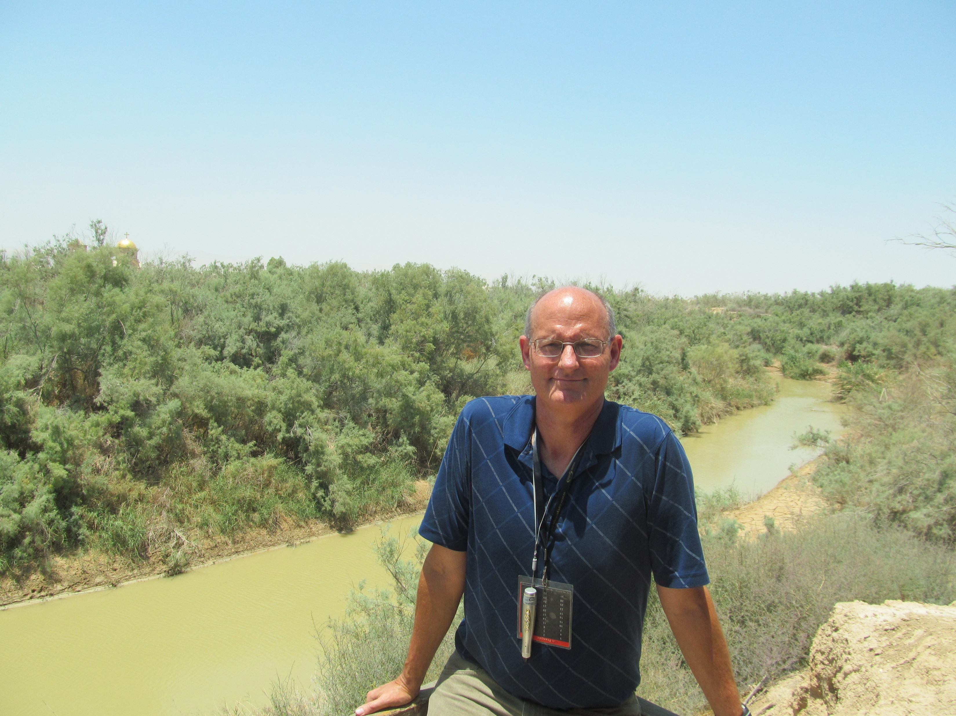
At the Jordan River

Slide 9
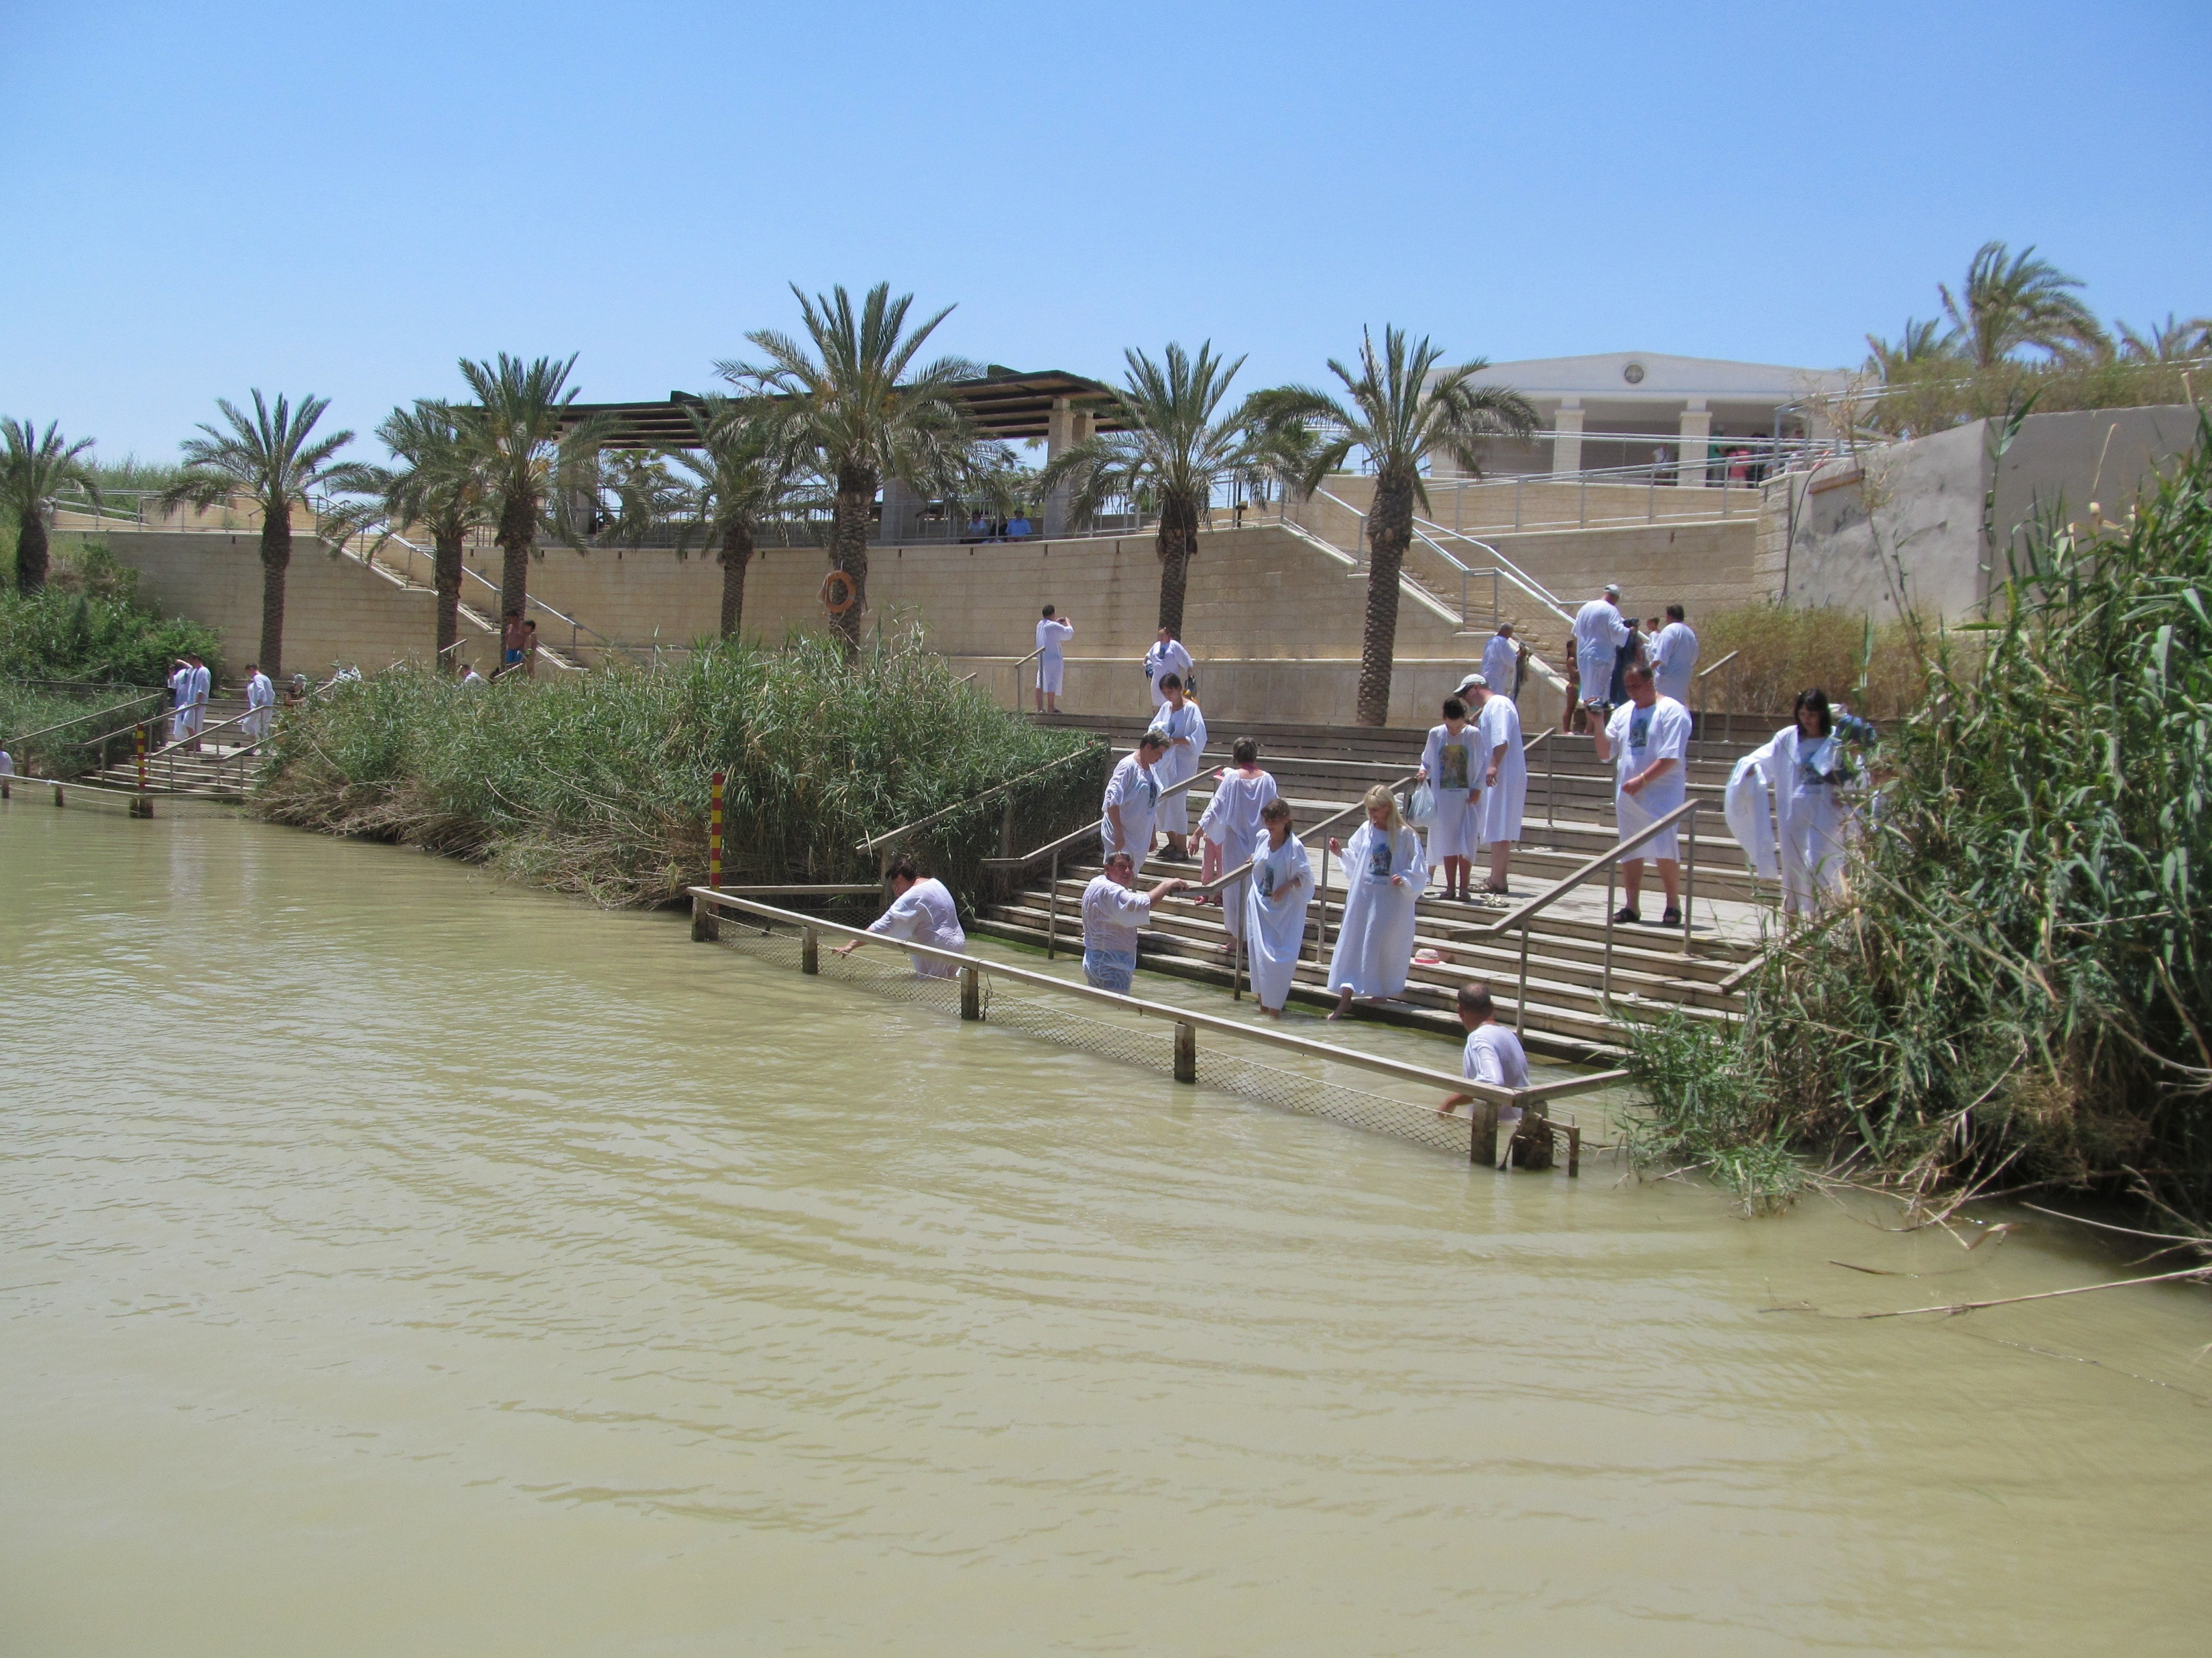
Jewish Baptisms

Slide 10
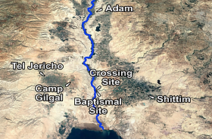
Dead Sea

Slide 11
Joshua 4 Crossing the Jordan River Entering the Promised Land
There is a lot of symbolism and a lot of ceremony as the people enter the Promised Land.
Joshua as prefigure of Christ
The Ark: The presence of God goes before the people
Passing through water: Walking by faith. Being baptized into Joshua
12 stones
Circumcision as a prefigure of baptism.

Slide 12
Ceremonies
1. The people are consecrate before entering.
2. Priests in the river, mediating between Israel and God.
3. 12 men—one from each tribe standing in the river.
4. A tower of 12 stones of remembrance.
5. Circumcision.
6. Passover.
7. Renewal of the Covenant at Mt. Ebal.
God wants us to remember!

Slide 13
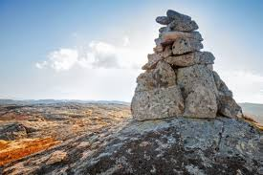
Joshua 4:1-9
“Not remembering is the greatest enemy of faith.”
-Dale Davis

Slide 14
Joshua 4:10-18
Joshua to the priests carrying the ark:
“Come up out of the water!”
No sooner had they set their feet on the dry ground, than the waters of the Jordan returned to their place and ran at flood stage as before
How Dramatic Is That?!!

Slide 15
Joshua 4:19-5:1
“On the tenth day of the first month.”
Exodus 12:2 Exactly 40 years after the people chose a lamb for the Passover sacrifice.
God has redeemed his people and brought them into the Promised Land.
Their “salvation” is complete!

Slide 16
Joshua 5:2-12 Well… Not quite. Circumcision Ceremony #6
Circumcision as a prefigure of baptism.
Colossians 2:11-12 Baptism is spiritual circumcision.
The removal of the flesh.
Joshua 5:9 Today I have rolled away the reproach of Egypt from you.
Has God “rolled away” the reproach of Egypt from you?

Slide 17
Joshua 5:10 On the evening of the 14th day of Nisan, they celebrated the Passover.
Great symbolism. Great ceremony Remember!

Slide 18
Summary
It is time to enter the Promised Land.
Consecrate yourselves and walk by faith.
Pass through the water and submit to spiritual circumcision.
Let us set up stones of remembrance of the great things God has done.

Slide 19
Communion
The Lord’s Supper is our 12 stones.
Joshua 4b-7 Remind your children.
Luke 22:19, 1 Corinthians 11:24-25
“Do this to remember me.”

