Slide 1
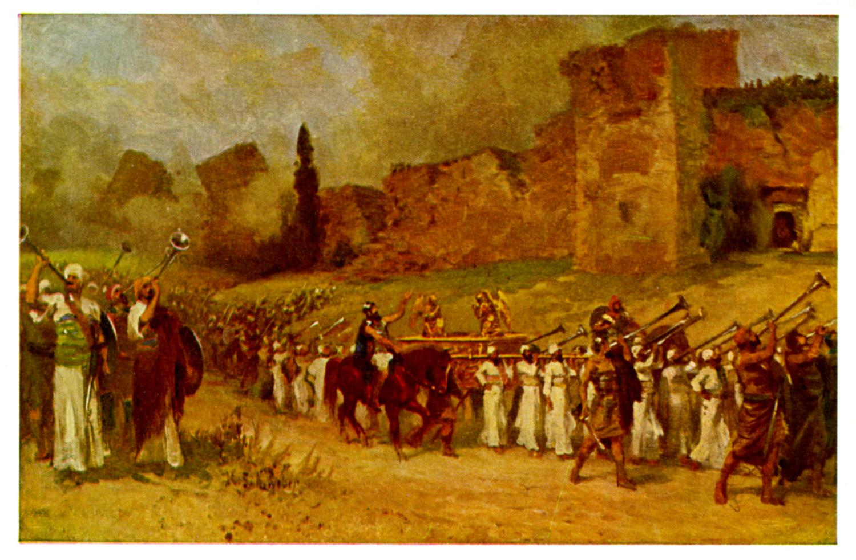
Joshua IV The Walls Come Down

Slide 2
Background to Joshua
Three ways of thinking about Joshua:
1. A Historical Book (Joshua, Judges, 1,2 Sam, 1,2 Kings)
2. The completion of Deuteronomy (Hexateuch)
3. A book about godly leadership

Slide 3
Theme Passage
Joshua 1:6 Be strong and courageous, because you will lead these people to inherit the land I swore to their ancestors to give them.

Slide 4
Joshua 3:1-17 Crossing the Jordan River
God goes before his people.
The last missing ingredient: Great faith!

Slide 5
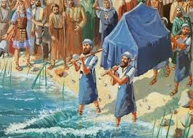
Joshua III Time to Enter the Promised Land
Joshua 3:17 “All Israel passed by [the ark] until the whole nation had completed the crossing on dry ground.
The second generation is baptized into Joshua

Slide 6
Joshua 4:10-18
Joshua to the priests carrying the ark:
“Come up out of the water!”
No sooner had they set their feet on the dry ground, than the waters of the Jordan returned to their place and ran at flood stage as before
How Dramatic Is That?!!

Slide 7
Joshua 5:2-12 Circumcision
Circumcision as a prefigure of baptism.
Joshua 5:9 Today I have rolled away the reproach of Egypt from you.

Slide 8
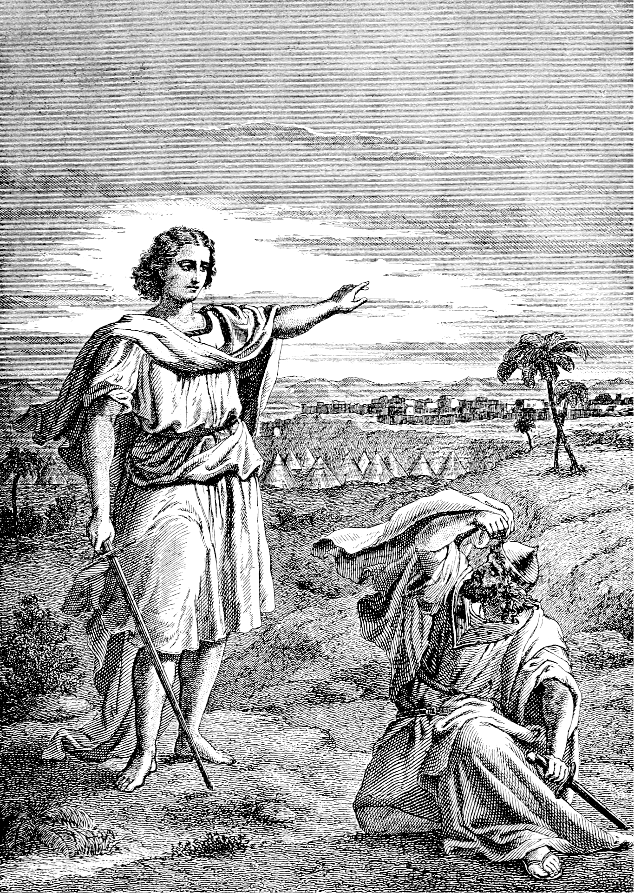
Joshua IV The Walls Come Down
Joshua 5:13-15
Joshua, the New Moses
Joshua is consecrated for the work of God.

Slide 9
Joshua 6:1-5 Strange Battle Plans
Joshua 6:1 The gates were securely barred.
So were the hearts of the people of Jericho.
Jacob wrestled with God (Genesis 32)
Moses questioned God (Exodus 3 & 4)
Joshua obeyed God

Slide 10
Keys to Kingdom Victory
God goes before us.
A consecrated, faithful and obedient leader.
Careful obedience to God.
Faithfully and courageously advancing.

Slide 11
Joshua 6:6-7
Joshua Obeys God to the letter
The people’s great faith mirrors that of Joshua.

Slide 12
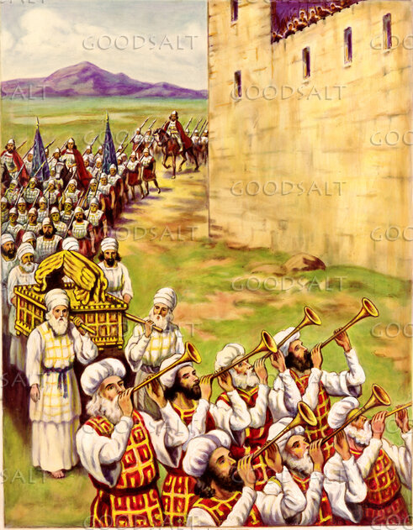
Joshua 6:8-16 Walking By Faith
What were the people of Jericho thinking?

Slide 13
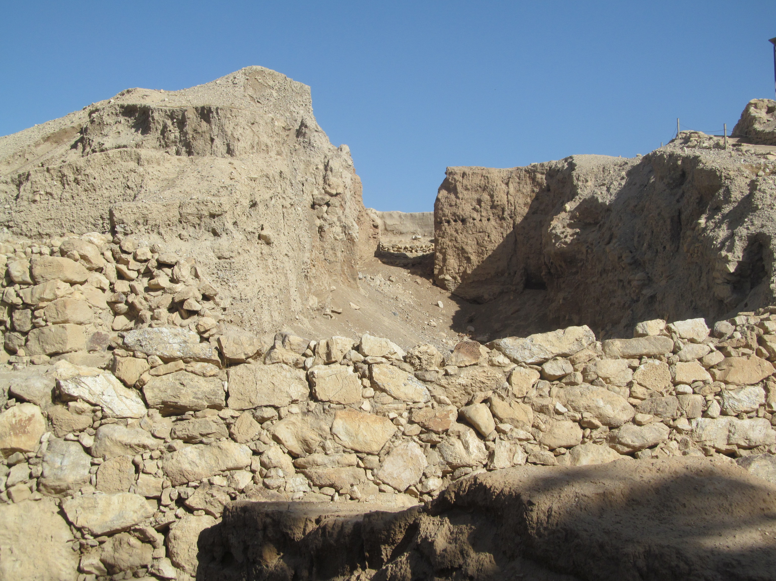
Ancient Jericho About 0.7 miles in circumference April: 85° F

Slide 14
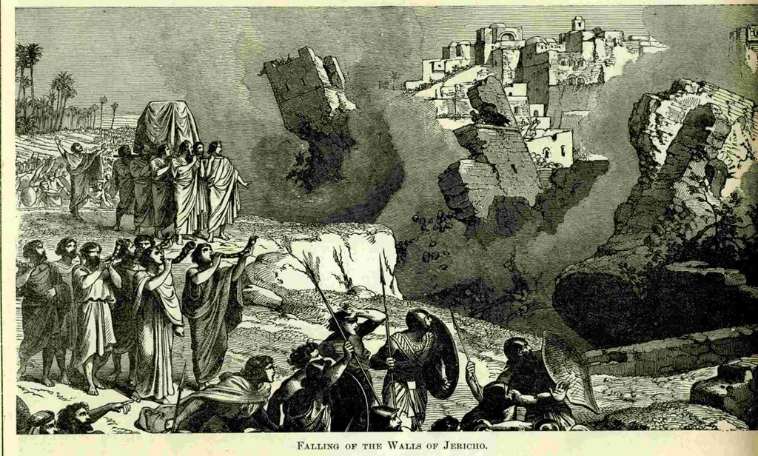
Joshua 6:17-21 The Walls of Jericho Collapse
An unqualified miracle.
With a wall: Virtually impregnable
Without a wall: Virtually defenseless

Slide 15
Faithful Obedience and Devotion
Joshua 6:18, 21 Devote (herem) everything in the city to God.
Living things to destruction.
Valuables to the treasury of the Tabernacle.
The city to fire.
Those who refuse God’s offer of salvation will be devoted to destruction.
But the faithful, like Rahab, will be saved.

Slide 16
Joshua 6:26-27
What God says will happen, will happen, no matter how long.
1 Kings 16:34 500+ years later Hiel of Bethel made a big mistake!

Slide 17
Great Victory, But… Joshua 7:1
What happens when we do not devote all to the Lord?
What happens when we choose to disobey God?
What happens to God’s plans when there is “sin in the camp?”

Slide 18
Summary
Keys to victory for God’s people:
God prepares the way.
God prepares a consecrated leader.
Careful obedience to God’s commands.
Faithfully and courageously going in and taking the land.

