Slide 1
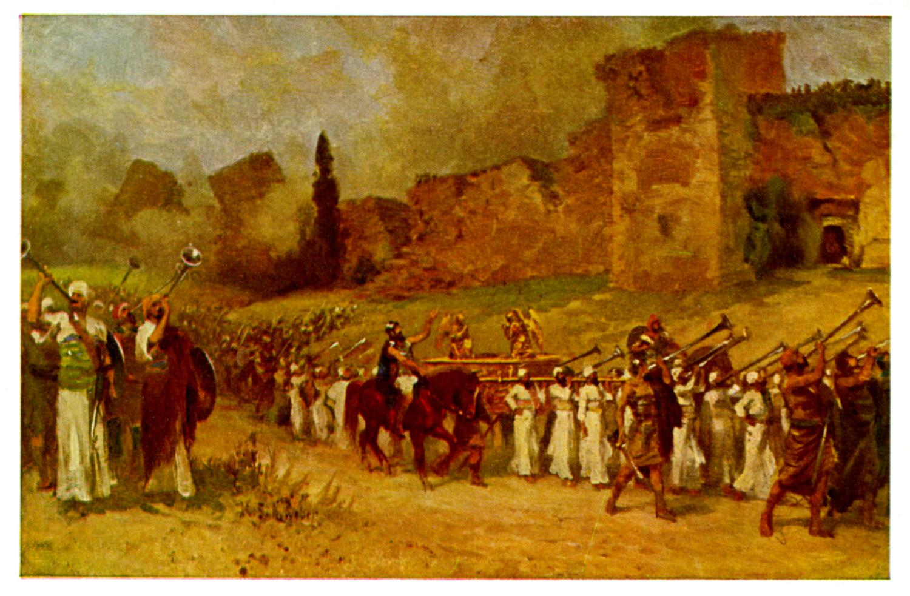
Joshua V Disaster at Ai

Slide 2
Background to Joshua
Three ways of thinking about Joshua:
1. A Historical Book (Joshua, Judges, 1,2 Sam, 1,2 Kings)
2. The completion of Deuteronomy
3. A book about godly leadership

Slide 3
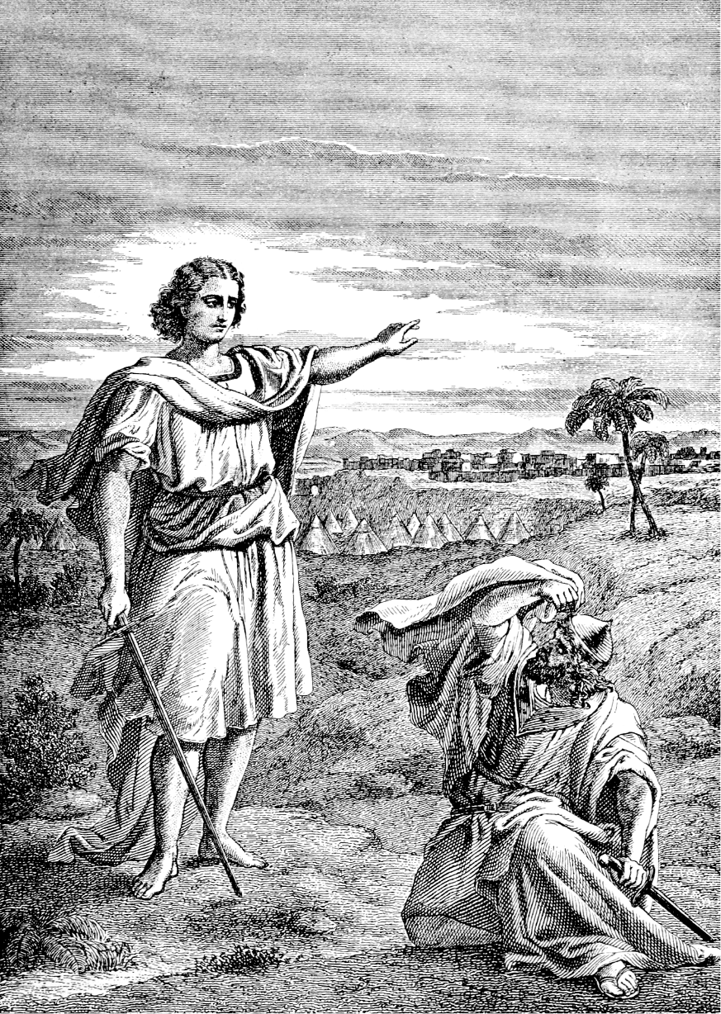
Joshua IV The Walls Come Down
Joshua 5:13-15
Joshua is consecrated for the work of God.

Slide 4
Joshua 6:1-5 Strange Battle Plans
Joshua 6:1 The gates were securely barred.
So were the hearts of the people of Jericho.

Slide 5
Keys to Kingdom Victory
God goes before us.
A consecrated, faithful and obedient leader.
Careful obedience to God.
Faithfully and courageously advancing.

Slide 6
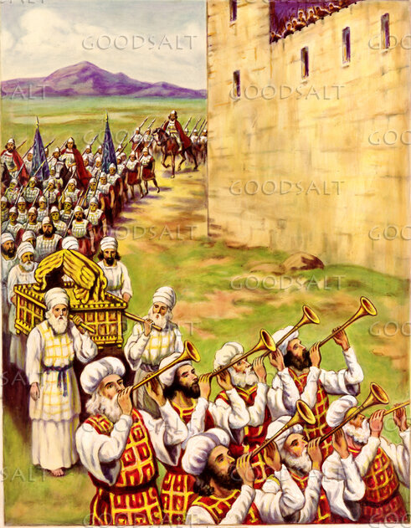
Joshua 6:8-16 Walking By Faith
What were the people of Jericho thinking?

Slide 7
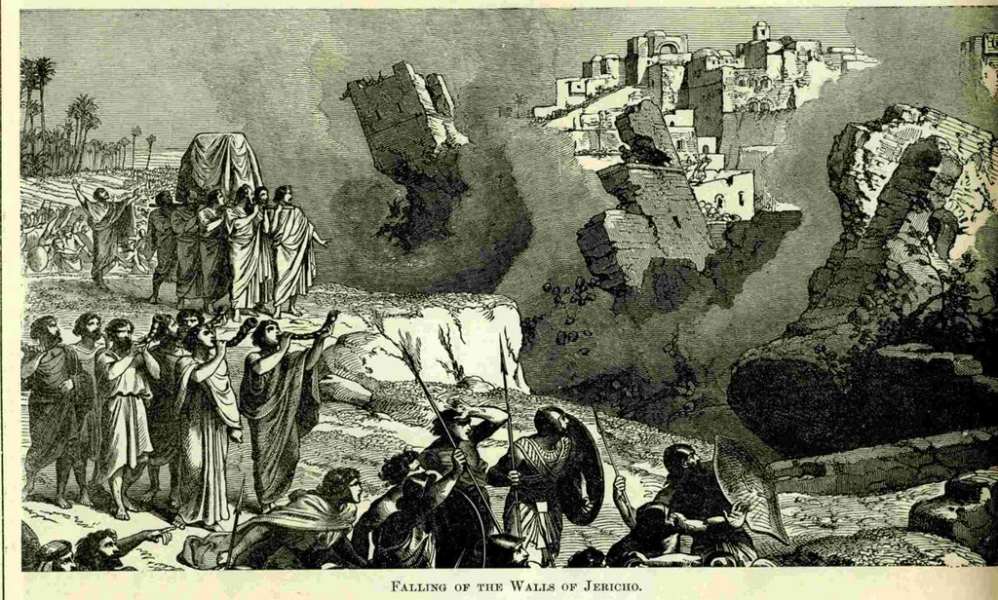
Joshua 6:17-21 The Walls of Jericho Collapse
An unqualified miracle.
With a wall: Virtually impregnable
Without a wall: Virtually defenseless

Slide 8
Faithful Obedience and Devotion
Joshua 6:18, 21 Devote (herem) everything in the city to God.
Those who refuse God’s offer of salvation will be devoted to destruction.
But the faithful, like Rahab, will be saved.

Slide 9
Great Victory, But… Joshua 7:1
What happens when we do not devote all to the Lord?
What happens when we choose to disobey God?
What happens to God’s plans when there is “sin in the camp?”

Slide 10
Joshua V: Disaster at Ai
Joshua 7:1-5 Why was Israel defeated at Ai?
Because they were confident in self, not in God?
Because they were hasty and did not pray?
No! Because God was opposed to them!
Because they did not devote everything to God.

Slide 11
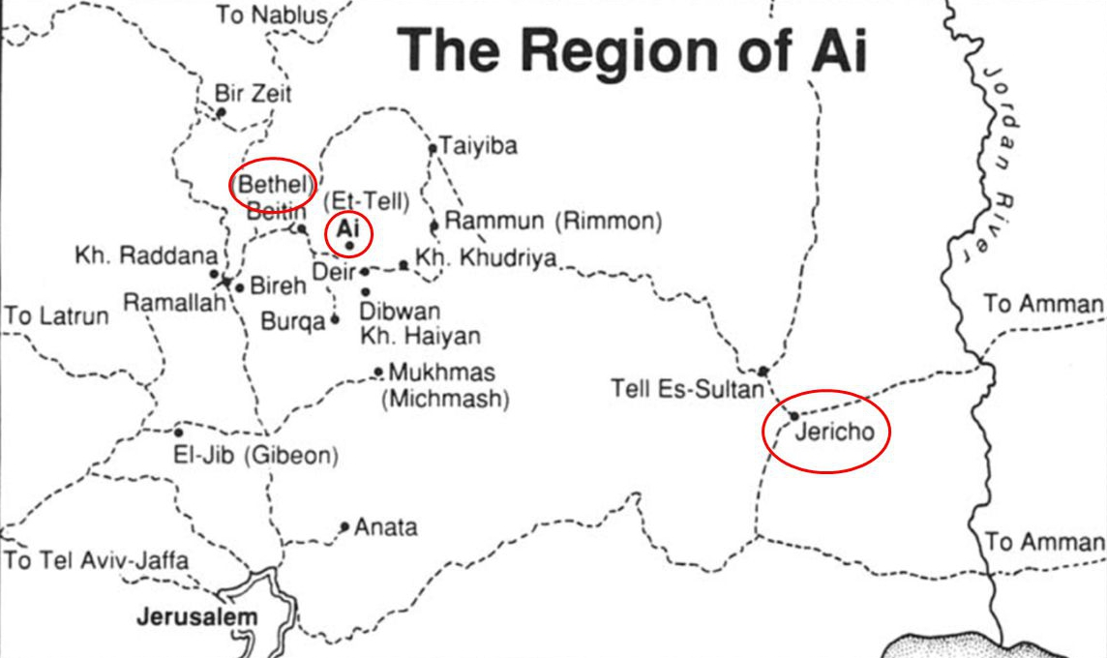
Ai: The key to the hill country and to Bethel

Slide 12
Joshua 7:6-26
v. 10-11 The problem: Israel has sinned!
v. 12 The result of sin—the result of lack of devotion: liable to destruction!
Lack of “success” Step #1: Deal with sin in the camp.
Question for us: Has the church sinned?

Slide 13
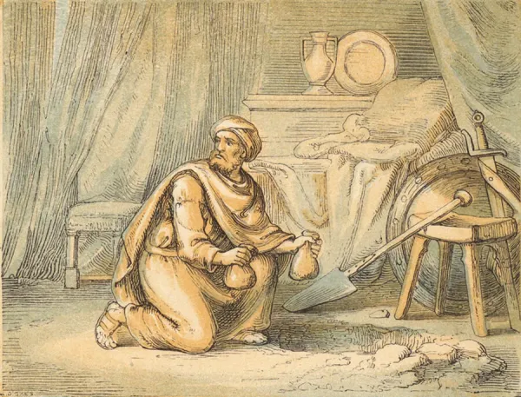
The Big Question This Morning
Do you have hidden, willful sin in your life?
Achan did, and the result was disaster!

Slide 14
The Need: Openness and Repentance
Question: Was Achan repentant? 2 Cor 7:11
Earnestness?
Indignation?
Alarm?
Longing and Concern?
Readiness to see justice done?
Achan was still defending/explaining himself

Slide 15
Consequences
Were the consequences on Achan and his family too much?
1 Corinthians 10:11 “These things happened and were written down as warnings for us.
New Testament Example: Ananias and Saphyra.
This lesson is for US!
“We cannot treat cancer with vitamin pills.”

Slide 16
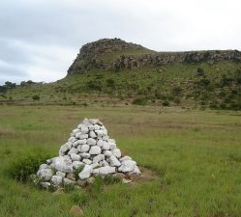
Joshua 7:26 Another Kind of “Stones of Remembrance”

Slide 17
Response
Do you have hidden, unrepented, willful sin?
What are the consequences, not just on you, but on the church?
Steps:
Confession
Repentance

Slide 18
Joshua 8:1-2 A Very Different Story
The spoils of Jericho have been fully devoted to YHWH
God is now with his people again. Victory is assured.
“You shall do to Ai what you did to Jericho.” (except this time you get to keep the plunder for yourselves)

Slide 19
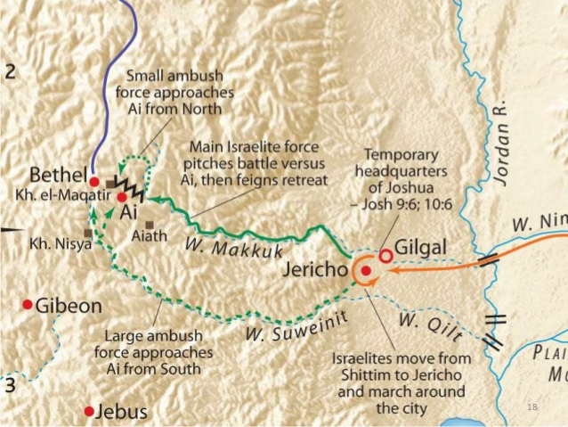
Joshua 8:3-29

Slide 20
Conclusion
God will withhold his blessing and victory from his people if they fail to devote themselves to Him and if there is “sin in the camp.”
The solution:
Confession
Repentance
Then God can again return to blessing his people.

Slide 21
Have a great Jesus week!

