Slide 1

2 Peter II
Confidence in God’s Word

Slide 2
Themes of 2 Peter
True knowledge of God.
Growth in holiness.
The Return of Christ as motivation for holiness.

Slide 3
Theme Passage of 2 Peter
2 Peter 1:3 “His divine power has given us everything we need for a godly life through our knowledge of him who called us by his own glory and goodness.”

Slide 4
2 Peter 1:3-4 Wow!
Through Christ we have power for everything we need!
Especially for holy living.
How do we receive this power?
Through our knowledge of (not about) Him.
Through this same power, we have his great and precious promises!

Slide 5
2 Peter 1:3-4 Wow!
Through these promises we may participate in the divine nature!!! Col 2:9-10
How do we participate in the divine nature? Through personal holiness.

Slide 6
2 Peter 1:5-9 For this very reason…
For what reason?
-because of his great and precious promises and
-because we participate in the divine nature
We MUST make every effort to grow into what he has already declared us to be.

Slide 7
Growth!
A. Goodness
B. Knowledge
C. Self-control
D. Perseverance
E. Godliness
F. Mutual affection
G. Love
Which do you most need to grow in?

Slide 8
2 Peter 1:8-9
Only two options!
1. A productive and effective Christian life or
2. You are blind and short-sighted

Slide 9
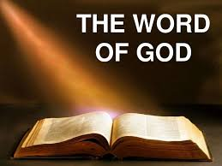
2 Peter 2:12-21 Confidence in God’s Word
v. 12-15 Back to Basics
v. 16-18 Even More Confident in God’s Word
v. 19-21 God’s Word is Truly Inspired

Slide 10
2 Peter 1:12-15 Back to Basics
Peter’s parting message (v. 14)
Remember the basics of your faith!
Who God is. Who Jesus is. How we are saved. The need for faith. The need for holiness. The need to stay close to God. Serving the poor. The need to love one another.
Do these bore you?

Slide 11
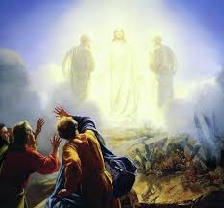
2 Pet 1:16-19a Even More Certain
Context: The Transfiguration
Peter: I saw the entire Old Testament come true right in front of me, with my very eyes!!!
Let me count the ways.

Slide 12
Even More Certain
Miracles:
Feeding 5000, healing at Bethesda, man born blind, Lazarus, Legion…..
Prophecies fulfilled:
Bethlehem, Nazareth, Jonah, crucified, pierced…

Slide 13
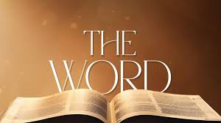
2 Peter 1:19-21 The Word is Inspired!
Pay Careful Attention to God’s Word!!!
The Bible is inspired by the Holy Spirit

Slide 14
Summary
We’re going to go back again and again to the basics.
These things are true. They really happened. They confirm the Old Testament—even more than before.
The Bible is inspired by God
So, let us pay very careful attention to it, read it and obey it.

