Slide 1

Welcome to the Alpha Omega Midweek

Slide 2

Announcements
Bible Talks:
Mon 6:30 106 Mulberry, Atwater
Mon 7:30 Lantern Café UCM
Tues 6:30 1195 Pinnacle Dr.
Th 12:00 Merced College
Wed 7:30 Midweek Devotional Next Week, back at UC Men and Women
Fri 7:00 Game Night at Oakes

Slide 3

Coming Up
Sat 3/28 6:00 Yosemite Hike
Marriage Retreat 3/28-29
Grand Canyon Hike 4/11
Spring Campus Retreat 4/24-26
https://tithe.ly/event-registration/#/10976730
Special Missions Contribution Last Week in June.
ICMC July 30-Aug 2. Milwaukee. We will cover travel if you do it early enough.

Slide 4


Slide 5
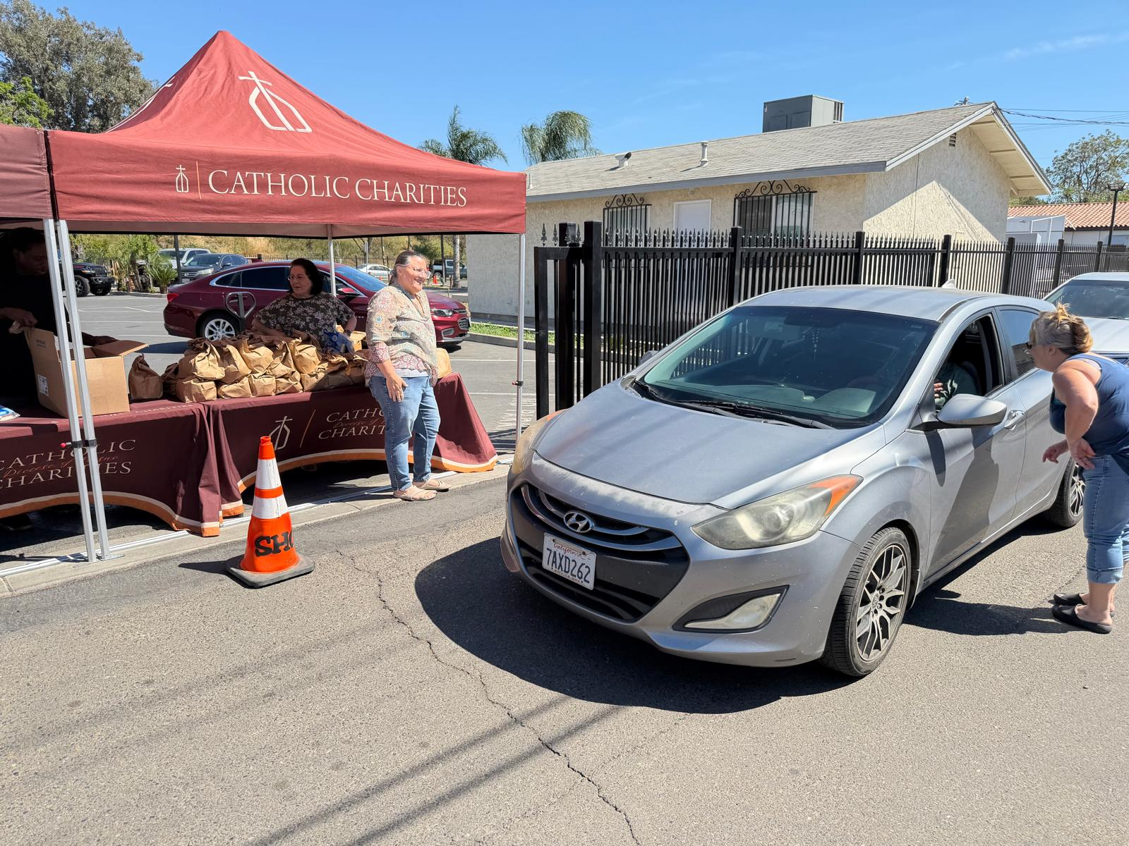
Sandy and Jan!

Slide 6
Difficult Questions for Christians
Bioethics (cloning, IFV, brain implants, gene therapy, etc.)
Reproduction and Christianity (abortion, birth control IVF)
Gender and Christianity.
Christianity and Military Service.
Christianity and Politics
Christianity and Race.
Christianity and Culture, Modesty, etc.
Gambling, Drinking, Medical Marijuana.
There is a lot there!!!!!!!

Slide 7
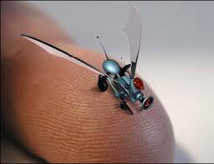
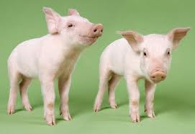
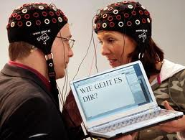
Christianity and Bioethics
John Oakes

Slide 8
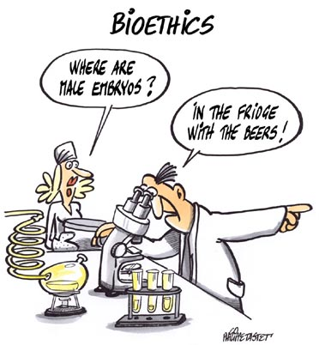
Outline
I. What is bioethics?
II. Why Should a Christian Care About Bioethics?
III. Toward a Christian Response to Questions of Bioethics.
IV. A Case Study: Stem Cell Research

Slide 9
A Useful Definition of “Bioethics”
Ben Mitchell and John F. Kilner in Does God Need our Help?
Bioethics is a process of “distinguishing between what we should pursue and what we shouldn’t pursue in matters of life and health.”

Slide 10
Morality vs. Ethics
Morality has to do with right and wrong and assumes an authoritative definition
Ethics has to do with better or worse or cost/benefit analysis and has primarily to do with human-human interaction.
Christians may have a fair amount in common with the wider world on ethical questions, but probably not on moral questions.

Slide 11
Why Should a Christian Care About Bioethics?
Biotechnology: Scientific methodologies specifically directed toward manipulating living things—whether human or non-human.
Examples: antibiotics, psychopharmaceuticals, genetically modified crops, recombinant DNA technologies (to produce necessary hormones such as insulin or blood clotting factors for example). Chemically engineered drugs, organ transplants, pacemakers, computer-aided prosthesis, gene therapy, stem cell and fetal tissue therapies, human and therapeutic cloning, neural implants (against Parkinsons, for example) and much more….

Slide 12
Just To Get You Thinking
To my SCI 110 Intro to Scientific Thought Class:
1. You think a new technology is ethically bad today, but 30 years from now you will celebrate it. IVF
2. You think a new technology is a great idea today, but 30 years from now you will think it was an ethical disaster. DDT
Law of unintended consequences
3. The pace of scientific discovery and production of new technologies has outpaced human’s ability to grasp the ethical implications.
4. You cannot trust the scientists on this one.

Slide 13
manHuman Enhancement
Leon Kass: “Human nature itself lies on the operating table, ready for alteration, for eugenic and neuropsychic enhancement, for whole-sale redesign.”
Humanity Plus: “Transhumanists view human nature as a work-in-progress, a half-baked beginning that we can learn to remold in desirable ways.”
Breast implants, anabolic steroids. Legitimate therapeutic drugs used for enhancement (Ritalin, SSRIs, antidepressants, etc.). Alzheimer’s drugs used to improve natural memory. Eugenics to eliminate deafness, genetic diseases, to improve athletic abilities, etc.

Slide 14
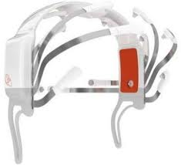
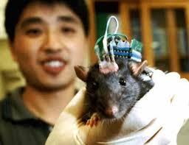
Will Gamers Be Able to Resist Brain Implants?

Slide 15
Human Enhancement
“The very identity of the human person and the very substance of reality are presumably called into question by developments in artificial intelligence, in genetics, and in virtual reality.” Albert Borgmann
The artificial improvement of human beings will come, one way or another, whether we like it or not, as soon as the progress of biological understanding makes it possible. When people are offered technical means to improve themselves and their children, no matter what they conceive improvements to mean, the offer will be accepted. Improvement may mean better health, longer life, a more cheerful disposition, a stronger heart, a smarter brain, the ability to earn more money as a rock star or baseball player or business executive. The technology of improvement may be hindered or delayed by regulation, but it cannot be permanently denied. Freeman J. Dyson, Physicist.

Slide 16
A Simple Answer
Well, as long as it is voluntary….
Is it really voluntary? The answer: Not really, due to social pressure (example: steroids)
Will all have equal access?
All of these issues cry out for a “Christian” response.

Slide 17
Some Questions to Think About
What is the purpose of human existence?
What is the meaning of human dignity?
What is free will and what is its relationship to technologies?
What is a soul and what are the implications of the mind/body/soul relationship?
What is the meaning of human autonomy, is this a Christian value, and is it in play in these technologies?

Slide 18
Questions (cont.)
Are we prepared to let market forces determine the direction of biotechnological advance?
Should we leave control for the direction of biotechnological moves in the hands of avowed naturalists/scientific materialists?
Are we going to simply take the “It is in God’s hands” approach to this?

Slide 19
Toward a Christian Response to Bioethical Questions
The naturalist view:
We are the purposeless result of blind natural forces. We are temporal and are not spiritual. In this world view, biotechnological choices come down to cost/benefit analysis alone. Human dignity (worth) is a questionable concept.
In the Christian world view, the individual has a dignity because we are made in the image of God (Genesis 1:26-27, Genesis 9:6) which should be respected. This limits the viability of cost/benefit analysis.

Slide 20
Human Dignity
“Human dignity in the biblical perspective does not depend solely on who we are but, more important, on who God is—as well as on what God has done, is now doing and will do in the future” (from Biotechnology and the Human Good)
Are we guests, invaders or caretakers?
Hebrews 2:8 (quoting Psalm 8:6) God put us over the physical earth. We are responsible for it.

Slide 21
Human Responsibility
Genesis 2:15 (about the garden) keep (shamar) it
Genesis 1:28 Fill the earth and subdue it.
But…
1 Cor 4:2 It is required that those who have been given a trust must prove faithful.
Conclusion: We do not worship nature (biocentrism) but we are over nature as responsible, caring stewards.

Slide 22
A cautionary tale: The Tower of Babel
Genesis 11 Come let us build…. and make a name for ourselves.
C S Lewis in The Abolition of Man, “What we call man’s power over nature turns out to be a power exercised by some men over other men with nature as its instrument.”
Applied to biotech, should we have as a goal to remake, redesign and prefabricate ourselves?
Did Jesus enhance or reengineer either himself or others?

Slide 23
A Preliminary Answer
Morally and ethically responsible stewardship (guided by a biblical understanding of the relationship between the created (man) and the creator).
The ultimate goal of Christian medicine is not immortality. Our goal is not to avoid death at all costs, but to create as fulfilled a life on earth as we can.
We should use biotechnologies to relieve suffering in a way which protects human dignity without making humans less human.
We should do through technology what Jesus did in his ministry (relieve suffering, create a greater quality of life, avoid unnecessary, untimely death)

Slide 24
Another Way to Put It
The natural Christian attitude seems to be liberal when it comes to using technology to reduce suffering and to improve the quality of natural life, but to be conservative in unnaturally altering life for personal or monetary benefit.

Slide 25
Helpful Questions (from Biotechnology and the Human Good by Ben Mitchel et al)
1. Does the technology assist us in fulfilling or stewardship responsibilities?
2. Does the technology require or promote the commodification or destruction of human life? Does the technology demean, debase or degrade individuals?
3. Does the technology primarily appeal to our basest inclinations?
4. Is the technology a vehicle to promote our own narcissistic self-absorption?

Slide 26
Questions (cont.)
5. Does the pursuit or use of the technology make just use of resources? Or does it use gross amounts of natural resource for a limited positive result?
6. Does the technology promote genuine human flourishing or does it more likely promote technological and economic imperatives? Must we adapt to the technology, or was the technology designed to adapt to human nature and human needs?
7. How much additional technology is necessary to produce, maintain or safely constrain/contain the technology?

Slide 27
IV. A Case Study: Stem Cell Research
Are there moral implications? We should start there. (answer: maybe)
Are there ethical issues? (Yes. Only for the wealthy, great cost with limited benefit)
Is this to enhance human capability or is it to give health and alleviate suffering? (mostly the second)
Is there sufficient negative harm to others which more than offsets possible good?
Caution: We will not all agree on these things…

Slide 28
What about Human Cloning?
Do you mean human cloning or therapeutic cloning?
Are there moral implications? We should start there. (I say no)
Are there ethical issues? (absolutely)
Is this to enhance human capability or is it to give health and alleviate suffering? (it seems to be the first)
Is there sufficient negative harm to others which more than offsets possible good? (you decide)

Slide 29
Psychoactive Drugs and Mental Health
This is a very fraught issue, and it is a very complex issue!
Is there a moral issue? Is it a sin to use drugs to alter our state of mind? What about using psychadelics?
Is the Christian view that our first/automatic response ought to be to avoid the use of mind-affecting drugs if at all possible, or ought it be to let the professionals tell us what is best?

Slide 30
Suggestions
Be careful about presupposing the proper “Christian” view on any particular topic. Be prepared to do some research (and be really careful where you do that research!!!!) Be willing to have deep convictions, but also to show grace toward those with whom you do not agree—whether they are believers or not.

Slide 31
Discussion
Which issue in the general area of bioethics did you find most interesting or of concern to you?
Have you formed any thoughts on this issue? Are they related to morality or to ethics?

Slide 32
Difficult Questions for Christians II
Reproduction and Christianity
Abortion
Contraception
In Vitro Fertilization, Surrogacy, etc.

Slide 33
Levels of Discussion
1. What can we say for sure (biblical statement or command)?
2. What can we infer or reasonably conclude based on biblical principles?
3. What are some gray areas, in which faithful, Bible-believing Christians will differ?

Slide 34
Levels of Discussion
1. What can we say for sure (biblical statement or command)?
2. What can we infer or reasonably conclude based on biblical principles?
3. What are some gray areas, in which faithful, Bible-believing Christians will differ?

Slide 35
Abortion and Christianity
A. God encourages (commands?) that humans produce children. Genesis 1:28 Psalms 127:4 God helps barren women.
B. But… God allows and in some cases encourages some to not marry. Matthew 19:10-12 1 Corinthians 7:25-38
Conclusion: Marriage and child-bearing are honored and even encouraged, but not commanded of Christians.

Slide 36
Bible Scriptures on Abortion
Poor proof-texts: Psalm 51:5 Exodus 21:22-25

Slide 37
“Infer or Reasonable Conclude”
But… The Sanctity of Life is VERY biblical.
Psalm 139:13-14 Jeremiah 1:5
Conclusion: All human life is sacred and Christians ought in every case to protect the sanctity of human life.
Aside: The primitive church saved unwanted life of “exposed” children.

Slide 38
An Ethical Argument Against Abortion
1. “Viable” unborn children should not be killed.
2. “Viability” is an arbitrary distinction, with no logical ethical or moral meaning.
3. Therefore, it is unethical (and immoral/sinful?) to take the life of any unborn child—even an “unviable” one.

Slide 39
But… Is it that simple?
When does human life begin?
A. At fertilization.
B. At implantation in the womb.
The Bible does not answer that question.

Slide 40
Conclusion
From the Christian perspective, it is immoral and a sin, from the time of implantation of the embryo in the mother’s womb to willfully take the life of that child.
But, what about the pregnant teenager? What if I cannot afford to raise the child? What if it will destroy my educational opportunities? What about my social life?
Answer: Conviction, but primarily compassion, not judgment.

Slide 41
Two Questions
1. What about a non-believing friend who chooses to take the life of her child? Should we condemn or support?
2. What about people we meet (men or women!) who have already had an abortion?
- aware that this is a sin.
- compassion, comfort, forgiveness

Slide 42
What Should I Do About This?
Offer compassion and forgiveness.
Should I demonstrate against abortion? Should I picket abortion clinics?
Should I take direct action to help support the option of adoption?
Answer: Your choice.

Slide 43
Last Consideration
What about the (rare) possibility of needing to choose between the life of the mother and that of the unborn child?
- In most, but not all cases, it is a choice between the death of one or of both.
- Ethicists and many Christians believe the choice is a clear one. In principle, the life of the mother takes priority.
-In quite rare cases, this is a fantastically difficult choice.

Slide 44
II. Christianity and Contraception
Scriptures: None! Genesis 38:8-10 Onan.
This is a very poor proof-text. The sin here is selfish sexual gratification, not birth control.
Conclusion: Christians will differ, but the Bible is relatively unhelpful on this topic.
Suggestion: Be aware that faithful, God-loving believers will differ on this question.

Slide 45
Is All Birth Control the Same?
The “pill”
IUD
Morning-after pills
All prevent pregnancy/ovulation and none destroy fertilized embryos.
The “abortion pill” (actually pills) is completely different! It takes the life of an unborn child.

Slide 46
III In Vitro and Surrogacy
In-Vitro Fertilization (IVF)
At one time (like 40 years ago) most Christians of many stripes condemned this as an immoral stepping on the prerogative of God.
Ethical concerns? (cost, suffering, etc.)

Slide 47
So… Is IVF Okay for Christians?
Debatable!!!
The issue of multiple embryos, some of which are destroyed.
Alternative: Implantation of all fertilized embryos.
Conclusion: Faithful, God-fearing discipes will disagree on this.

Slide 48
Surrogacy
Q: Would a Christian couple ever use a surrogate mother to give birth to their child? What about a donated egg or donated sperm?
Q: Would a Christian woman ever act as a surrogate for a friend or a relative, or even for $?
Chat GPT: Surrogacy is not explicitly forbidden in the Bible, but Christian views are deeply divided, ranging from viewing it as a loving act of compassion to a violation of the sanctity of marriage and human dignity. While some, particularly in certain Protestant denominations, may accept it, the Roman Catholic Church formally opposes all forms of surrogacy, viewing it as a disruption of the natural marital union.

Slide 49
Discussion Questions
1. What do you feel about the Christian idea of the sanctity of life? Is this a clear and absolute Christian moral position?
2. What question was raised by this class that you would like to discuss in this group?
3. It was claimed in this class that there is no Bible verse on abortion specifically. Do you agree with this claim (not sure is fine)? If so, does it bother you to have such an important question not addressed?

Slide 50
Christianity and Gender
Major areas of concern to Christians:
Homosexuality
Transgender

Slide 51
Levels of Discussion
1. What can we say for sure (biblical statement or command)?
2. What can we infer or reasonably conclude based on biblical principles?
3. What are some gray areas, in which faithful, Bible-believing Christians will differ?

Slide 52
Homosexuality and Christianity
Two goals:
A. Present a clear biblical picture regarding homosexual behavior.
B. To do so in a way which makes those with same-sex attractions not feel judged, or shamed, but to feel welcomed in our fellowship.
Separate attraction from action

Slide 53
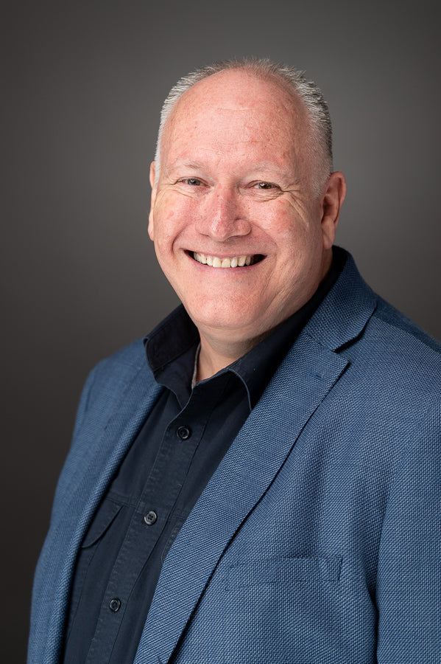
An Illustration: Guy Hammond

Slide 54


Slide 55


Slide 56
Lust is a sin
Matthew 5:27 “You have heard that it was said, ‘You shall not commit adultery.’ But I tell you that anyone who looks at a woman lustfully has already committed adultery with her in his heart.”
Men toward women, women toward men, men toward men, women toward women.
But… Temptation is not sin.
Conclusion: Same-sex attraction is not sin per se.

Slide 57
The Bible and Homosexual Behavior: Jesus
Matthew 19:4-6 “Haven’t you read,” he replied, “that at the beginning the Creator ‘made them male and female,’ and said, ‘For this reason a man will leave his father and mother and be united to his wife, and the two will become one flesh’? So they are no longer two, but one flesh. Therefore, what God has joined together, let no one separate.”
Matthew 5:31-32 “It has been said, ‘Anyone who divorces his wife must give her a certificate of divorce.’ But I tell you that anyone who divorces his wife, except for sexual immorality, makes her the victim of adultery, and anyone who marries a divorced woman commits adultery.”

Slide 58
Male and Female
Jesus: God’s plan for sexuality is that it be between a male and a female within the covenant of marriage.
God made us male and female for a reason
Genesis 2:24 “That is why a man leaves his father and mother an is united to his wife, and they become one flesh.”

Slide 59
Bible and Homosexual Behavior: Old Testament
Leviticus 18:22 “Do not have sexual relations with a man as one does with a woman; that is detestable.”
Leviticus 20:13 “If a man has sexual relations with a man as one does with a woman, both of them have done what is detestable. They are to be put to death; their blood will be on their own heads.”
Leviticus 18 context: your neighbor’s wife, your daughter-in-law, your wife’s sister, “do not sacrifice your children to Molech,” and “Do not have sexual relations with an animal.
All of these were common in the ancient Near East.

Slide 60
Non-sexual behavior as well
Deuteronomy 22:5
Ephesians 5:25-27
1 Peter 3:4
Of course, there are broad areas of overlap…
But God expects us to recognize and stay within masculine and feminine roles

Slide 61
Objections
That is the Old Testament. That is the Law of Moses, and Christians do not observe Old Testament prohibitions (Sabbath, kosher, more than one crop in a field)
Response: Look at the context of Leviticus 18, and note that these activities are called “detestable.” Eating pork is not described as “detestable.”

Slide 62
Bible and Homosexual Behavior: New Testament
1 Corinthians 6:9-10 “Or do you not know that wrongdoers will not inherit the kingdom of God? Do not be deceived: Neither the sexually immoral nor idolaters nor adulterers nor men who have sex with men nor thieves nor the greedy nor drunkards nor slanderers nor swindlers will inherit the kingdom of God.”

Slide 63
Bible and Homosexual Behavior: New Testament
1 Timothy 1:8-10 “We know that the law is good if one uses it properly. We also know that the law is made not for the righteous but for lawbreakers and rebels, the ungodly and sinful, the unholy and irreligious, for those who kill their fathers or mothers, for murderers, for the sexually immoral, for those practicing homosexuality, for slave traders and liars and perjurers—and for whatever else is contrary to the sound doctrine.”

Slide 64
Bible and Homosexual Behavior: New Testament
Romans 1:26-27 Because of this, God gave them over to shameful lusts. Even their women exchanged natural sexual relations for unnatural ones. In the same way the men also abandoned natural relations with women and were inflamed with lust for one another.”

Slide 65
Objections
1. These passages are with regard to pederasty (older men with enslaved children of the same gender), not homosexuality in general.
Response: That is simply not true! That is an ad hoc argument.
2. But David had a homosexual relationship with Jonathan 1 Sam 1:26
3. But they love one another. What can possibly be wrong with that?

Slide 66
Objections
4. The New Testament is so outdated on this topic. It is embarrassing.
5. God made me this way.
The question of nature vs nurture: There may be a grain of truth here.
But, all of us have particular tendencies in our own sinful nature which God commands that we must overcome.

Slide 67
A couple of thoughts
1. Heterosexual Christians must be very humble in judging those with this particular sinful tendency. Will you throw the first stone?
2. Nevertheless, Christianity is about holiness and righteous behavior. All of us must choose to turn away from our own personal sinful desires (money, sex, food, power, control)

Slide 68
Can a person stop being gay?
Mabye. Maybe not.
What about prayer?
What about “conversion therapy?”
Guy Hammond: “I have prayed this prayer many, many times, but I do so no longer.”
Remember: Same-sex-attraction is not sinful.

Slide 69
What Should I/We Do?
1. Call people to holy behavior. Avoid sentimentality.
2. Love and show heart-felt compassion to those who have unwanted (and even wanted!) same-sex attraction. Accept them. Do not shame them, and help them to overcome shame. Make them feel safe among us. Remember the woman caught in adultery in John 8:1-11.
3. These two exist in tension, but do not contradict.
“I desire mercy, not sacrifice.” Hosea 6:6, Matthew 9:13, Matthew 12:7

Slide 70
Discussion Questions
1. Do you ever have thoughts or use words which, if expressed to a person who is either actively homosexual or who has same-sex-attractions feel like they would not be welcomed here?
2. Are you influenced by sentimentality on this issue?
3. If Jesus were to come into a group in which he observed a person who is “gay,” how would he treat that person?

Slide 71
Transgender and Christianity
Is one’s gender determined by God?
Is one’s gender determined by biology?
Is one’s gender determined by personal decision?
What is the science of gender and sex?

Slide 72
Levels of Discussion
1. What can we say for sure (biblical statement or command)?
2. What can we infer or reasonably conclude based on biblical principles?
3. What are some gray areas, in which faithful, Bible-believing Christians will differ?

Slide 73
Transgender and Christianity
Two goals:
A. Present a clear biblical picture regarding gender and Christianity.
B. To do so in a way which makes those who have chosen to identify with a gender other than their biological sex not feel judged, or shamed, but to feel welcomed in our fellowship.

Slide 74
The Bible and Gender
Genesis 1:27 So God created mankind in his image, in the image of God He created them, male and female He created them.
But, our being created in the image of God is independent of sex or gender. Gal 3:28 In Christ… there is neither male nor female.
God does not have X or Y chromosomes and both male and female imagery is used of God, more or less equally.

Slide 75
But… God created sex/gender
Genesis 2:24 This is why a man leaves his father and mother and is united to his wife, and they become one flesh.
Also Deuteronomy 22:5 “A woman must not wear men’s clothing, nor a man wear women’s clothing, for the Lord your God detests anyone who does this.”
(but, here God is not discussing transgender)

Slide 76
What Can We Infer
From category #2 (reasonable inference)
God is not pleased with humans who choose not to accept who he made them to be—either male or female.
Objection: This is reading into the biblical text.
Response: True, but this is a reasonable, common-sense inference from what the Bible does say.

Slide 77
Caution: This topic is very fraught.
Q: What about a person who comes to us, and who has already gone through pharmaceutical or surgical sex-changing procedures?
From our lecture on bioethics:
The natural Christian attitude seems to be liberal when it comes to using technology to reduce suffering and to improve quality of life, but to be conservative on unnaturally altering life for personal benefit.

Slide 78
But the issue is still fraught!
Q: What if someone comes to us who is already transgender—who has already very significantly altered their bodies?
Case study: Brandon.

Slide 79
Category 3: Grey Areas
Other issues: Gender Dysphoria
“Gender Dysphoria is a medically recognized and clinically significant distress arising from a mismatch between a person’s gender identity and their sex assigned at birth. It represents a deep, lasting discomfort with one’s body, often causing anxiety and depression.
Demanding reassignment in this case may be dangerous.

Slide 80
Caution: Suicide and Transgender
Suicide rates among transgender individuals is 4-15 times higher than the general population.
Is this because choosing to be transgender is inherently dangerous to mental healty, or is this because of social marginalization, shaming and persecution?
Conclusion: Both, and let the Christian not be part of the second cause!

Slide 81
A Preliminary Conclusion
We can and should have strong convictions that God created us male and female, but we need to bend over backwards to avoid labeling, shaming those who come to us as transgender. And we need to be cautious to let them reach their own conclusion on the sinfulness of their choice and what they will choose to do about it.

Slide 82
What About Pronouns?
Q: Should we, as Christians, go against our convictions on the binary nature of gender and use they/them or he/she instead of she/he?
Option #1 Avoid the use of pronouns.
Better option: Out of respect for the individual, address people in the way they have humbly asked us to address them.

Slide 83
Rare (but real) Cases
A. XXY individuals. Klinefelter syndrome. 0.1-0.2%. One in 500-1000. Most are identified as male.
B. People incorrectly identified at birth due to ambiguous genitalia—unexpressed sexual characteristics. “Intersex.”
0.018% (not 1.7%!!!) One in 5,000.
Advice: This is rare, but handle with kid gloves.

Slide 84
What about teens?

Slide 85
Summary
On the margins, the distinction between sex and gender is not completely the work of the enemies of Christianity. Be cautious here
But, on the whole, God has unambiguously created humans male and female, and we should not let the marginal cases cloud what God has said and what he has created.

Slide 86
What Should I/We Do?
1. Call people to holy behavior. Avoid sentimentality.
2. Love and show heart-felt compassion to those who have transgender desires and have identified as transgender. Accept them. Do not shame them, and help them to overcome shame. Make them feel safe among us. Remember the woman caught in adultery in John 8:1-11.
3. These two exist in tension, but do not contradict.
“I desire mercy, not sacrifice.” Hosea 6:6, Matthew 9:13, Matthew 12:7

Slide 87
My article: Themes
Good apologetics: know the arguments
Acceptance, Inclusion, and Love
  Douglas Jacoby says, “Many Christians have failed to offer respect, love, and affection to gays, transgender, as well as to many other classes of persons. Maybe we need to remember that while Jesus freely associated with all sorts of people, he did so to demonstrate a divine love that motivates them to repentance. Think of his meal with Zacchaeus (Luke 19). Remember his meal with Simon the Pharisee (Luke 7)” (bolding added). Jesus was respectful and loving. He was also affectionate. He spent intimate time with people that others would have scorned. Often those who say they follow Jesus withhold their touch and affection from those who are gay, lesbian, bisexual, or transgender. Or they withhold their friendship and do not engage in close connection. Or they advise others not to be affectionate or too close. Take a good look at Jesus. We need to imitate Him and specifically we need to imitate His giving touch, His generous affection, and His genuine connection with others.

Slide 88
Discussion Questions
1. Do you believe it is sinful for a person to choose not to accept as their gender the sex that they were created as by God?
2. Have you had personal interaction with someone who is transgender? If you are comfortable, share your experience with the group, and what you feel would be an appropriate way to interact with this person as a Christian.

Slide 89
Christianity and the Military
Questions for thought:
1. Is it OK for a disciple of Jesus to be in the military—in a position in which they may be required to take the life of an innocent “enemy” in a military conflict?
2. What about a Russian (or Ukranian) serving in the army? What about one from the North or the South in the Civil War?
3. Is the “just war” theory valid?
4. What about a country with mandatory military service?
5. What about the biblical statement, “the authorities that exist have been established by God?”

Slide 90
Our approach
1. What can we say for sure, based on the Bible?
2. What can we infer or reasonable conclude based on biblical principles?
3. What are some gray areas where we should have our personal convictions, but show grace to those who think differently?

Slide 91
Jesus and Warfare
Matthew 5:43-44 “Love your enemies and pray for those who persecute you.”
Matthew 5:39 “Do not resist and evil person. If anyone slaps you on the right cheek, turn to them the other cheek as well.
Matthew 26:52 “All who draw the sword will die by the sword.”

Slide 92
Jesus and Warfare
John 18:36 “My kingdom is not of this world.”
Conclusion: Jesus was a pacifist who would not encourage his followers to engage in armed conflict in a supposedly morally just war.
Objection: But Jesus used military examples in his parables!
Answer: He also said “I come like a thief in the night.” !!

Slide 93
Paul
2 Corinthians 10:3-4 We do not wage war as the world does.
Conclusion from category 1:
A war for the sake of spreading Christianity or for guarding Christian belief is absolutely ruled out.
The Crusades and the Inquisition were un-Christian.

Slide 94
Question #2
What about Christians being involved in the military of legitimate states?
Luke 7:9 The Centurion.
Early Church Fathers: Clement of Alexandria (AD 150-215), Tertullian (AD 155-240), Hippolytus (AD 170-230), Origen (AD 185-250, and Lactantius (AD 240-320) all wrote strongly opposing Christian involvement in the military.
Fact: The early church was decidedly pacifist.

Slide 95
The Early Church (cont.)
But… Maybe their opposition was situational, given the requirement to make pagan sacrifice.
Augustine supported the joining of Church and State, and created the idea of the just Christian war.
Augustine: Grave evils can sometimes only be prevented through war. Defended the right of self-defense and defense of the innocent.

Slide 96
A Defense of the just war concept
1. God commanded that Israel engage in warfare to take the Promised Land. (objection, but this was a theocracy, which we do not have now)
Jesus: “My kingdom is not of this world.” and Luke 17:21 The kingdom of God is within (among) you.”
2. In a fallen world it is impossible for a stable government to exist without a military for defense. Even pacifists will agree with this!

Slide 97
A Defense of the just war concept
3. Paul defended the right of governing authorities to enforce their decisions, in some cases, through the use of force. Romans 13:1-7. “They do not bear the sword for no reason.”

Slide 98
Toward a Conclusion
1. Ought a Christian believer voluntarily join the military, given that they may be put in the position to take the life of a morally innocent person, or support others who do so?
2. Ought a disciple of Jesus join the military in a country with legally mandatory military service? (Israel, Russia, Ukraine, etc.)
What about conscientious objection status? Hacksaw Ridge

Slide 99
Toward a Conclusion
3. What about lethal self-defense or defense of family or the innocent? (gun ownership for such purposes)
4. What about a disciple of Jesus serving in the police, where the use of deadly force also might be required?

Slide 100
Conclusions
Category #1
1. Jesus was without qualification a pacifist, who would not use nor condone the use of violence either for military purposes or for self-defense, and probably not even to defend another.
2. Warfare for a “Christian” objective, to spread the faith or to defend the faith is ruled out.
The Crusades, and any religious war is ruled out as “Christian.”

Slide 101
Conclusions: Getting Personal Now
Category #2
3. Given Scripture and the history of Christianity, I reasonable infer that a Christian ought not to voluntarily choose the military as his/her career. The likelihood of finding oneself in a morally questionable position outweighs any proposed “positive” of military service for a Christian.
But… That is my personal conclusion.

Slide 102
Conclusions: Getting Personal Now
Category #3
4. Given Romans 13:1-7 Those already in the military and those who live in legally mandated military service is a gray area, and ought to be left as a matter of individual conscience.
5. Using deadly force in self-defense, or, more likely, in defense of one’s family or of the innocent is a gray area, and ought to be left a matter of individual conscience.

Slide 103
Conclusions: Getting Personal Now
Category #3
6. The role of the police is, theoretically, “to protect and to serve.” It is not to take violent offensive against perceived enemies. It is an acceptable and honorable career for Christians.
Exceptions: There are countries that it is impossible to serve in the police without taking part in corruption. Thankfully, this is not the case in the United States.

Slide 104
Discussion Questions
1. Do you agree with the statement that Jesus is, without qualification, a pacifist? Might he have made an exception, personally for himself?
2. Where do you find yourself in the area of using lethal force for self-defense or to defend the life of another?
3. Do you think that Pfc Desmond Doss ought to have been willing to bear arms to serve his country?
4. Has this lesson affected how you think about these question?

Slide 105
Christianity and Politics
As a Christian, what political party ought I align with?
What causes ought I support?
Are there “Christian” political causes?
Are there anti-Christian political causes?

Slide 106
Our approach
1. What can we say for sure, based on the Bible?
2. What can we infer or reasonable conclude based on biblical principles?
3. What are some gray areas where we should have our personal convictions, but show grace to those who think differently?

Slide 107
Premises For Our Discussion
We are citizens of the Kingdom of God. This takes precedence of any and all political questions.
The Bible, and the example of Jesus’ life determines what we will do.
The goal of this discussion is unity of God’s people.

Slide 108
Questions for Thought
What is the boundary between the kingdom of God and political perspectives?
Can the world be a better place? Ought we take part in that?
What ought I to stand and fight for in the worldly realm?
When should I remain silent for the sake of unity?

Slide 109
Who is in the Church?
Conservatives/Republicans
Progressives/Democrats
Communists
Libertarian
Socialists
Anarchists, Royalists, Isolationists, Globalists…
How do we maintain unity among these folks? Romans 15:7-9

Slide 110
God vs Satan
God wants to bring people together and to create unity.
Satan wants to create division and disunity through race, politics, education, gender

Slide 111
Religion and Politics Do Not Mix Well
Joshua 5:13-14 God: I am not on either “side.” Are you on my side?
Consider the history of theocracy and church/state politics.
Iran today. Crusades. Ireland.
When people say “God is on our side,” Run!!!

Slide 112
What Does God Have to Say?
Isaiah 55:8-9 God is on the side of holiness.
Jesus’ goal: John 17:20-21 May they be one as we are one.

Slide 113
Jesus and Politics
Who did Jesus support?
Romans, Sadducees, Pharisees, Herodians, Zealots?
Did Jesus ever make a statement supporting one over the other?
Look who was in Jesus’ group! Matthew (Romans), Simon the Zealot, Nicodemus the Pharisee
Gal 3:26, Col 3:11 Neither Jew nor Gentile, male nor female, slave or free, Barbarian, Scythian

Slide 114
Jesus and Politics
Who did Jesus associate with?
Mark 7:24-28 A Greek-speaking Syro-Phoenecian woman.
John 4 A Samaritan woman.
Matthew 8:5-13 A Roman Centurion
Matthew 15:21-28 A Canaanite woman
Luke 7:36-50, John 8:1-11 Sinful women
John 18:36 My kingdom is not of this world.

Slide 115
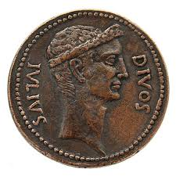
Gotcha Jesus: What about taxes?
Luke 20:25 Give to Caesar what is Caesar’s, and to God what is God’s.

Slide 116
“America: Love It Or Leave It”
Jesus (John 18:36) But now my kingdom is from another place.
Ephesians 2:19-22 Ours is a holy kingdom!
Can you think of a holy political cause/political party?
Suggestion: Do NOT use Scripture to back up your political beliefs.

Slide 117
Our Citizenship Is In Heaven
My loyalty: Jesus
My party: Christian
My leader: Jesus
Jesus is the solution to ALL the world’s problems. John 16:33 Take heart, I have overcome the world.”
We have the greatest cause in the world.

Slide 118
Christian Causes?
Christians should fight for the environment.
Christians should fight for the rights of the immigrant.
Christians should fight to end abortion.
Christians should fight the drug problem.
Christians should fight against the LGBTQ agenda.
Christians should fight to prevent communicable diseases.
Christians should fight for racial and social justice.
Christians should fight for the poor.
Christians should fight for access to education.
Christians should fight for freedom.

Slide 119
My cause is the right cause!
Should your cause be the church’s cause?
If you choose one or more causes, do NOT use political means, do not try to force others to join your cause, and, whatever you do, do not create division.
Matthew 23:23-24 Our cause is faith, justice and mercy
Jesus’s cause: Love.

Slide 120
Listen Up
In whatever cause you choose to promote:
1. Do not create division.
2. Do not publicly align with a particular political or other party.
3. Be VERY careful what you post on social media.
4. Make friends, not enemies.

Slide 121
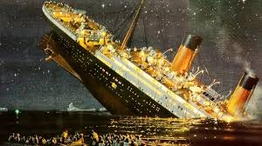
An Illustration: The Titanic
Before it sank: 1st class, 2nd class, 3rd class, steerage.
After it sank: Only two classes. Saved and lost.

Slide 122
Discussion Questions
1. What cause would you like to fight/advocate for?
2. How might one pursue that cause in a way which could be divisive rather than constructive of the Kingdom of God?
3. Is there a political sect that you are particularly challenged to accept in the church? What can you do about that?

Slide 123

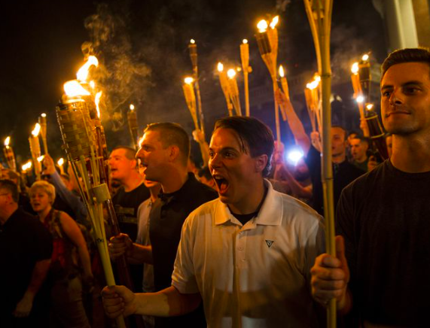
Christianity and Race
Charlottesville.Virginia, 2017
A CONVERSATION ON RACE AND THE CHRISTIAN ETHIC

Slide 124
DEFINITIONS
RACE – SOCIALLY CONSTRUCTED, TRADITIONAL DIVISION OF HUMANITY; people who usually (but not always) share common descent and certain physical characteristics
CULTURE – BELIEFS, BEHAVIORS, OBJECTS AND OTHER CHARACTERISTICS COMMON to members of a particular group or society
RACISM - [SYSTEMIC POWER + PREJUDICE] variety of practices, beliefs, social relation and phenomena that work to reproduce racial hierarchy and social structure that yield superiority, power and privilege for some and discrimination/oppression for others (as opposed to racist)

Slide 125
DEFINITIONS
BIGOTRY - [OBSTINATE PREJUDICE] the action of a person who is devoted to his/her own opinions and prejudices; especially one who regard or treats members of a group (such as racial or ethnic group) with hatred and intolerance
PREJUDICE - [PRECONCEIVED PERCEPTION] NEGATIVE OUTLOOK toward a person or group based on perceived status or characteristics – often held independently of facts about person or group

Slide 126
TWO TRUTHS AND A LIE
WE LIVE IN A POST-RACIAL COLORBLIND SOCIETY
RACISM CAN ONLY BE PERPETRATED BY THE DOMINANT GROUP IN A SOCIETY
RACE IS A SOCIAL CONSTRUCT WITH A DYNAMIC DEFINITION RATHER THAN STATIC

Slide 127
THE LIE IS…
WE LIVE IN A POST-RACIAL / COLORBLIND SOCIETY … COLORBLIND IDEOLOGY is a false premise that strips individuals of the characteristics that contribute to their experiences

Slide 128
Is being “colorblind” the solution?
In the US, a “colorblind” society is a Western-oriented, white-oriented culture.
I am not colorblind. I honor and value and celebrate different cultures.

Slide 129
Category #1 Does the Bible Address Racism?
No! The concept of race did not exist in the ancient world.
The idea of race was invented in Western Europe, primarily to explain and justify colonialism.
Race is a scientific fallacy. Race is a social construct.

Slide 130
But… The New Testament is a Handbook for Dealing with Diverse and Conflicting Cultures.
Aramaic/Hebraic vs Greek-speaking Jews Acts 6:1-2
“Persecution could not stop or even slow the church, but cultural divisions can destroy it.”

Slide 131
Diverse Cultures in the New Testament
The Jewish/Samaritan problem. Acts 8:4-8
The biggie!!! Jew/Gentile. Ephesians 2:11-18 He made the two one.
Ephesians 3:2-6 The great Mystery!

Slide 132
Diverse Cultures and Classes in the NT
Rich and Poor James 2:1-7
Colossians 3:11 Greek, barbarian and Scythian.
Acts 28:1-2 “Islanders” = barbaros/barbarians
Galatians 3:26 male and female. For another time…
A present-day example: Cameroon and Michael Burns.

Slide 133
That Was Then, This is Now. What About Us?
Do our churches have numerical racial diversity, or do we have truly diverse churches?
Do people of color feel the need to “act white?”
Are white people afraid of saying something “dumb?”
Do we have racial issues?
Ask a white person, then ask a person of color…

Slide 134
Michael Burns
“Dominant cultures tend to be unaware that they have cultures.” Their culture is “normal.”
“Non-dominant cultures tend to either blend in or to get defiant and cling to cultural norms.”
Other cultures are very aware
Believe me!

Slide 135
Example: Galatians 2:11-14
The dominant Jewish culture assumed that the Gentiles had to adapt to the existing culture.
Peter, using worldly wisdom, withdrew from Gentile fellowship to make peace.
Paul uses a kingdom midset. No Way! Not ever!

Slide 136
“We Need to End the Conspiracy of Silence”

Slide 137
LISTENING IS A THING
End the Conspiracy of Silence
ONE OF THE GREATEST TOOLS IN BUILDING TOWARD RECONCILIATION IS A SET OF EARS TO HEAR

Slide 138
Toward Reconciliation: CROSSING THE LINE
“ONE OF THE MAJOR PROBLEMS IN OUR WORLD RIGHT NOW IS THAT OFTEN WHEN PEOPLE WHO ARE CONSIDERED WHITE AND THOSE WHO ARE CONSIDERED PEOPLE OF COLOR DO TALK TO ONE ANOTHER, NOT ONLY DO THEY HAVE OPPOSITE PERSPECTIVES, THEY ALSO USE DIFFERENT MEANINGS FOR THE SAME LANGUAGE AND THAT LEADS TO TALKING PAST ONE ANOTHER”
MICHAEL BURNS
CROSSING THE LINE

Slide 139
Systematic Racism Out There
And the Trauma Is Real
Bakersfield, Mycresha Burns, Kansas, Cameroon, Abuja,

Slide 140
Does This Affect Our Churches?
In a word… Yes. Trauma is easily triggered. Buttons are easily pushed.

Slide 141
So, What Can We Do?
Galatians 3:9 Carry one another’s burdens.
And let’s be honest who has the racially-caused burdens.

Slide 142
CAN WE TALK? FOR A MINUTE
SIT DOWN. BE HUMBLE.
THROW GUILT OUT THE WINDOW
IF YOU ARE A CHRISTIAN, WHITE MALE AND WEALTHY – you navigate differently
ACCEPT AND VALIDATE THE EXPERIENCES OF OTHERS
RECOGNIZE RACE CONVERSATION IS ESSENTIAL TO PROLIFERATING THE GOSPEL

Slide 143
Toward a Solution
Compassionate burden-bearing listening.
Romans 12:21 Do not be overcome by evil, but overcome evil with good.
We need to talk!

Slide 144

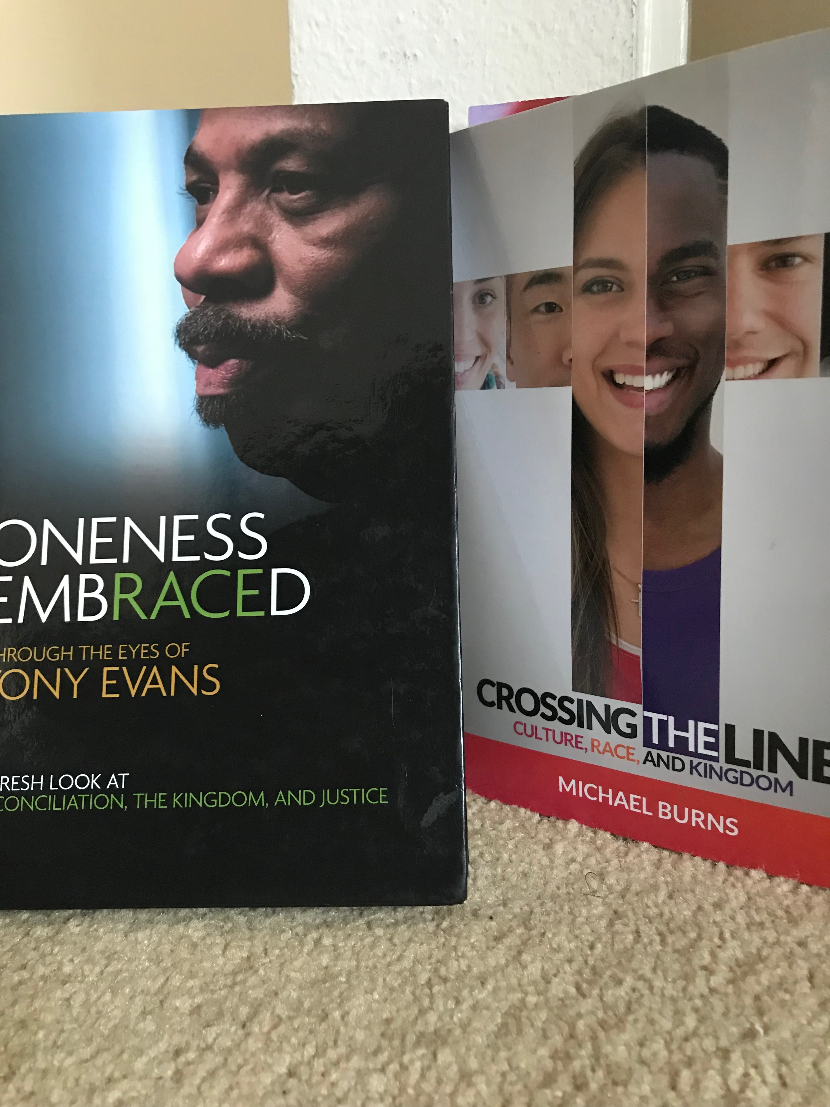
RESOURCES TO ENGAGE
Oneness Embraced by Dr. Tony Evans
Crossing the Line by Michael Burns
www.Blacktaxandwhitebenefits.com

Slide 145
Discussion Questions
1. Do you have any personal experience (of you or a close friend) of racial profiling, DWB and the like?
2. Are there any hot-button phrases for you—things that others might say you would be easily offended by?
3. Have you ever been accused of being culturally or racially insensitive? How did you react?
4. Have you ever misinterpreted another person’s actions because you had a different cultural basis from them?

