Slide 1
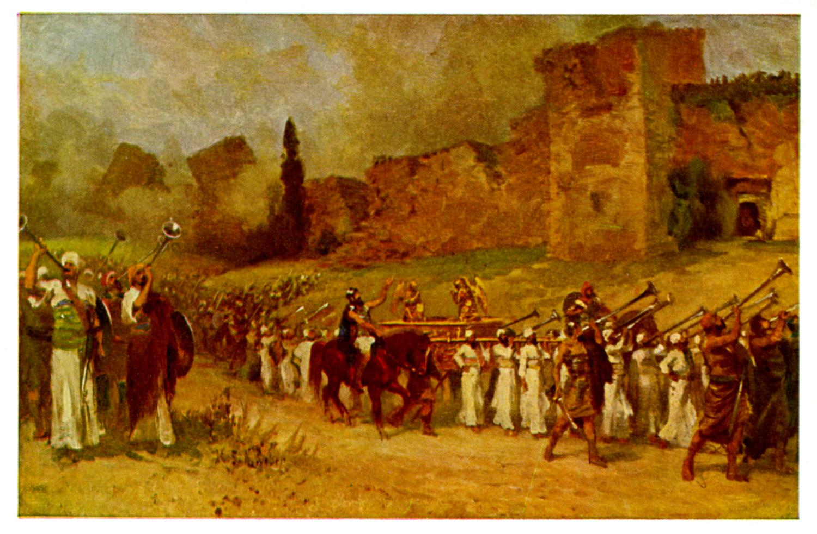
Joshua VI Victory at Ai

Slide 2
Great Victory, But… Joshua 7:1
What happens when we do not devote all to the Lord?
What happens when we choose to disobey God?
What happens to God’s plans when there is “sin in the camp?”

Slide 3
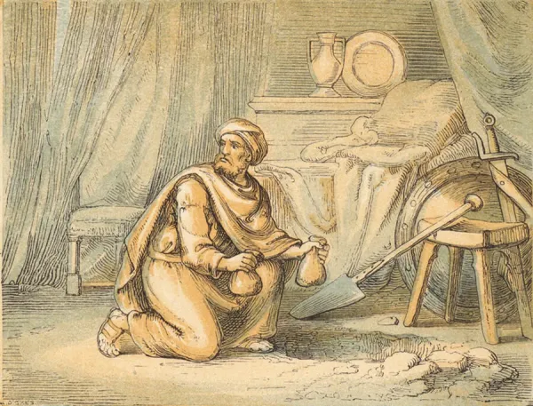
The Big Question This Morning
Do you have hidden, willful sin in your life?
Achan did, and the result was disaster!

Slide 4
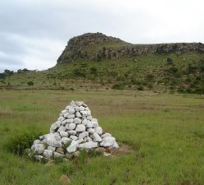
Joshua 7:26
Another Kind of “Stones of Remembrance”

Slide 5
Response
Do you have hidden, unrepented, willful sin?
Steps:
Confession
Repentance

Slide 6
Joshua 8:1-2 A Very Different Story
The spoils of Jericho have been fully devoted to YHWH
God is now with his people again. Victory is assured.
“Do not be afraid; do not be discouraged.
“You shall do to Ai what you did to Jericho.” (except this time you get to keep the plunder for yourselves)

Slide 7
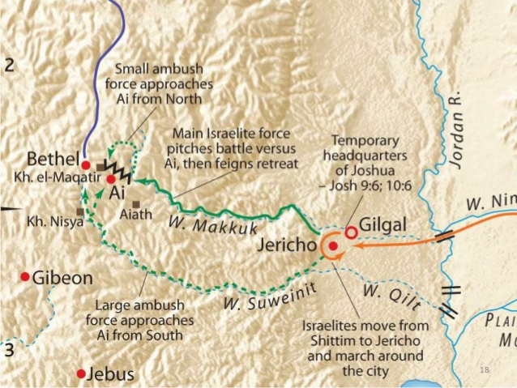
Joshua 8:3-29
God’s plan to defeat Ai

Slide 8
Joshua 8:3-29
Set and ambush
Hold up a javelin
Joshua obeyed YHWY to the “T.”
Do you desire spiritual discernment?
Philippians 1:9-10
Romans 12:1-2

Slide 9
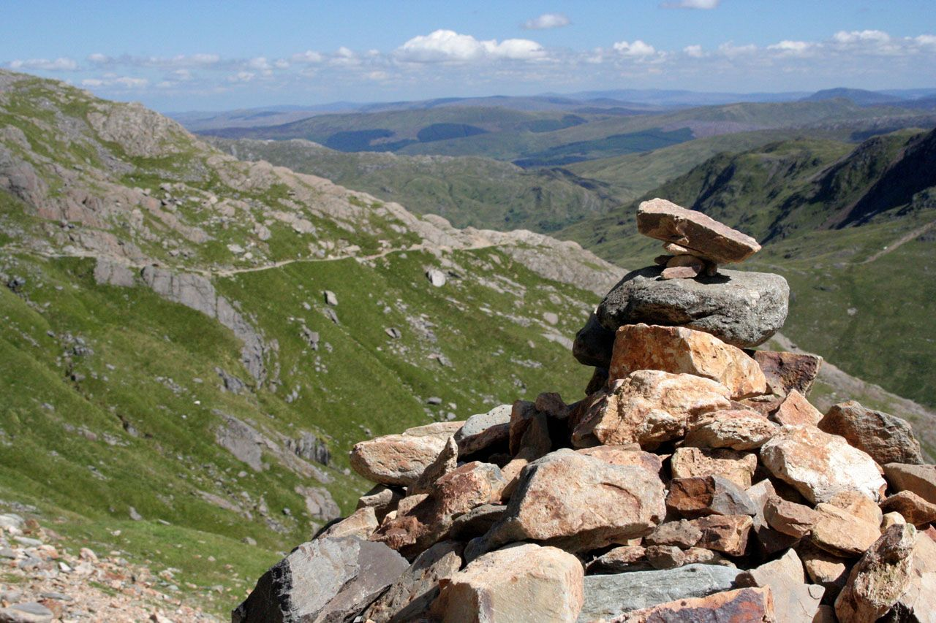
Stones of Remembrance
1. Gilgal: Remembering the miraculous crossing.
2. Jericho: Remembering the cost of rebellion
3. Ai: Remembering God’s victory.

Slide 10
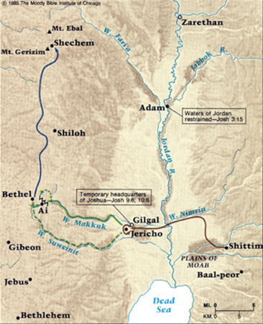
Joshua 8:30-35
Renewing the Covenant at Shechem. Deut 27:1-8
Mt Ebal: Curses
Mt Gerazim: Blessings

Slide 11
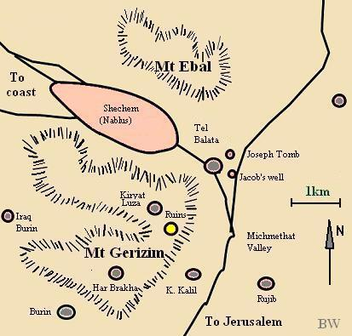
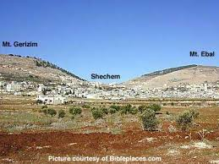

Slide 12
Joshua 9:1-2
Consequences for the sin of one man—for not devoting everything to the Lord.
The Canaanites, Jebusites, Amorites, Perizzites, Hivites no longer fear the Lord.
Imagine the massive result of one sin “in the camp!!”

Slide 13
Joshua 9:3-15 The Gibeonite Deception
Note the parallels between the Gibeonites and Rahab.
v. 14 A very costly oversight: They did not seek the will of God. They did not get advice.
Proverbs 15:22 Plans fail for lack of counsel.
Proverbs 12:15 A wise person listens to advice.

Slide 14
Joshua 9:16-27
Like Rahab, God shows grace to the Gibeonites for their faith in Him.
v. 20 We will let them live.
v. 24 The faith of the Gibeonites.
v. 26 So Joshua/Jeshua/Jesus saved them…

Slide 15
Summary
If we fully devote ourselves to God, he will go before us to take the “land” of Merced County.
But we must obey God’s instructions to a “T.”
We must seek spiritual discernment in order to do what is best.
We must seek spiritual wisdom and advice from wise counselors when making big decisions.

