Slide 1
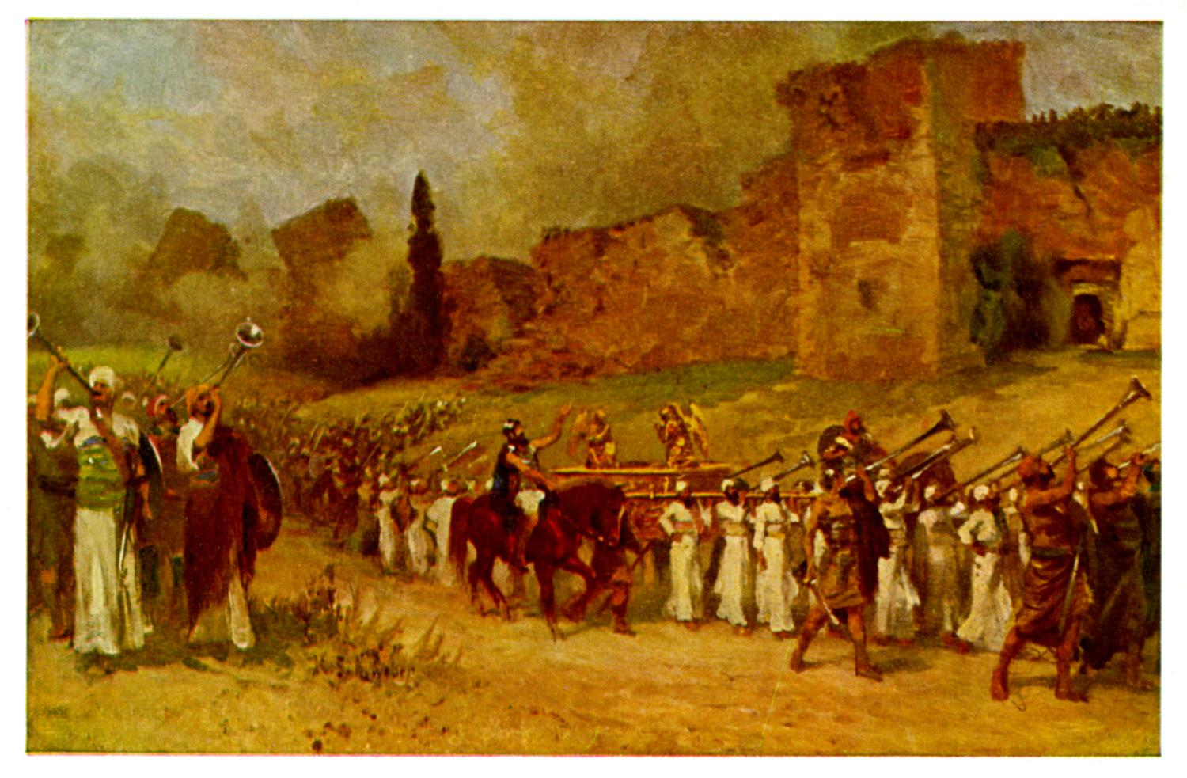
Joshua VII The Day the Sun Stood Still

Slide 2
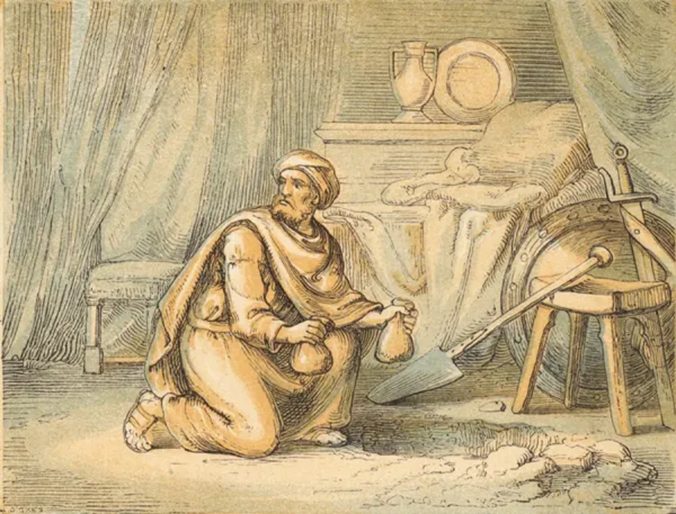
Joshua 7 Sin in the Camp Disaster at Ai
What happens when we do not devote all to the Lord?
What happens to God’s plans when there is “sin in the camp?”
Do you have hidden sin in your life? Things not devoted to God?

Slide 3
Joshua 8:1-2 A Very Different Story
The spoils of Jericho have been fully devoted to YHWH
God is now with his people again. Victory is assured.
“Do not be afraid; do not be discouraged.

Slide 4
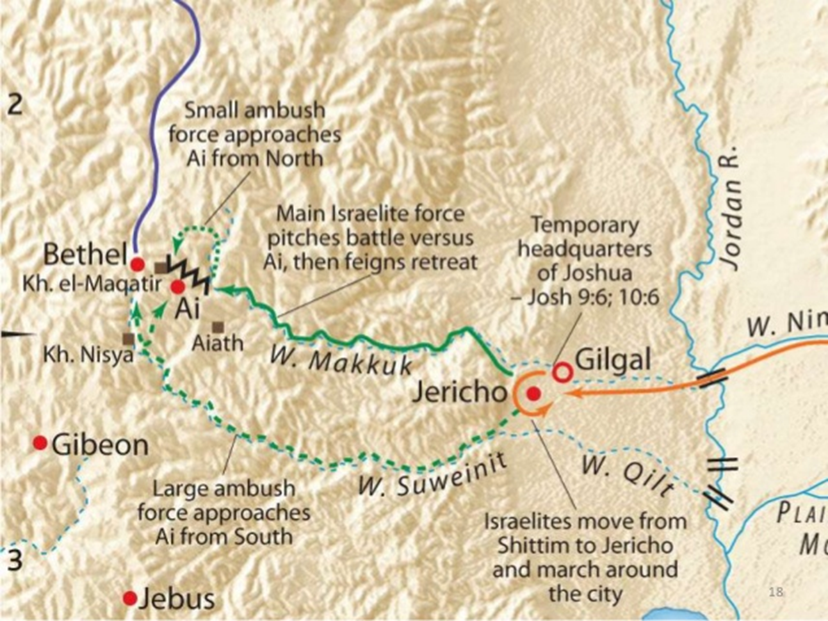
Joshua 8:3-29
God’s plan to defeat Ai:
Set and ambush
Hold up a javelin
Joshua obeyed YHWY to the “T.”

Slide 5
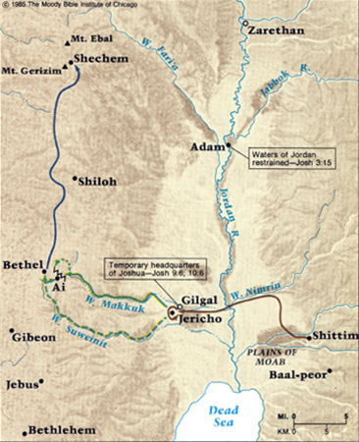
Joshua 8:30-35
Renewing the Covenant at Shechem. Deut 27:1-8
Mt Ebal: Curses
Mt Gerazim: Blessings

Slide 6
Joshua 9:1-2
Consequences for the sin of one man—for not devoting everything to the Lord.
The Canaanites, Jebusites, Amorites, Perizzites, Hivites no longer fear the Lord.
Imagine the massive result of one sin “in the camp!!”

Slide 7
Joshua 9:3-15 The Gibeonite Deception
The Gibeonites, like Rahab fear and trust in the Lord. So, God saves the Gibeonites.
v. 14 A very costly and foolish oversight: They did not seek the will of God. They did not get advice.
Proverbs 15:22 Plans fail for lack of counsel.
Proverbs 12:15 A wise person listens to advice.

Slide 8
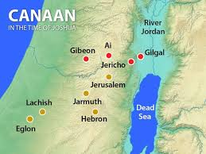
Joshua 10, 11: The Day the Sun Stood Still
The Southern Campaign
Adoni-Zedek of Jerusalem defies Israel and YHWH

Slide 9
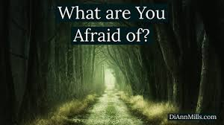
Joshua 10:8 Do Not Be Afraid
Deuteronomy 31:6
Joshua 1:6,7,9
Joshua 8:1
Joshua 10:8
And, by the way…
Joshua 10:25

Slide 10
Joshua 10:9-15
v. 9-10 Keys to victory for God’s people:
1. God threw them into confusion.
2. They made an all-night march.
God with us
Godly discretion and advice
Great effort and…. V. 12 Prayer

Slide 11
Powerful Prayer
Joshua 10:14 …a day when God listened to a human being.
And the sun “stood still”
James 5:17-18 Elijah a mere human being.

Slide 12
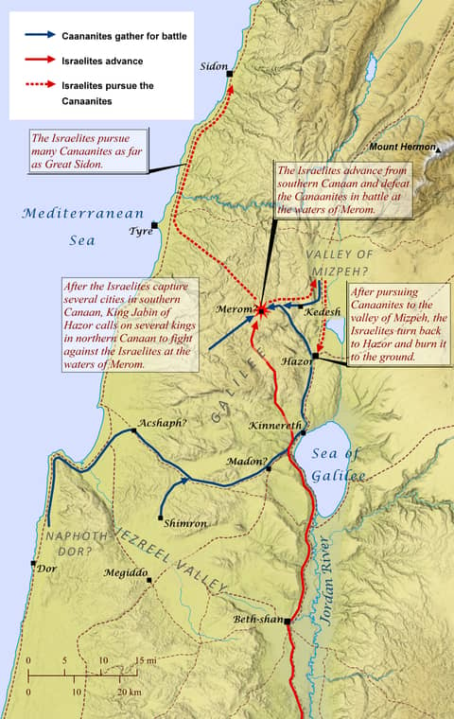
Joshua 11:1-7 The Northern Campaign
Canaanites, Amorites, Hittites, Perizzites, Jebusites and Hivites.
A huge army, as numerous as the sand on the seashore.

Slide 13
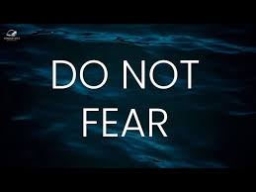
“A huge army, as numerous as the sand on the seashore.”
So, what does God tell Joshua?
v. 6 “Do not be afraid of them, because by this time tomorrow I will hand all of them over to Israel.”
Deuteronomy 20:1-4
Do you get the message?

Slide 14
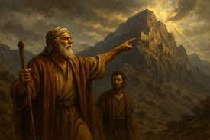
Joshua 14:6-16
Caleb:
Gave a minority report. God can do it!
Based his confidence on God’s promises.
Was strong and courageous.
Give me the hill country!!!

Slide 15
Summary
God has great plans for us as a church and for you individually.
1. God will go before us.
2. Seek discernment and wise counsel.
3. Be strong and courageous.
4. Pray.
5. And take action. Go out and do something by faith.

