Slide 1
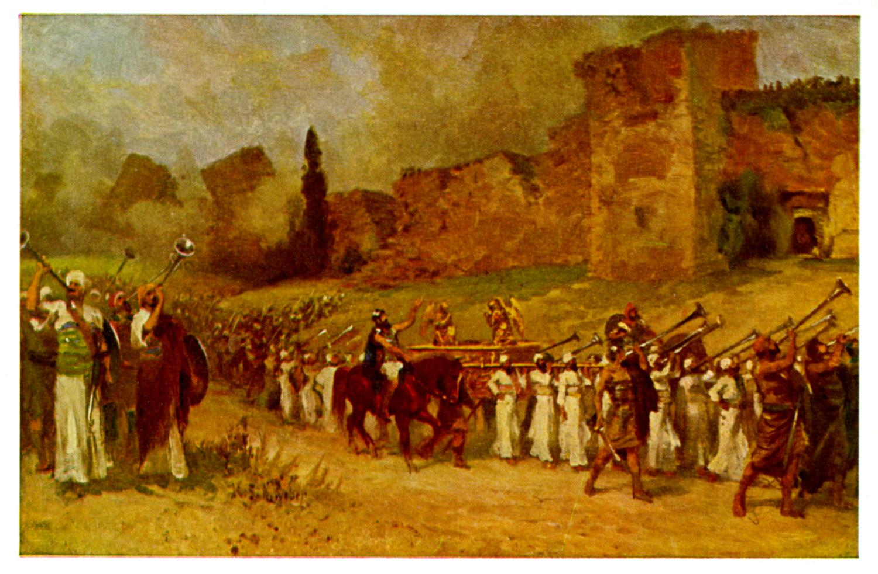
Joshua VIII
As For Me and My House

Slide 2
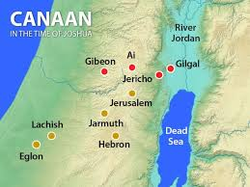
Joshua 10, 11: The Day the Sun Stood Still
The Southern Campaign
Adoni-Zedek of Jerusalem defies Israel and YHWH

Slide 3
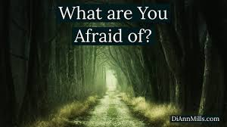
Joshua 10:8 Do Not Be Afraid
Deuteronomy 31:6
Joshua 1:6,7,9
Joshua 8:1
Joshua 10:8
And, by the way…
Joshua 10:25

Slide 4
Powerful Prayer
Joshua 10:14 …a day when God listened to a human being.
And the sun “stood still”
James 5:17-18 Elijah a mere human being.

Slide 5
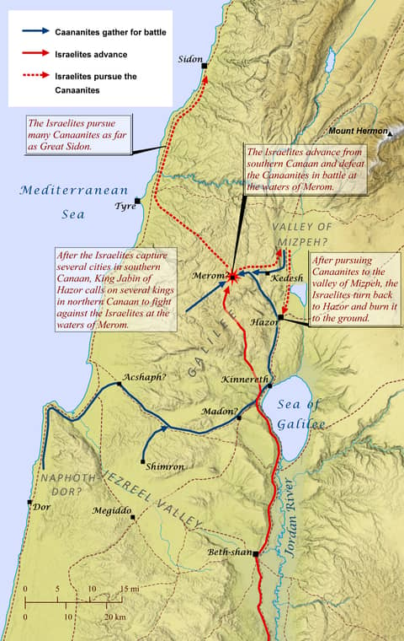
Joshua 11:1-7 The Northern Campaign
Canaanites, Amorites, Hittites, Perizzites, Jebusites and Hivites.
A huge army, as numerous as the sand on the seashore.

Slide 6
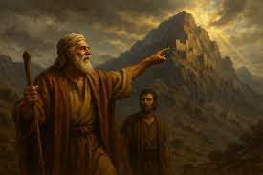
Joshua 14:6-16
Caleb:
Gave a minority report. God can do it!
Give me the hill country!!!

Slide 7
Joshua 22-24 As For Me And My House
What are Joshua’s parting thoughts for us?
Consider “salvation history.”
God has always been faithful. God has always shown hesed.
Therefore, let us do the same. Let us remain faithful. Let us show hesed—covenant loyalty/love

Slide 8
The Audience of Joshua 22-24
-The second generation. Those who crossed the Jordan with Joshua.
-Also future Israelites during the time of Judges.
The key to faith in Hebrews: Belief in things unseen.
The key to faith in Joshua: Belief in things you have seen.

Slide 9
Joshua 22 Gad, Reuben and Menasseh
Joshua 22:1-5 Keep hesed. Keep covenant loyalty.
How?
Love the Lord your God.
2. Walk in obedience.
3. Serve God with all your heart.

Slide 10
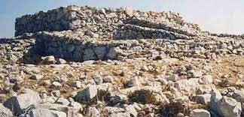
Judges 22:6-34 Holiness vs. Unity
The Western tribes are up in arms. They are disobeying Deuteronomy 12:13-14 sacrifices “only at one place.” Am I my brother’s keeper?
The Eastern tribes: We are trying to maintain unity.

Slide 11
Joshua 23-24 Parting Words
Joshua 23:1-5
v. 2-4 Remember all that God has done for you already.
v. 5 Believe he will do the same in the future.

Slide 12
Joshua 23:6-13
God has already done amazing things, yes???
For this to continue do this:
1. Obey God’s words.
2. Separate yourselves from the pagan nations

Slide 13
Be Holy Be Separate
1 Corinthians 7:39 Only in the Lord
2 Corinthians 6:14 Do not be yoked with unbelievers.
“The application of obedient separation in the Christian life is frequently difficult and sometimes agonizing.”
They will be traps for you.

Slide 14
Joshua 24:1-15 Remember What God Has Done
v. 1-4 I blessed Abraham, a man of faith.
v. 5-10 I blessed Moses and saved the people from slavery.
v. 11-13 I blessed Joshua and saved you through him.
God: I have ALWAYS maintained hesed/covenant loyalty

Slide 15
Joshua 24:14-15 The Bottom Line
Choose today whom you will serve.
Multitudes, multitudes in the Valley of Decision.

Slide 16
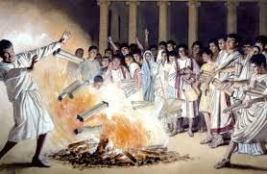
Joshua 24:16-24
The people: We will do it! “Far be it from us…”
Joshua: Forgive me, but I am skeptical.
The people: No, trust us!
Joshua: Put your money where your mouth is. Get rid of your idols. Acts 19:17-20.

Slide 17
Joshua 24:29-33 Epilogue
God has always maintained covenant loyalty—hesed.
Example: Joseph’s bones. 400+ years
Hosea 11:1 Out of Egypt I called my son. Joseph, Moses, Israel, Jesus, us!!!!
And he will bring us into the Promised Land. Amen!

Slide 18
Summary
Remember
Obey
Separate Yourselves
Choose today whom you will serve

