Slide 1

2 Peter IV Be Careful of False Teachers

Slide 2
Themes of 2 Peter
True knowledge of God.
Growth in holiness.
The Return of Christ as motivation for holiness.

Slide 3
Theme Passage of 2 Peter
2 Peter 1:3 “His divine power has given us everything we need for a godly life through our knowledge of him who called us by his own glory and goodness.”

Slide 4

2 Peter 2:12-21 Confidence in God’s Word
v. 12-15 Back to Basics
v. 16-18 Even More Confident in God’s Word
v. 19-21 God’s Word is Truly Inspired

Slide 5
Last Week
2 Peter 2:1-3 Be careful of false teachers and of those who falsely claim to be prophets.
This week: More of the same.

Slide 6
2 Peter 2:1-3 Beware of False Teachers
Destructive heresies
Take sin lightly—pray Jesus into your heart
In it for the money—prosperity gospel
2 Tim 4:1-5 They teach what our itching ears want to hear.
Once saved, always saved
“This is my prophecy” “God told me to tell you…”

Slide 7
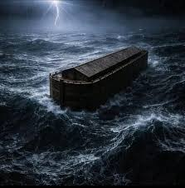
2 Peter 2:4-9 God Judges False Teachers
Angels who sinned
Noah and the Flood apathy, disobedience

Slide 8
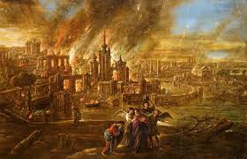
2 Peter 2:4-9 God Judges False Teachers
Sodom and Gomorrah sensuality
But God rescued Noah and he rescued Lot and he will rescue us.
Luke 17:32 Remember Lot’s wife.

Slide 9
2 Peter 2:9b-16 False Teachers
Follow corrupt desires and
Despise authority
Even angels would not do that, but they do!
Balaam is their model Numbers 22-24
-in it for the $$$$
-enticed Israel to sin Revelation 2:14-15

Slide 10
2 Peter 2:17-22
Springs without water.
Their “liberation” produces slavery!

Slide 11
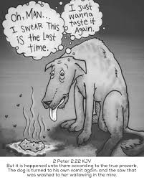
2 Peter 2:17-22
Your salvation is at stake!
Like a dog returning to its vomit.
Like a pig going back to the mud
Hebrews 6:4, 10:26-31

Slide 12
Summary
Beware of false teachers!
They claim to speak for God but do not.
They flatter, they itch ears, they offer easy salvation, they teach freedom.
Do not listen to them. They are springs without water.
God will judge them, but he will save you!
2 Peter 1:10-11

