Slide 1

2 Peter VI
Be Prepared for Christ’s Return

Slide 2
Themes of 2 Peter
True knowledge of God.
Growth in holiness.
The Return of Christ as motivation for holiness.

Slide 3
2 Peter 2:1-3 Beware of False Teachers
They take sin lightly—pray Jesus into your heart
They are in it for the money—prosperity gospel
2 Tim 4:1-5 They teach what our itching ears want to hear.
Once saved, always saved
“This is my prophecy” “God told me to tell you…”

Slide 4
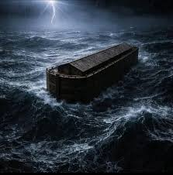
2 Peter 2:4-9 God Judges False Teachers
Noah and the Flood apathy, disobedience

Slide 5
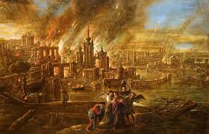
2 Peter 2:4-9 God Judges False Teachers
Sodom and Gomorrah sensuality
But God rescued Noah and he rescued Lot and he will rescue us.

Slide 6
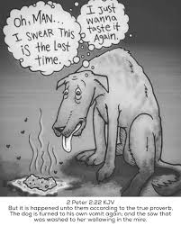
2 Peter 2:17-22
They are springs without water. They teach liberty, but produce slavery.
Your salvation is at stake!
Like a dog returning to its vomit.

Slide 7
2 Peter 3 Prepare for the Return of Christ
2 Peter 3:1-2
v. 2 Dear friends, recall the OT Prophets
v. 14 Dear friends, make every effort to be blameless
v. 17 Dear friends, be on guard against false teachers

Slide 8

2 Peter 3:3-7
“Above all…”
Do not listen to those scoffers
Jesus will return at the end of time. Mark it down!

Slide 9
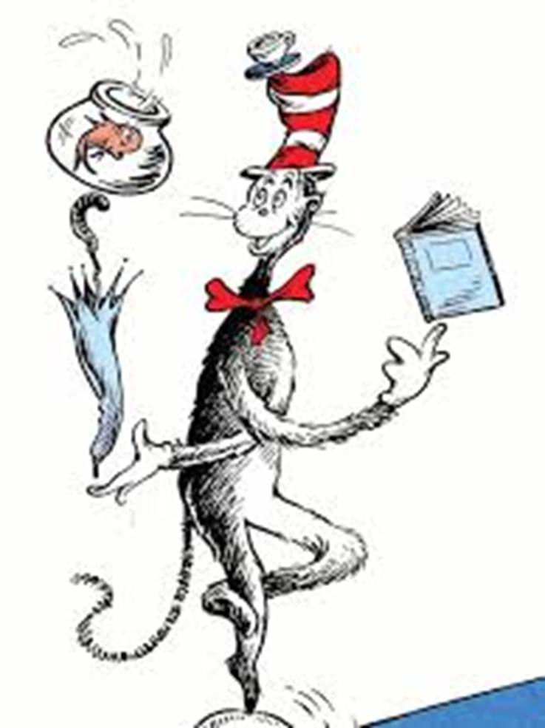
2 Peter 3:3-7
Why is belief in the immanent return of Christ such a big thing in the Christian life?
God want us to live as if Christ will come at any time. Because he will!

Slide 10
Be Prepared
Matthew 25:1-14 Keep watch!
We live in the shadow of the second coming of Christ.
Matthew 24:42-44 Again, keep watch!!!
The scoffer says, “History proves it is not reasonable to believe in the second coming.”
Peter says (2 Peter 3:7) “They deliberately forget.” the flood and Sodom.

Slide 11
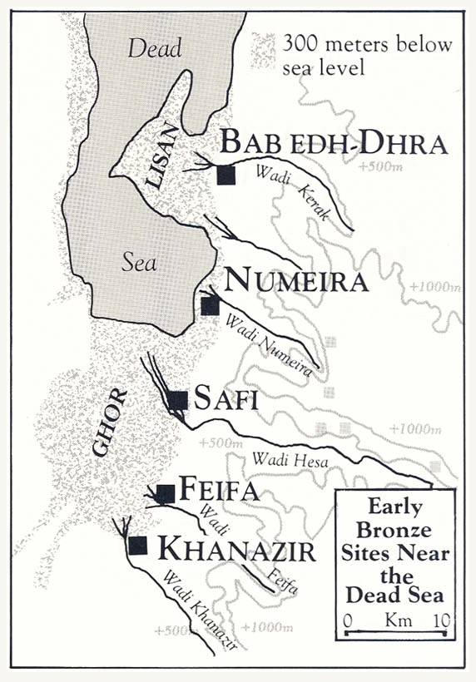
v. 7 “By the same word…
As with Noah and then with Lot.
First water, then fire.
BTW The destruction of Sodom really happened
Genesis 19

Slide 12
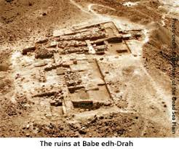
Ruins at Bab ed-Dhra (Sodom)

Slide 13
What Do We Learn From the Flood and Sodom?
We learn that this world is governed, not just by natural law, but also by a moral law that sin and rebellion requires judgment by God.
Matthew 24:36-39 “Eat, drink and be merry…”
The second coming of Christ is a day both of judgment and of salvation. Make sure it is salvation for you!
Deuteronomy 32:22 A day of purification

Slide 14

2 Peter 3:8-18
In the light of the second coming, how ought we to live?
The scoffers: “Where is this coming?”
God: A day is like a thousand years.
$$\frac{2000}{13.5bⅈl}×2000Yrs=0.025sec$$

Slide 15
So… How Should We Live?
As if Jesus might come back today and
As if Jesus will not come back for many years
2 Peter 3:9 God is waiting to give us an opportunity to repent.
v 10 But… The Day will come like a thief Matt 24:43-44
Habakkuk 2:3

Slide 16
2 Peter 3:11-13 The Main Point of 2 Peter
You ought to live holy and godly lives.
Q: How are you doing on this?
Speed the coming of Christ. Are you speeding the coming of Christ?
Look forward to his coming. Get excited! God is making everything new!!! It will be amazing.
Isaiah 65:17-21

Slide 17
Dear Friends…
v. 14 Make every effort to be found spotless, blameless and at peace.
v. 17 Be on guard against false teachers.

Slide 18
Summary
The second coming of Christ is immanent and it is real. You can mark it down!
Therefore, let us not listen to the scoffers, and let us grow in grace and knowledge and let us live holy, godly lives, and let us speed the coming of Christ.

