Slide 1

Welcome to the Alpha Omega Midweek

Slide 2
Difficult Questions for Christians
Bioethics (cloning, IFV, brain implants, gene therapy, etc.)
Reproduction and Christianity (abortion, birth control IVF)
Gender and Christianity.
Christianity and Military Service.
Christianity and Politics
Christianity and Race.
Christianity and Philosophy Modernism/Postmodernism
Christianity and Culture, Modesty, Gambling, Drinking, Medical Marijuana.
There is a lot there!!!!!!!

Slide 3
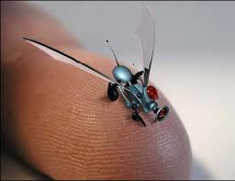
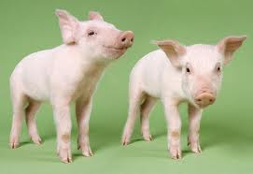
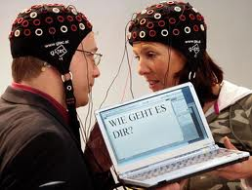
Christianity and Bioethics
John Oakes

Slide 4
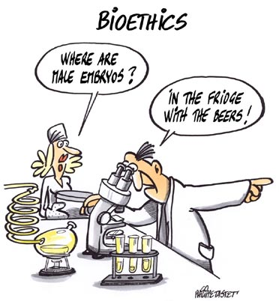
Outline
I. What is bioethics?
II. Why Should a Christian Care About Bioethics?
III. Toward a Christian Response to Questions of Bioethics.
IV. A Case Study: Stem Cell Research

Slide 5
A Useful Definition of “Bioethics”
Ben Mitchell and John F. Kilner in Does God Need our Help?
Bioethics is a process of “distinguishing between what we should pursue and what we shouldn’t pursue in matters of life and health.”

Slide 6
Morality vs. Ethics
Morality has to do with right and wrong and assumes an authoritative definition
Ethics has to do with better or worse or cost/benefit analysis and has primarily to do with human-human interaction.
Christians may have a fair amount in common with the wider world on ethical questions, but probably not on moral questions.

Slide 7
Why Should a Christian Care About Bioethics?
Biotechnology: Scientific methodologies specifically directed toward manipulating living things—whether human or non-human.
Examples: antibiotics, psychopharmaceuticals, genetically modified crops, recombinant DNA technologies (to produce necessary hormones such as insulin or blood clotting factors for example). Chemically engineered drugs, organ transplants, pacemakers, computer-aided prosthesis, gene therapy, stem cell and fetal tissue therapies, human and therapeutic cloning, neural implants (against Parkinsons, for example) and much more….

Slide 8
Just To Get You Thinking
To my SCI 110 Intro to Scientific Thought Class:
1. You think a new technology is ethically bad today, but 30 years from now you will celebrate it. IVF
2. You think a new technology is a great idea today, but 30 years from now you will think it was an ethical disaster. DDT
Law of unintended consequences
3. The pace of scientific discovery and production of new technologies has outpaced human’s ability to grasp the ethical implications.
4. You cannot trust the scientists on this one.

Slide 9
manHuman Enhancement
Leon Kass: “Human nature itself lies on the operating table, ready for alteration, for eugenic and neuropsychic enhancement, for whole-sale redesign.”
Humanity Plus: “Transhumanists view human nature as a work-in-progress, a half-baked beginning that we can learn to remold in desirable ways.”
Breast implants, anabolic steroids. Legitimate therapeutic drugs used for enhancement (Ritalin, SSRIs, antidepressants, etc.). Alzheimer’s drugs used to improve natural memory. Eugenics to eliminate deafness, genetic diseases, to improve athletic abilities, etc.

Slide 10
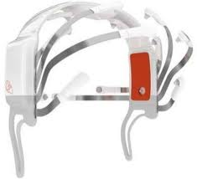
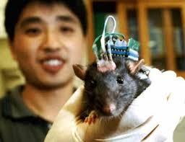
Will Gamers Be Able to Resist Brain Implants?

Slide 11
Human Enhancement
“The very identity of the human person and the very substance of reality are presumably called into question by developments in artificial intelligence, in genetics, and in virtual reality.” Albert Borgmann
The artificial improvement of human beings will come, one way or another, whether we like it or not, as soon as the progress of biological understanding makes it possible. When people are offered technical means to improve themselves and their children, no matter what they conceive improvements to mean, the offer will be accepted. Improvement may mean better health, longer life, a more cheerful disposition, a stronger heart, a smarter brain, the ability to earn more money as a rock star or baseball player or business executive. The technology of improvement may be hindered or delayed by regulation, but it cannot be permanently denied. Freeman J. Dyson, Physicist.

Slide 12
A Simple Answer
Well, as long as it is voluntary….
Is it really voluntary? The answer: Not really, due to social pressure (example: steroids)
Will all have equal access?
All of these issues cry out for a “Christian” response.

Slide 13
Some Questions to Think About
What is the purpose of human existence?
What is the meaning of human dignity?
What is free will and what is its relationship to technologies?
What is a soul and what are the implications of the mind/body/soul relationship?
What is the meaning of human autonomy, is this a Christian value, and is it in play in these technologies?

Slide 14
Questions (cont.)
Are we prepared to let market forces determine the direction of biotechnological advance?
Should we leave control for the direction of biotechnological moves in the hands of avowed naturalists/scientific materialists?
Are we going to simply take the “It is in God’s hands” approach to this?

Slide 15
Toward a Christian Response to Bioethical Questions
The naturalist view:
We are the purposeless result of blind natural forces. We are temporal and are not spiritual. In this world view, biotechnological choices come down to cost/benefit analysis alone. Human dignity (worth) is a questionable concept.
In the Christian world view, the individual has a dignity because we are made in the image of God (Genesis 1:26-27, Genesis 9:6) which should be respected. This limits the viability of cost/benefit analysis.

Slide 16
Human Dignity
“Human dignity in the biblical perspective does not depend solely on who we are but, more important, on who God is—as well as on what God has done, is now doing and will do in the future” (from Biotechnology and the Human Good)
Are we guests, invaders or caretakers?
Hebrews 2:8 (quoting Psalm 8:6) God put us over the physical earth. We are responsible for it.

Slide 17
Human Responsibility
Genesis 2:15 (about the garden) keep (shamar) it
Genesis 1:28 Fill the earth and subdue it.
But…
1 Cor 4:2 It is required that those who have been given a trust must prove faithful.
Conclusion: We do not worship nature (biocentrism) but we are over nature as responsible, caring stewards.

Slide 18
A cautionary tale: The Tower of Babel
Genesis 11 Come let us build…. and make a name for ourselves.
C S Lewis in The Abolition of Man, “What we call man’s power over nature turns out to be a power exercised by some men over other men with nature as its instrument.”
Applied to biotech, should we have as a goal to remake, redesign and prefabricate ourselves?
Did Jesus enhance or reengineer either himself or others?

Slide 19
A Preliminary Answer
Morally and ethically responsible stewardship (guided by a biblical understanding of the relationship between the created (man) and the creator).
The ultimate goal of Christian medicine is not immortality. Our goal is not to avoid death at all costs, but to create as fulfilled a life on earth as we can.
We should use biotechnologies to relieve suffering in a way which protects human dignity without making humans less human.
We should do through technology what Jesus did in his ministry (relieve suffering, create a greater quality of life, avoid unnecessary, untimely death)

Slide 20
Another Way to Put It
The natural Christian attitude seems to be liberal when it comes to using technology to reduce suffering and to improve the quality of natural life, but to be conservative in unnaturally altering life for personal or monetary benefit.

Slide 21
Helpful Questions (from Biotechnology and the Human Good by Ben Mitchel et al)
1. Does the technology assist us in fulfilling or stewardship responsibilities?
2. Does the technology require or promote the commodification or destruction of human life? Does the technology demean, debase or degrade individuals?
3. Does the technology primarily appeal to our basest inclinations?
4. Is the technology a vehicle to promote our own narcissistic self-absorption?

Slide 22
Questions (cont.)
5. Does the pursuit or use of the technology make just use of resources? Or does it use gross amounts of natural resource for a limited positive result?
6. Does the technology promote genuine human flourishing or does it more likely promote technological and economic imperatives? Must we adapt to the technology, or was the technology designed to adapt to human nature and human needs?
7. How much additional technology is necessary to produce, maintain or safely constrain/contain the technology?

Slide 23
IV. A Case Study: Stem Cell Research
Are there moral implications? We should start there. (answer: maybe)
Are there ethical issues? (Yes. Only for the wealthy, great cost with limited benefit)
Is this to enhance human capability or is it to give health and alleviate suffering? (mostly the second)
Is there sufficient negative harm to others which more than offsets possible good?
Caution: We will not all agree on these things…

Slide 24
What about Human Cloning?
Do you mean human cloning or therapeutic cloning?
Are there moral implications? We should start there. (I say no)
Are there ethical issues? (absolutely)
Is this to enhance human capability or is it to give health and alleviate suffering? (it seems to be the first)
Is there sufficient negative harm to others which more than offsets possible good? (you decide)

Slide 25
Psychoactive Drugs and Mental Health
This is a very fraught issue, and it is a very complex issue!
Is there a moral issue? Is it a sin to use drugs to alter our state of mind? What about using psychadelics?
Is the Christian view that our first/automatic response ought to be to avoid the use of mind-affecting drugs if at all possible, or ought it be to let the professionals tell us what is best?

Slide 26
Suggestions
Be careful about presupposing the proper “Christian” view on any particular topic. Be prepared to do some research (and be really careful where you do that research!!!!) Be willing to have deep convictions, but also to show grace toward those with whom you do not agree—whether they are believers or not.

Slide 27
Discussion
Which issue in the general area of bioethics did you find most interesting or of concern to you?
Have you formed any thoughts on this issue? Are they related to morality or to ethics?

Slide 28
Difficult Questions for Christians II
Reproduction and Christianity
Abortion
Contraception
In Vitro Fertilization, Surrogacy, etc.

Slide 29
Levels of Discussion
1. What can we say for sure (biblical statement or command)?
2. What can we infer or reasonably conclude based on biblical principles?
3. What are some gray areas, in which faithful, Bible-believing Christians will differ?

Slide 30
Levels of Discussion
1. What can we say for sure (biblical statement or command)?
2. What can we infer or reasonably conclude based on biblical principles?
3. What are some gray areas, in which faithful, Bible-believing Christians will differ?

Slide 31
Abortion and Christianity
A. God encourages (commands?) that humans produce children. Genesis 1:28 Psalms 127:4 God helps barren women.
B. But… God allows and in some cases encourages some to not marry. Matthew 19:10-12 1 Corinthians 7:25-38
Conclusion: Marriage and child-bearing are honored and even encouraged, but not commanded of Christians.

Slide 32
Bible Scriptures on Abortion
Poor proof-texts: Psalm 51:5 Exodus 21:22-25

Slide 33
“Infer or Reasonable Conclude”
But… The Sanctity of Life is VERY biblical.
Psalm 139:13-14 Jeremiah 1:5
Conclusion: All human life is sacred and Christians ought in every case to protect the sanctity of human life.
Aside: The primitive church saved unwanted life of “exposed” children.

Slide 34
An Ethical Argument Against Abortion
1. “Viable” unborn children should not be killed.
2. “Viability” is an arbitrary distinction, with no logical ethical or moral meaning.
3. Therefore, it is unethical (and immoral/sinful?) to take the life of any unborn child—even an “unviable” one.

Slide 35
But… Is it that simple?
When does human life begin?
A. At fertilization.
B. At implantation in the womb.
The Bible does not answer that question.

Slide 36
Conclusion
From the Christian perspective, it is immoral and a sin, from the time of implantation of the embryo in the mother’s womb to willfully take the life of that child.
But, what about the pregnant teenager? What if I cannot afford to raise the child? What if it will destroy my educational opportunities? What about my social life?
Answer: Conviction, but primarily compassion, not judgment.

Slide 37
Two Questions
1. What about a non-believing friend who chooses to take the life of her child? Should we condemn or support?
2. What about people we meet (men or women!) who have already had an abortion?
- aware that this is a sin.
- compassion, comfort, forgiveness

Slide 38
What Should I Do About This?
Offer compassion and forgiveness.
Should I demonstrate against abortion? Should I picket abortion clinics?
Should I take direct action to help support the option of adoption?
Answer: Your choice.

Slide 39
Last Consideration
What about the (rare) possibility of needing to choose between the life of the mother and that of the unborn child?
- In most, but not all cases, it is a choice between the death of one or of both.
- Ethicists and many Christians believe the choice is a clear one. In principle, the life of the mother takes priority.
-In quite rare cases, this is a fantastically difficult choice.

Slide 40
II. Christianity and Contraception
Scriptures: None! Genesis 38:8-10 Onan.
This is a very poor proof-text. The sin here is selfish sexual gratification, not birth control.
Conclusion: Christians will differ, but the Bible is relatively unhelpful on this topic.
Suggestion: Be aware that faithful, God-loving believers will differ on this question.

Slide 41
Is All Birth Control the Same?
The “pill”
IUD
Morning-after pills
All prevent pregnancy/ovulation and none destroy fertilized embryos.
The “abortion pill” (actually pills) is completely different! It takes the life of an unborn child.

Slide 42
III In Vitro and Surrogacy
In-Vitro Fertilization (IVF)
At one time (like 40 years ago) most Christians of many stripes condemned this as an immoral stepping on the prerogative of God.
Ethical concerns? (cost, suffering, etc.)

Slide 43
So… Is IVF Okay for Christians?
Debatable!!!
The issue of multiple embryos, some of which are destroyed.
Alternative: Implantation of all fertilized embryos.
Conclusion: Faithful, God-fearing discipes will disagree on this.

Slide 44
Surrogacy
Q: Would a Christian couple ever use a surrogate mother to give birth to their child? What about a donated egg or donated sperm?
Q: Would a Christian woman ever act as a surrogate for a friend or a relative, or even for $?
Chat GPT: Surrogacy is not explicitly forbidden in the Bible, but Christian views are deeply divided, ranging from viewing it as a loving act of compassion to a violation of the sanctity of marriage and human dignity. While some, particularly in certain Protestant denominations, may accept it, the Roman Catholic Church formally opposes all forms of surrogacy, viewing it as a disruption of the natural marital union.

Slide 45
Discussion Questions
1. What do you feel about the Christian idea of the sanctity of life? Is this a clear and absolute Christian moral position?
2. What question was raised by this class that you would like to discuss in this group?
3. It was claimed in this class that there is no Bible verse on abortion specifically. Do you agree with this claim (not sure is fine)? If so, does it bother you to have such an important question not addressed?

Slide 46
Christianity and Gender
Major areas of concern to Christians:
Homosexuality
Transgender

Slide 47
Levels of Discussion
1. What can we say for sure (biblical statement or command)?
2. What can we infer or reasonably conclude based on biblical principles?
3. What are some gray areas, in which faithful, Bible-believing Christians will differ?

Slide 48
Homosexuality and Christianity
Two goals:
A. Present a clear biblical picture regarding homosexual behavior.
B. To do so in a way which makes those with same-sex attractions not feel judged, or shamed, but to feel welcomed in our fellowship.
Separate attraction from action

Slide 49
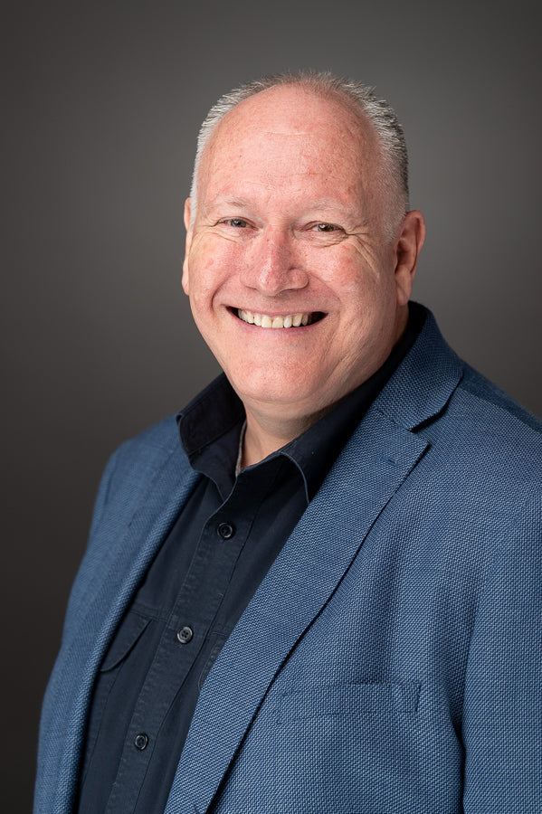
An Illustration: Guy Hammond

Slide 50


Slide 51


Slide 52
Lust is a sin
Matthew 5:27 “You have heard that it was said, ‘You shall not commit adultery.’ But I tell you that anyone who looks at a woman lustfully has already committed adultery with her in his heart.”
Men toward women, women toward men, men toward men, women toward women.
But… Temptation is not sin.
Conclusion: Same-sex attraction is not sin per se.

Slide 53
The Bible and Homosexual Behavior: Jesus
Matthew 19:4-6 “Haven’t you read,” he replied, “that at the beginning the Creator ‘made them male and female,’ and said, ‘For this reason a man will leave his father and mother and be united to his wife, and the two will become one flesh’? So they are no longer two, but one flesh. Therefore, what God has joined together, let no one separate.”
Matthew 5:31-32 “It has been said, ‘Anyone who divorces his wife must give her a certificate of divorce.’ But I tell you that anyone who divorces his wife, except for sexual immorality, makes her the victim of adultery, and anyone who marries a divorced woman commits adultery.”

Slide 54
Male and Female
Jesus: God’s plan for sexuality is that it be between a male and a female within the covenant of marriage.
God made us male and female for a reason
Genesis 2:24 “That is why a man leaves his father and mother an is united to his wife, and they become one flesh.”

Slide 55
Bible and Homosexual Behavior: Old Testament
Leviticus 18:22 “Do not have sexual relations with a man as one does with a woman; that is detestable.”
Leviticus 20:13 “If a man has sexual relations with a man as one does with a woman, both of them have done what is detestable. They are to be put to death; their blood will be on their own heads.”
Leviticus 18 context: your neighbor’s wife, your daughter-in-law, your wife’s sister, “do not sacrifice your children to Molech,” and “Do not have sexual relations with an animal.
All of these were common in the ancient Near East.

Slide 56
Non-sexual behavior as well
Deuteronomy 22:5
Ephesians 5:25-27
1 Peter 3:4
Of course, there are broad areas of overlap…
But God expects us to recognize and stay within masculine and feminine roles

Slide 57
Objections
That is the Old Testament. That is the Law of Moses, and Christians do not observe Old Testament prohibitions (Sabbath, kosher, more than one crop in a field)
Response: Look at the context of Leviticus 18, and note that these activities are called “detestable.” Eating pork is not described as “detestable.”

Slide 58
Bible and Homosexual Behavior: New Testament
1 Corinthians 6:9-10 “Or do you not know that wrongdoers will not inherit the kingdom of God? Do not be deceived: Neither the sexually immoral nor idolaters nor adulterers nor men who have sex with men nor thieves nor the greedy nor drunkards nor slanderers nor swindlers will inherit the kingdom of God.”

Slide 59
Bible and Homosexual Behavior: New Testament
1 Timothy 1:8-10 “We know that the law is good if one uses it properly. We also know that the law is made not for the righteous but for lawbreakers and rebels, the ungodly and sinful, the unholy and irreligious, for those who kill their fathers or mothers, for murderers, for the sexually immoral, for those practicing homosexuality, for slave traders and liars and perjurers—and for whatever else is contrary to the sound doctrine.”

Slide 60
Bible and Homosexual Behavior: New Testament
Romans 1:26-27 Because of this, God gave them over to shameful lusts. Even their women exchanged natural sexual relations for unnatural ones. In the same way the men also abandoned natural relations with women and were inflamed with lust for one another.”

Slide 61
Objections
1. These passages are with regard to pederasty (older men with enslaved children of the same gender), not homosexuality in general.
Response: That is simply not true! That is an ad hoc argument.
2. But David had a homosexual relationship with Jonathan 1 Sam 1:26
3. But they love one another. What can possibly be wrong with that?

Slide 62
Objections
4. The New Testament is so outdated on this topic. It is embarrassing.
5. God made me this way.
The question of nature vs nurture: There may be a grain of truth here.
But, all of us have particular tendencies in our own sinful nature which God commands that we must overcome.

Slide 63
A couple of thoughts
1. Heterosexual Christians must be very humble in judging those with this particular sinful tendency. Will you throw the first stone?
2. Nevertheless, Christianity is about holiness and righteous behavior. All of us must choose to turn away from our own personal sinful desires (money, sex, food, power, control)

Slide 64
Can a person stop being gay?
Mabye. Maybe not.
What about prayer?
What about “conversion therapy?”
Guy Hammond: “I have prayed this prayer many, many times, but I do so no longer.”
Remember: Same-sex-attraction is not sinful.

Slide 65
What Should I/We Do?
1. Call people to holy behavior. Avoid sentimentality.
2. Love and show heart-felt compassion to those who have unwanted (and even wanted!) same-sex attraction. Accept them. Do not shame them, and help them to overcome shame. Make them feel safe among us. Remember the woman caught in adultery in John 8:1-11.
3. These two exist in tension, but do not contradict.
“I desire mercy, not sacrifice.” Hosea 6:6, Matthew 9:13, Matthew 12:7

Slide 66
Discussion Questions
1. Do you ever have thoughts or use words which, if expressed to a person who is either actively homosexual or who has same-sex-attractions feel like they would not be welcomed here?
2. Are you influenced by sentimentality on this issue?
3. If Jesus were to come into a group in which he observed a person who is “gay,” how would he treat that person?

Slide 67
Transgender and Christianity
Is one’s gender determined by God?
Is one’s gender determined by biology?
Is one’s gender determined by personal decision?
What is the science of gender and sex?

Slide 68
Levels of Discussion
1. What can we say for sure (biblical statement or command)?
2. What can we infer or reasonably conclude based on biblical principles?
3. What are some gray areas, in which faithful, Bible-believing Christians will differ?

Slide 69
Transgender and Christianity
Two goals:
A. Present a clear biblical picture regarding gender and Christianity.
B. To do so in a way which makes those who have chosen to identify with a gender other than their biological sex not feel judged, or shamed, but to feel welcomed in our fellowship.

Slide 70
The Bible and Gender
Genesis 1:27 So God created mankind in his image, in the image of God He created them, male and female He created them.
But, our being created in the image of God is independent of sex or gender. Gal 3:28 In Christ… there is neither male nor female.
God does not have X or Y chromosomes and both male and female imagery is used of God, more or less equally.

Slide 71
But… God created sex/gender
Genesis 2:24 This is why a man leaves his father and mother and is united to his wife, and they become one flesh.
Also Deuteronomy 22:5 “A woman must not wear men’s clothing, nor a man wear women’s clothing, for the Lord your God detests anyone who does this.”
(but, here God is not discussing transgender)

Slide 72
What Can We Infer
From category #2 (reasonable inference)
God is not pleased with humans who choose not to accept who he made them to be—either male or female.
Objection: This is reading into the biblical text.
Response: True, but this is a reasonable, common-sense inference from what the Bible does say.

Slide 73
Caution: This topic is very fraught.
Q: What about a person who comes to us, and who has already gone through pharmaceutical or surgical sex-changing procedures?
From our lecture on bioethics:
The natural Christian attitude seems to be liberal when it comes to using technology to reduce suffering and to improve quality of life, but to be conservative on unnaturally altering life for personal benefit.

Slide 74
But the issue is still fraught!
Q: What if someone comes to us who is already transgender—who has already very significantly altered their bodies?
Case study: Brandon.

Slide 75
Category 3: Grey Areas
Other issues: Gender Dysphoria
“Gender Dysphoria is a medically recognized and clinically significant distress arising from a mismatch between a person’s gender identity and their sex assigned at birth. It represents a deep, lasting discomfort with one’s body, often causing anxiety and depression.
Demanding reassignment in this case may be dangerous.

Slide 76
Caution: Suicide and Transgender
Suicide rates among transgender individuals is 4-15 times higher than the general population.
Is this because choosing to be transgender is inherently dangerous to mental healty, or is this because of social marginalization, shaming and persecution?
Conclusion: Both, and let the Christian not be part of the second cause!

Slide 77
A Preliminary Conclusion
We can and should have strong convictions that God created us male and female, but we need to bend over backwards to avoid labeling, shaming those who come to us as transgender. And we need to be cautious to let them reach their own conclusion on the sinfulness of their choice and what they will choose to do about it.

Slide 78
What About Pronouns?
Q: Should we, as Christians, go against our convictions on the binary nature of gender and use they/them or he/she instead of she/he?
Option #1 Avoid the use of pronouns.
Better option: Out of respect for the individual, address people in the way they have humbly asked us to address them.

Slide 79
Rare (but real) Cases
A. XXY individuals. Klinefelter syndrome. 0.1-0.2%. One in 500-1000. Most are identified as male.
B. People incorrectly identified at birth due to ambiguous genitalia—unexpressed sexual characteristics. “Intersex.”
0.018% (not 1.7%!!!) One in 5,000.
Advice: This is rare, but handle with kid gloves.

Slide 80
What about teens?

Slide 81
Summary
On the margins, the distinction between sex and gender is not completely the work of the enemies of Christianity. Be cautious here
But, on the whole, God has unambiguously created humans male and female, and we should not let the marginal cases cloud what God has said and what he has created.

Slide 82
What Should I/We Do?
1. Call people to holy behavior. Avoid sentimentality.
2. Love and show heart-felt compassion to those who have transgender desires and have identified as transgender. Accept them. Do not shame them, and help them to overcome shame. Make them feel safe among us. Remember the woman caught in adultery in John 8:1-11.
3. These two exist in tension, but do not contradict.
“I desire mercy, not sacrifice.” Hosea 6:6, Matthew 9:13, Matthew 12:7

Slide 83
My article: Themes
Good apologetics: know the arguments
Acceptance, Inclusion, and Love
  Douglas Jacoby says, “Many Christians have failed to offer respect, love, and affection to gays, transgender, as well as to many other classes of persons. Maybe we need to remember that while Jesus freely associated with all sorts of people, he did so to demonstrate a divine love that motivates them to repentance. Think of his meal with Zacchaeus (Luke 19). Remember his meal with Simon the Pharisee (Luke 7)” (bolding added). Jesus was respectful and loving. He was also affectionate. He spent intimate time with people that others would have scorned. Often those who say they follow Jesus withhold their touch and affection from those who are gay, lesbian, bisexual, or transgender. Or they withhold their friendship and do not engage in close connection. Or they advise others not to be affectionate or too close. Take a good look at Jesus. We need to imitate Him and specifically we need to imitate His giving touch, His generous affection, and His genuine connection with others.

Slide 84
Discussion Questions
1. Do you believe it is sinful for a person to choose not to accept as their gender the sex that they were created as by God?
2. Have you had personal interaction with someone who is transgender? If you are comfortable, share your experience with the group, and what you feel would be an appropriate way to interact with this person as a Christian.

Slide 85
Christianity and the Military
Questions for thought:
1. Is it OK for a disciple of Jesus to be in the military—in a position in which they may be required to take the life of an innocent “enemy” in a military conflict?
2. What about a Russian (or Ukranian) serving in the army? What about one from the North or the South in the Civil War?
3. Is the “just war” theory valid?
4. What about a country with mandatory military service?
5. What about the biblical statement, “the authorities that exist have been established by God?”

Slide 86
Our approach
1. What can we say for sure, based on the Bible?
2. What can we infer or reasonable conclude based on biblical principles?
3. What are some gray areas where we should have our personal convictions, but show grace to those who think differently?

Slide 87
Jesus and Warfare
Matthew 5:43-44 “Love your enemies and pray for those who persecute you.”
Matthew 5:39 “Do not resist and evil person. If anyone slaps you on the right cheek, turn to them the other cheek as well.
Matthew 26:52 “All who draw the sword will die by the sword.”

Slide 88
Jesus and Warfare
John 18:36 “My kingdom is not of this world.”
Conclusion: Jesus was a pacifist who would not encourage his followers to engage in armed conflict in a supposedly morally just war.
Objection: But Jesus used military examples in his parables!
Answer: He also said “I come like a thief in the night.” !!

Slide 89
Paul
2 Corinthians 10:3-4 We do not wage war as the world does.
Conclusion from category 1:
A war for the sake of spreading Christianity or for guarding Christian belief is absolutely ruled out.
The Crusades and the Inquisition were un-Christian.

Slide 90
Question #2
What about Christians being involved in the military of legitimate states?
Luke 7:9 The Centurion.
Early Church Fathers: Clement of Alexandria (AD 150-215), Tertullian (AD 155-240), Hippolytus (AD 170-230), Origen (AD 185-250, and Lactantius (AD 240-320) all wrote strongly opposing Christian involvement in the military.
Fact: The early church was decidedly pacifist.

Slide 91
The Early Church (cont.)
But… Maybe their opposition was situational, given the requirement to make pagan sacrifice.
Augustine supported the joining of Church and State, and created the idea of the just Christian war.
Augustine: Grave evils can sometimes only be prevented through war. Defended the right of self-defense and defense of the innocent.

Slide 92
A Defense of the just war concept
1. God commanded that Israel engage in warfare to take the Promised Land. (objection, but this was a theocracy, which we do not have now)
Jesus: “My kingdom is not of this world.” and Luke 17:21 The kingdom of God is within (among) you.”
2. In a fallen world it is impossible for a stable government to exist without a military for defense. Even pacifists will agree with this!

Slide 93
A Defense of the just war concept
3. Paul defended the right of governing authorities to enforce their decisions, in some cases, through the use of force. Romans 13:1-7. “They do not bear the sword for no reason.”

Slide 94
Toward a Conclusion
1. Ought a Christian believer voluntarily join the military, given that they may be put in the position to take the life of a morally innocent person, or support others who do so?
2. Ought a disciple of Jesus join the military in a country with legally mandatory military service? (Israel, Russia, Ukraine, etc.)
What about conscientious objection status? Hacksaw Ridge

Slide 95
Toward a Conclusion
3. What about lethal self-defense or defense of family or the innocent? (gun ownership for such purposes)
4. What about a disciple of Jesus serving in the police, where the use of deadly force also might be required?

Slide 96
Conclusions
Category #1
1. Jesus was without qualification a pacifist, who would not use nor condone the use of violence either for military purposes or for self-defense, and probably not even to defend another.
2. Warfare for a “Christian” objective, to spread the faith or to defend the faith is ruled out.
The Crusades, and any religious war is ruled out as “Christian.”

Slide 97
Conclusions: Getting Personal Now
Category #2
3. Given Scripture and the history of Christianity, I reasonable infer that a Christian ought not to voluntarily choose the military as his/her career. The likelihood of finding oneself in a morally questionable position outweighs any proposed “positive” of military service for a Christian.
But… That is my personal conclusion.

Slide 98
Conclusions: Getting Personal Now
Category #3
4. Given Romans 13:1-7 Those already in the military and those who live in legally mandated military service is a gray area, and ought to be left as a matter of individual conscience.
5. Using deadly force in self-defense, or, more likely, in defense of one’s family or of the innocent is a gray area, and ought to be left a matter of individual conscience.

Slide 99
Conclusions: Getting Personal Now
Category #3
6. The role of the police is, theoretically, “to protect and to serve.” It is not to take violent offensive against perceived enemies. It is an acceptable and honorable career for Christians.
Exceptions: There are countries that it is impossible to serve in the police without taking part in corruption. Thankfully, this is not the case in the United States.

Slide 100
Discussion Questions
1. Do you agree with the statement that Jesus is, without qualification, a pacifist? Might he have made an exception, personally for himself?
2. Where do you find yourself in the area of using lethal force for self-defense or to defend the life of another?
3. Do you think that Pfc Desmond Doss ought to have been willing to bear arms to serve his country?
4. Has this lesson affected how you think about these question?

Slide 101
Christianity and Politics
As a Christian, what political party ought I align with?
What causes ought I support?
Are there “Christian” political causes?
Are there anti-Christian political causes?

Slide 102
Our approach
1. What can we say for sure, based on the Bible?
2. What can we infer or reasonable conclude based on biblical principles?
3. What are some gray areas where we should have our personal convictions, but show grace to those who think differently?

Slide 103
Premises For Our Discussion
We are citizens of the Kingdom of God. This takes precedence of any and all political questions.
The Bible, and the example of Jesus’ life determines what we will do.
The goal of this discussion is unity of God’s people.

Slide 104
Questions for Thought
What is the boundary between the kingdom of God and political perspectives?
Can the world be a better place? Ought we take part in that?
What ought I to stand and fight for in the worldly realm?
When should I remain silent for the sake of unity?

Slide 105
Who is in the Church?
Conservatives/Republicans
Progressives/Democrats
Communists
Libertarian
Socialists
Anarchists, Royalists, Isolationists, Globalists…
How do we maintain unity among these folks? Romans 15:7-9

Slide 106
God vs Satan
God wants to bring people together and to create unity.
Satan wants to create division and disunity through race, politics, education, gender

Slide 107
Religion and Politics Do Not Mix Well
Joshua 5:13-14 God: I am not on either “side.” Are you on my side?
Consider the history of theocracy and church/state politics.
Iran today. Crusades. Ireland.
When people say “God is on our side,” Run!!!

Slide 108
What Does God Have to Say?
Isaiah 55:8-9 God is on the side of holiness.
Jesus’ goal: John 17:20-21 May they be one as we are one.

Slide 109
Jesus and Politics
Who did Jesus support?
Romans, Sadducees, Pharisees, Herodians, Zealots?
Did Jesus ever make a statement supporting one over the other?
Look who was in Jesus’ group! Matthew (Romans), Simon the Zealot, Nicodemus the Pharisee
Gal 3:26, Col 3:11 Neither Jew nor Gentile, male nor female, slave or free, Barbarian, Scythian

Slide 110
Jesus and Politics
Who did Jesus associate with?
Mark 7:24-28 A Greek-speaking Syro-Phoenecian woman.
John 4 A Samaritan woman.
Matthew 8:5-13 A Roman Centurion
Matthew 15:21-28 A Canaanite woman
Luke 7:36-50, John 8:1-11 Sinful women
John 18:36 My kingdom is not of this world.

Slide 111
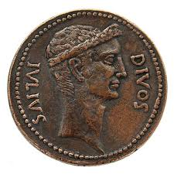
Gotcha Jesus: What about taxes?
Luke 20:25 Give to Caesar what is Caesar’s, and to God what is God’s.

Slide 112
“America: Love It Or Leave It”
Jesus (John 18:36) But now my kingdom is from another place.
Ephesians 2:19-22 Ours is a holy kingdom!
Can you think of a holy political cause/political party?
Suggestion: Do NOT use Scripture to back up your political beliefs.

Slide 113
Our Citizenship Is In Heaven
My loyalty: Jesus
My party: Christian
My leader: Jesus
Jesus is the solution to ALL the world’s problems. John 16:33 Take heart, I have overcome the world.”
We have the greatest cause in the world.

Slide 114
Christian Causes?
Christians should fight for the environment.
Christians should fight for the rights of the immigrant.
Christians should fight to end abortion.
Christians should fight the drug problem.
Christians should fight against the LGBTQ agenda.
Christians should fight to prevent communicable diseases.
Christians should fight for racial and social justice.
Christians should fight for the poor.
Christians should fight for access to education.
Christians should fight for freedom.

Slide 115
My cause is the right cause!
Should your cause be the church’s cause?
If you choose one or more causes, do NOT use political means, do not try to force others to join your cause, and, whatever you do, do not create division.
Matthew 23:23-24 Our cause is faith, justice and mercy
Jesus’s cause: Love.

Slide 116
Listen Up
In whatever cause you choose to promote:
1. Do not create division.
2. Do not publicly align with a particular political or other party.
3. Be VERY careful what you post on social media.
4. Make friends, not enemies.

Slide 117
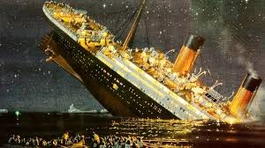
An Illustration: The Titanic
Before it sank: 1st class, 2nd class, 3rd class, steerage.
After it sank: Only two classes. Saved and lost.

Slide 118
Discussion Questions
1. What cause would you like to fight/advocate for?
2. How might one pursue that cause in a way which could be divisive rather than constructive of the Kingdom of God?
3. Is there a political sect that you are particularly challenged to accept in the church? What can you do about that?

Slide 119

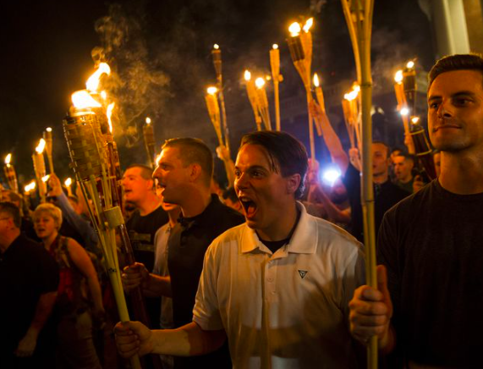
Christianity and Race
Charlottesville.Virginia, 2017
A CONVERSATION ON RACE AND THE CHRISTIAN ETHIC

Slide 120
DEFINITIONS
RACE – SOCIALLY CONSTRUCTED, TRADITIONAL DIVISION OF HUMANITY; people who usually (but not always) share common descent and certain physical characteristics
CULTURE – BELIEFS, BEHAVIORS, OBJECTS AND OTHER CHARACTERISTICS COMMON to members of a particular group or society
RACISM - [SYSTEMIC POWER + PREJUDICE] variety of practices, beliefs, social relation and phenomena that work to reproduce racial hierarchy and social structure that yield superiority, power and privilege for some and discrimination/oppression for others (as opposed to racist)

Slide 121
DEFINITIONS
BIGOTRY - [OBSTINATE PREJUDICE] the action of a person who is devoted to his/her own opinions and prejudices; especially one who regard or treats members of a group (such as racial or ethnic group) with hatred and intolerance
PREJUDICE - [PRECONCEIVED PERCEPTION] NEGATIVE OUTLOOK toward a person or group based on perceived status or characteristics – often held independently of facts about person or group

Slide 122
TWO TRUTHS AND A LIE
WE LIVE IN A POST-RACIAL COLORBLIND SOCIETY
RACISM CAN ONLY BE PERPETRATED BY THE DOMINANT GROUP IN A SOCIETY
RACE IS A SOCIAL CONSTRUCT WITH A DYNAMIC DEFINITION RATHER THAN STATIC

Slide 123
THE LIE IS…
WE LIVE IN A POST-RACIAL / COLORBLIND SOCIETY … COLORBLIND IDEOLOGY is a false premise that strips individuals of the characteristics that contribute to their experiences

Slide 124
Is being “colorblind” the solution?
In the US, a “colorblind” society is a Western-oriented, white-oriented culture.
I am not colorblind. I honor and value and celebrate different cultures.

Slide 125
Category #1 Does the Bible Address Racism?
No! The concept of race did not exist in the ancient world.
The idea of race was invented in Western Europe, primarily to explain and justify colonialism.
Race is a scientific fallacy. Race is a social construct.

Slide 126
But… The New Testament is a Handbook for Dealing with Diverse and Conflicting Cultures.
Aramaic/Hebraic vs Greek-speaking Jews Acts 6:1-2
“Persecution could not stop or even slow the church, but cultural divisions can destroy it.”

Slide 127
Diverse Cultures in the New Testament
The Jewish/Samaritan problem. Acts 8:4-8
The biggie!!! Jew/Gentile. Ephesians 2:11-18 He made the two one.
Ephesians 3:2-6 The great Mystery!

Slide 128
Diverse Cultures and Classes in the NT
Rich and Poor James 2:1-7
Colossians 3:11 Greek, barbarian and Scythian.
Acts 28:1-2 “Islanders” = barbaros/barbarians
Galatians 3:26 male and female. For another time…
A present-day example: Cameroon and Michael Burns.

Slide 129
That Was Then, This is Now. What About Us?
Do our churches have numerical racial diversity, or do we have truly diverse churches?
Do people of color feel the need to “act white?”
Are white people afraid of saying something “dumb?”
Do we have racial issues?
Ask a white person, then ask a person of color…

Slide 130
Michael Burns
“Dominant cultures tend to be unaware that they have cultures.” Their culture is “normal.”
“Non-dominant cultures tend to either blend in or to get defiant and cling to cultural norms.”
Other cultures are very aware
Believe me!

Slide 131
Example: Galatians 2:11-14
The dominant Jewish culture assumed that the Gentiles had to adapt to the existing culture.
Peter, using worldly wisdom, withdrew from Gentile fellowship to make peace.
Paul uses a kingdom midset. No Way! Not ever!

Slide 132
“We Need to End the Conspiracy of Silence”

Slide 133
LISTENING IS A THING
End the Conspiracy of Silence
ONE OF THE GREATEST TOOLS IN BUILDING TOWARD RECONCILIATION IS A SET OF EARS TO HEAR

Slide 134
Toward Reconciliation: CROSSING THE LINE
“ONE OF THE MAJOR PROBLEMS IN OUR WORLD RIGHT NOW IS THAT OFTEN WHEN PEOPLE WHO ARE CONSIDERED WHITE AND THOSE WHO ARE CONSIDERED PEOPLE OF COLOR DO TALK TO ONE ANOTHER, NOT ONLY DO THEY HAVE OPPOSITE PERSPECTIVES, THEY ALSO USE DIFFERENT MEANINGS FOR THE SAME LANGUAGE AND THAT LEADS TO TALKING PAST ONE ANOTHER”
MICHAEL BURNS
CROSSING THE LINE

Slide 135
Systematic Racism Out There
And the Trauma Is Real
Bakersfield, Mycresha Burns, Kansas, Cameroon, Abuja,

Slide 136
Does This Affect Our Churches?
In a word… Yes. Trauma is easily triggered. Buttons are easily pushed.

Slide 137
So, What Can We Do?
Galatians 3:9 Carry one another’s burdens.
And let’s be honest who has the racially-caused burdens.

Slide 138
CAN WE TALK? FOR A MINUTE
SIT DOWN. BE HUMBLE.
THROW GUILT OUT THE WINDOW
IF YOU ARE A CHRISTIAN, WHITE MALE AND WEALTHY – you navigate differently
ACCEPT AND VALIDATE THE EXPERIENCES OF OTHERS
RECOGNIZE RACE CONVERSATION IS ESSENTIAL TO PROLIFERATING THE GOSPEL

Slide 139
Toward a Solution
Compassionate burden-bearing listening.
Romans 12:21 Do not be overcome by evil, but overcome evil with good.
We need to talk!

Slide 140

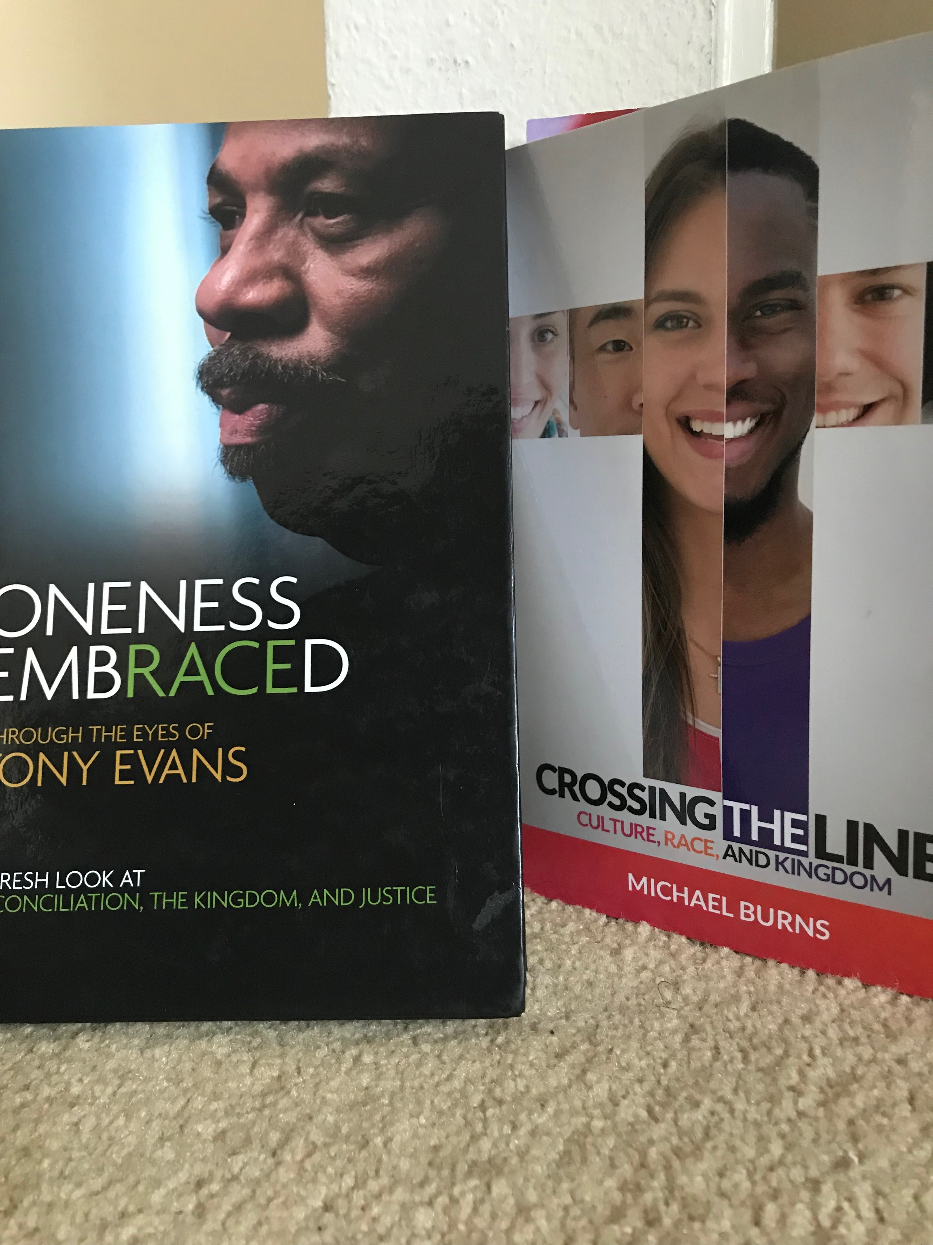
RESOURCES TO ENGAGE
Oneness Embraced by Dr. Tony Evans
Crossing the Line by Michael Burns
www.Blacktaxandwhitebenefits.com

Slide 141
Discussion Questions
1. Do you have any personal experience (of you or a close friend) of racial profiling, DWB and the like?
2. Are there any hot-button phrases for you—things that others might say you would be easily offended by?
3. Have you ever been accused of being culturally or racially insensitive? How did you react?
4. Have you ever misinterpreted another person’s actions because you had a different cultural basis from them?

Slide 142
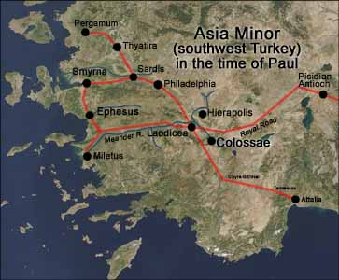
Christ vs. The World’s Philosophies
Colossians 2:6-23
John Oakes
2025 ICMC

Slide 143
Outline
I. Colossians: The Supremacy of Christ.
II. Premodernism, Modernism and Postmodernism

Slide 144
Colossians
Theme: The supremacy of Christ. The all-suffiency of Christ.
Written to oppose the supposed “Colossian Heresy.”
This is a philosophy/world view that includes the stoicheia—ABCs of the world.

Slide 145
Christ in Colossians
Col 1:2 We are brothers and sisters in Christ.
Col 1:3 We thank God, the father of our Lord Jesus Christ.
Col 1:4 Our faith is in Christ Jesus.
Col 1:7 Epaphras a faithful servant and minister of Christ.
Col 1:13 God has brought us into the kingdom of his Son.
Col 1:14 We have redemption in Christ.
Col 1:14 We have forgiveness of sins in Christ.
Col 1:15 The Son is the firstborn over all creation.
Col 1:16 In Christ, through him and for him all things were created.

Slide 146
Christ in Colossians
Col 1:17 Christ is before all things.
Col 1:17 In Christ all things hold together.
Col 1:18 Christ has supremacy in all things.
Col 1:19 All the fullness of God dwells in Christ.
Col 1:20 Christ is reconciling all things to Himself.
Col 1:22 We are presented holy in God’s sight by Christ.
Col 1:24 Christ is the head of the body.
Col 1:27 God’s glorious mystery is Christ in you.
Col 1:28 Christ is him who we proclaim.

Slide 147
Christ in Colossians
Col 1:29 Christ’s power works in us.
Col 2:2 The mystery of God is in Christ.
Col 2:5 Our faith is in Christ.
Col 2:6 We live our lives in Christ.
Col 2:9 In Christ, the fullness of deity dwells in bodily form.
Col 2:10 In Christ, we are brought to fullness.
Col 2:11 In Christ we were circumcised.
Col 2:13 We are made alive in Christ.
Col 2:17 The Law is a shadow. The reality is in Christ.

Slide 148
Christ in Colossians
Col 2:20 We died with Christ.
Col 3:1 We have been raised with Christ.
Col 3:3 Our life is hidden with Christ.
Col 3:4 Christ is our life.
Col 3:11 Christ is all in all.
Col 3:17 Do all in the name of the Lord Jesus

Slide 149
Colossians 2:8 stoicheia
Let no one take you captive to hollow and deceptive philosophy which depends on human tradition and the elemental forces (stoicheia) of the world rather than on Christ.
Elemental forces
Basic components of philosophy
First principles of the world
ABCs
stoicheia vs Christ and his Kingdom

Slide 150
Stoicheia of our world
Prosperity gospel
American dream
Comfort/materialism
Personal security 401-k
Being a good person
Universal salvation
Moral relativism
Entertainment/leisure

Slide 151
stoicheia of our world
Postmodernism
Modernism/Scientism
Republicanism and social conservative politics
Democratism and progressive politics
Can these philosophies deceive us, kidnap us, and drag us from Christ?

Slide 152
Fullness in Christ
Col 1:10 We have fullness in Christ. We need nothing from the world.
Fullness = pleroma = filled full
Col 1:11-12 We are circumcised in Christ—the world/flesh has been removed in Christ.
We are moral being in Christ, not by moral behavior.
We are socially just people in Christ, not through supporting social justice causes.

Slide 153
Conclusion
Our fullness is in Christ.
The world’s philosophies have nothing to offer us.
Let us seek righteousness through Christ, not the stoicheia of the world

Slide 154
Christianity vs The World’s Philosophies :
Christianity in a Post-MODERN Age
John Oakes 2025 ICEC

Slide 155
Christianity and Postmodernism: Friend or Foe?
The good news is that secular humanism is on the way out. The bad news is that something worse is taking its place. That something worse is called postmodernism. -David McAlister
Evangelicals have often uncritically accepted the modern view of knowledge despite the fact that at certain points the postmodern critique is more in keeping with Christian theological understandings -Stanley Grenz A Primer on Postmodernism

Slide 156
Our Outline
What is Modernism and why has it been rejected by most intellectuals?
What is Postmodernism?
Postmodernism and Culture
A Christian Response to Postmodernism

Slide 157
A Very Brief Intellectual History
Pre-modern
Age
Modern
Age
Post-modern
Age
Rationalism breeding skepticism
Relativism breeding situationism

Slide 158
The seismic shift
Pre-modern | Modern | Post-Modern
Belief in divinity | Ambivalent about divinity | Divinity as self-expression
Conviction is virtue Tolerance is evil | Rationality is virtue | Tolerance is virtue Conviction is bad
Authority is God | Authority is logic and science | Authority is self or the group
Change brought about by adherence to a standard | Change brought about by what is rational | Change contingent on self-expression and culture

Slide 159
A Slightly More Detailed Outline
Pre-modern: Catholicism
Renaissanace/Humanism: Protestantism
Early Modernism/Enlightenment Age of Reason
Late Modernism: Deism and Skepticism
Postmodernism

Slide 160
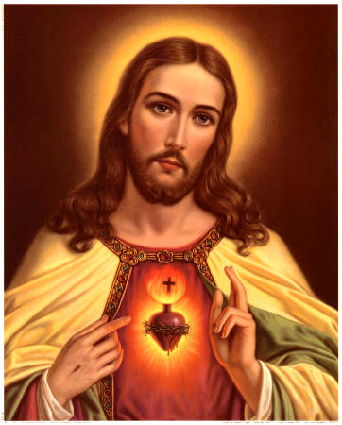
Pre-Modern Age
Knowledge based on faith and authority
Anselm of Cantebury “I believe in order to know.”
Emphasis on corporate rather than individual

Slide 161
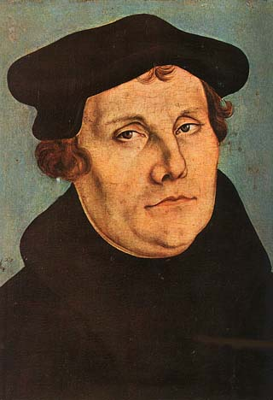
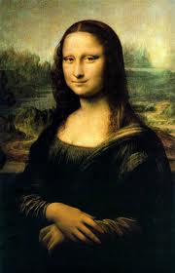
Renaissance and Reformation
More emphasis on the value of the individual
Led to the Reformation
Led to the Scientific Revolution and to Modernism

Slide 162
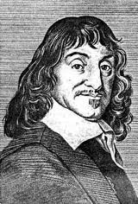
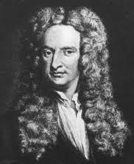
The Birth of Modernism
Rene Descartes: Rationalism. I think, therefore I am. Reason is king.
Isaac Newton: Principia
The Mechanical Universe. Do we need God any more?

Slide 163
Modernism
The autonomous rational human of Descartes meets the mechanical universe of Newton.
Modernism is essentially optimistic
Knowledge is objective, good, and accessible to humans
Human reasoning is the ultimate authority for truth.

Slide 164
The Enlightenment/The Age of Reason
Using Reason we can ask and answer all important questions.
Elevates the role of the individual and the value of personal freedom (John Locke)
How would that have impacted Christianity?

Slide 165
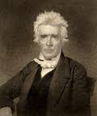
Modernism and Christianity
The “Restoration Movement” is a good example of Modernist Christianity
Command, Example, Necessary Demonstration
Scientifically analyze the Bible
Weak on principles
Strong doctrinal orientation
Alexander Campbell

Slide 166
Characteristics of a “Modern” Church
Stresses doctrine over practice. Either/or approach to truth.
Stresses individuality over corporate aspects of Christianity.
Right belief leads to right practice.
Rejects superstition, minimizes the miraculous and the influence of the Holy Spirit.

Slide 167
Characteristics of a “Modern” Church
More sectarian, less ecumenical because of the influence of propositional truth. More judgmental.
Emphasis on preaching more than worship
Relies on evidence, a stronger emphasis on verbal inspiration of the Bible
The ICOC is a modern, not a postmodern church movement

Slide 168
The Death of Modernism
Modernism is not dead, by the way, but….
WWI, WWII, Hiroshima
Exposure to alternative world views from the East—Western mindset is not the only powerful one.
Pessimism and Rejection by most of Modernism.

Slide 169
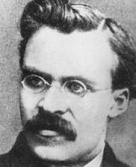
Rise of (Intellectual) Postmodernism
Nietzche (1844-1900): God is dead. Truth is dependent on language. Truth is created not discovered.
Reject the correspondence theory of truth: A proposition is
“true” if it corresponds to or is consistent with reality.

Slide 170
Martin Heidegger (1884-1976)
Rejects correspondence theory of truth
Truth is found in culture, narrative, not facts

Slide 171
The Big Three: Foucault, Derrida and Rorty
Michael Foucault: Truth is a fabrication or a fiction. Science is an ideology. History has no objective meaning. It is socially produced. Truth is social.
Jacques Derrida: Reading is a violent act of mastery over the text. Invented deconstruction.
Richard Rorty: Truth a matter of human convention. Truth is found in coherence rather than correspondence.

Slide 172
Postmodern Thinking
Postmoderns have no worldview (except the view that there is no correct worldview)
Truth is found in the community, not in the individual.
Postmodernism rejects ontological truth and metanarritives. (in other words it accepts relativism)
The goal of postmodernism is to “deconstruct” beliefs such as Christianity—to destroy its violent metanarrative—to make it meaningless.

Slide 173
Postmodernism and Culture
Postmoderns prefer difference to uniformity heterogeneity to homogeneity
Postmoderns prefer the local to the universal “Think globally, act locally”
Postmoderns value the community over the individual.
Postmodernist is not searching for truth but collecting experience.
Current pop culture is a reflector of postmodern thinking.
The postmodern values, above all, diversity and tolerance.

Slide 174
Strengths of Postmodernism
1. Celebrates cultural and other kinds of diversity.
2. Open-minded, Tolerant (generally but not always a good thing).
3. A more accurate view of history than the modern view.
4. Open to Eastern and other ways of thinking. Not married to Western as the only good way of thinking.
5. Celebrates relationships and community.
6. Refutes the false and prideful claims of Modernism— especially the idea that humans can discover truth.

Slide 175
Weaknesses of Postmodernism
1. Denies the existence of truth when truth is real. Its most basic premise is simply not true.
2. Circular reasoning. Are you absolutely sure there is no absolute truth?
3. No moral compass. This is scary!
4. Dismisses the role of the revolutionary, the idealist (for example Jesus).

Slide 176
Postmodernism and Christianity
Christianity clearly includes propositional truth!
Jesus: Your Word is Truth. (John 17:17)
Postmodernists: There is no center. No metanarative
Christianity: Jesus is the center. Jesus/salvation is a metanarative
Postmodernism can be a helpful critique to modernist approach to scripture but it rejects the idea that a scripture has a single interpretation (2 Peter 1:21). This is absolutely unacceptable in the Christian context.

Slide 177
Strengths of Postmodernism for Christianity
(yes, there are some!)
Allows us to recognize that in Christianity which is not strictly rational. Helps us to appreciate that which is “mysterious” in Christianity.
Helps us to know that principles have different applications in different cultures.
Helps us to recognize that much of what we call Christianity is really just Americanity/Westernism—viewed through this lens
Helpful in hermeneutics—to recognize influence of culture and world view on scripture.

Slide 178
Positives (cont.)
Rightly points out that the Modernist ideal of discovering universal truth through rational analysis is not realistic.
It will help us to be less judgmental.
Helps us to celebrate the communal aspects of Christianity and to defeat the hyper individualism which has crept into the Church.
Helps us to remember the need to do social good, to help and be involved in our communities.

Slide 179
Characteristics of the Postmodern Church
1. Ecclectic. More open to a wide variety of ideas and beliefs.
2. More interested in community and relationships than in individual faith.
3. More socially aware and more oriented toward social justice.
4. Less interested in doctrine.

Slide 180
Summary
Watch your life (postmodernism) and your doctrine (modernism) closely. Persevere in them, for if you do so, you will save both yourself and your hearers (1 Tim 4:16)

Slide 181
Discussion Questions
1. Give one positive and one negative of “modernism,” as it relates to Christianity.
2. Give one positive and one negative of “postmodernism,” as it relates to Christianity.
3. Just for fun: Give one positive and one negative of premodernism as it relates to Christianity.

Slide 182
Hot Topics for the Church (but not the world)
Christianity and Culture: Modesty, Gambling, Drinking, Medical Marijuana, Entertainment and more.

Slide 183
Levels of Discussion
1. What can we say for sure (biblical statement or command)?
2. What can we infer or reasonably conclude based on biblical principles?
3. What are some gray areas, in which faithful, Bible-believing Christians will differ?

Slide 184
One More “Level”
4. What about actions which are not sinful per se but which offend the consciences of many fellow believers?

Slide 185
Levels of Discussion
1. What can we say for sure (biblical statement or command)?
2. What can we infer or reasonably conclude based on biblical principles?
3. What are some gray areas, in which faithful, Bible-believing Christians will differ?
4. What about actions which are not sinful per se but which offend the consciences of many fellow believers?

Slide 186
The Bible and Conscience
Romans 14:1-12 The weak and the strong.
Debatable issues of conscience.
Examples: What movies? What to post on Instagram? Drinking. Attending events with drinking. Dancing at a night club. Playing poker for money. Medical marijuana. And many more.

Slide 187
Romans 14:13-23
v. 14 If we regard a thing as unclean, then it is unclean. Offending our conscience is a sin.
v. 15 The key to this issue is love, not freedom.
v. 16 Be willing to not do a thing in public which is a stumbling block to another.
v. 19 Building up the body is way more important than defending your freedom in Christ.

Slide 188
Summary on Conscience
Q: Can doing something which is not sinful be a sin?
A: Yes!
1. It is sinful for the “strong” to do an otherwise unsinful thing if it can reasonably be thought to be a stumbling block to the weak. (v. 21-22)
2. It is sinful for a “weak” disciple to do what he or she believes to be sinful in their conscience (v. 23)

Slide 189
Now to the Issues A. Alcohol
Level 1 Drunkenness is a sin. Gal 5:19, Ephesians 5:18, Proverbs 20:1 and many more.
Drunkenness is a willful sin. Don’t do it! Ever!!!
Level 3 So, what is the definition of drunk?
California: 0.08% blood alcohol.
For smaller people: 2 drinks = drunk
For larger people: 3 drinks = drunk

Slide 190

My Advice and Practice
The rule of 1.

Slide 191
Level 4 And Drinking. Conscience!
Some (many) believers are convinced all drinking of alcohol is sinful.
Many fellow believers have addiction issues and their limit is a hard zero!!!
Suggestion: Do not serve any alcohol at all at Christian events. If you drink, keep it to the rule of one, and do not do so in larger public settings.
Do not ever post pictures of you drinking on social media. Zero tolerance!

Slide 192
B. Gambling
This issue can be confusing and complicated. Casinos, lottery, on-line gambling, poker, etc. Personal bets. The stock market (but that is different)
Level 1 Get ready for a shock: There are no Scriptures on this topic!
Level 2 Biblical principle informs us that we ought to use our money wisely, with spiritual purposes in mind. Proverbs 3:9 Honor God with your money. Luke 16:1-13 Use worldly wealth to gain friends for yourselves… you will be welcomed into eternal dwellings.

Slide 193
Gambling: Conclusion So Far
Gambling is not sinful per se, but any kind of gambling which involves any significant amount of money, or which is not for fun is sinful!!!
Warning: On-line gambling is extremely dangerous. DO NOT DO IT
Level 4 Many believers cannot gamble on any level in a clear conscience. Many are addicted to gambling. Many disciples should not gamble at all—even the lottery!
Suggestion: If you do very modest kinds of gambling (poker for a few $, lottery, casino for less that $50, etc…) do it on the down-low.

Slide 194
Marijuana
Two categories: “Recreational” use and “Medicinal” use.
Level 2 Biblical principle informs us that getting “high” on mind-altering drugs is a sin.
1 Corinthians 6:12 “I have the right to do anything”… but I will not be mastered by anything.
1 Corinthians 6:19-20 Our bodies are a temple of the Holy Spirit. Honor God with your body.
Galatians 5:20 witchcraft = pharmakea = taking of a mind-altering drug.

Slide 195
Marijuana (cont)
Level 2 The WWJD principle. Can you even imagine Jesus smoking a joint or taking a cannabis-laced product?
Level 4 Applies ONLY to medical uses.
ONLY if actually prescribed by a legitimate physician.
This is highly likely to be a stumbling block to many believers. Keep it to yourself.

Slide 196
Modesty
Level 1 There are very few scriptures on this topic!
1 Tim 2:9 I want women to dress modestly, with decency and propriety.
1 Peter 3:3-4 Women should be cautious about using “outward adornment.” (but this is not even about modesty)
Conclusion: It is a sin for women to dress immodestly.
Dear women: Please accept an apology from us men that our fleshly nature limits your freedom!

Slide 197
Modesty (cont.)
Level 3 So, what is the definition of immodest dress?
Suggestions:
1. Women, discuss this amongst yourselves.
2. Aim for somewhere in the middle or to the “right” of the middle.
3. Avoid legalism and meanness on this issue!!!!
4. But do not ignore this issue.

Slide 198
Other Questions/Issues?

Slide 199
Discussion Questions
1. Give an example of a Christian issue of sin and conscience in which you would be classified as “weak” (on which you tend toward the conservative)
2. Given an example of a Christian issue of sin and conscience on which you would be classified as “strong.” (you see it as not sinful, but you know others do)
3. For both, discuss how you ought to treat those in the other camp.

