Slide 1
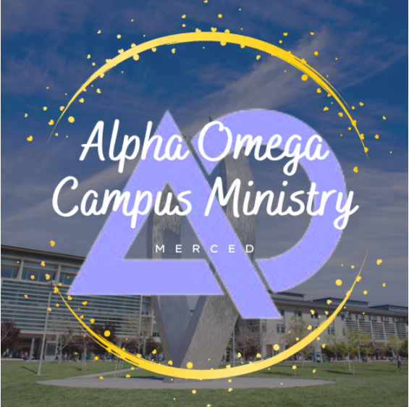
Welcome to the Alpha Omega Midweek

Slide 2

Announcements
Bible Talks
Mon 6:30 106 Mulberry Atwater
Mon 7:30 Lantern Café UCM
Tues 6:30 1195 Pinnacle Dr.
Th 12:00 Merced College
Fri 3:00 Move-in for Rodriguez’
Fri 6:00 Driving Range 3536 N. Santa Fe Ave. Game night after.
Worship Sun 11:00 500 Buena Vista Ad. Bldg, Rm 4

Slide 3
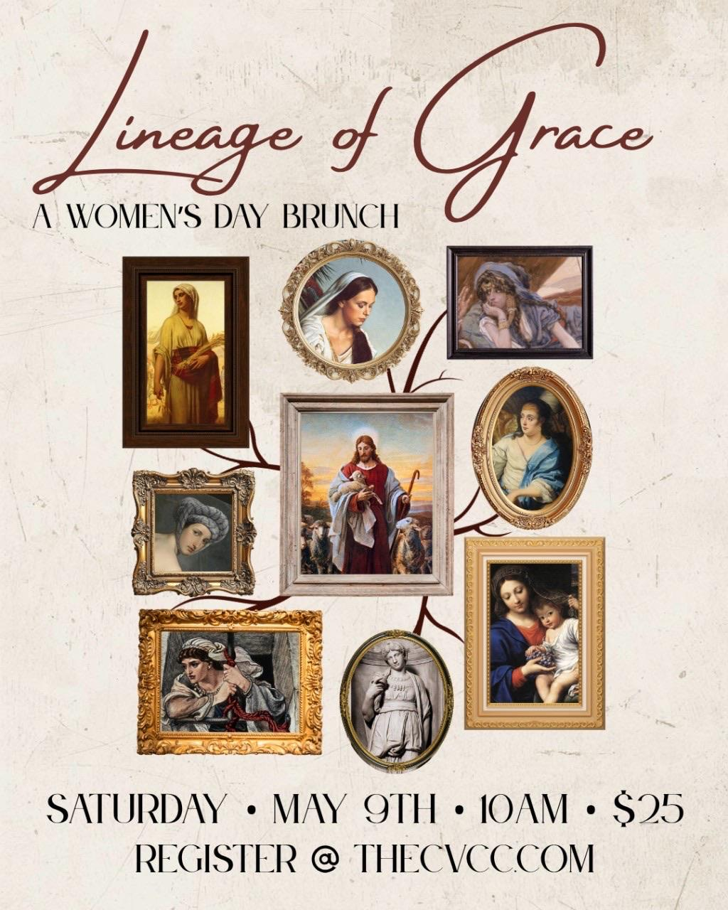
Coming Up
Serving at Catholic Charities Sat 5/9
Women’s Day in Fresno May 9 10:00 “Lineage of Grace.” $25 CVCC
ICMC Milwaukee July 30-Aug 2

Slide 4
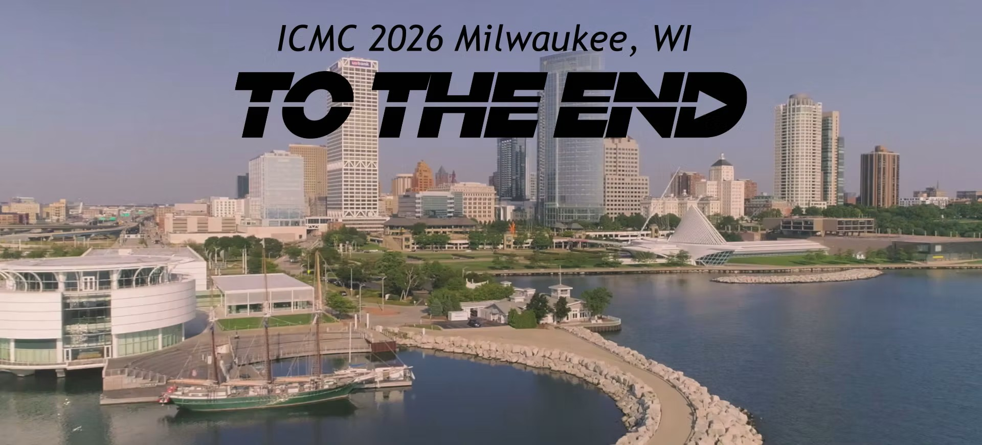

Slide 5
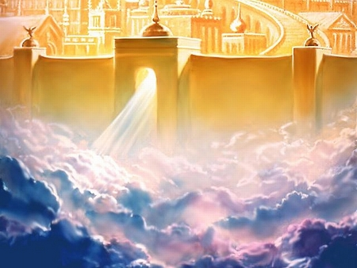
The Kingdom of God
John Oakes
Merced
Spring, 2026

Slide 6
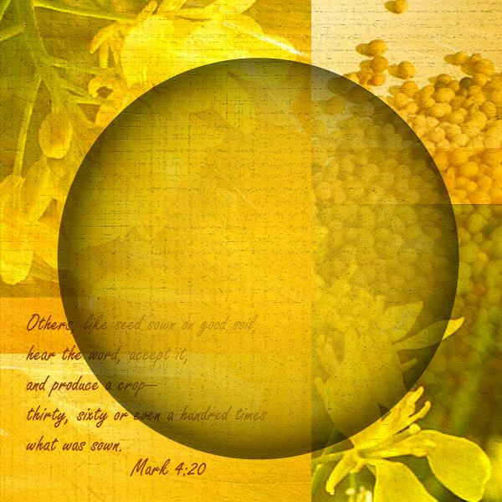
What is the Kingdom of God?
Mustard Seeds
The Kingdom of God is….
The Kingdom of God is not…

Slide 7

I. The Kingdom of God is the topic Jesus spent by far the most time talking about. Acts 1:3

Slide 8
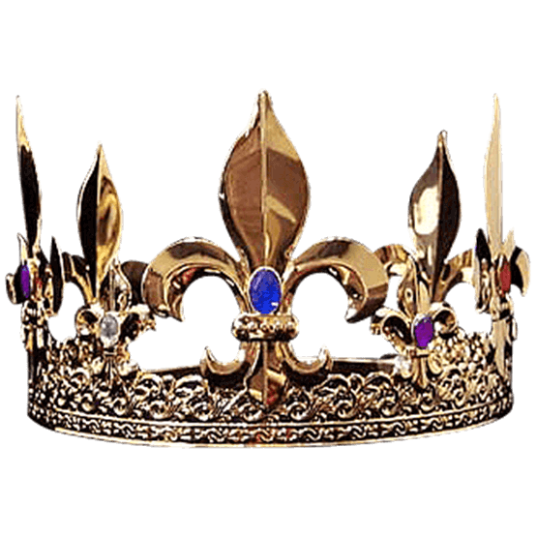
II. The Kingdom of God is a “place” where God is king—where God reigns. -It is a life lived in submission to God

Slide 9
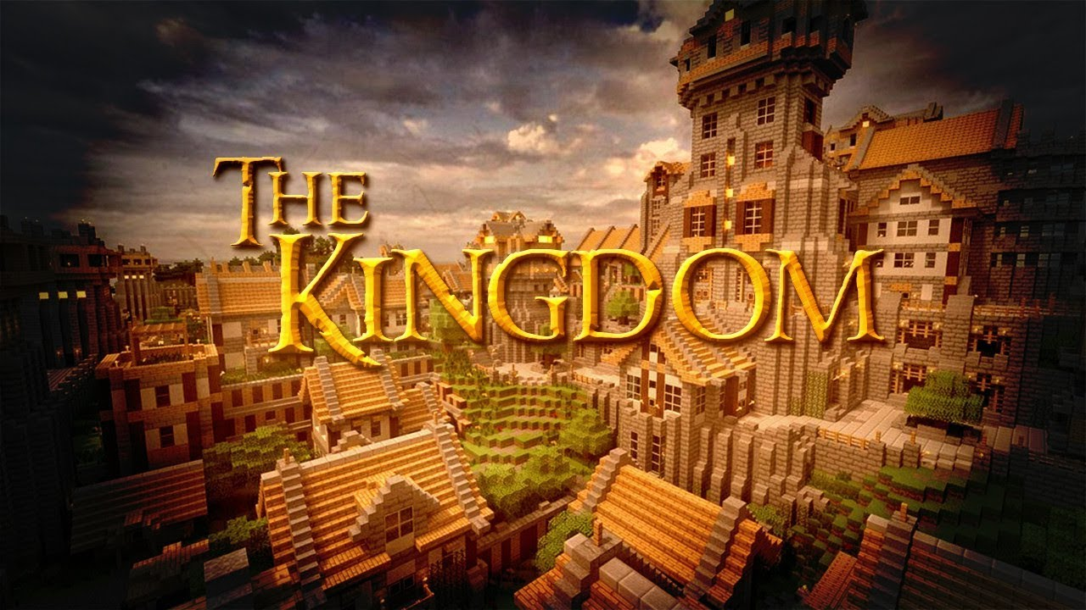
III. The Kingdom of God is a very big concept.

Slide 10
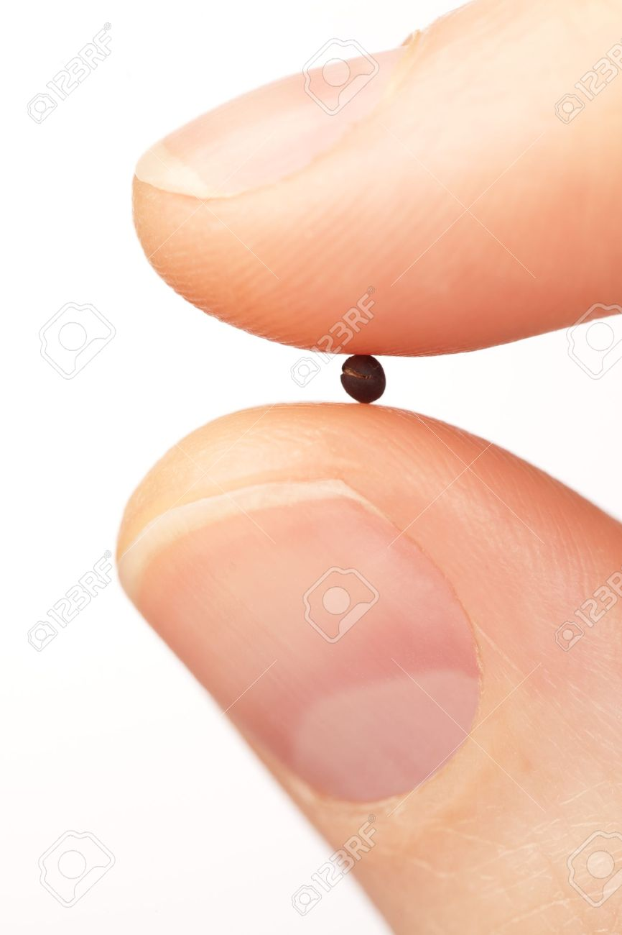
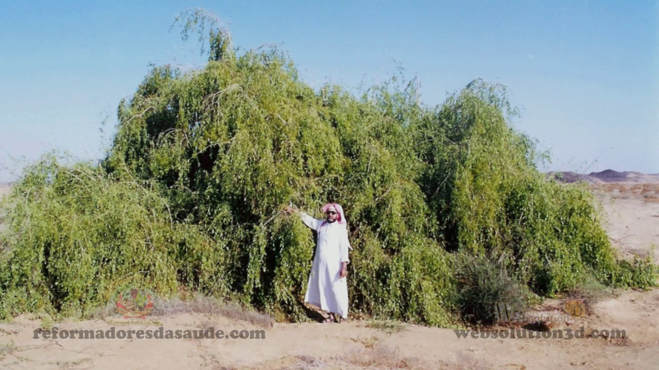
IV. The Kingdom of God is revealed in parables (because it has to be)

Slide 11
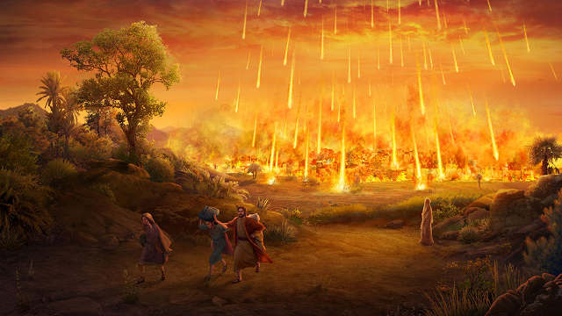
V. The Kingdom of God is something which breaks out suddenly and dramatically.
The Flood
Sodom and Gomorrah
Passover, Exodus
Mt. Sinai
Jordan River
Assyria takes Samaria
Babylon takes Judah
Cyrus takes Babylon
Pentecost
Second Coming of Jesus

Slide 12
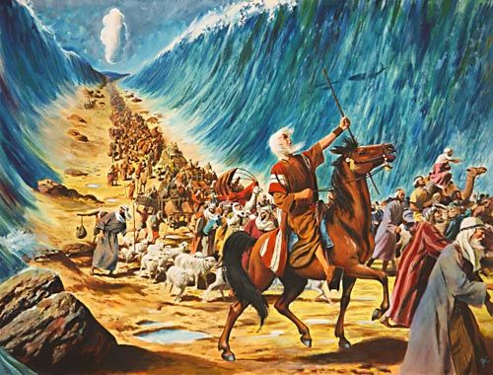
VI. The Kingdom of God is revealed in history.
Hebrews 1:1
Matthew 3:2
Isaiah 2:1-4
In these last days…

Slide 13
VII. The Kingdom of God is not coextensive with or equal to the church. The Kingdom of God came with Christ's death and Resurrection and must be further extended by Christians until it has been brought into perfection by Christ at the end of time. The Christian does this by living the way Christ lived, by thinking the way Christ thought, and by promoting peace and justice. This can be accomplished by discerning how the Holy Spirit (God) is calling one to act in the concrete circumstances of one's life.

Slide 14

VIII. The Kingdom of God is already but not yet.

Slide 15
Already But Not Yet
“God’s colonial outpost, the church, lives as a witness, in the present, of things to come. Through Christ we have experienced resurrection, though we will face death. Because of Golgotha, we have salvation, yet we wait in hope for the revelation of our redemption. We have the “first fruits” (Rom 8:23) of the Spirit as God’s pledge of the rest of the harvest.” [Kingdom Come, Hicks and Valentine]

Slide 16
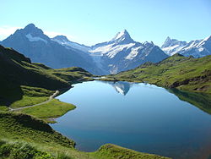
IX. Nature—the physical earth is the Kingdom of God.
Romans 8:18-21

Slide 17
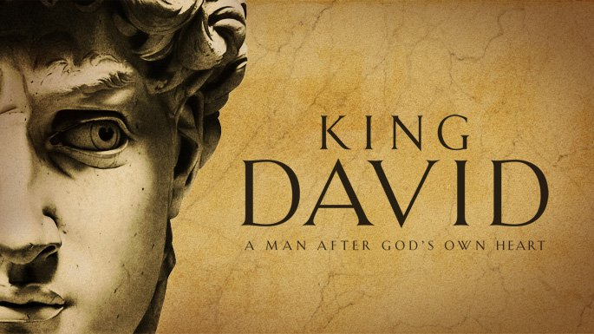
X. Israel is the Kingdom of God.

Slide 18
XI. The Church is the Kingdom of God. (and I am not contradicting myself) The church is an outpost of the Kingdom of God. The church is a city on a hill. The church is the best chance many non-believers have of seeing the kingdom.

Slide 19
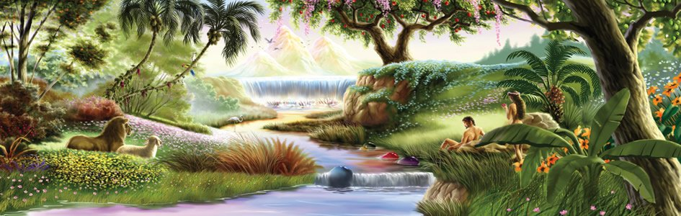
XII. The Garden of Eden is the Kingdom of God.
Revelation 22:1-5, Ezekiel 47:1-12

Slide 20
Discussion Questions
1. In your own words, “The Kingdom of God is…”
2. What did you learn about the Kingdom of God tonight?

Slide 21

XIII. The Kingdom of God is heaven on earth. Rev 21:1-4

Slide 22
XIV. The Kingdom of God is within (among) us. It is not a physical place. It has no borders. Luke 17:21 It is not of this world John 18:36

Slide 23
XV. The Kingdom of God is entered by being born again. John 3:1-9

Slide 24
XVI. The Kingdom of God is a radical ethic in complete opposition to the worldly ethic.
Hebrews 11:13-16 Foreigners and Strangers
Hebrews 11:8-10 like a stranger in a foreign country.
Philippians 3:20 Citizens of heaven.

Slide 25
A Counter-Cultural Kingdom
David Lipscomb: “God calls us to a radical alien mentality, but he provides the power for such a life through his indwelling and empowering Holy Spirit that transforms us into the image of his Son.”
“To live in the shadow of the second coming is to take seriously the ethic of Jesus. The peculiarity of disciples is not that they wear quaint clothing or don’t use modern technology. Rather their strangeness is located in their embrace of an ethic the world considers nonsense.” [Kingdom Come Hicks and Valentine]

Slide 26
XVII The Kingdom of God is best understood from the Sermon on the Mount
Matthew 5:3-10
poor
mourn
meek
hungry
merciful
peace-maker
persecuted

Slide 27
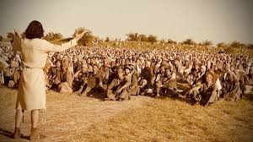
The Sermon on the Mount
Matthew 5:17-22, 38-48
Matthew 6:19-21 Treasure in the kingdom.
Matthew 6:22-23 The eye is the lamp
Matthew 6:25-33 Do not give a thought to your life… Seek first his kingdom

Slide 28
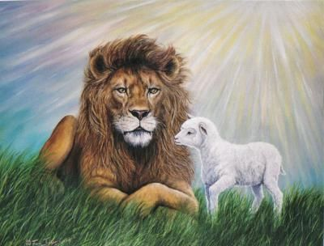
XVIII. The Kingdom of God is a “place” where things are as they ought to be.
Isaiah 11:6-9
Isaiah 65:17-25
Isaiah 2:3-4

Slide 29
XIX. The Kingdom of God cannot be moved. Hebrews 12:25-29

Slide 30
XXI. The Kingdom of God is a place where God’s will is done. Matthew 6:10

Slide 31
XXII. The Kingdom of God is of inestimable value.
Searched for
A pearl…
A hidden treasure.

Slide 32
XXIV. The Kingdom of God is revealed, proclaimed, preached, announced.
Mark 1:14-15

Slide 33
Discussion Questions
1. How would you describe Kingdom values to a person in “the world?”
2. In Matthew 6:25 Jesus said, “Do not give a thought to this world.” What does that mean to you?

Slide 34
Our Role in the Kingdom
Individually
In our churches
In our communities

Slide 35
Individual in the Kingdom of God
Seek first the kingdom yourself
Live a life in submission to God
Live as his instrument.
Living out the Sermon on the Mount.
One Year Challenge
Become a Missionary
Your job: Transform the world.

Slide 36
In Our Churches
Join the life of the church.
Ask: What is God doing right now in Merced. What is the Holy Spirit doing?
Give generously
Start a program, a ministry.

Slide 37
In Our Communities
Get intimately involved in creating social justice.
Bring the kingdom to the community and the community to the kingdom.
Social justice is not something we do, it is who we are.
Example: Lindsey Dominguez in SD

Slide 38
The Kingdom of God in the Old Testament
The Day of the Lord is a period of time when God openly intervenes in history and the affairs of men—both in judgment and in blessing. Joel 1:15 Woe because of that day!!!
Isaiah 2:12-22 Prideful individuals
Isaiah 13:6-13, 17-21 Babylon
Isaiah 34:4,8-10 Edom
Jeremiah 46:10 Egypt

Slide 39
The Kingdom of God in the Old Testament
Joel 2:1-2 Joel 2:11-17 Blow the trumpet! Jesus is coming back!!!
Joel 2:28-31 The Day of the Lord can be good news for some
Joel 3:9-14 Decision Time!
(Amos 5:18-20, Obadiah 15, Zephaniah 1:1f)
Malachi 4:5

Slide 40
The Day of the Lord in the NT
2 Thess 1:6-10
Matt 24:36-39
Phil 2:14-16 (and 2 Cor 1:12-14)
1 Cor 5:5
2 Thess 2:1-4
1 Thess 5:1-11
2 Pet 3:8-10
Finish: Zechariah 14:1-21

