Slide 1
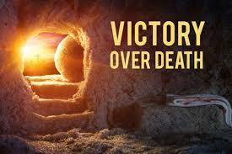
Merced Christian Church
Easter Service

Slide 2
What Do You Fear?
Life without meaning?
Lack of intimate relationships?
Debilitating disease?
Failure? Betrayal?
What about death? Death is the great enemy!

Slide 3
Death Has Only One Enemy
Born in poverty
Humble beginnings
From a small town
Jesus of Nazareth.

Slide 4
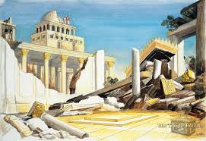
Jesus: I Will Overcome Death!
Scene #1
John 2:16 “Destroy this temple and I will raise it in three days.”

Slide 5
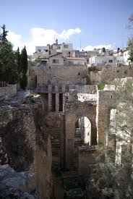
Jesus: I Will Destroy Death!
Scene #2 John 5:21-30
Healing at Bethesda.
Those who hear and believe have eternal life.

Slide 6
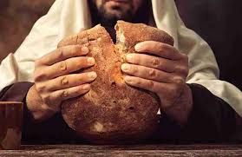
Jesus: I Will Destroy Death!
Scene #3
John 6:38-52
Whoever eats this bread will live forever.
John 6:53-59
Eat my flesh and drink my blood.

Slide 7
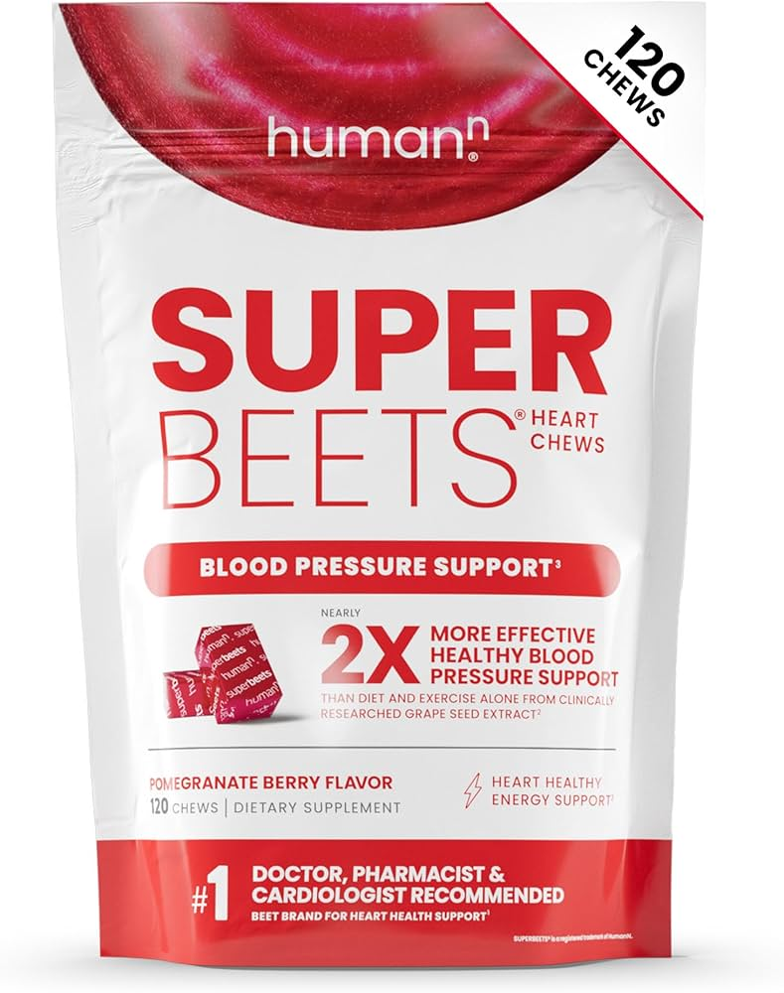
Superfood!
“Whoever eats my flesh and drinks my blood has eternal life.”

Slide 8
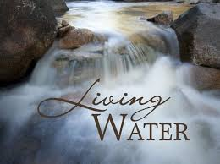
Jesus: I Will Destroy Death!
Scene #4
John 7:37-39
Rivers of living water will flow from them…
Ezekiel 36:24-30
Ezekiel 47:1-12

Slide 9
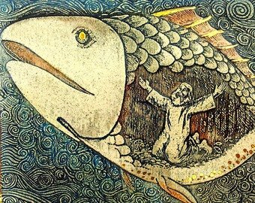
Jesus: I Will Destroy Death!
Scene #5
Matthew 12:38-40
As Jonah was in the belly of a great fish for three days and three nights…

Slide 10
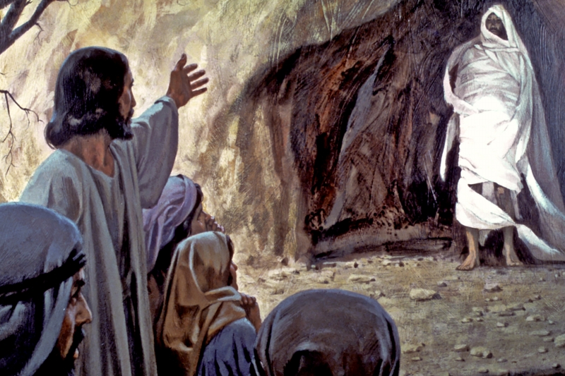
Jesus: I Will Destroy Death!
Scene #6
John 11:25
I Am the Resurrection and the life. The one who believes in me will live, even though they die.

Slide 11
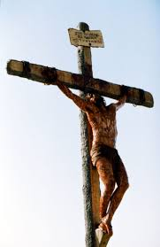
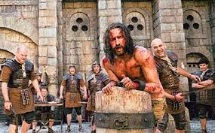
But… They Took Him Out
All is lost. Monied and religious interest won! Satan won!

Slide 12
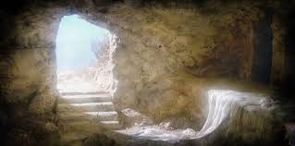
Stop the Presses!
Romans 6:8-10
Since Christ was raised from the dead, death has no mastery over him.

Slide 13
Jesus: I Will Destroy Death!
1 Corinthians 15:42-57
Where, O Death is your victory?
Where, O Death is your sting?

Slide 14
Communion: Resurrection Power
Romans 6:2-7
If we are united with him in his death, we will also be united with him in his resurrection.

