Slide 1

1, 2 Timothy and Titus
“The Pastoral Epistles”

Slide 2
Author, Occasion and Date
The author, without reasonable doubt, is Paul. Look at the intimacy of his relationship with Timothy!
The “occasion” is Paul’s immanent execution, and the need to pass on his ministry to his most trusted, right-hand minister, Timothy. 2 Tim 2:1-5
The date is around AD 65-66 (at least for 2 Timothy), during Paul’s second imprisonment in Rome.

Slide 3
Purpose and Themes
The purpose is pastoral—in other words it is to prepare Timothy to care for the churches Paul has planted and/or led.
Themes:
The life of the evangelist/minister. Holy living
The work of the evangelist.
Opposing false teaching, controversies and divisiveness.
The raising up of leaders in the church.

Slide 4
1 Timothy
Theme passage: 1 Tim 3:15
(these instructions are so that) “you will know how people ought to conduct themselves in God’s household (family), which is the church of the living God, the pillar and the foundation of the truth.”

Slide 5
1 Timothy 1:1-2
Timothy my true son.
Met in Lystra on 1st Missionary Journey Acts 14:18-21 Timothy a boy or young teen.
Took along as a missionary on 2nd Missionary Journey Acts 16:1-3. Early 20’s? (1 Tim 4:12 Timothy still young in AD 65)

Slide 6
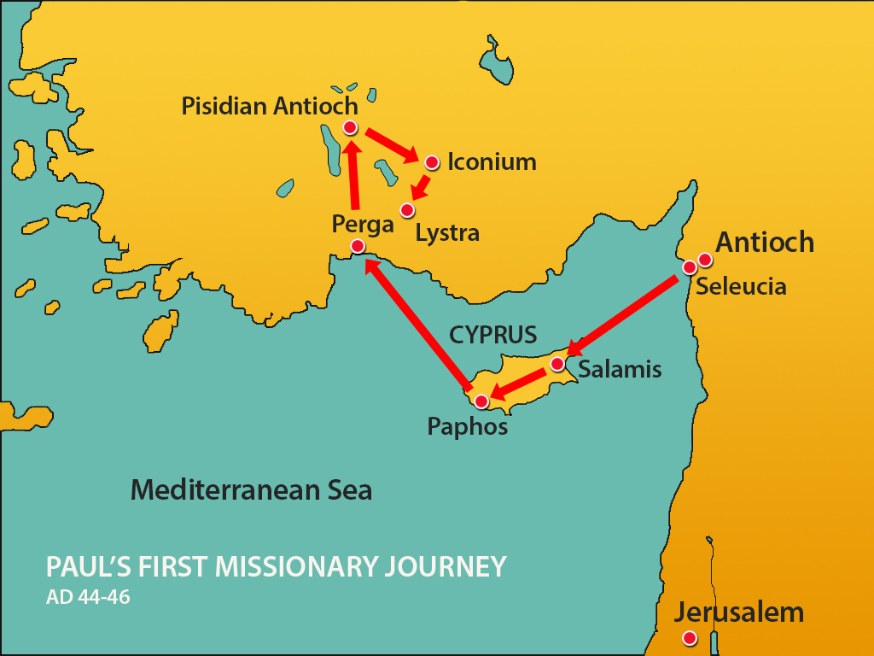
Paul met Timothy in Lystra on the “first missionary journey” (Acts 14:8-21)

Slide 7
1 Timothy 1:3-7 Meaningless Talk
False doctrines, myths, conspiracy theories, genealogies, and controversial speculation
Nephilim, 1 Enoch, Who wrote _______? Age of the earth, Second coming/rapture, Documentary hypothesis, DeuteroIsaiah, Ending of Mark etc., etc., etc., etc…
Exalt mind over heart.
Prefer discussion to action.
Look down on lowly, zealous “uneducated” disciples

Slide 8
Why Is “Meaningless Talk” Such a Big Problem?
v. 6 It does not produce love.
It produces division.
It distracts us from what is important, which is faith, love, hope, the salvation of the world.

Slide 9
Discussion Questions
1. Are you someone who is attracted to controversies, new theories, and relatively unimportant (but interesting) matters?
2. Do you have someone in the church to whom you are really close, and a partner in the gospel, like Timothy to Paul?

Slide 10


Congratulations and Bon Voyage!!!

Slide 11
2 Timothy Entrust To Reliable Men
2 Timothy a “pastoral letter.”
A letter about discipling and raising up leaders.
Paul wants to leave a spiritual legacy through Timothy.
Q: Do you want your life to count for something great?

Slide 12
2 Timothy 1:1-5
Sound discipling is based on real friendship and love.
I constantly remember
Tears
Joy

Slide 13
2 Timothy 1:6-8
Ours is a ministry based on the work of the Holy Spirit!
→ A spirit of power, love and self-control
Who are you ministering to? Does your ministry show evidence of power, love and self-discipline?
The Disciplined Life by Robert Taylor
Your Future Self Will Thank You by Drew Dyck

Slide 14
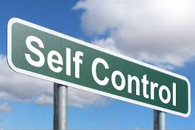
Are you a person who would be described as having good self-control?
Without it, your life will produce very little.

Slide 15
2 Timothy 1:13-14
Find a mentor—a mature disciple whose life you can emulate.
Take on tasks and do them the way your mentor would. Serve at retreat, Lead a Bible group, “disciple” a younger Christian, lead a Bible study. Make the tabling happen.

Slide 16
2 Timothy 2:1-7 This Is The Key!!!
The things you have heard me say in the presence of many witnesses entrust to reliable men who will also be qualified to teach others.
Bottom line: Are you a reliable person?
When you are given a task, you complete it
When you see a need, you take initiative.
You are self-motivated.

Slide 17
Practical Advice for Leaders
1. Do not get involved in civilian affairs.
2. Compete by the rules. Don’t take short-cuts.
3. Be a hard worker.

Slide 18
Do you want your life to make a difference?
Choose today to live a powerful, self-disciplined life.
Find a mentor and learn from observing them and taking advice from them.
Be reliable!!!!
Do not be involved in “civilian affairs.”
Don’t take shortcuts
Be diligent

Slide 19
Discussion Questions
1. Are you a person whom others would describe as a “reliable man?”
2. How are you doing on your self-control? What areas do you need to improve in?
3. Do you have too much involvement in “civilian affairs?”

