Slide 1


Slide 2
The Hand That Rocks the Cradle
Ross Walace
Woman, how divine your mission
Here upon our natal sod!
Keep, oh, keep the young heart open
Always to the breath of God!
All true trophies of the ages
Are from mother-love impearled;
For the hand that rocks the cradle
Is the hand that rules the world.

Slide 3
Blessings on the hand of women!
Fathers, sons, and daughters cry,
And the sacred song is mingled
With the worship in the sky—
Mingles where no tempest darkens,
Rainbows evermore are hurled;
For the hand that rocks the cradle
Is the hand that rules the world.

Slide 4
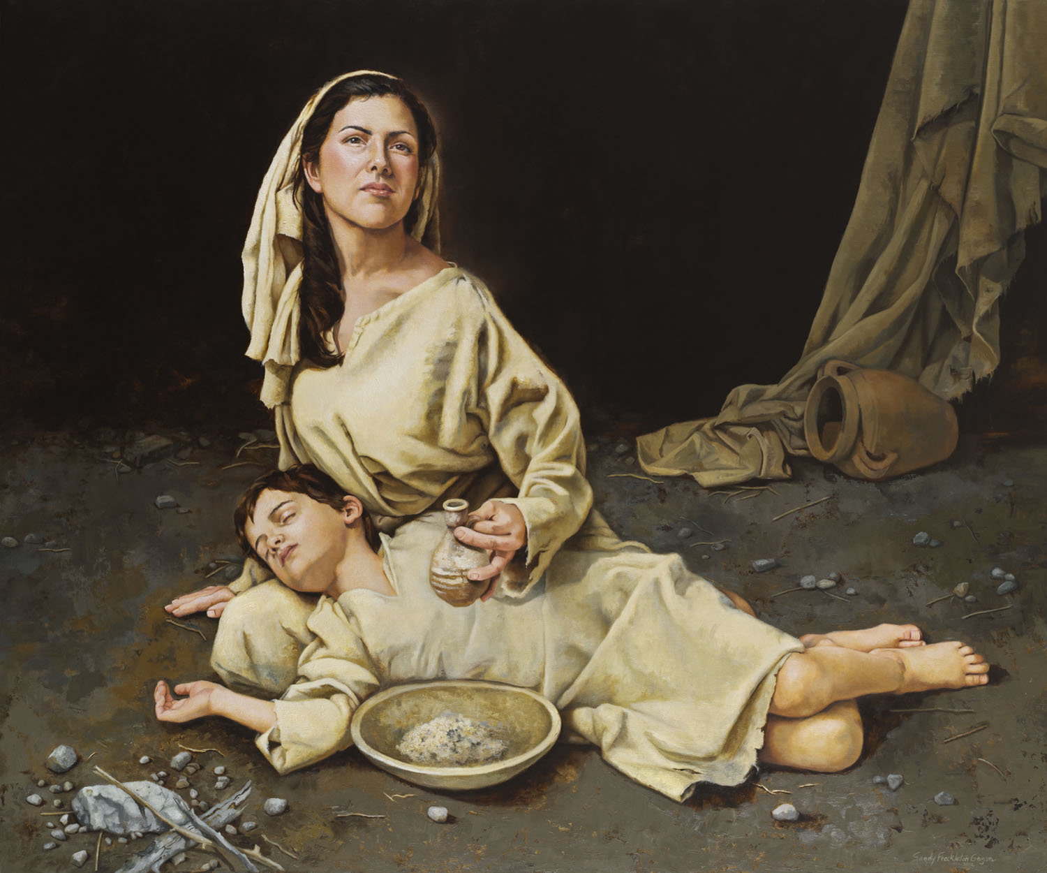
The Widow of Zarephath
1 Kings 17:7-24
God hears the cries of mothers of faith who cry out to God.
God answers their prayers.
God sent Elijah, a prefigure of Christ and Elijah saved her child.
Give me your son

Slide 5
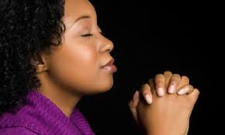
God hears the prayers of moms
Of widows
Of single mothers

Slide 6
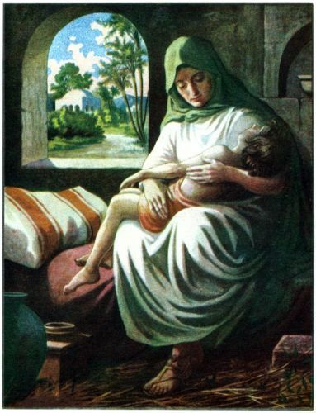
The Shunammite Woman
2 Kings 4:8-34
Hosts Elijah
God gives her a son.
Puts her son in God’s hands
Elisha raises the Shunammite Woman’s son.

Slide 7
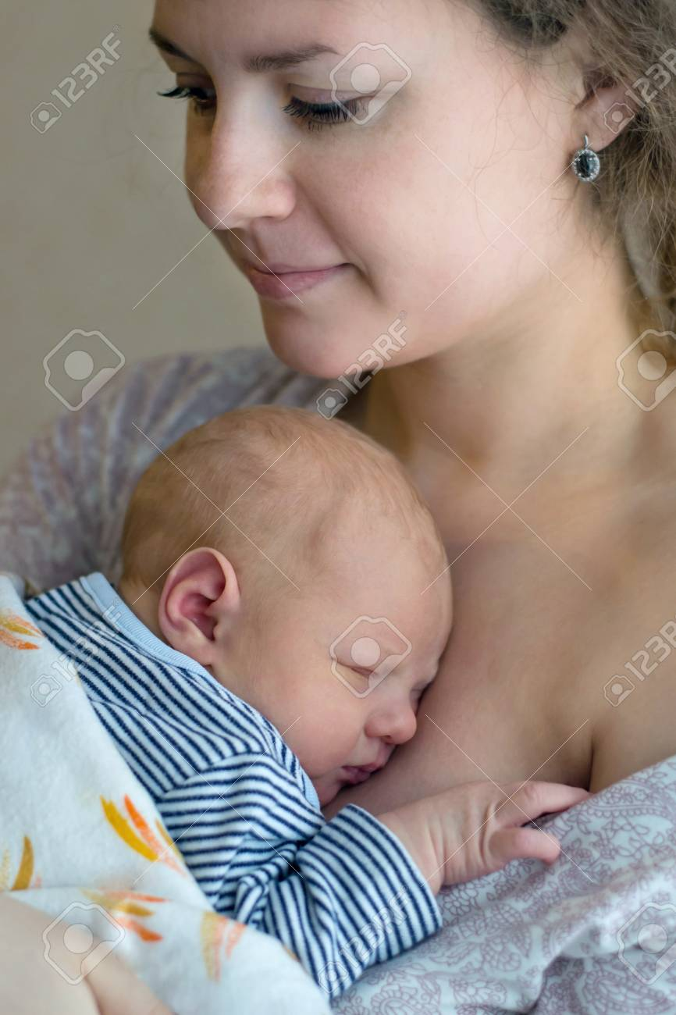
God Loves Us
With A Mother’s Love
Isaiah 49:15-18
Can a mother forget the baby at her breast? Though she may forget, I will never forget you.
See, I have engraved you in the palms of my hands….

Slide 8

Thanks, Mom

