Slide 1
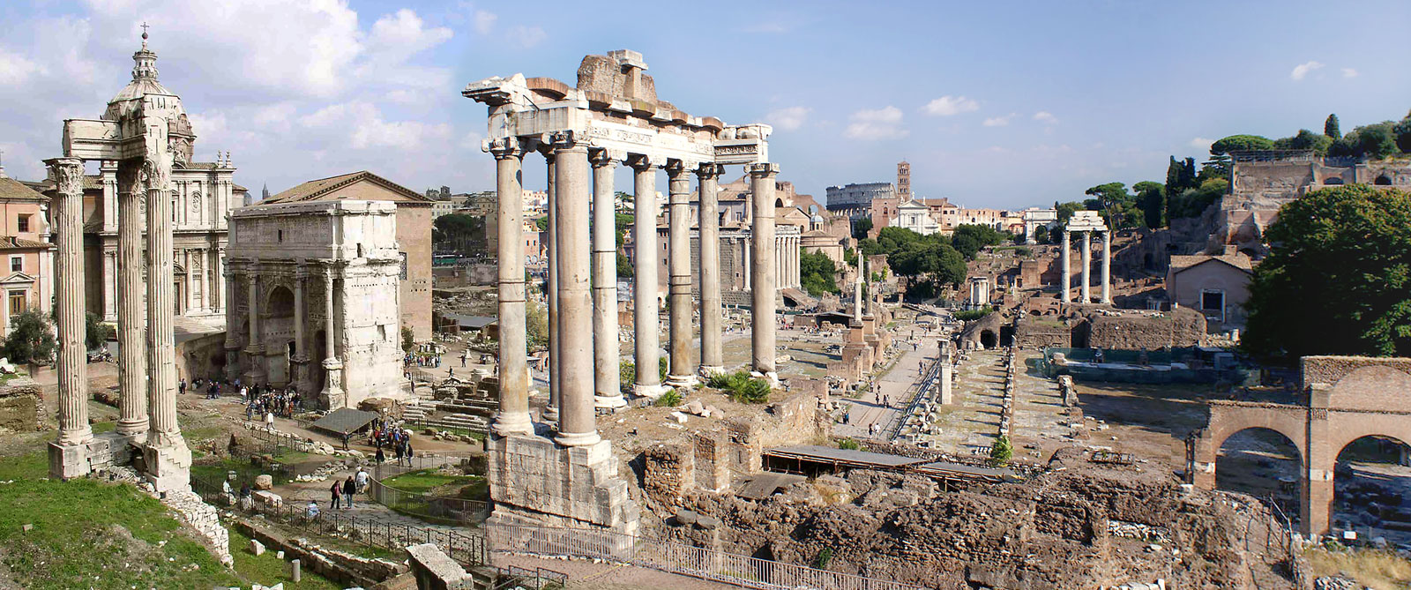
Romans 5 & 6
Dead to Sin Alive In Christ

Slide 2
Romans So Far
Romans 1:1-3:20 All have sinned: Jew and Gentile. All are lost.
Romans 3:20-4:25 A way of justification and salvation. Righteousness is by the blood of Jesus through the faith of Abraham.

Slide 3
Romans 5:1-11
Romans 5:1-11 Because of our faith in Jesus Christ:
v. 1 Justified.
v. 1 Peace with God.
v. 2 Access to God.
v. 2 We will stand.
v. 4-5 Hope
5:6-8 At just the right time… How fortunate and blessed we are. How much does God love us? Jesus died.
5:9-11 Aren’t justified and saved equivalent?
No. Justified about the past. Saved about the future.

Slide 4

Romans 5:12-19 Adam and Jesus
Adam and Jesus are both very similar and very different.

Slide 5
Romans Ch 6-8 The Way of Holiness
Romans 6 Practical application of Romans 1-5
What is the application of Romans 5?
Should we take advantage of God’s grace? NO WAY!!!
Why not? Because we are dead in Christ.
Died with Christ = Dead to sin. Answer: We should die to sin, and live a new life (v. 4)

Slide 6
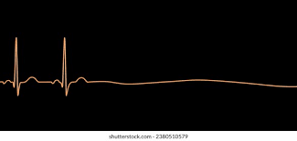
Dead to Sin Alive In Christ
How do dead people act?

Slide 7
What Does Baptized Into Christ Mean?
At that very moment, the death of Christ applies to you.
Dead IN sin becomes Dead TO sin.
Gal 3:27 “All of you who were baptized into Christ have clothed yourselves with Christ.”
If you are “in Christ” when did you come into Christ?

Slide 8

If We are in Christ, How and when did we get into Christ?
Believe into Christ?
Repent into Christ?
Pray into Christ?
How do you get in there?
You were out here

Slide 9
Romans 6:5-14 Paul explains himself with if… then…
Romans 6:5 For if we have been united with him in his death like his, we will certainly also be united with him in a resurrection like his.”
Q: What if we have not been united with him in his death in baptism?
A: Then we will certainly not also be united with him in a resurrection like his.

Slide 10
Romans 6:5-14 Paul explains himself with if… then…
6:8 If we died with Christ we will live with him.
Q: What if we have NOT died with Christ?
A: Then we will not live with Christ.

Slide 11
Romans 6:5-14 cont. What does death with Christ look like?
v. 4 We should live a new life. Free of guilt, shame, safe, filled with hope.
v. 6 The old self crucified. No longer slaves to sin. Sin no longer has mastery over us.
Romans 6:11 Count yourself dead to sin.
Let us strive to become what Christ has already made us to be. Already, but not yet.
Romans 6:13 Q: What do you offer yourself to?

Slide 12
How do we do this?
Romans 6:13 Offer yourself to God.
Question for the day: What/who do you offer yourself to?

Slide 13
Romans 6:15-23 Whose slave are you?
We are all slaves. Whose slave are you?
6:18 Slavery to Christ means freedom from sin. You are a “slave” of righteousness. You can’t help it!
Romans 6:21 “How was that working for you?”
Romans 6:23 What does sin earn for us?
What is eternal life the wages of? Nothing!

Slide 14
Conclusion: So… How should we live?
At just the right time, Christ died for you.
In baptism,you died with Christ.
So, let us live a life consistent with that present reality. Let us become what Christ has declared us to be. Let us offer ourselves to righteousness. Let us daily put behind sin and grow in holiness.

