Slide 1
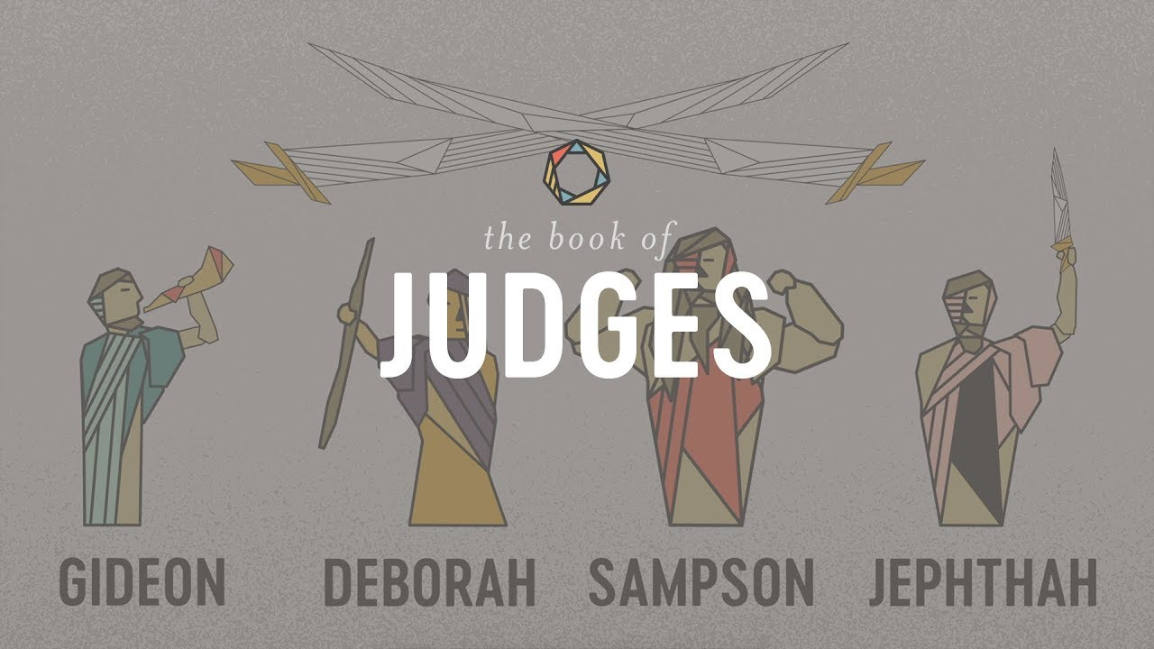
The Book of Judges I: God’s Discipline and God’s Deliverance

Slide 2
Themes of Judges
God’s Discipline
God’s Patience and Mercy
Our Need For a Savior
God’s Salvation
Our Need for Godly Leadership

Slide 3
Theme Passages From Judges
Judges 17:6, 21:25 “In those days Israel had no king. Everyone did as he saw fit.”
Or
Judges 5:2 When the princes of Israel take the lead, when the people willingly offer themselves—praise the Lord!

Slide 4
The Setting of Judges
The setting is The Book of Joshua!
God has done amazing things.
Saved Israel from slavery in Egypt.
Miraculous crossing of the Jordan River.
Victory over Jericho.
Conquering much of the Promised Land
So… How will Israel act moving forward? Very Badly!

Slide 5
The Pattern In Judges
God’s people rebel and sin.
Out of love, God disciplines them.
The people cry for mercy.
God sends a messianic prefigure/Judge to save them.
Rinse and Repeat
Psalm 106:34-48

Slide 6
Things To Look For in Judges
In Judges we learn a lot about God.
In Judges we learn a lot about ourselves.
1 Corinthians 10:6-11 “These things occurred as examples to keep us from setting our hearts on evil things as they did.”

Slide 7
Judges 1
Two patterns:
1. When the tribes worked together in unison they were always victorious.
2. When they subdued peoples, they failed to obey God and drive them out of the land. This became a fatal mistake.

Slide 8
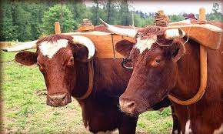
Judges 2:1-3
You shall not make a covenant with the people of this land.”
2 Corinthians 6:14-17 Do not be unequally yoked with unbelievers. Come our from among them.
Dale Davis: “What began as toleration became apostasy. What seemed so reasonable proved lethal.”

Slide 9

Would God Do That?
Judges 2:3 God purposefully did not drive the Canaanites out to test his people.
Judges 3:1-6 v. 4 “They were left to test the Israelites.”
Deuteronomy 8:2 “He tested you, to see what was in your hearts—whether you would keep his commands.”
James 1:13 God does not tempt anyone. Hmmm….

Slide 10
Judges 2:6-9
“The people served the Lord throughout the lifetime of Joshua and of the elders who outlived him, and who had seen all the great things the Lord had done for Israel.”
God’s people need a strong, spiritual leadership—otherwise entropy sets in.

Slide 11
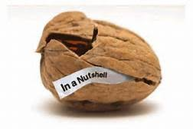
Judges 2:10-23 Judges In a Nutshell
v. 10 “Another generation grew up who knew neither the Lord, nor what he had done for Israel.”
They knew all about him, but they did not know him.
Christianity is an experiential religion.

Slide 12
Judges: We Need Two Things
1. We need to remember the great things God has done. “Amnesia leads to apostasy.”
2. We need to actively experience God working in our lives on an ongoing basis.
Without this the result: They did evil in the eyes of the Lord.

Slide 13
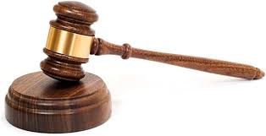
God’s Discipline
Did God judge them?

Slide 14
God’s Discipline
Did God judge them?
No! He disciplined them.
God’s plan A: Loving discipline
God’s plan B: Loving discipline
God’s plan C: Loving discipline
……
God’s plan G: Judgement

Slide 15
Judges 2:15
They were in great distress
Judges 3:9 “They cried out to the Lord.”
Judges 3:15 “They cried out to the Lord.”
So, What did God do? He sent a Savior! God has both a “hard” side and a “soft” side. When we cry for help, we bring out his soft side.

Slide 16

Who’s God Gonna Call?
Othniel, Ehud, Shamgar, Ibzan, Abdon, Elon, Deborah, Jephthah, Jair, Tola, Gideon, Samson.
Samuel, David….
Jesus!!!
Did we deserve this? NO!!!
Why, God? Because of his patience and mercy.

Slide 17
The Message of Judges
Don’t worry. You can mess up as badly and as often as you like. All you have to do is cry out to God and he will rescue you every time. NOT!
Judges 2:17 They quickly turned v. 19 the people returned to ways even more corrupt.

Slide 18
The Message of Judges
Don’t worry. You can mess up as badly and as often as you like. All you have to do is cry out to God and he will rescue you every time.
v. 17 They quickly turned v. 19 the people returned to ways even more corrupt.
No!!!!!!!!!!!!
1 Corinthians 10:6-13 Do not be like them!

Slide 19
Judges 3:7-11 A Case Study: Othniel
Israel sinned—they forgot God
God’s anger was aroused. He subjected them to Aram eight years.
Israel cried out to the Lord for help.
God sent Othniel to save/Judge them
Israel had peace for 40 years.

Slide 20
Summary
We were in rebellion, sin, idolatry
We cried out to God, and he sent a Savior: Jesus Christ
We repented, made him Lord, were baptized and saved.
But if you think you stand, be careful that you do not fall.
We need to remember the great deeds of God.
We need to experience God through active involvement in his graceful work to save the world.

