Slide 1
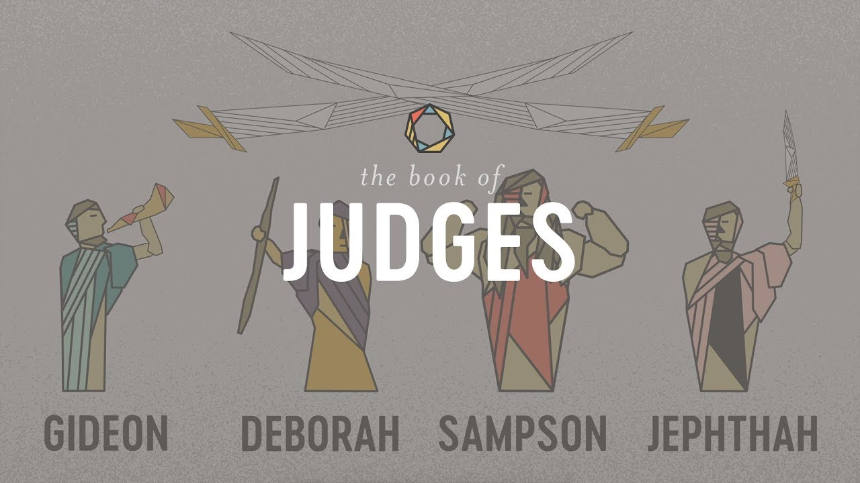
The Book of Judges III:
Deborah: Savior of Israel

Slide 2
Themes of Judges
God’s Discipline
God’s Patience and Mercy
Our Need For a Savior/God’s Salvation
Our Need for Godly Leadership

Slide 3
Theme Passages From Judges
Judges 17:6, 21:25 “In those days Israel had no king. Everyone did as he saw fit.”
Or
Judges 5:2 When the princes of Israel take the lead, when the people willingly offer themselves—praise the Lord!

Slide 4
The Setting of Judges
The setting is The Book of Joshua!
God has done amazing things.
Saved Israel from slavery in Egypt.
Miraculous crossing of the Jordan River.
Victory over Jericho.
Conquering much of the Promised Land
So… How will Israel act moving forward? Very Badly!

Slide 5
The Pattern In Judges
God’s people rebel and sin.
Out of love, God disciplines them.
The people cry for mercy.
God sends a messianic prefigure/Judge to save them.
Rinse and Repeat

Slide 6
Judges 1
Two patterns:
1. When the tribes worked together in unison they were always victorious.
2. When they subdued peoples, they failed to obey God and drive them out of the land. This became a fatal mistake.

Slide 7
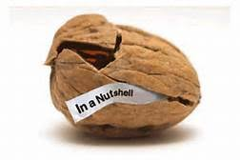
Judges 2:10-23 Judges In a Nutshell
v. 10 “Another generation grew up who knew neither the Lord, nor what he had done for Israel.”
They knew all about him, but they did not know him.
Christianity is an experiential religion.

Slide 8
Judges: We Need Two Things
1. We need to remember the great things God has done. “Amnesia leads to apostasy.”
2. We need to actively experience God working in our lives on an ongoing basis.
Without this the result: They did evil in the eyes of the Lord.

Slide 9
God’s Discipline
Did God judge them?
No! He disciplined them.
God’s plan A: Loving discipline
God’s plan B: Loving discipline
God’s plan C: Loving discipline
……
God’s plan G: Judgement

Slide 10
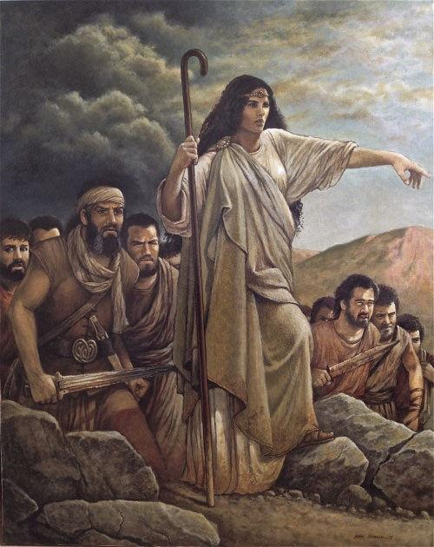
Deborah: Savior of Israel
Judges 3 Ehud
Judges 4 & 5 Deborah

Slide 11
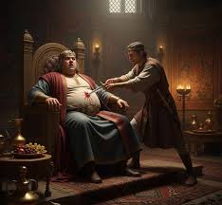
Judges 3:12-30 A Shocking Story
v. 12-15 Rinse and Repeat.
Israel cried out and God sent a Savior: Ehud
v. 15-30 Does God condone what Ehud did?
Ehud to Eglon: I have a message for you: Stop oppressing my people!

Slide 12
The Message of Judges 3
What Ehud did may not be God’s preferred method, but in His loving response to our cries for mercy, God sends a Savior—Ehud.

Slide 13
Judges 4 & 5 Deborah Savior of Israel
Judges 4:1-3 Rinse and Repeat.
The score:
Jabin has 900 iron chariots.
Israel has 0 iron chariots.
Judges 4:4-23 Deborah: prophet and judge of Israel.
(also Huldah 2 Kings 22:14-20)

Slide 14
Judges 4:4-23
Prophet Deborah to General Barak: Now is to time to go and save Israel.
Barak to Deborah: Theoretically, I trust God, but, in practice, I trust in God’s leader more.
v. 14 Deborah to Barak: Go! Has not the Lord gone ahead of you?
God to you: Go! Have I not gone ahead of you?

Slide 15
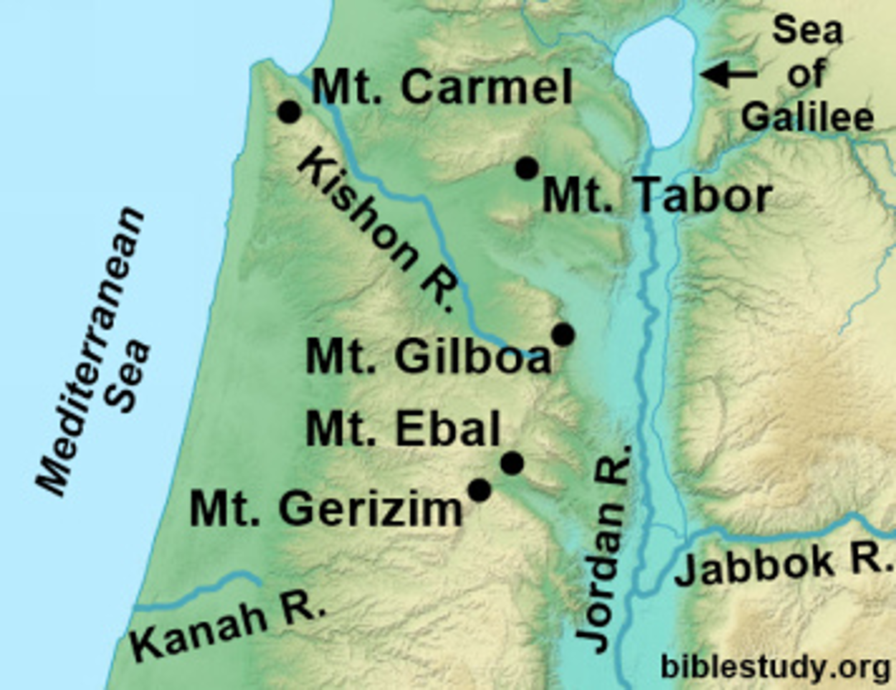
Judges 4:4-23
v. 15 So Israel routed Sisera
How? Judgess 5:4, Judges 5:21. God flooded the Kishon River.
Message to us: When God says go, go!

Slide 16

The Kishon River: A Wadi

Slide 17
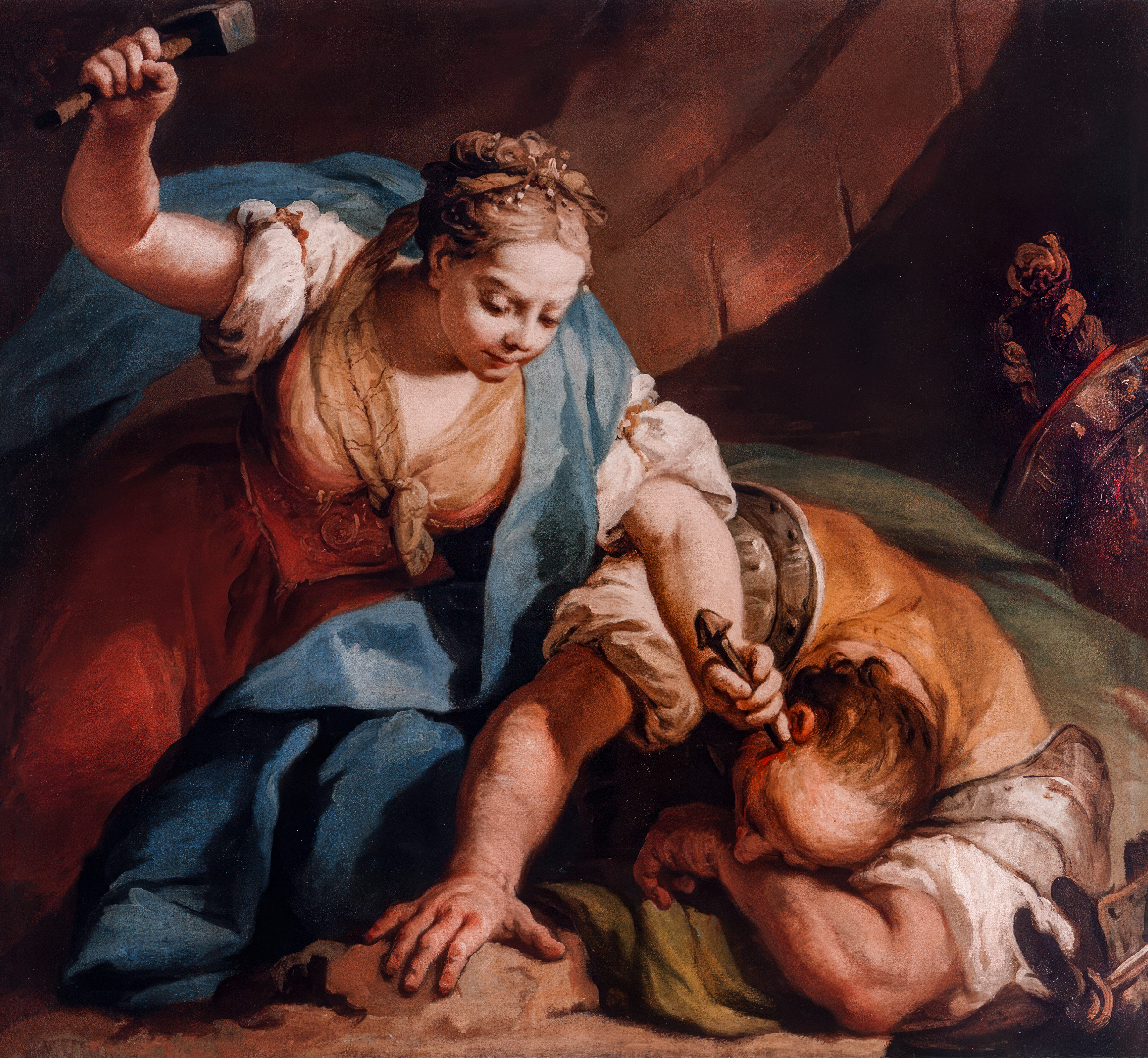
Judges 4:17-22 God judges Israel’s Oppressor
Does God approve of what Jael did to Sisera—deceiving him and taking his life?

Slide 18
Judges 5 Deborah’s Song
v. 2 When the princes (or princesses) of Israel take the lead, and the people willingly offer themselves, Praise the Lord!
v. 9 My heart… is with the willing volunteers among the people. Praise the Lord!

Slide 19
Judges 5 Deborah’s Song
Praise for those who willingly joined the battle:
Ephraim, Benjamin, Zebulun and Issachar.
No praise or even curses for those who held back out of fear. Reuben, Asher, Meroz.
Conclusion: May all your enemies perish, Lord, but may all who love you be like the sun when it rises in its strength.

Slide 20
Summary
To those who, in their sin, cry out to God for mercy, God will send a Savior. For them: Deborah For us: Jesus
Victory requires strong, spiritual, faithful leaders.
God is calling you and me to be “soldiers” in the battle to save souls—to bring the message of salvation to all people.

