Slide 1
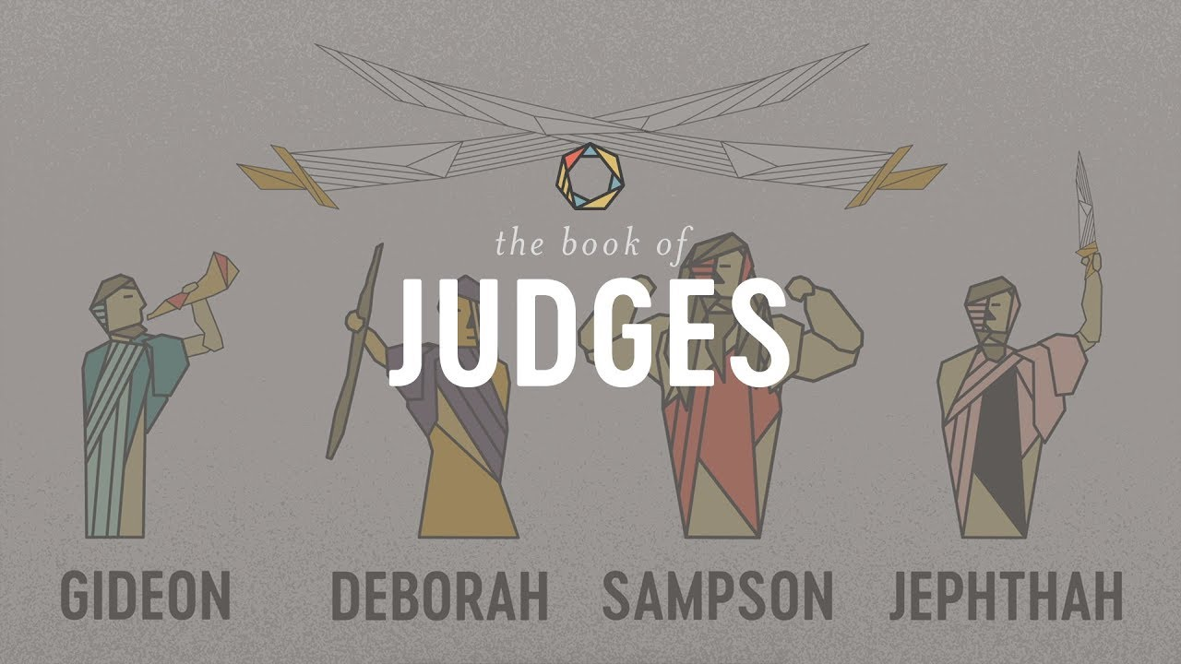
The Book of Judges IV:
Gideon: God’s Warrior

Slide 2
Themes of Judges
God’s Discipline
God’s Patience and Mercy
Our Need For a Savior/God’s Salvation
Our Need for Godly Leadership

Slide 3
Theme Passages From Judges
Judges 17:6, 21:25 “In those days Israel had no king. Everyone did as he saw fit.”
Or
Judges 5:2 When the princes of Israel take the lead, when the people willingly offer themselves—praise the Lord!

Slide 4
The Pattern In Judges
God’s people rebel and sin.
Out of love, God disciplines them.
The people cry for mercy.
God sends a messianic prefigure/Judge to save them.
Rinse and Repeat

Slide 5
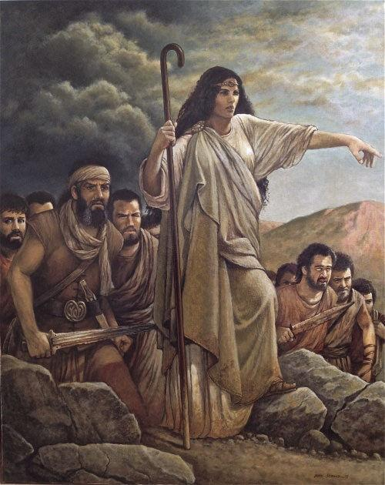
Deborah: Savior of Israel
Judges 3 Ehud: Savior of Israel
Judges 4 & 5 Deborah: Prophet, Judge and Savior of Israel

Slide 6
Judges 4 & 5 Deborah Savior of Israel
Judges 4:1-3 Rinse and Repeat.
The score:
Jabin has 900 iron chariots.
Israel has 0 iron chariots.
Judges 4:4-23 Deborah: prophet and judge of Israel.

Slide 7
Judges 5 Deborah’s Song
v. 2 When the princes (or princesses) of Israel take the lead, and the people willingly offer themselves, Praise the Lord!
v. 9 My heart… is with the willing volunteers among the people. Praise the Lord!

Slide 8
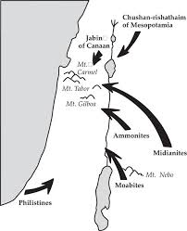
Judges 6 Gideon: God’s Warrior
Judges 6:1-6 Rinse and Repeat Moabites, Canaanites, now the Midianites “like swarms of locusts.”

Slide 9
Judges 6:7-10
God: Am I asking too much? I just ask one thing.
Deuteronomy 6:4 Hear, O Israel, the Lord our God is one God. Love the Lord your God with all your heart, with all your soul and with all your strength.
But like Adam and Eve, we want more.

Slide 10
Judges 6:11-18 Gideon: A Very Unlikely Savior
v. 12 God is with you, mighty warrior.
Gideon: Who, me?
Why are you not blessing us?
God: Do you remember Mt. Ebal?

Slide 11
God’s Message to Gideon (and to you)
1. v. 14 You may not be strong, but go in the strength you have.
2. v. 16 Besides, I will be with you!
That is enough!
Gideon: Yeah, but… What about you?

Slide 12
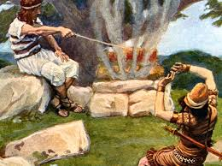
God’s Patience and Mercy to Gideon (and to you)
Unfaithful Gideon: God, give me a sign!
Merciful and patient God: OK!

Slide 13
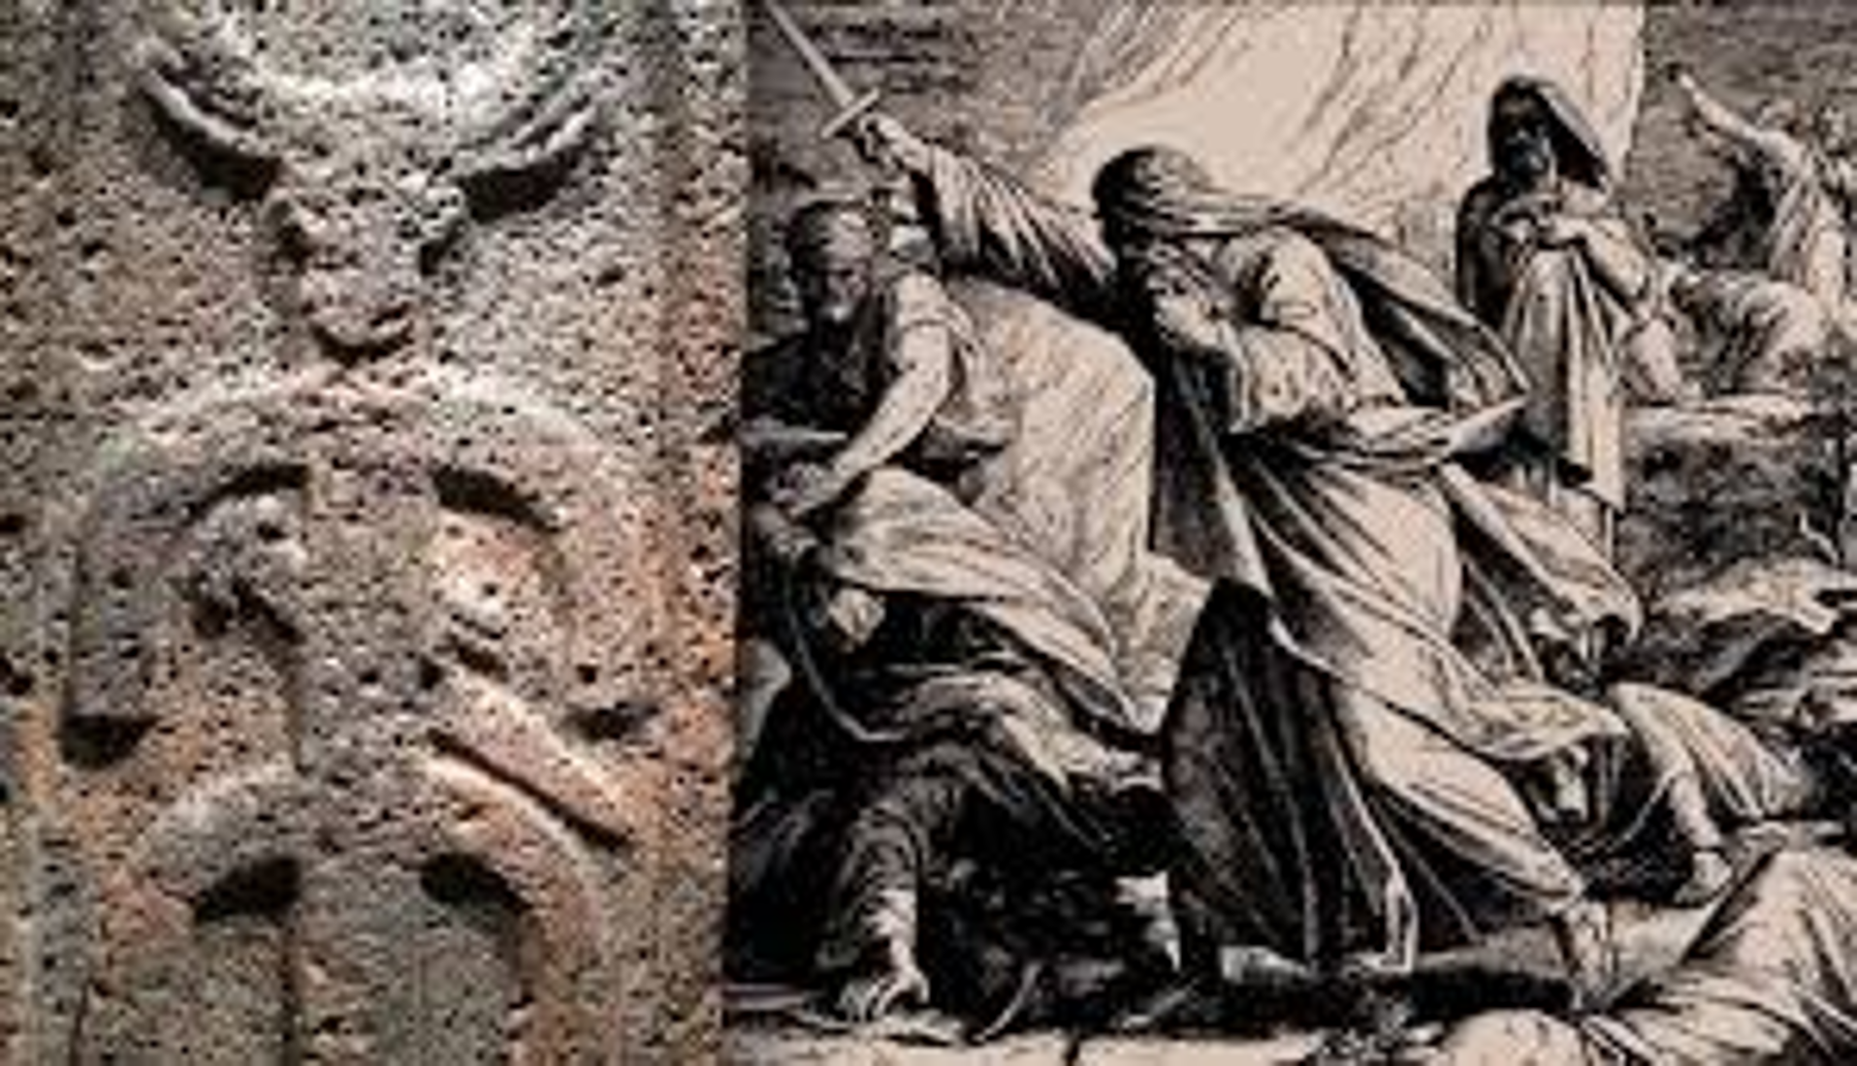
Judges 6:25-29 Gideon Finally Takes Action
Baal: Canaanite god of fertility and storms

Slide 14
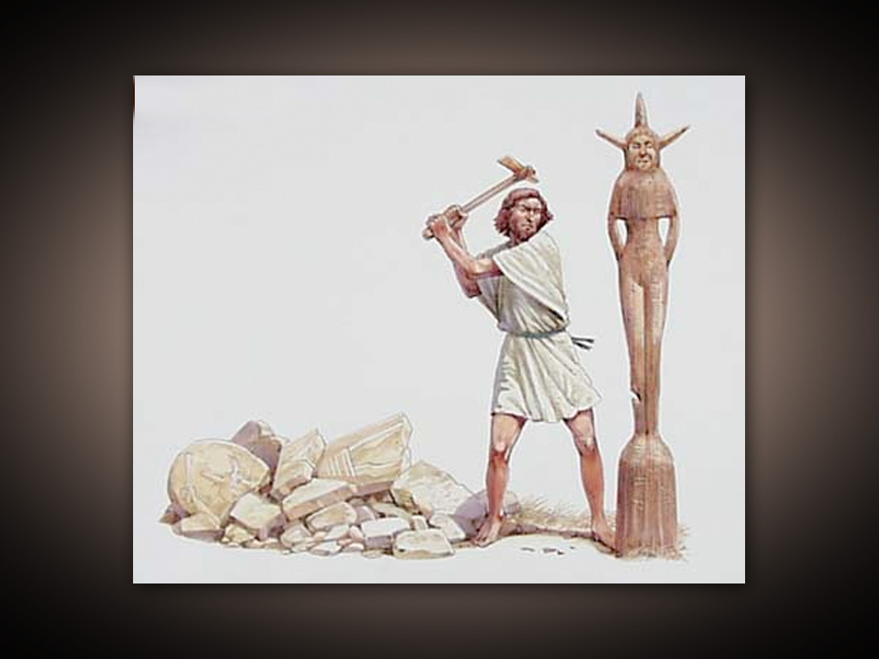
Asherah
Mother goddess Queen of Heaven

Slide 15
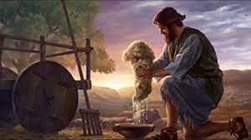
Making Godly Decisions: Put Out a Fleece?
Consult the Scripture.
Apply biblical principles.
Seek godly wisdom.
Pray to God for wisdom.
And decide!

Slide 16
Summary
God will discipline us when we trust in idols rather than Him.
When we cry out, a merciful and patient God will come to save.
God will use some very unlikely people to do great things.
When God calls us to take action, he will be with us! We should go in the strength we have.

