Slide 1
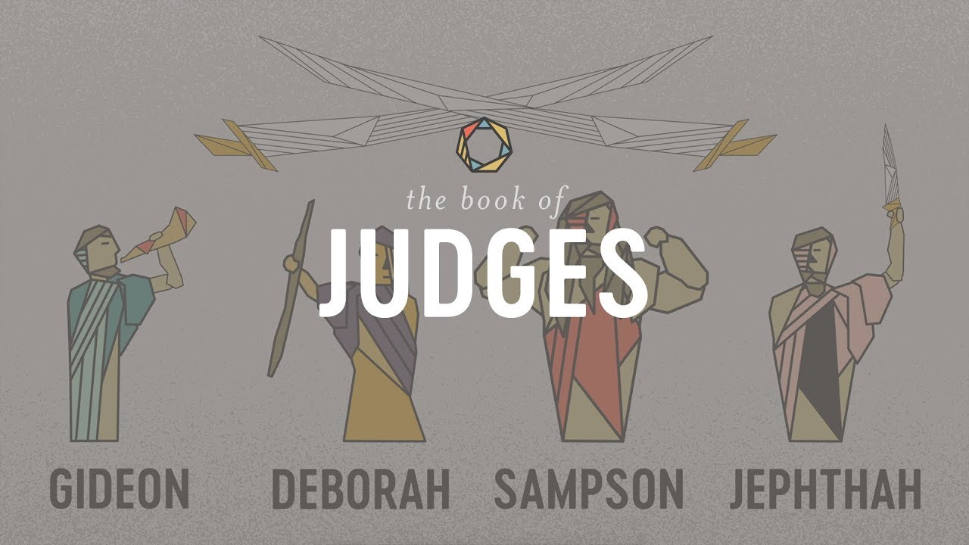
The Book of Judges V:
Gideon: God’s Warrior
Part 2

Slide 2
Themes of Judges
God’s Discipline
God’s Patience and Mercy
Our Need For a Savior/God’s Salvation
Our Need for Godly Leadership

Slide 3
Theme Passages From Judges
Judges 17:6, 21:25 “In those days Israel had no king. Everyone did as he saw fit.”
Or
Judges 5:2 When the princes of Israel take the lead, when the people willingly offer themselves—praise the Lord!

Slide 4
The Pattern In Judges
God’s people rebel and sin.
Out of love, God disciplines them.
The people cry for mercy.
God sends a messianic prefigure/Judge to save them.
Rinse and Repeat

Slide 5
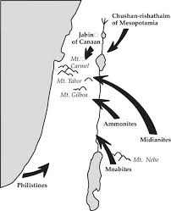
Judges 6 Gideon: God’s Warrior Part I
Judges 6:1-6 Rinse and Repeat Moabites, Canaanites, now the Midianites “like swarms of locusts.”

Slide 6
Judges 6:11-18 Gideon: A Very Unlikely Savior
v. 12 God is with you, mighty warrior.
Gideon: Who, me?
God’s message to Gideon:
1. v. 14 You may not be strong, but go in the strength you have.
2. v. 16 Besides, I will be with you!

Slide 7
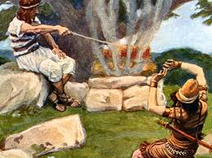
God’s Patience and Mercy to Gideon (and to you)
Unfaithful Gideon: God, give me a sign!
Merciful and patient God: OK!

Slide 8
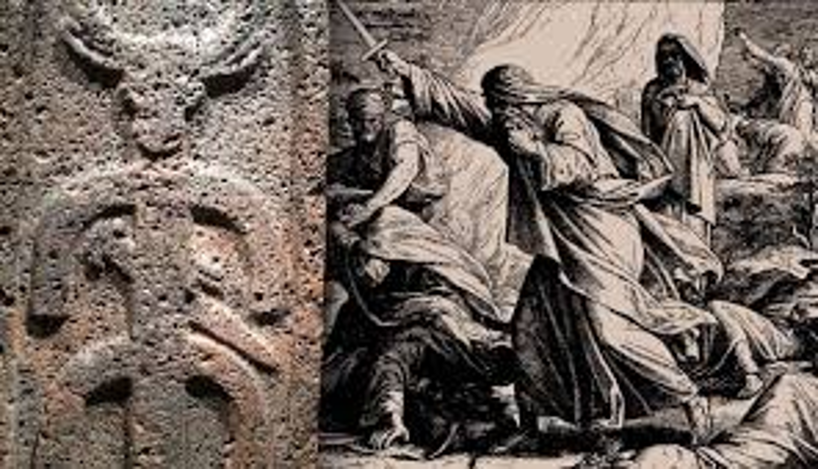
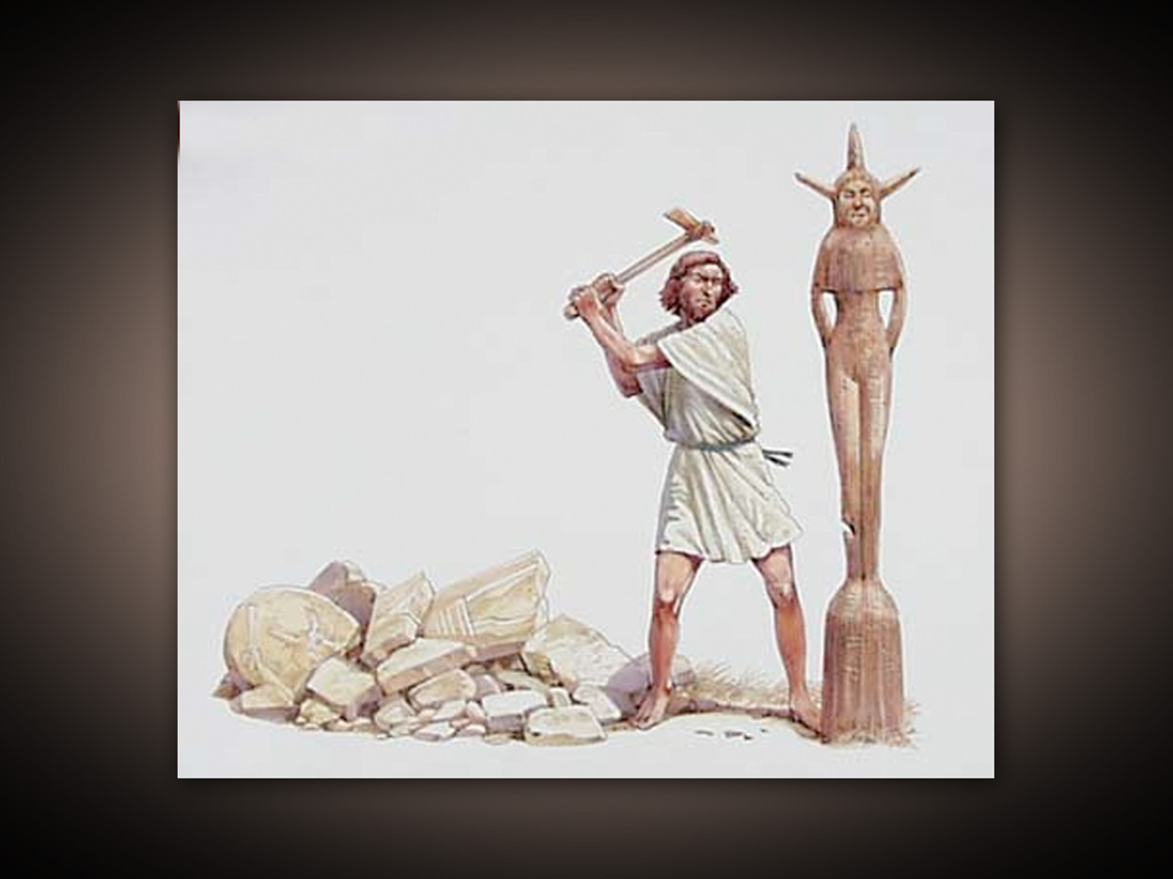
Judges 6:25-29 Gideon Finally Takes Action
Baal
Asherah

Slide 9
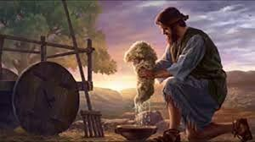
Judges 6:36-40
Making Godly Decisions: Put Out a Fleece?
Consult the Scripture.
Apply biblical principles.
Seek godly wisdom.
Pray to God for wisdom.
And decide!

Slide 10
Judges 7 Gideon: God’s Warrior
The facts:
Midian: “like swarms of locusts” Judges 7:12
Midian: 135,000 soldiers Judges 8:10
Israel: 32,000 soldiers Judges 7:3
Not good odds!
God: You have too many soldiers!

Slide 11
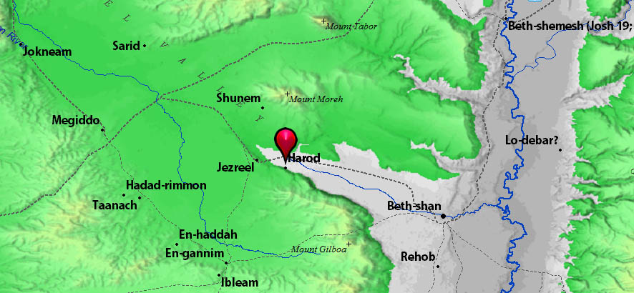
The Valley of Jezreel,
The Spring of Harod and Mt. Moreh

Slide 12
Israel At The Spring of Harod
“Anyone who trembles”
20,000 go home.
Would you have gone home?
The Spring of Harod

Slide 13
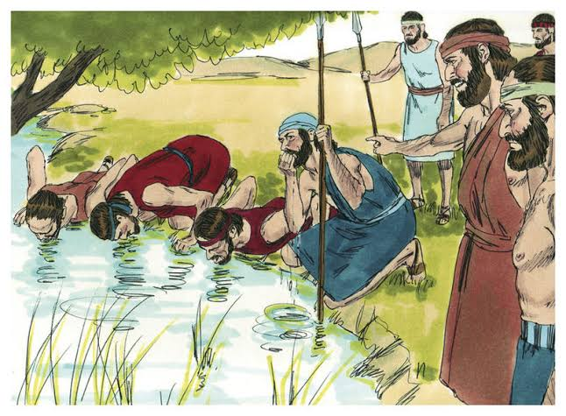
God: 135,000
vs.
10,000
You still have too many!
Kneelers vs tongue-lappers

Slide 14
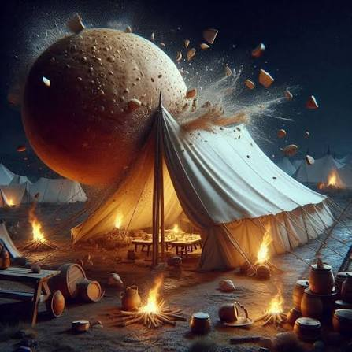
Judges 7:9-15
God encourages Gideon and Israel
I had a dream:
A round loaf of barley came tumbling into the Midianite camp.

Slide 15
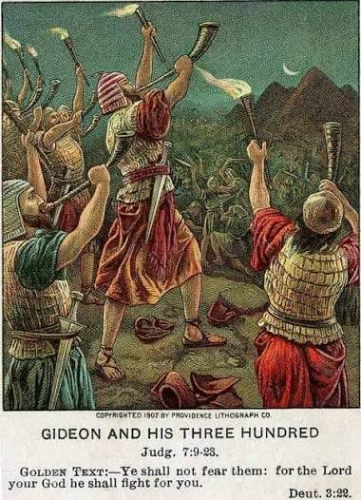
Judges 7:16-24 A Crazy Battle Plan!
Gideon: Do exactly as I do.
Blow your trumpets, smash your jars and raise your torches.
“A sword for the Lord and for Gideon!”

Slide 16
Judges 8 Praise for those who go into the battle
Judgment for those who hold back.
Judges 8:1-7
Gideon to the Ephraimites: What have I accomplished compared to you.
The men of Sukkoth: We are not ready to join God’s bandwagon.
Gideon to Sukkoth: I will tear your flesh with desert thorns and briers

Slide 17
Gideon: Post Script
Judges 8:12 The entire Midianite army routed.
Judges 8:16 Gideon refuses the offer to be king of Israel.
The land had peace for 40 years.
But… Gideon had 70 sons and “many wives.”
Abimelek means “My father is king.”

Slide 18
Summary
A merciful and patient God wants to save people in Merced.
He will use flawed, imperfect men and women to do it.
God says, “I am with you mighty warrior.” and “Go in the strength you have.
But, plan #1 is to zealously remove the idols in our lives.
And then, take zealous action, trusting in God, and we will see great victories and many saved in Merced.

