Slide 1
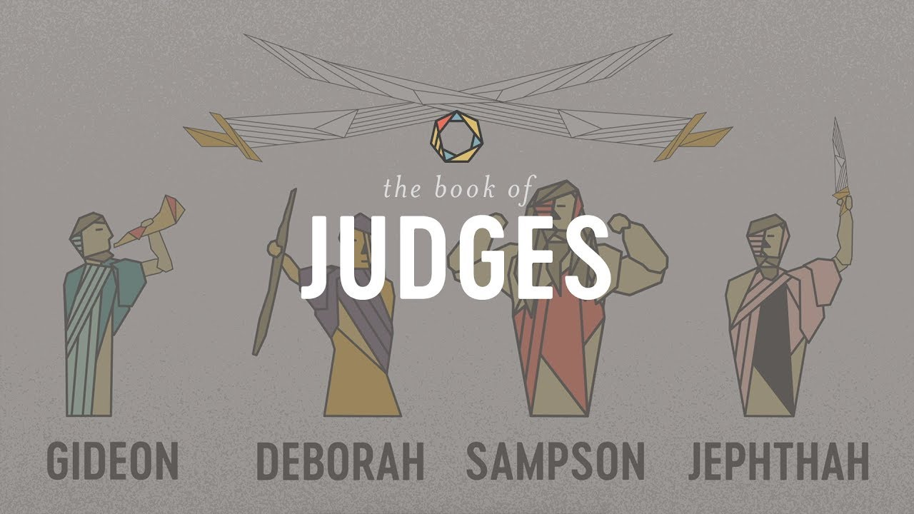
The Book of Judges VI
Jephthah: Savior of Israel

Slide 2
Themes of Judges
God’s Discipline
God’s Patience and Mercy
Our Need For a Savior/God’s Salvation
Our Need for Godly Leadership

Slide 3
Theme Passages From Judges
Judges 17:6, 21:25 “In those days Israel had no king. Everyone did as he saw fit.”
Or
Judges 5:2 When the princes of Israel take the lead, when the people willingly offer themselves—praise the Lord!

Slide 4
The Pattern In Judges
God’s people rebel and sin.
Out of love, God disciplines them.
The people cry for mercy.
God sends a messianic prefigure/Judge to save them.
Rinse and Repeat

Slide 5
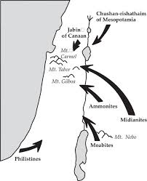
Judges 6 Gideon: God’s Warrior Part I
Judges 6:1-6 Rinse and Repeat Moabites, Canaanites, now the Midianites “like swarms of locusts.”

Slide 6
Judges 6:11-18 Gideon: A Very Unlikely Savior
v. 12 God is with you, mighty warrior.
Gideon: Who, me?
God’s message to Gideon:
1. v. 14 You may not be strong, but go in the strength you have.
2. v. 16 Besides, I will be with you!

Slide 7
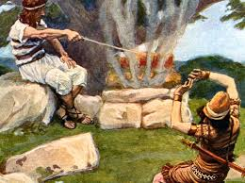
God’s Patience and Mercy to Gideon (and to you)
Unfaithful Gideon: God, give me a sign!
Merciful and patient God: OK!

Slide 8
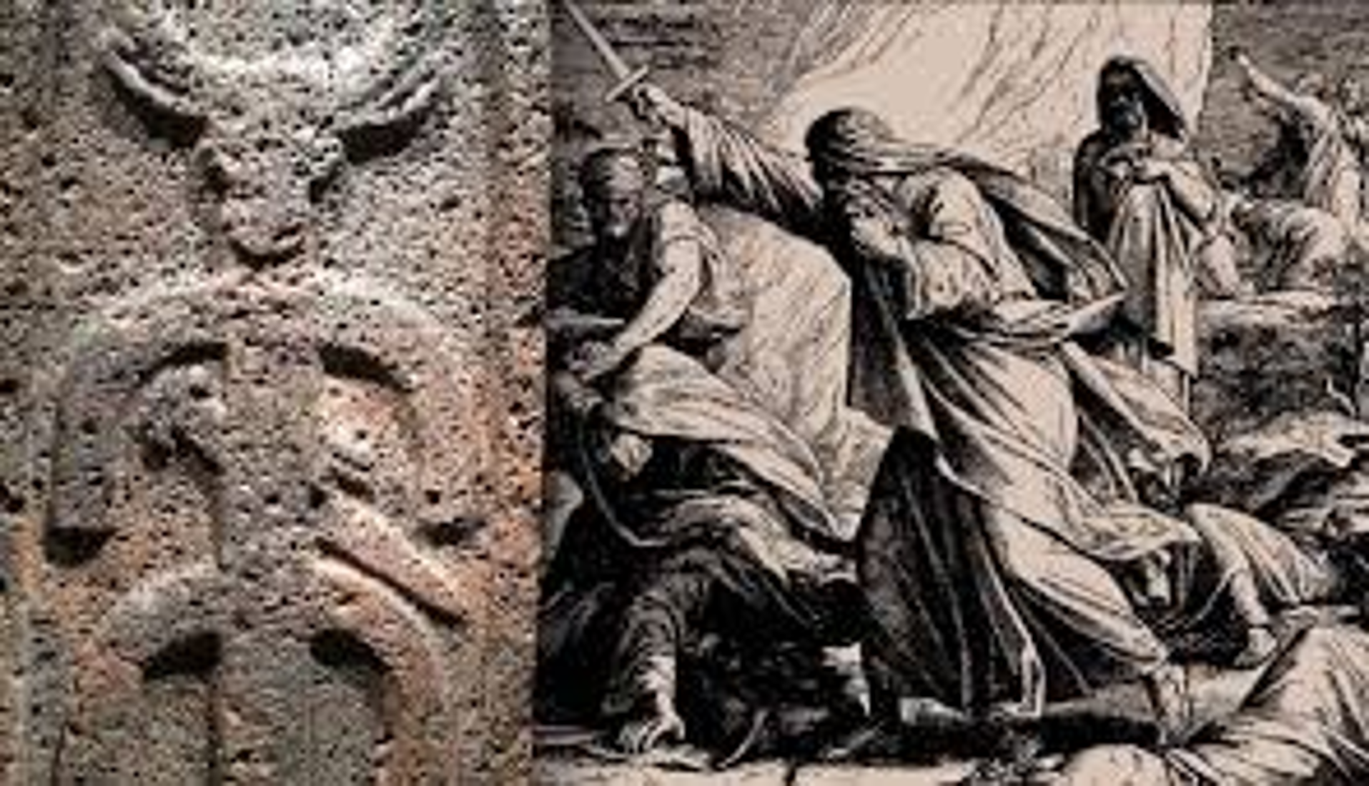
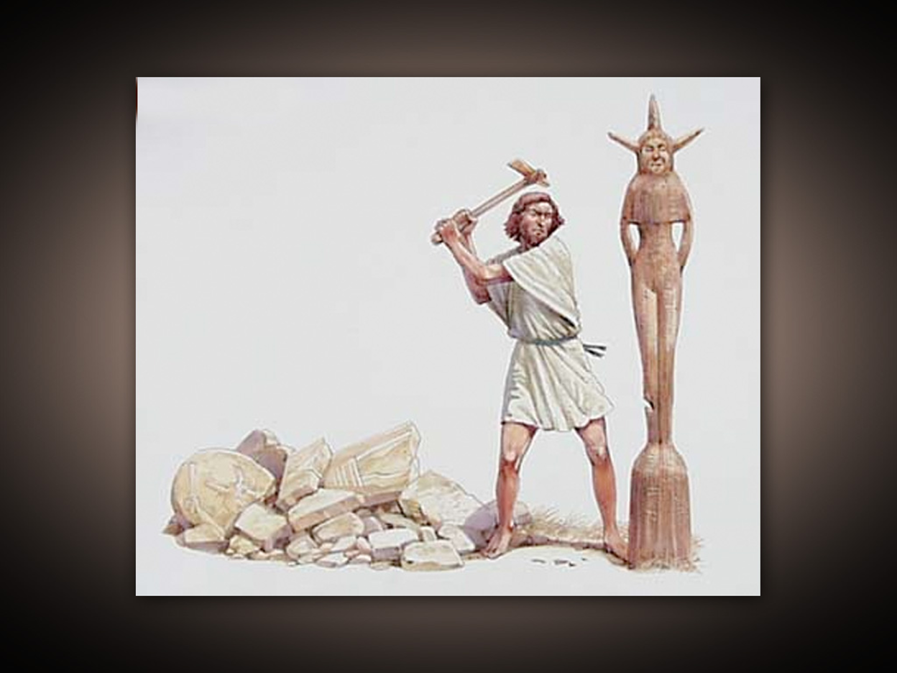
Judges 6:25-29 Gideon Finally Takes Action
Baal
Asherah

Slide 9
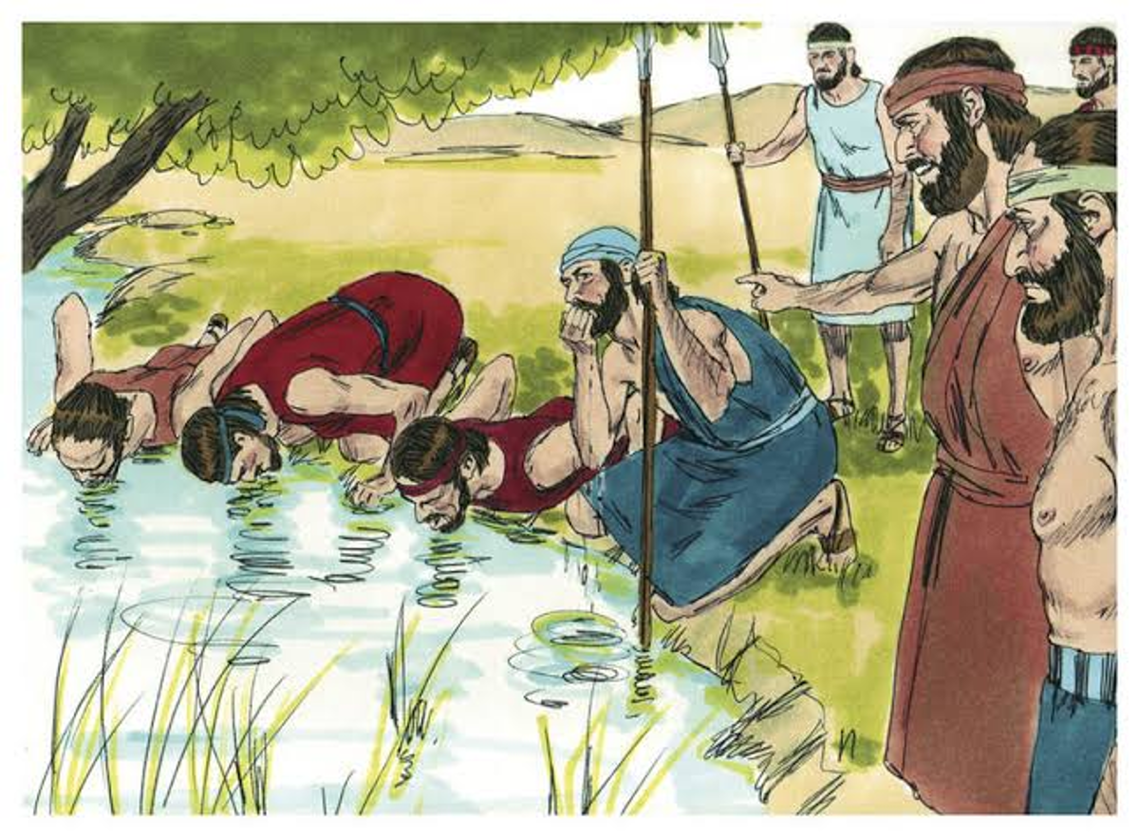
Judges 7 Gideon: God’s Warrior
Midian: “like swarms of locusts” 135,000 soldiers
Israel: 32,000 soldiers Not good odds!
God: You have too many soldiers!
10,000 soldiers: Too many!
300 soldiers: Just right!

Slide 10
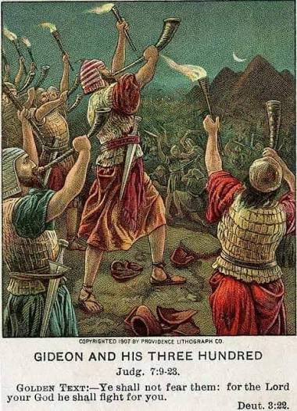
Judges 7:16-24 A Crazy Battle Plan!
Gideon: Do exactly as I do.
Blow your trumpets, smash your jars and raise your torches.
“A sword for the Lord and for Gideon!”

Slide 11
Jephthah: Savior of Israel
Judges 9 A bad legacy for Gideon.
Gideon: A great warrior but a bad husband and father.
For us: Remember, spirituality begins, not on the battlefield, but at home.
Abimelek murders the 70 sons of Gideon.

Slide 12
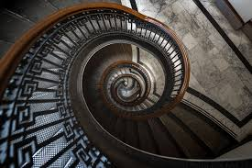
Judges 10:6-14 Israel goes from bad to worse
Idolatry produces a downward spiral

Slide 13

Canaanites worshipped Baal and Asherah
Aram worshipped Haddad
Sidon worshipped Eshmun
Moab worshipped Chemosh and Ashtart
Ammon worshipped Milcom and Chemosh
Philistia worshipped Dagon and Molech.
Baal, Ashtaroth, Haddad, Eshmun, Chemosh, Ashtart, Milcom, Dagon and Molech, Oh My!

Slide 14
Judges 10:7
God sold Israel into the hands of the Philistines and the Ammonites.
For us: Into the hands of Satan John 12:31, 2 Cor 4:4
Would God do that?
1 Corinthians 5:5
v. 10 After 18 years, finally, Israel cried out to the Lord
v. 11-14 God: I am done with you. Judgment time.

Slide 15
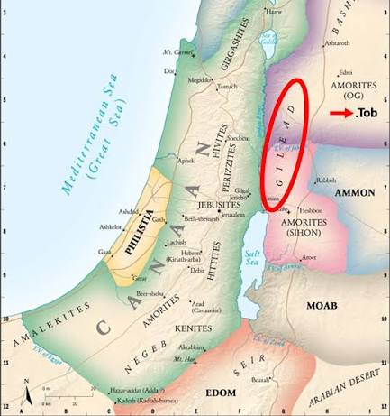
Ammonites and Philistines

Slide 16
Judges 10:15-18 Repentance?
Israel to God: Do as you please with us.
On their own initiative, Israel turns away from the idols.
A VERY patient an merciful God: OK. One more time!
Phew!

Slide 17
Judges 11 Jephthah: Savior of Israel
Unlike Gideon, Jephthah is a natural military leader, but jealous Israel drives him away to Tob.
Ammonites attack, and Israel turns to Jephthah.
Save us and we will make you king.
Are you like that?

Slide 18
Judges 11:29-35
Jephthah makes a foolish vow.
YHWH: If you will give me and Israel victory over the Ammonites, whatever comes out of my house when I return will be given as a burnt offering.
Us to God: If you will do ABC, I will do XYZ

Slide 19

Advice: If you know the right thing to do:

Slide 20
Judges 11:36-40
Did Jephthah offer his daughter as a human sacrifice?
v. 37 I will never marry (not I will die).
v. 39 And she was a virgin (not and she was his only child).

Slide 21
Summary
Turning to idolatry puts us into a downward spiral.
At the bottom of that spiral, God may hand us over to Satan. Do not let that happen!!!!
If we will repent, God will send Jephthah/Jesus to us to redeem us and deliver us from slavery to Satan.
Do not ever bargain with God. If you know the right thing to do, just do it!

