Slide 1
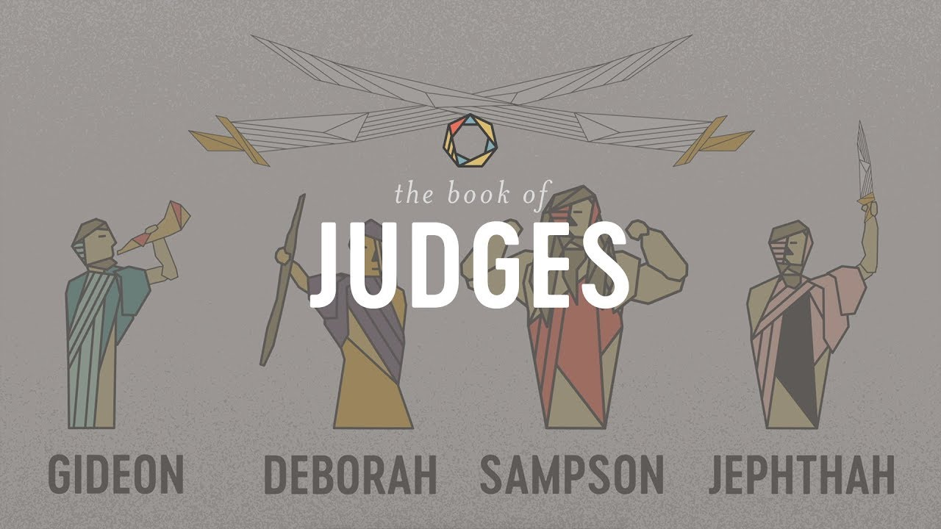
The Book of Judges VII
Samson: An Imperfect Savior

Slide 2
Themes of Judges
God’s Discipline
God’s Patience and Mercy
Our Need For a Savior/God’s Salvation
Our Need for Godly Leadership

Slide 3
Theme Passages From Judges
Judges 5:2 When the princes of Israel take the lead, when the people willingly offer themselves—praise the Lord!

Slide 4
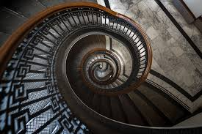
Judges 10:6-14 Israel goes from bad to worse
Idolatry produces a downward spiral
Baal, Ashtoreth, Haddad, Eshmon, Chemosh, Ashtart, Milcom, Dagon and Moloch.

Slide 5
Judges 10
God sold Israel into the hands of the Philistines and the Ammonites.
For us: Into the hands of Satan
Would God do that?
Yes!
v. 10 After 18 years, finally, Israel cried out to the Lord
v. 11-14 God: I am done with you. Judgment time.

Slide 6
Judges 10:15-18 Repentance?
Israel to God: Do as you please with us.
On their own initiative, Israel turns away from the idols.
A VERY patient an merciful God: OK. One more time!

Slide 7
Judges 11 Jephthah: Savior of Israel
Jephthah makes a foolish vow.
YHWH: If you will give me and Israel victory over the Ammonites, whatever comes out of my house when I return will be given as a burnt offering.
Us to God: If you will do ABC, I will do XYZ

Slide 8

Advice: If you know the right thing to do:

Slide 9
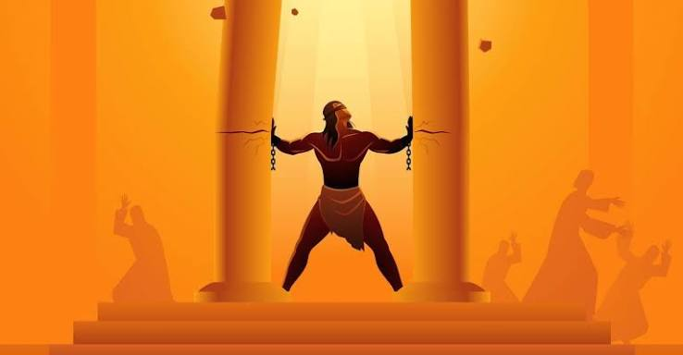
Samson: A Very Flawed Savior
A great irony: Samson, the most flawed of all the Judges, is also the one God uses most clearly as a Savior and prefigure of Christ.
Why would God do that?

Slide 10
Samson: A Very Flawed Savior
But, maybe that is the point of choosing Samson…
Romans 5:6 At just the right time.
Ephesians 2:1-5 We were dead in our sins, but God made us alive in Christ.
Israel was dead in her sins, but God made them alive in Samson

Slide 11
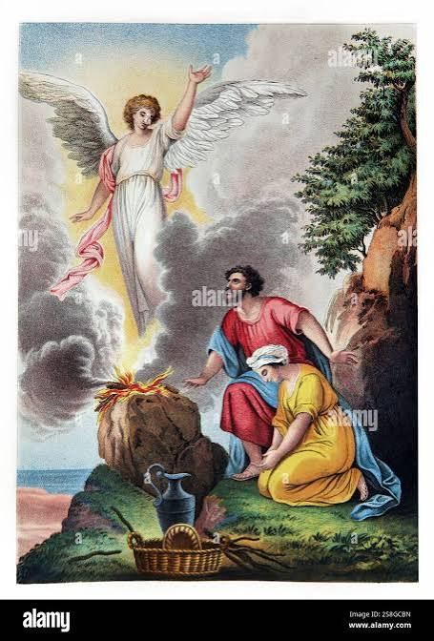
Judges 13:1-12
A Beautiful Story!
Manoah’s wife is barren. Sara, Rebekah, Rachel, Hannah, Elizabeth…
A son who is Savior is miraculously born
v. 5 “He will take the lead in delivering Israel.

Slide 12
Judges 13:1-12 A Beautiful Story!
A son who will be a Nazirite
Jesus is a Nazarene nezer/neser
Means both dedicated and branch
Isaiah 11:1-3, Jeremiah 23:5 Messiah the branch of Jesse, the branch of David.

Slide 13

Judges 13:17-25 Another Prefigure of Christ
My name is Wonderful!
The angel ascended in the flame.
Manoah: We are doomed to die!
A beautiful start to an ugly story

Slide 14
Samson: From good to bad to worse to Savior of Israel
Judges 14:1-4 Samson, the Prodigal Son, went down to Timnah…
A young (and very beautiful) Philistine woman.
Samson’s weakness: A wandering eye, lust!
v. 2 “Get her for me as a wife!”
v. 4 Very surprising: God is using this to save Israel.

Slide 15
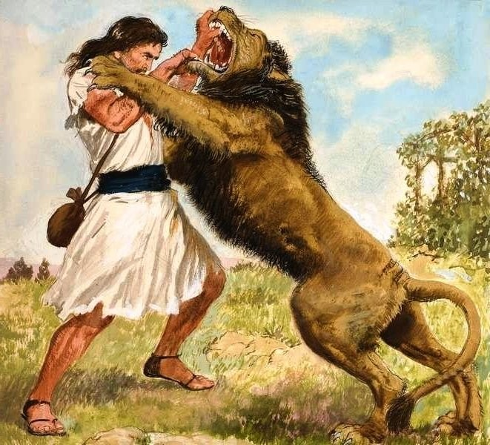
Judges 14
What is sweeter than honey?
What is stronger than a lion?
Samson’s wife: Tell me if you love me!

Slide 16
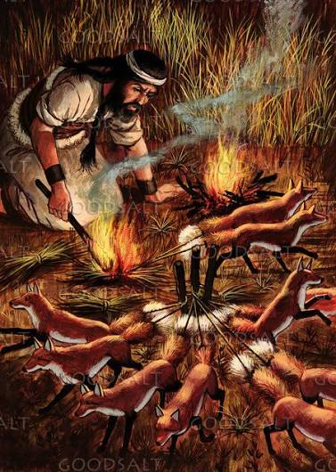
Judges 15 More of the Same
The Jews betray their Savior and hand him over to be killed.
Samson, despite his strength, allows himself to be handed over.
Samson breaks out of captivity, overcoming soldiers

Slide 17
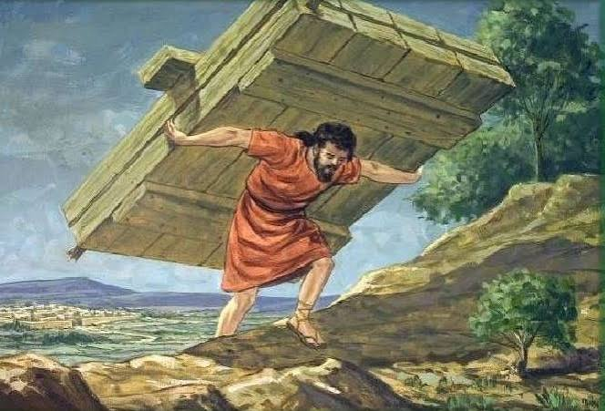
Judges 16 More of the Same
Betrayed for pieces of silver

Slide 18
See the Pattern: Samson is Israel/Us
Chosen by God
Set apart by God for His service
Blessed by God
Empowered by God
Compromise, sin, idolatry and mixing with the world
Disciplined by God, and, ultimately, judged by God.

Slide 19
Messianic Prefigure
Judges 16:18 Betrayed for silver.
Judges 16:25 Arrested, bound and mocked.
Judges 16:27-31 But… In the end, Samson, like Christ, stretches out his arms, and gives his life to save Israel.
Samson: Flawed Judge, Prefigure of Christ, and Savior of Israel.

Slide 20
Post Script: Judges Ch 17-21
Israel goes from bad to worse and, finally, God (partially) judges Israel.
Judges 17 Micah makes an idol.
Judges 17:6 In those days, Israel had no king. Everyone did as he saw fit.
Judges 18 Dan turns to idolatry.
Judges 19 Benjamin degraded.
Judges 20 Benjamin judged.
Judges 21 A remnant of Benjamin saved.

Slide 21
Summary
Samson: A VERY flawed Savior and messianic prefigure
Miraculous birth
Dedicated to God from birth
Nazirite/Nazarene dedicated/Branch
Ascends to heaven
Empowered by the Holy Spirit
Saves Israel
Betrayed by his brothers
Allowed himself to be handed over

Slide 22
Summary
Samson: A VERY flawed Savior and messianic prefigure
Sold for pieces of silver
Mocked
Voluntarily gave his life to save Israel
Samson, a very flawed Savior and prefigure of the Messiah

