Slide 1
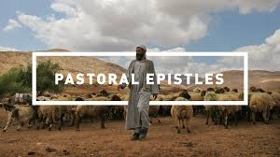
1, 2 Timothy and Titus
“The Pastoral Epistles”

Slide 2
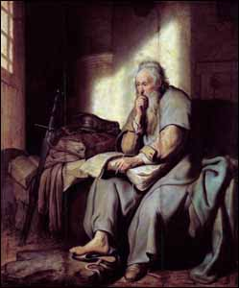
2 Tim 4 I Have Fought the Good Fight
Context:
65-66 AD Paul is in prison in Rome, and is about to be executed.
To “Timothy my true son in the faith.” (1 Tim 1:2)

Slide 3
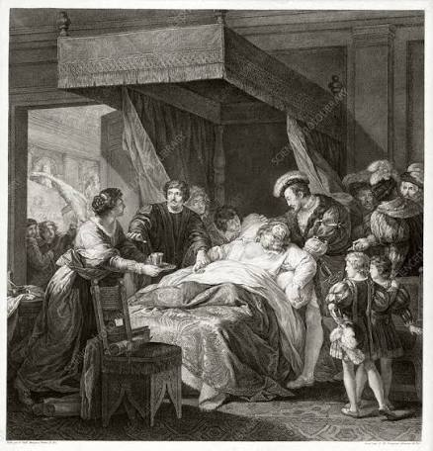
Your Dying Day…
Q: What will you be thinking about?
Paul has two things on his mind:
1. Preach the Word
2. I have fought the good fight.

Slide 4
2 Timothy 4:1-5
PREACH THE WORD!
Preach the gospel. 1 Corinthians 15:3-4
In season and out of season.
Correct, rebuke, encourage and instruct (teach).
With great patience: teach then encourage, then correct, then rebuke

Slide 5

It will not be a piece of cake!
People will not tolerate sound doctrine.
Do not itch the ears of your hearers

Slide 6
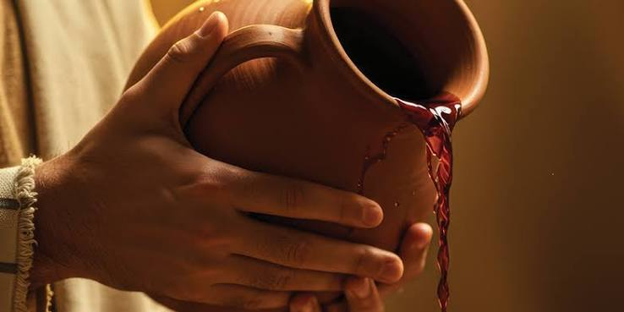
2 Timothy 4:6-8
I am already being poured out like a drink offering.
A nesek is a biblical drink offering where wine was poured out on the altar as part of ancient worship. It usually accompanied grain sacrifices, symbolizing a total surrender or pouring out of life to God.

Slide 7
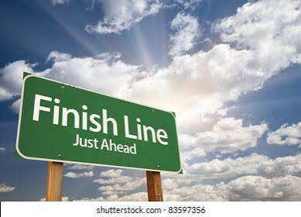
Paul is thinking about two things
I am already being poured out
And
I have fought the good fight, I have finished the race.

Slide 8
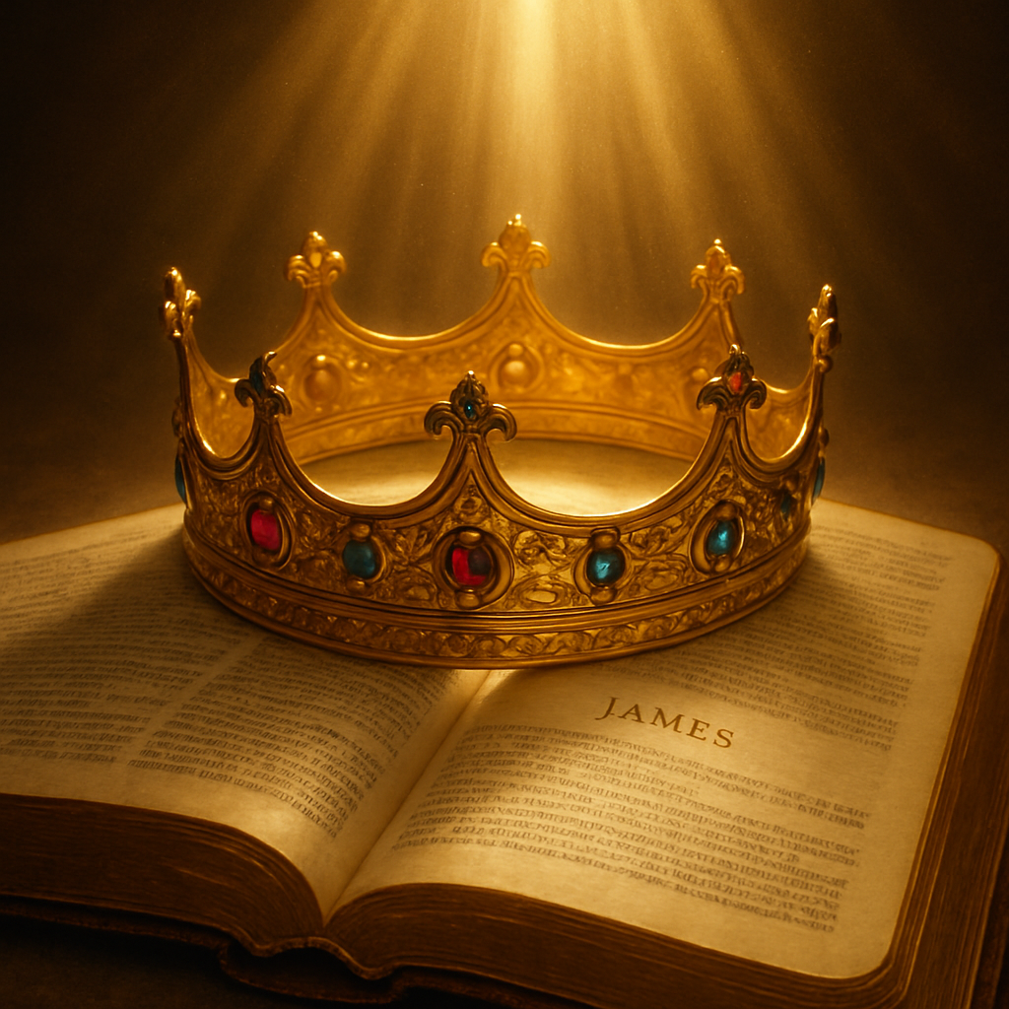
The Crown of Righteousness

Slide 9
Discussion Questions
1. Is there anything you are tempted to hold back in the cup—to not pour out?
2. A crazy question, but… What do you hope will be your legacy?

Slide 10
Would You Be Poured Out?
Would you be poured out like wine upon the altar for me?
Would you be broken like bread, to feed the hungry?
Would you be so one with me that I may do just as I will?
Would you be light and life and love, my word fulfill?

Slide 11
Would You Be Poured Out?
Yes, I’ll be poured out like wine upon the altar for you.
Yes, I’ll be broken like bread, to feed the hungry.
Yes, I’ll be so one with you that you may do just as you will..
Yes, I’ll be light and life and love, your word fulfill. (end)

