Slide 1
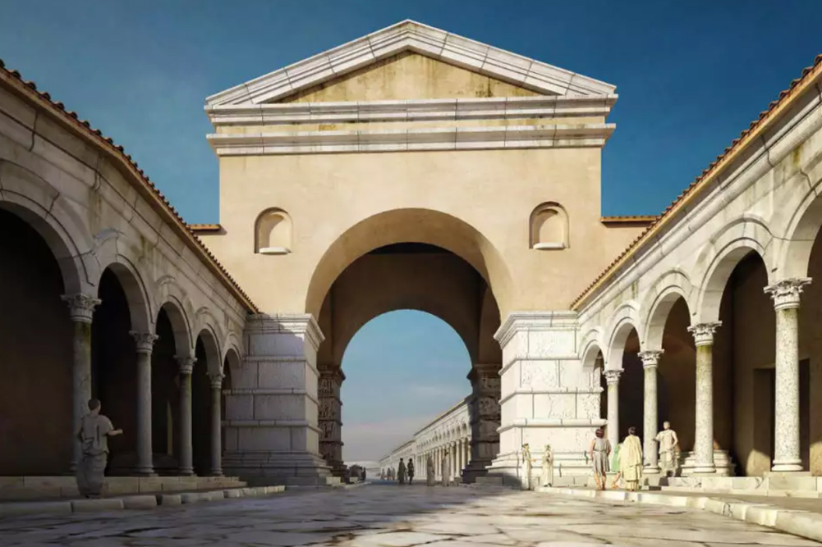
1 Thessalonians 1
Your Labor Prompted By Love
Thessalonica: Acts 17:1-10

Slide 2
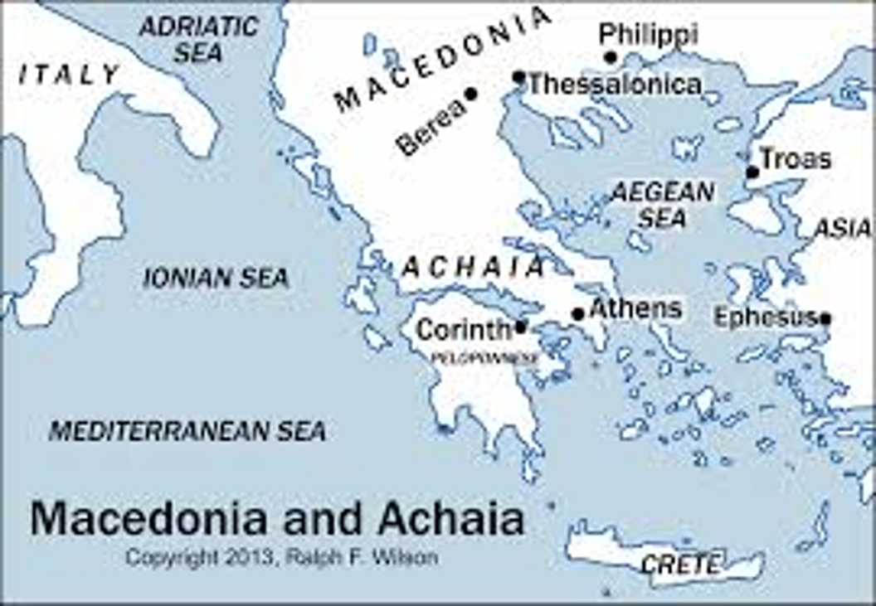
Thessalonica
Acts 17:1-10
Paul reasoned from the Scripture.
They have spread trouble all over the world

Slide 3
Background to 1 Thessalonians
Written from Athens or Corinth AD 51-52
The first book of the New Testament written.
Purpose: To commend to encourage and to instruct the very young church in Thessalonica.

Slide 4
Outline of 1 Thessalonians
Paul: I am encouraged by you because:
A.
B.
C.
D.

Slide 5
Theme Passage in 1 Thessalonians
1 Thessalonians 1:2-3 We always thank God for all of you and continually mention you in our prayers. We remember before our God you work produced by faith, your labor prompted by love, and your endurance inspired by hope in our Lord Jesus Christ

Slide 6
1 Thess 1:2-3
Paul: I continually mention you in my prayers.
Who do you “continually mention” in your prayers?

Slide 7
Paul Notices Three Very Good Things
1. Their work produced by faith.
2. Their laber prompted by love.
3. Their endurance inspired by hope in our Lord Jesus Christ.

Slide 8
1. Work Produced by Faith
Work ergou, deed Literally: Work of faith
How great is your faith?
What “work” for Christ will you do this Fall?
Evaluation Day: 2 Corinthians 13:5

Slide 9
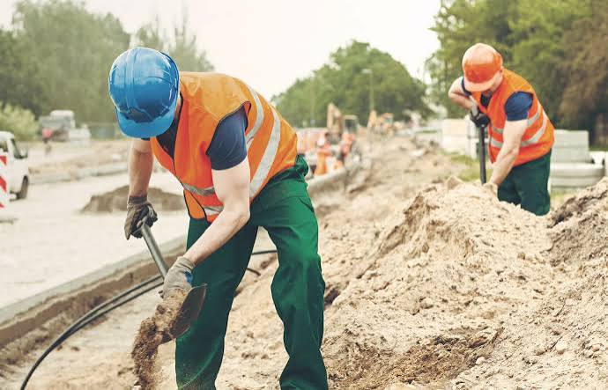
2. Labor Prompted by Love
Labor kopou
Labor is something you do continually.
Faith will get you started (work) but love will keep you going for the long haul (labor)

Slide 10

3. Endurance Inspired by Hope
Hope: Faithful expectation.
Do we, as disciples, need to have endurance?
Yes!

Slide 11
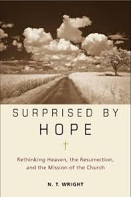
N. T. Wright

Slide 12
Hope in the Resurrection
1 Peter 1:3
Acts 23:6
Romans 6:5
Romans 8:11
John 11:25

Slide 13
Summary
God wants to encourage you today. Why?
Because of your work produced by fait
Because of your labor prompted by love and
Because of your endurance inspired by hope in the resurrection of Jesus Christ.

