Slide 1
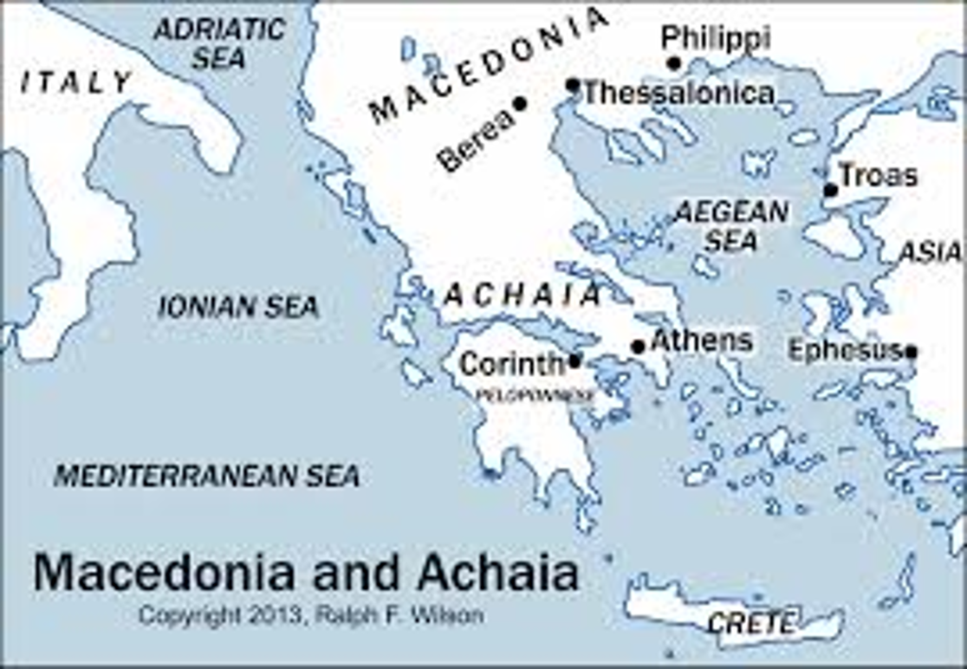
1 Thessalonians II
We Are Family
Thessalonica: Acts 17:1-10

Slide 2
Background to 1 Thessalonians
Written from Athens or Corinth AD 51-52
The first book of the New Testament written.
Purpose: To commend to encourage and to instruct the very young church in Thessalonica.

Slide 3
Theme Passage in 1 Thessalonians
1 Thessalonians 1:2-3 We always thank God for all of you and continually mention you in our prayers. We remember before our God you work produced by faith, your labor prompted by love, and your endurance inspired by hope in our Lord Jesus Christ

Slide 4
Paul Notices Three Very Good Things In the Church in Thessalonica
1. Their work produced by faith.
2. Their laber prompted by love.
3. Their endurance inspired by hope in our Lord Jesus Christ.

Slide 5
1 Thess 1:4-2:12 We Are Family!
1 Thessalonians 1:4-10 How did Paul know that the Thessalonians were chosen by God?
Power
Holy Spirit
Deep Convictions

Slide 6
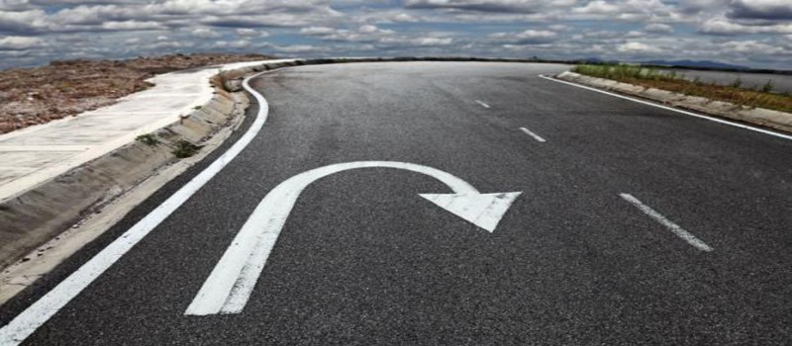
Turn Away From Idols

Slide 7
1 Thessalonians 2:1-6
Our visit was not without results
Pure motives

Slide 8
1 Thess 2:7-12 We Are Family
We were like children among you.
We were like a nursing mother among you.
We were like a father among you.

Slide 9

We were like children among you
humble
teachable
fun
innocent
open

Slide 10
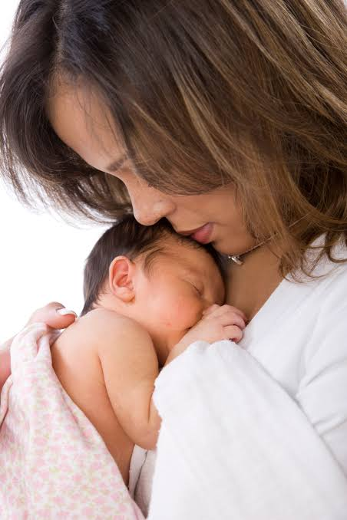
As a nursing mother
Nurturing
Affectionate
Warm
Selfless service
Toil, hard work
We shared with our lives as well

Slide 11

Like a father with his children
Encouraging
Comforting
Urging
Setting boundaries
Protecting from danger
Setting goals, planning

Slide 12
Summary
The gospel comes with power, the Holy Spirit and conviction.
We love one another as family:
Like a child among one another
Like a nursing mother among one another
Like a father among one another

