Slide 1
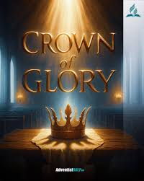
1 Thessalonians III
Our Joy, Our Glory, Our Crown

Slide 2
Background to 1 Thessalonians
Written from Athens or Corinth AD 51-52
The first book of the New Testament written.
Purpose: To commend to encourage and to instruct the very young church in Thessalonica.

Slide 3
Paul Notices Three Very Good Things In the Church in Thessalonica
1. Their work produced by faith.
2. Their laber prompted by love.
3. Their endurance inspired by hope in our Lord Jesus Christ.

Slide 4
1 Thess 2:7-12 We Are Family
We were like children among you.
We were like a nursing mother among you.
We were like a father among you.

Slide 5
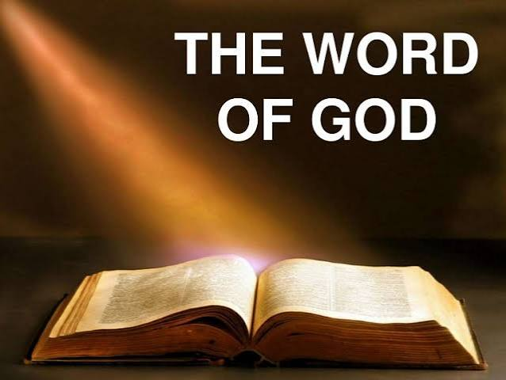
Our Joy, Our Glory and Our Crown
1 Thessalonians 2:13-16
The Word of God
We are a Jesus Church
But, we are also a Bible Church

Slide 6
1 Thessalonians 2:17-3:5
Like being orphaned.
Intense longing.
For what is our hope, our joy, or the crown in which we will glory in the presence of our Lord Jesus when he comes? Is it not you? Indeed, you are our glory and joy.

Slide 7
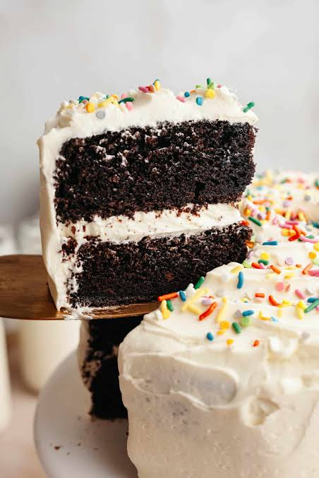
“I thought Jesus was our hope, our joy, our glory and our crown.”
True, but you are the frosting on the cake!

Slide 8
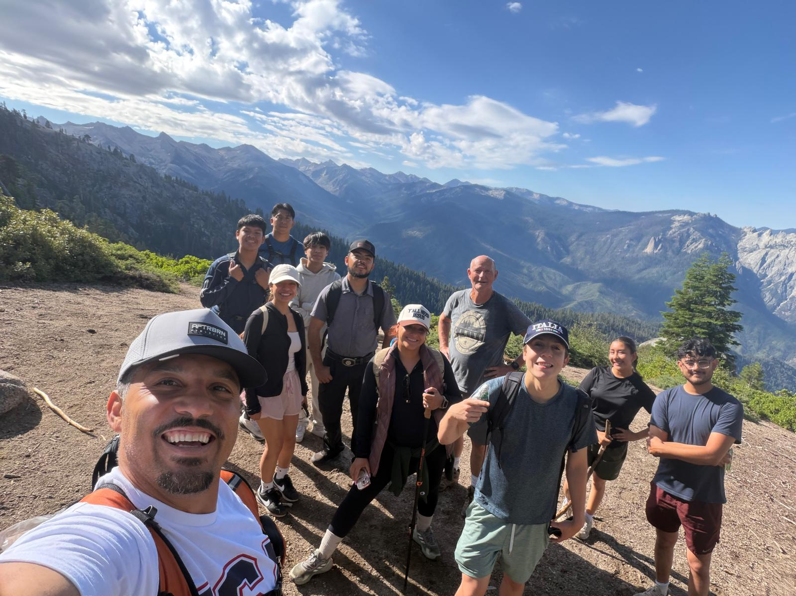
On Judgment Day, You are Our Hope, Our Joy, Our Glory and our Crown

Slide 9
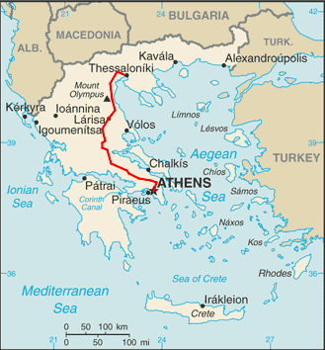
1 Thessalonians 3:1
Paul: I could stand it no longer!
293 miles
5 hr 18 min by car
5 hr 12 min by train
55 min by air
27 hr by ferry
2+ weeks walking.

Slide 10
1 Thessalonians 3:6-13
Great news from Timothy!
Pleasant memories
We were encouraged
For now we really live.
Earnest prayer night and day

Slide 11
Summary
We are a Jesus church, but we are also a Bible church. It is the Word of God!
Preaching the Word brings persecution.
But… Most of all…
You are our Joy, our Hope, our Glory and our Crown!

