Slide 1
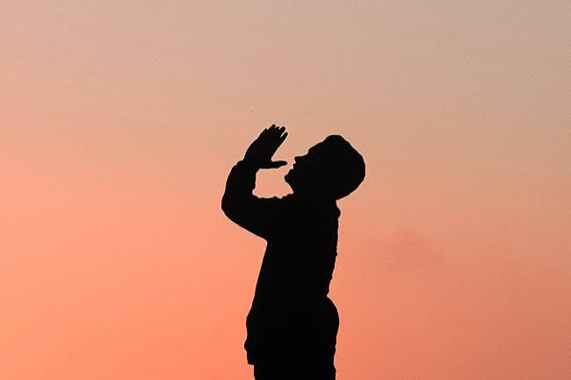
1 Thessalonians VI
Pray Continually

Slide 2
Paul Notices Three Very Good Things In the Church in Thessalonica
1. Their work produced by faith.
2. Their laber prompted by love.
3. Their endurance inspired by hope in our Lord Jesus Christ.

Slide 3
1 Thessalonians 2:17-3:5
We were like orphans…
For what is our hope, our joy, or the crown in which we will glory in the presence of our Lord Jesus when he comes? Is it not you? Indeed, you are our glory and joy.

Slide 4
1 Thessalonians 4:13-18
About end-times… The parousia lit. presence
What will it be like?
v. 16 A trumpet sound. Matthew 24:31
The dead in Christ will rise first, then those who are still alive will join them to lead christ in a triumphal procession to the transformed earth.

Slide 5
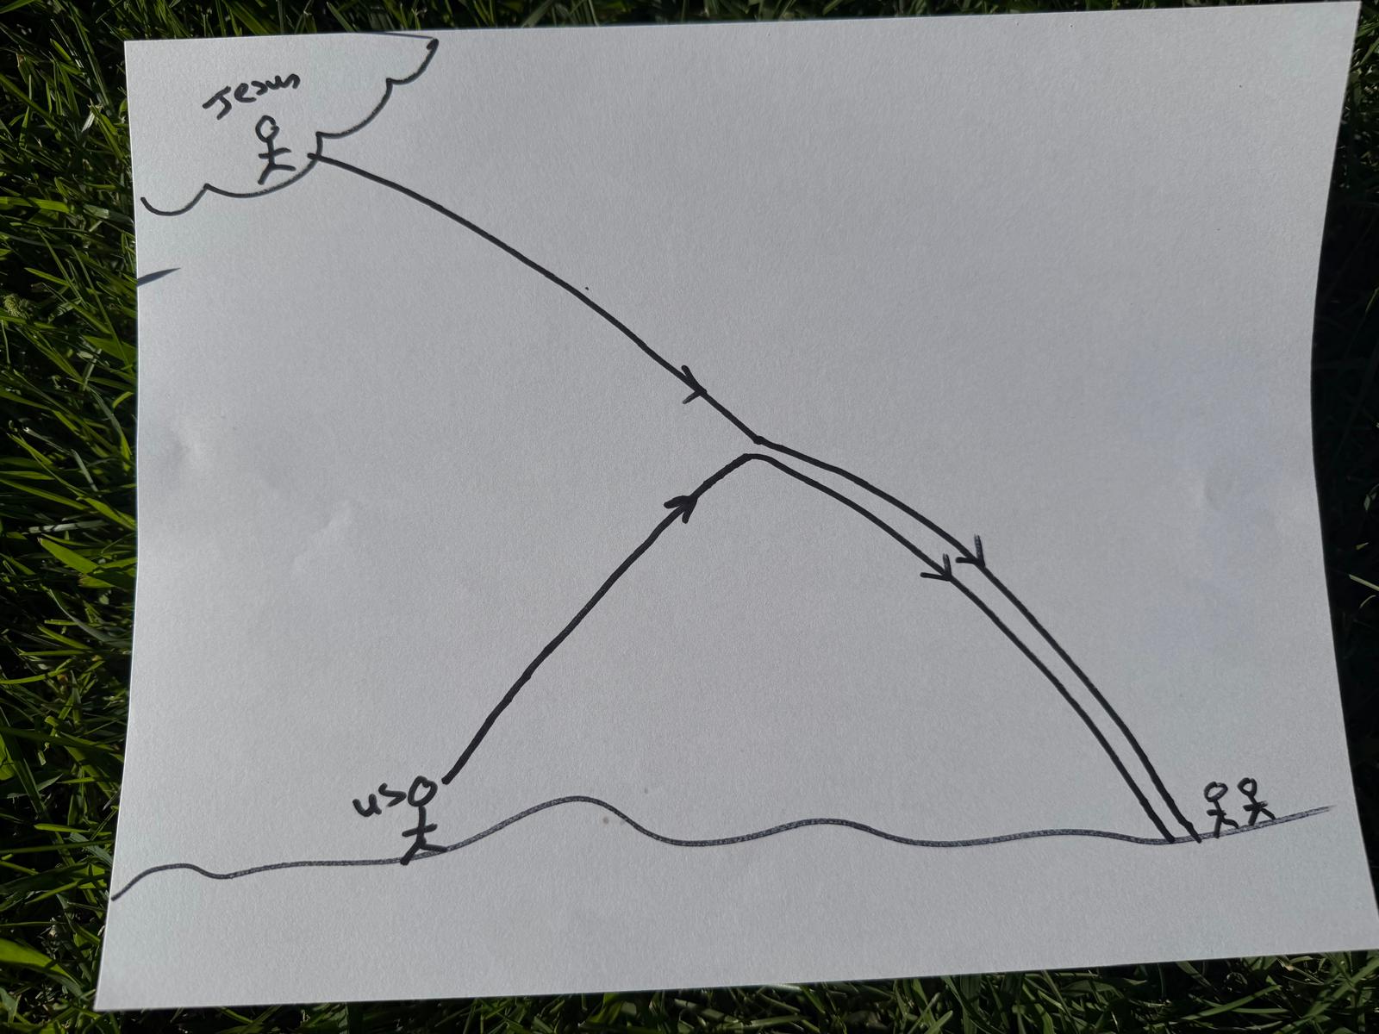
The language of 1 Thess 4 is of a royal procession.
Palm Sunday
The Coming of the Lord parousia

Slide 6
The Main Point
We have hope!
Why? Because of the resurrection of Christ, which is proof of our future resurrection.
Therefore, encourage one another with these words.

Slide 7

1 Thessalonians 5:1-11 How Should We Live?
About dates and times…
Paul’s point: The date and time are not important!
Why? Because no one knows. It will come like a thief.

Slide 8
The Day of the Lord
Satan’s strategy is to distract us.
1. By overly focusing on the timing or the details. or
2. By getting us to ignore entirely that it is coming.
1 Thess 5:3 While people are saying “peace and safety.”
2 Peter 3:3-7 People will say, “Where is this coming?”

Slide 9
So, How Should We Live?
1 Thess 5:4-8 Let us be awake and sober.
2 Peter 3:10-14 Live holy and godly lives. Make every effort to be found spotless, blameless and at peace with Him.
1. We should live as if Jesus were to come back today.
And
2. We should live as if Jesus will not come back for a while.

Slide 10
So, How Should We Live?
Encourage one another and build each other up!
In Christ, You got this!

Slide 11
1 Thessalonians 5:12-13
Hold them in highest regard… muchississimo
Who? Those who work hard among you and are over you in the Lord.
Leon Morris: Good leaders need good followers.

Slide 12
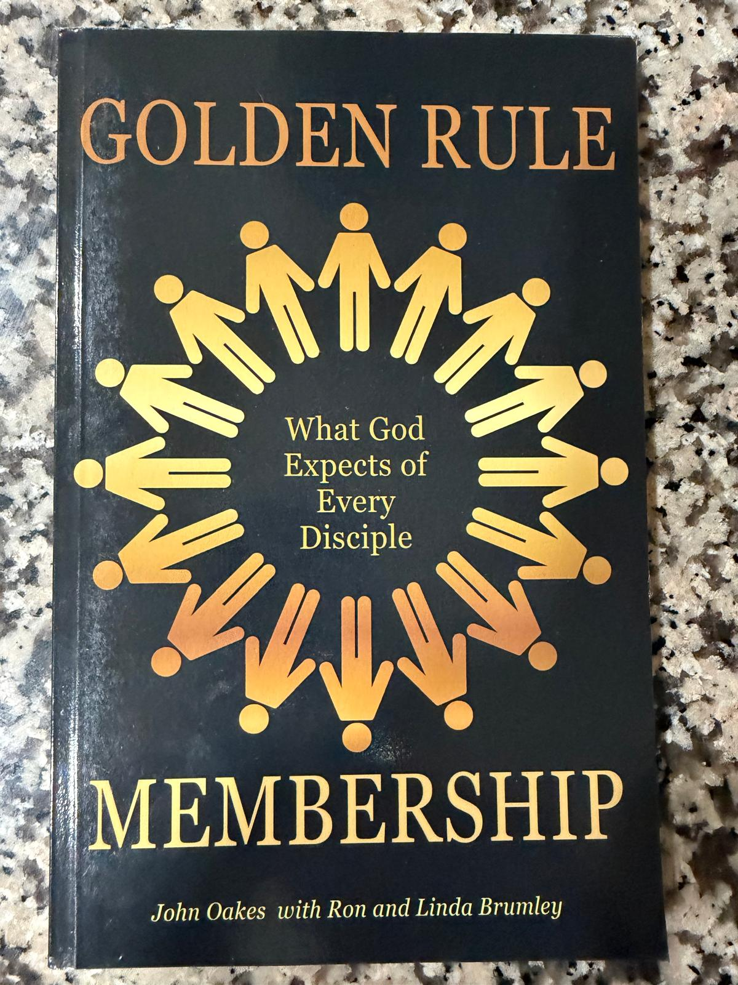
The Golden Rule for members:
Treat your leaders they way you would want to be treated if you were the leader.

Slide 13
Hebrews 13:7 Consider the outcome of their way of life and imitate their faith.
Imitate their faith, not their faults and mistakes.
Hebrews 13:17 Obey your leaders and submit to their authority. They keep watch over you as men who must give an account. Obey them so that their work will be a joy, not a burden, for that would be of no advantage to you.
Judges 5:2 When the princes of Israel take the lead and the people willingly offer themselves, praise the Lord.

Slide 14
1 Thessalonians 5:14-15 Discernment
1. Warn the idle and disruptive. The “culpably idle.”
2. Encourage the disheartened. Temporary trial.
3. Help the weak. Weak spiritually or in life-circumstance.
No matter what… Show patience with the failings of all.

Slide 15
1 Thessalonians 5:16-22 Pray Continually
Rejoice Always Pray about the present.
Pray Continuously Pray about the future.
Give Thanks in All Circumstances Pray about the past.
The Fellowship Offering
Free-Will Offering (Lev 22:23) Pray about the present
Vow Offering (Lev 11:16) Pray about the future
Thank-Offering (Lev 7:11-15) Pray about the past

Slide 16
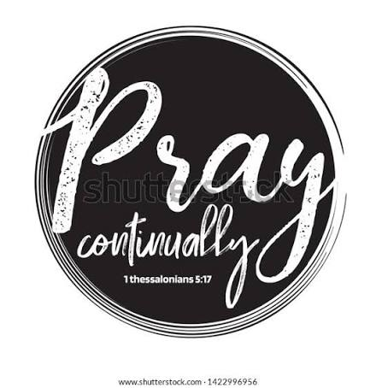
Pray Continually
Have times of prayer
and
Live a prayerful life
-at a stoplight
-at a moment of discouragement
-for no particular reason

Slide 17
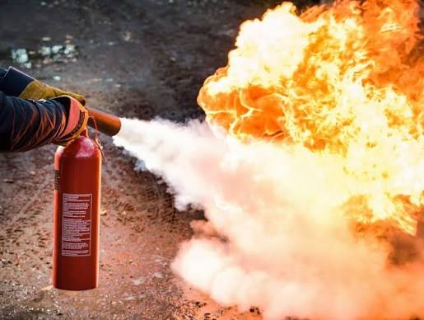
Do Not Quench the Spirit
-by sinning
-by not listening to the Holy Spirit/failing to pray continually
Galatians 5:16, 18, 25
Walk by the Spirit
Be led by the Spirit
Keep in step with the Spirit

Slide 18
Summary
Support and encourage your leaders
Learn discernment: Admonish the idle, encourage the discouraged and help the weak. And be patient!
Pray continually, and, whatever you do, do not quench the Holy Spirit

