Slide 1
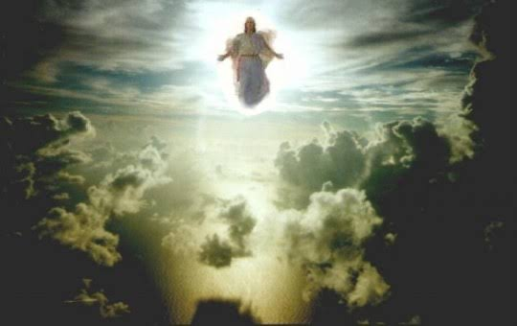
1 Thessalonians IV
The Coming of the Lord

Slide 2
Paul Notices Three Very Good Things In the Church in Thessalonica
1. Their work produced by faith.
2. Their laber prompted by love.
3. Their endurance inspired by hope in our Lord Jesus Christ.

Slide 3
1 Thess 2:7-12 We Are Family
We were like children among you.
We were like a nursing mother among you.
We were like a father among you.

Slide 4
1 Thessalonians 2:17-3:5
Paul’s amazing love for the Thessalonians
Separated like being orphaned.
Intense longing.
For what is our hope, our joy, or the crown in which we will glory in the presence of our Lord Jesus when he comes? Is it not you? Indeed, you are our glory and joy.

Slide 5
1 Corinthians 4:1-8
As for the other matters…
Be sanctified
Avoid sexual immorality
[Control your own body or Acquire a wife carefully]
Do not take advantage of a brother or sister (sexually)

Slide 6
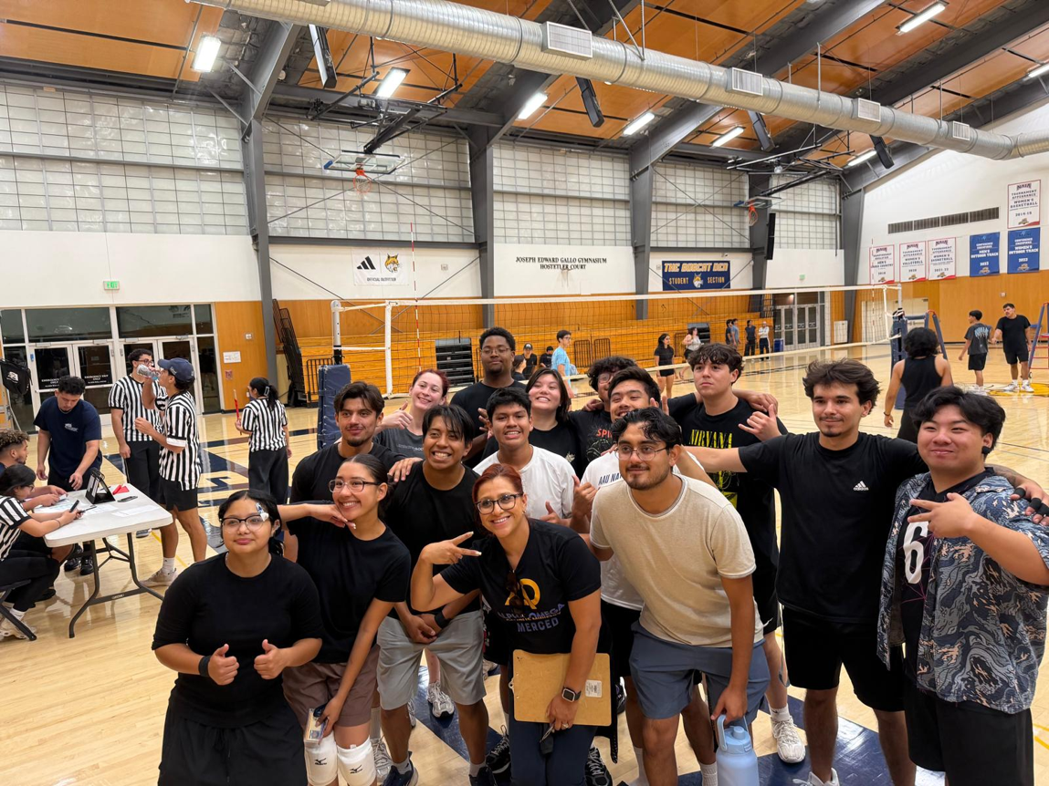
1 Thessalonians 4:9-12
Now about brotherly love (phileo)

Slide 7

1 Thessalonians 4:9-12
Your ambition? To lead a quiet life and mind your own business.
Why???
So you can win the respect of outsiders

Slide 8
1 Thessalonians 4:13-18
About end-times…
Their issue? What about those who have died? Will they join us in the future resurrection?
The main point: v. 18 Encourage one another with these words.

Slide 9
For them… Will those who have died be resurrected?
For us… What about the Rapture, the Tribulation Armageddon, Antichrist, and the 1000 year reign of Christ in Jerusalem?
Dispensational Premillenialism
Answer: We have hope because of the resurrection of Christ.

Slide 10
HOPE: The Coming/parousia of the Lord
We believe that Jesus died and rose again.
So we believe when we die, we also will rise again.
When?
v. 15 at the coming of the Lord. The parousia lit. presence
1 Cor 15:20-23 when He comes (parousia), we will be made alive.
1 Cor 15:42-43 the perishable will become imperishable.

Slide 11

Give Me the Details: What Will It Be Like?
v. 16 A trumpet sound. Matthew 24:31
The Feast of Trumpets rosh hashannah yom teruah
Rabbis: reflect and repent. Pull an all-nighter. Prepare for the Day of the Lord.
Matt 24:36 You do not know the day or the hour.

Slide 12
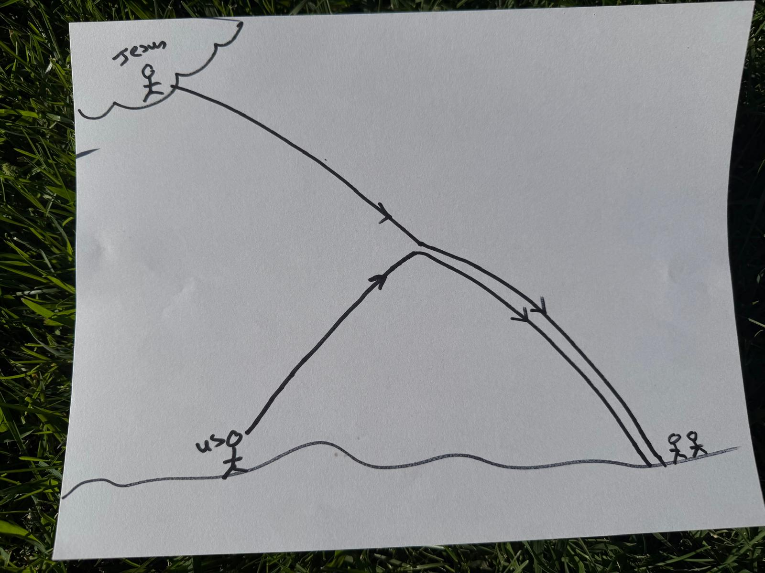
The language of 1 Thess 4 is of a royal procession.
Palm Sunday
The Coming of the Lord parousia

Slide 13
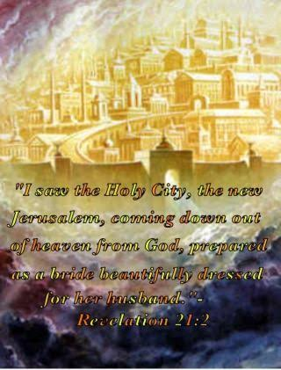
Are We Going to Heaven?
No! Heaven is coming to us.
Revelation 21:1-2
1 Corinthians 15:52-57
Romans 8:11, 23-25

Slide 14
1 Thessalonians 4:18
Therefore, encourage one another with these words.
Activity: Encourage your neighbor this morning about the Coming of Christ. What will you hear? What will you see? What will you feel? What will you think?
Aristedes (2nd century) “If any righteous one among them passes from the world, they rejoice and offer thanks to God; and they escort the body as if they were setting out from one place to another place near.”

Slide 15
Summary
Let us live sanctified/holy lives.
Let us avoid even a hint of sexual immorality and pursue male/female relationships in a godly way.
Let us love one another with brotherly love phileo
Let us live quiet lives and avoid worldly ambition.
Let us be encouraged by the hope and certainty of the Coming of Christ, when we will meet him and be given new, immortal bodies.

